Slide 1
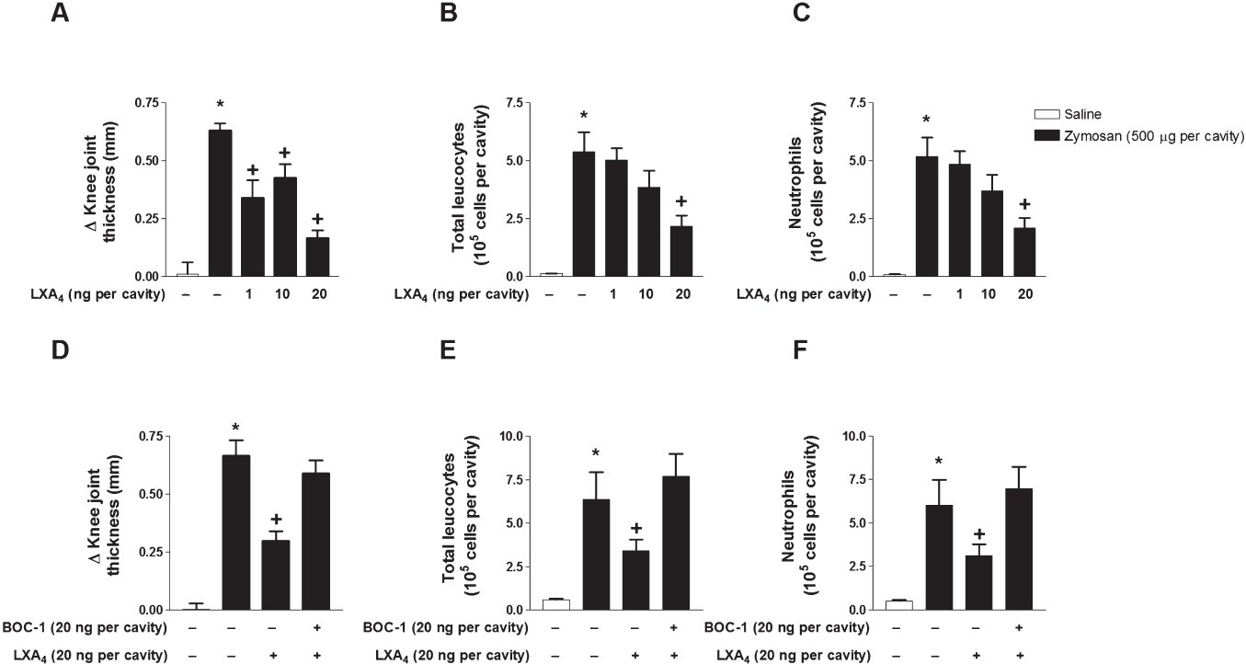
From FP Conte et al. Br J Pharmacol 2010 doi:10.1111/j.1476-5381.2010.00950.x/bph.950
British Journal of Pharmacology © 2010 The British Pharmacological Society

Slide 2
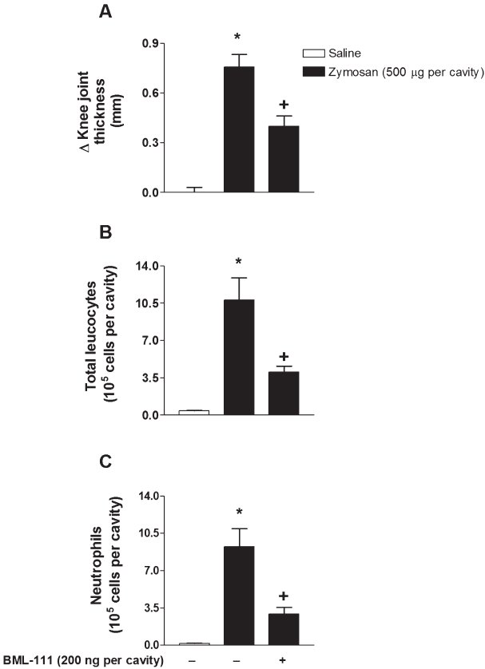
From FP Conte et al. Br J Pharmacol 2010 doi:10.1111/j.1476-5381.2010.00950.x/bph.950
British Journal of Pharmacology © 2010 The British Pharmacological Society

Slide 3
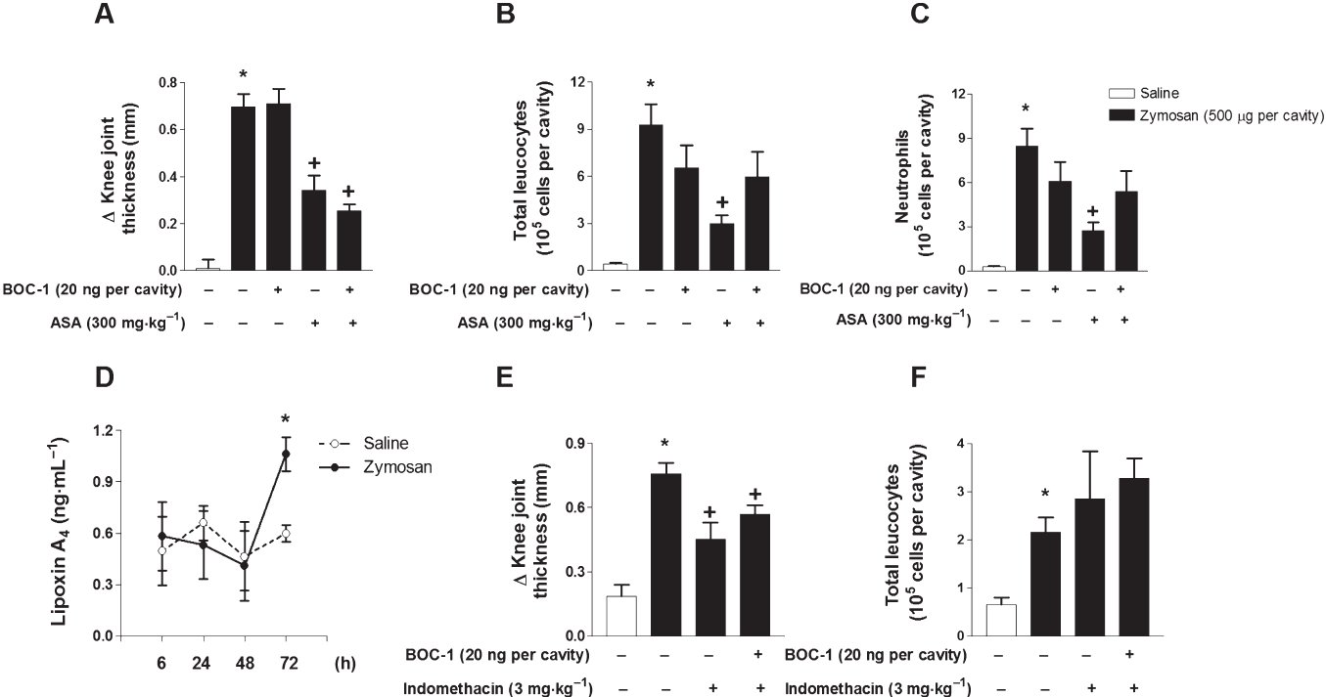
From FP Conte et al. Br J Pharmacol 2010 doi:10.1111/j.1476-5381.2010.00950.x/bph.950
British Journal of Pharmacology © 2010 The British Pharmacological Society

Slide 4
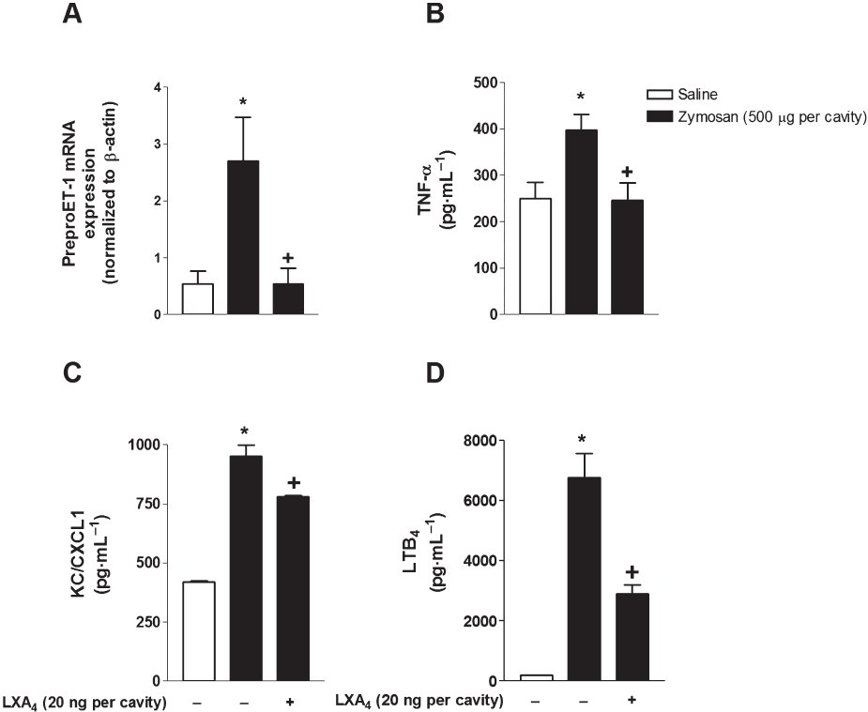
From FP Conte et al. Br J Pharmacol 2010 doi:10.1111/j.1476-5381.2010.00950.x/bph.950
British Journal of Pharmacology © 2010 The British Pharmacological Society

Slide 5
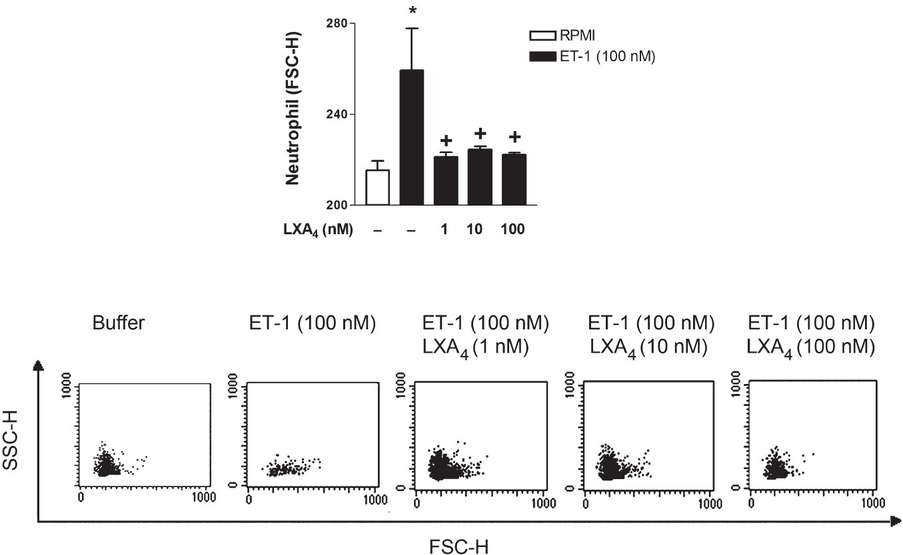
From FP Conte et al. Br J Pharmacol 2010 doi:10.1111/j.1476-5381.2010.00950.x/bph.950
British Journal of Pharmacology © 2010 The British Pharmacological Society

Slide 6
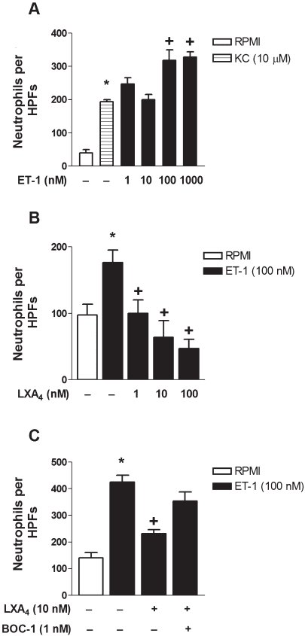
From FP Conte et al. Br J Pharmacol 2010 doi:10.1111/j.1476-5381.2010.00950.x/bph.950
British Journal of Pharmacology © 2010 The British Pharmacological Society

Slide 7
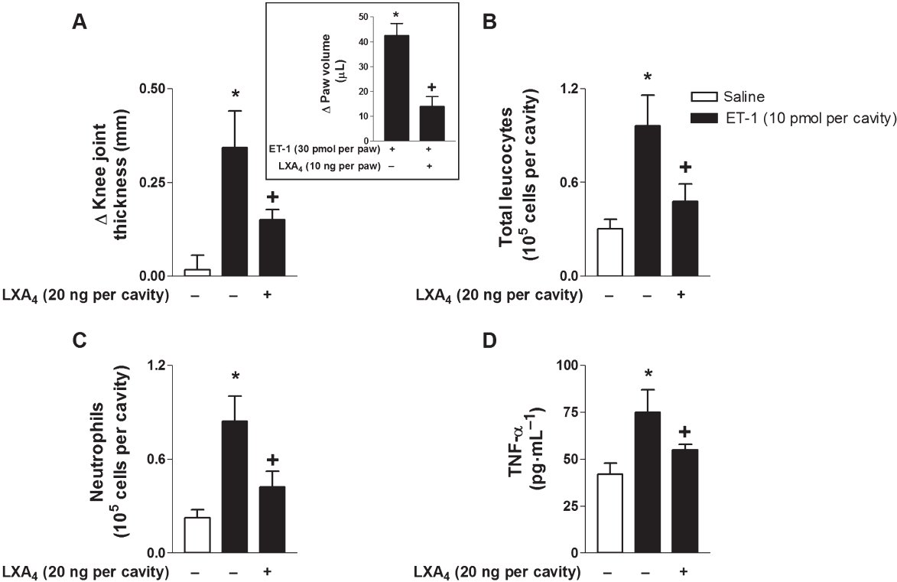
From FP Conte et al. Br J Pharmacol 2010 doi:10.1111/j.1476-5381.2010.00950.x/bph.950
British Journal of Pharmacology © 2010 The British Pharmacological Society

Slide 8
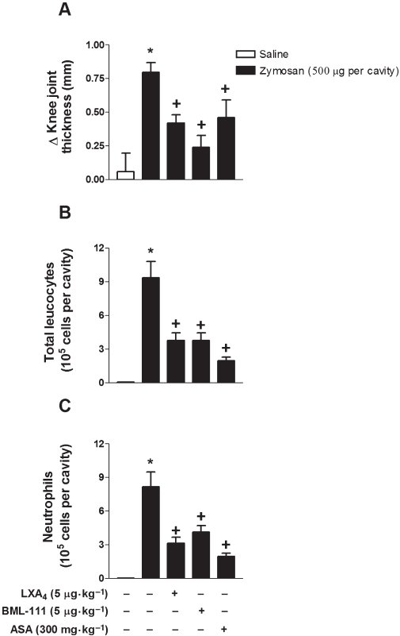
From FP Conte et al. Br J Pharmacol 2010 doi:10.1111/j.1476-5381.2010.00950.x/bph.950
British Journal of Pharmacology © 2010 The British Pharmacological Society

