Slide 1
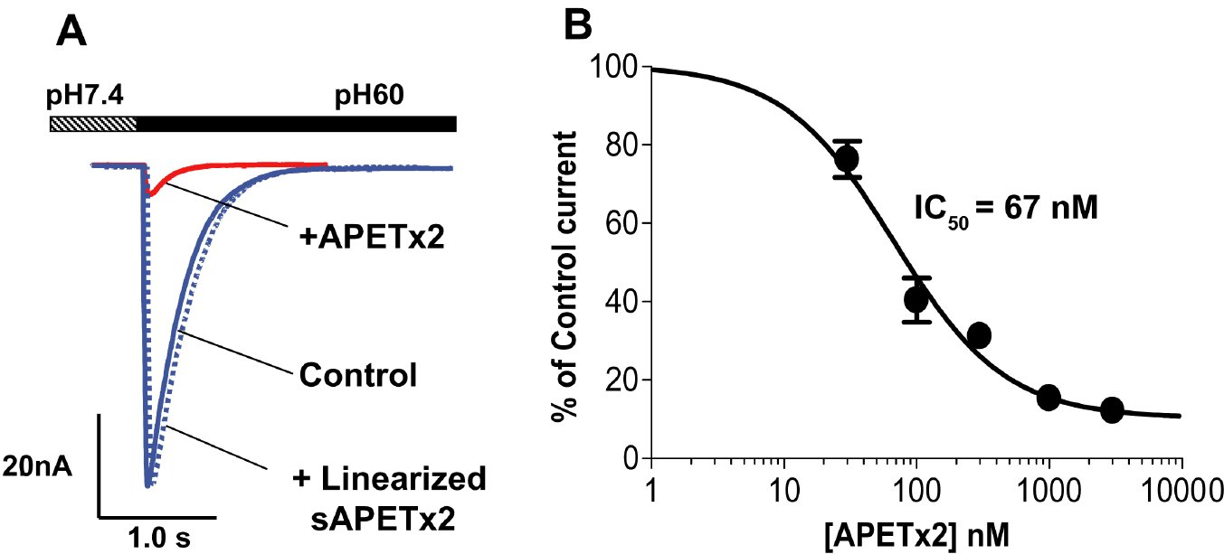
From J Karczewski et al. Br J Pharmacol 2010
doi:10.1111/j.1476-5381.2010.00918.x/bph.918
British Journal of Pharmacology © 2010 The British Pharmacological Society

Slide 2
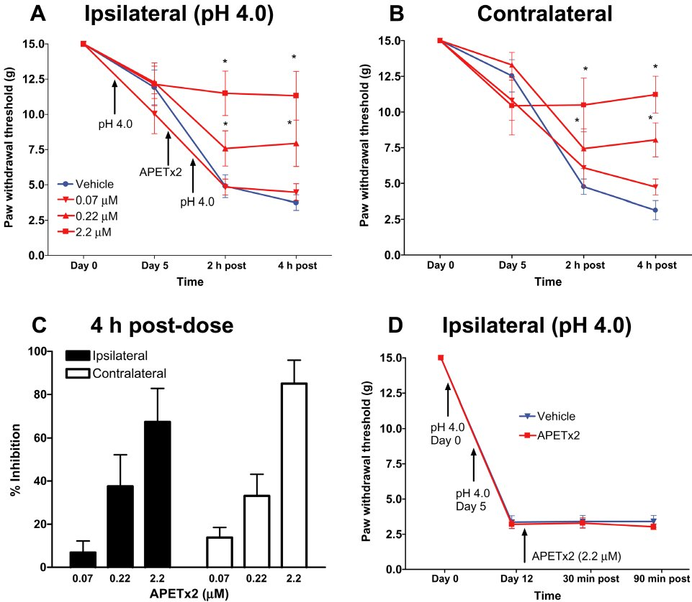
From J Karczewski et al. Br J Pharmacol 2010
doi:10.1111/j.1476-5381.2010.00918.x/bph.918
British Journal of Pharmacology © 2010 The British Pharmacological Society

Slide 3
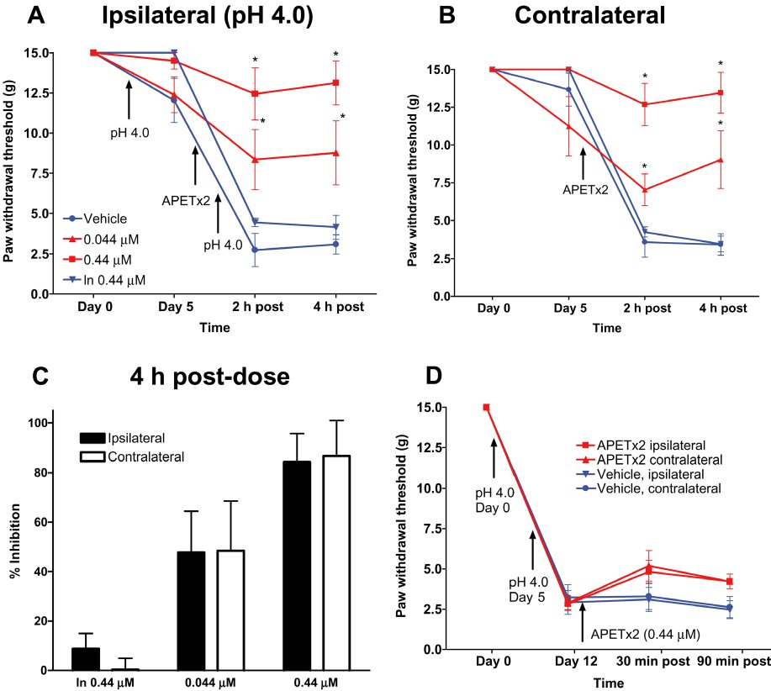
From J Karczewski et al. Br J Pharmacol 2010
doi:10.1111/j.1476-5381.2010.00918.x/bph.918
British Journal of Pharmacology © 2010 The British Pharmacological Society

Slide 4
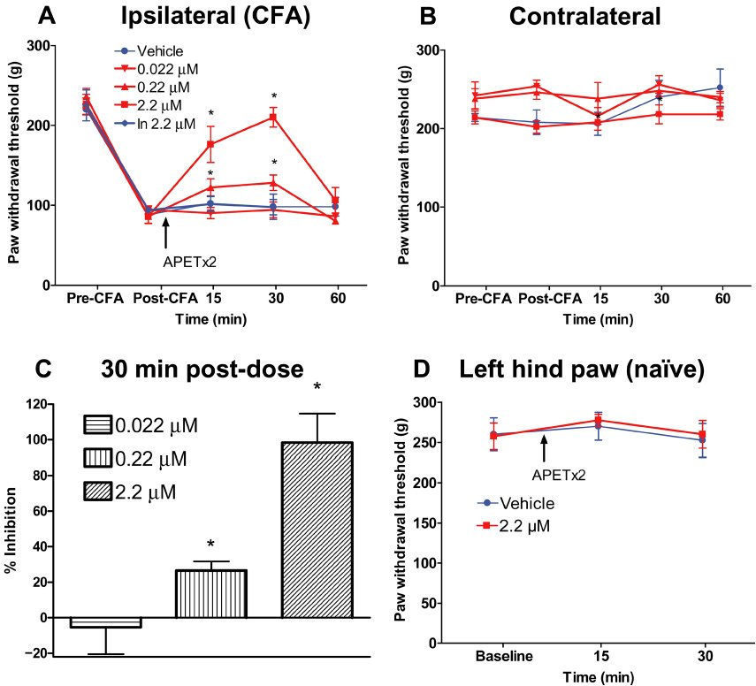
From J Karczewski et al. Br J Pharmacol 2010
doi:10.1111/j.1476-5381.2010.00918.x/bph.918
British Journal of Pharmacology © 2010 The British Pharmacological Society

Slide 5
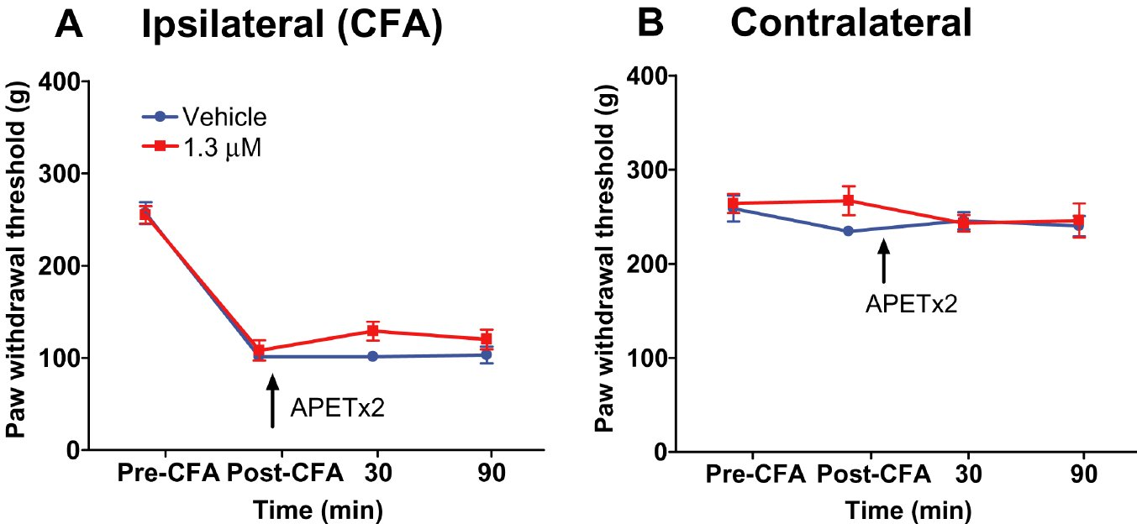
From J Karczewski et al. Br J Pharmacol 2010
doi:10.1111/j.1476-5381.2010.00918.x/bph.918
British Journal of Pharmacology © 2010 The British Pharmacological Society

