Slide 1
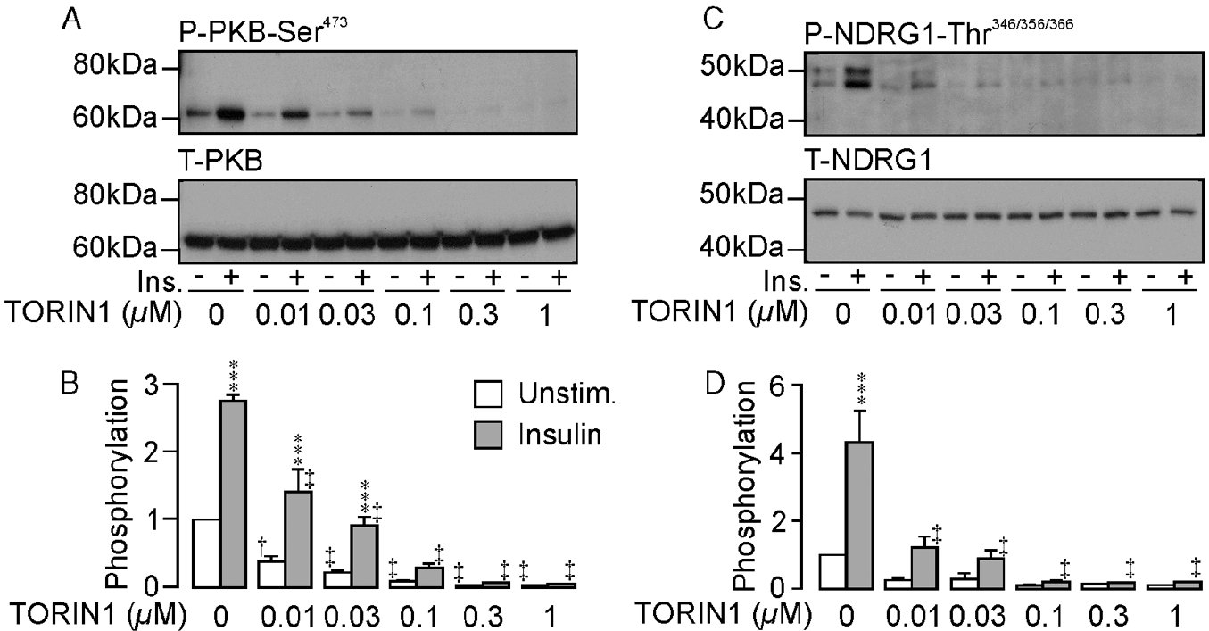
From MK Mansley and SM Wilson. Br J Pharmacol 2010
doi:10.1111/j.1476-5381.2010.01003.x/bph.1003
British Journal of Pharmacology © 2010 The British Pharmacological Society

Slide 2
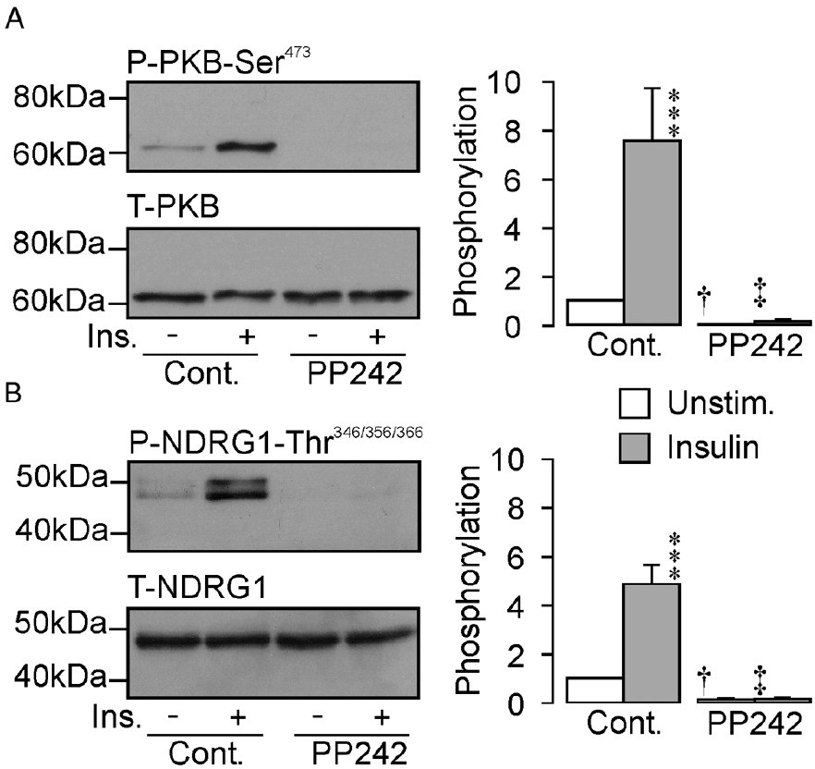
From MK Mansley and SM Wilson. Br J Pharmacol 2010
doi:10.1111/j.1476-5381.2010.01003.x/bph.1003
British Journal of Pharmacology © 2010 The British Pharmacological Society

Slide 3
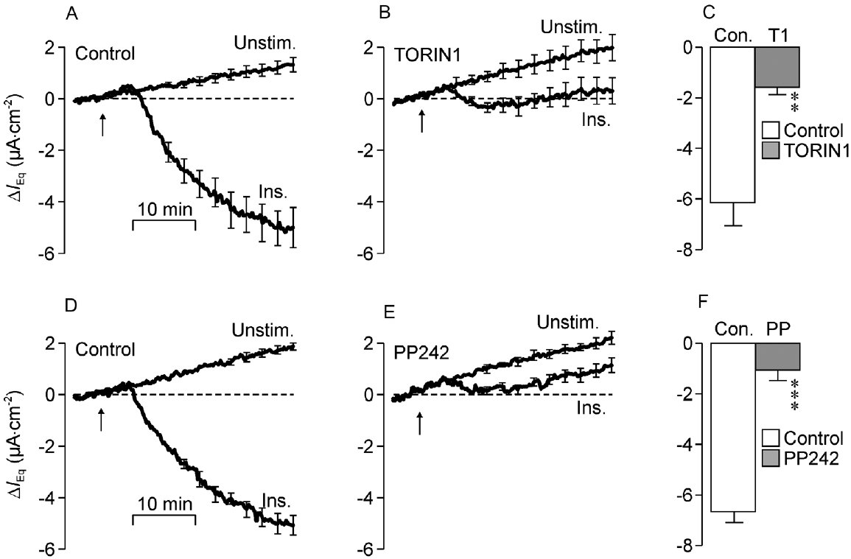
From MK Mansley and SM Wilson. Br J Pharmacol 2010
doi:10.1111/j.1476-5381.2010.01003.x/bph.1003
British Journal of Pharmacology © 2010 The British Pharmacological Society

Slide 4
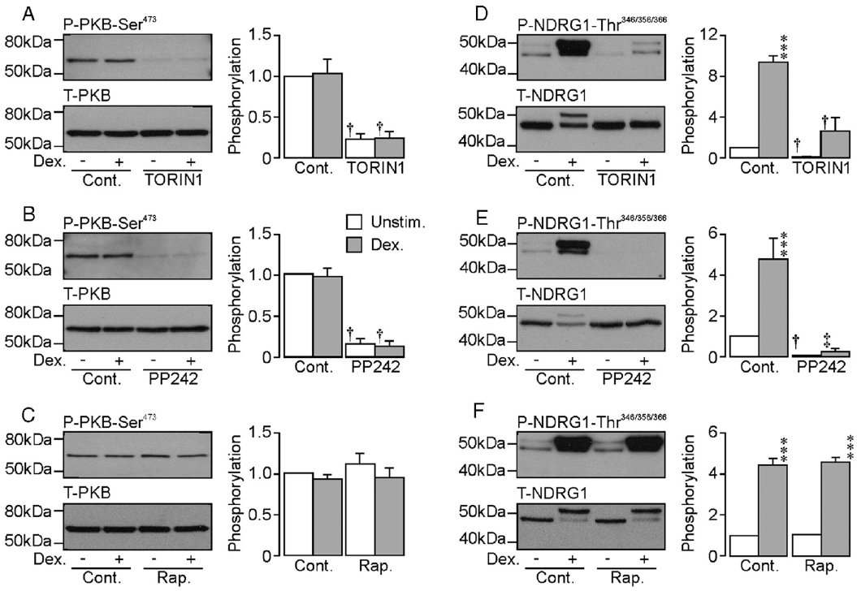
From MK Mansley and SM Wilson. Br J Pharmacol 2010
doi:10.1111/j.1476-5381.2010.01003.x/bph.1003
British Journal of Pharmacology © 2010 The British Pharmacological Society

Slide 5
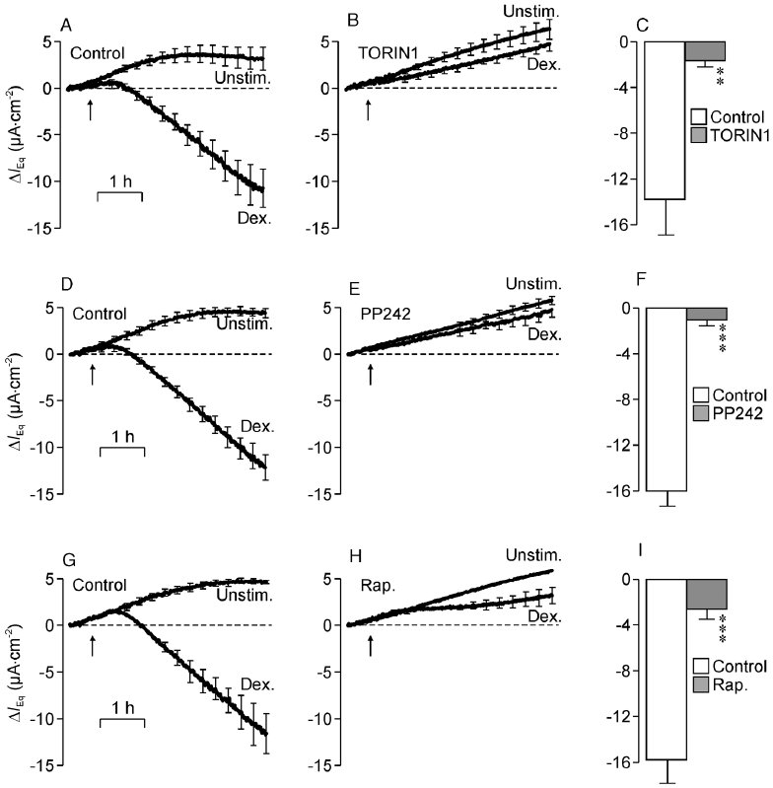
From MK Mansley and SM Wilson. Br J Pharmacol 2010
doi:10.1111/j.1476-5381.2010.01003.x/bph.1003
British Journal of Pharmacology © 2010 The British Pharmacological Society

Slide 6
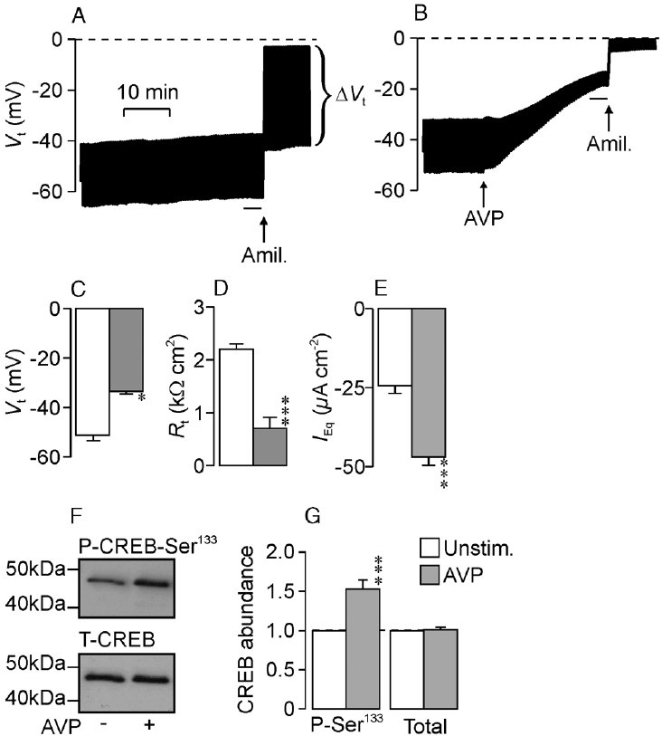
From MK Mansley and SM Wilson. Br J Pharmacol 2010
doi:10.1111/j.1476-5381.2010.01003.x/bph.1003
British Journal of Pharmacology © 2010 The British Pharmacological Society

Slide 7
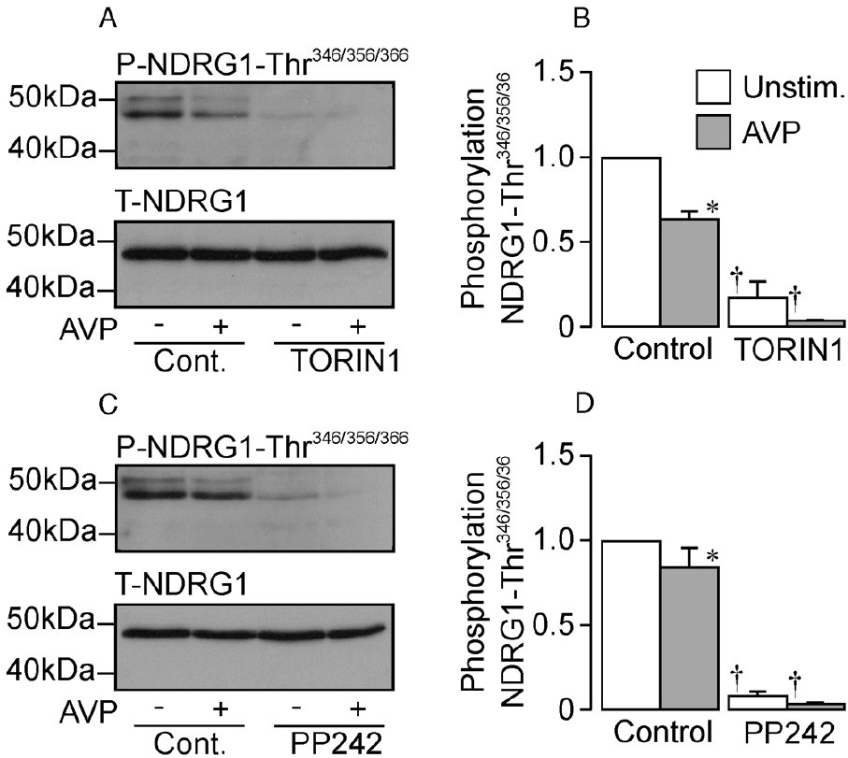
From MK Mansley and SM Wilson. Br J Pharmacol 2010
doi:10.1111/j.1476-5381.2010.01003.x/bph.1003
British Journal of Pharmacology © 2010 The British Pharmacological Society

Slide 8
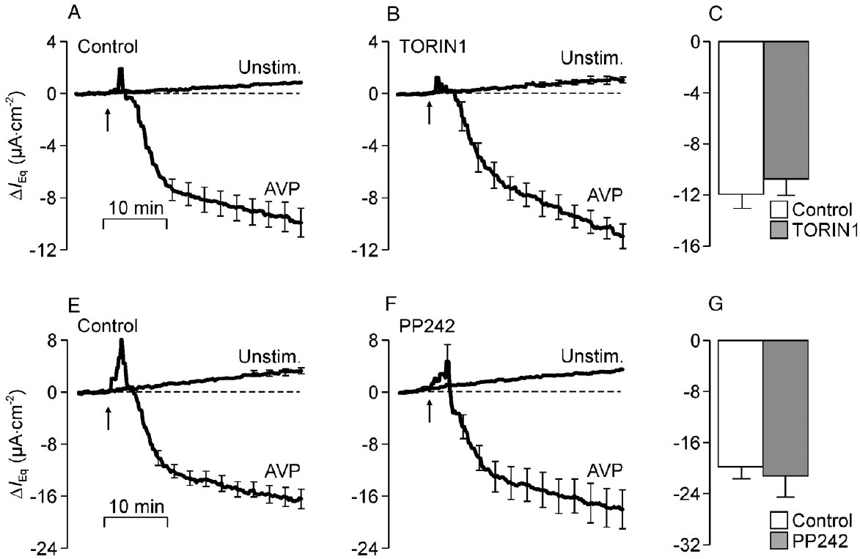
From MK Mansley and SM Wilson. Br J Pharmacol 2010
doi:10.1111/j.1476-5381.2010.01003.x/bph.1003
British Journal of Pharmacology © 2010 The British Pharmacological Society

