Slide 1
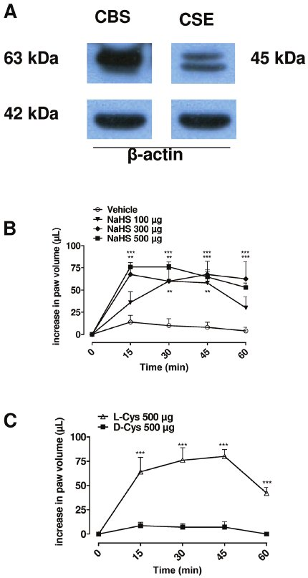
From Rd di Villa Bianca et al. Br J Pharmacol 2010
doi:10.1111/j.1476-5381.2010.01016.x/bph.1016
British Journal of Pharmacology © 2010 The British Pharmacological Society

Slide 2
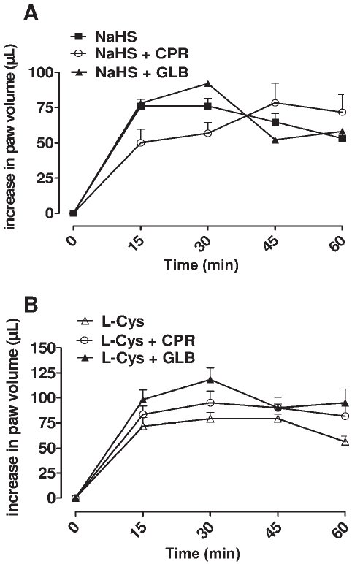
From Rd di Villa Bianca et al. Br J Pharmacol 2010
doi:10.1111/j.1476-5381.2010.01016.x/bph.1016
British Journal of Pharmacology © 2010 The British Pharmacological Society

Slide 3
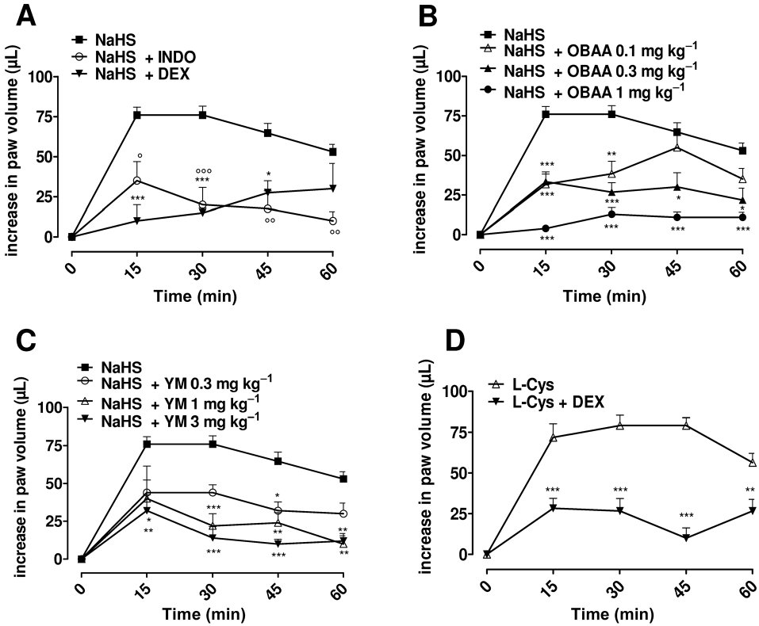
From Rd di Villa Bianca et al. Br J Pharmacol 2010
doi:10.1111/j.1476-5381.2010.01016.x/bph.1016
British Journal of Pharmacology © 2010 The British Pharmacological Society

Slide 4
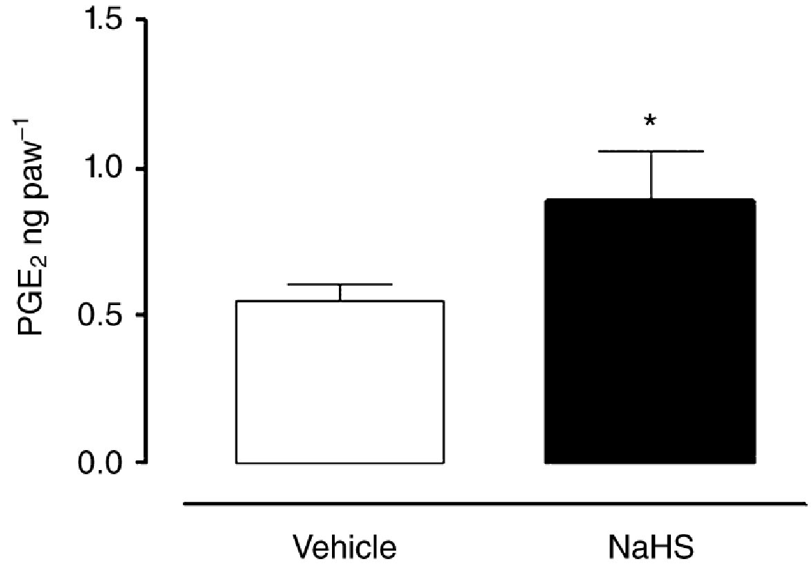
From Rd di Villa Bianca et al. Br J Pharmacol 2010
doi:10.1111/j.1476-5381.2010.01016.x/bph.1016
British Journal of Pharmacology © 2010 The British Pharmacological Society

Slide 5
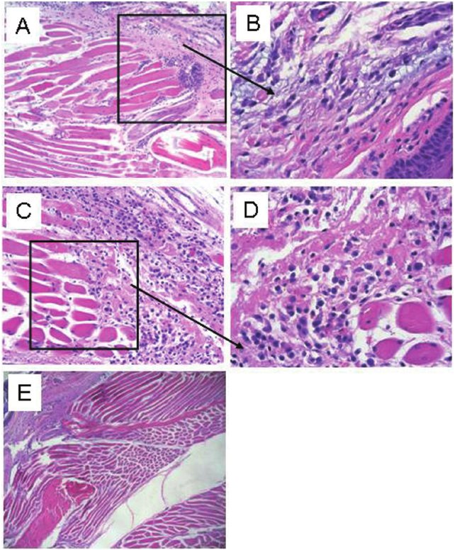
From Rd di Villa Bianca et al. Br J Pharmacol 2010
doi:10.1111/j.1476-5381.2010.01016.x/bph.1016
British Journal of Pharmacology © 2010 The British Pharmacological Society

