Slide 1
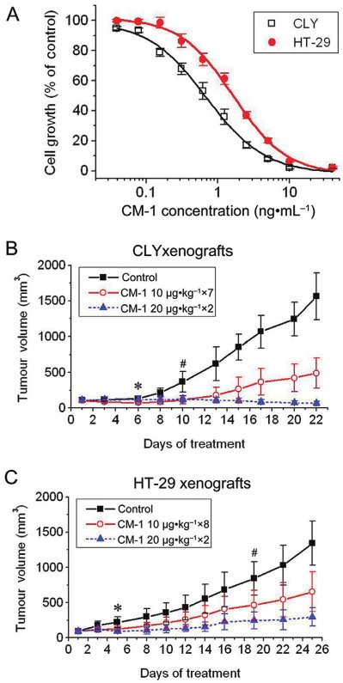
From L-N Li et al. Br J Pharmacol 2010
doi:10.1111/j.1476-5381.2010.01042.x/bph.1042
British Journal of Pharmacology © 2010 The British Pharmacological Society

Slide 2
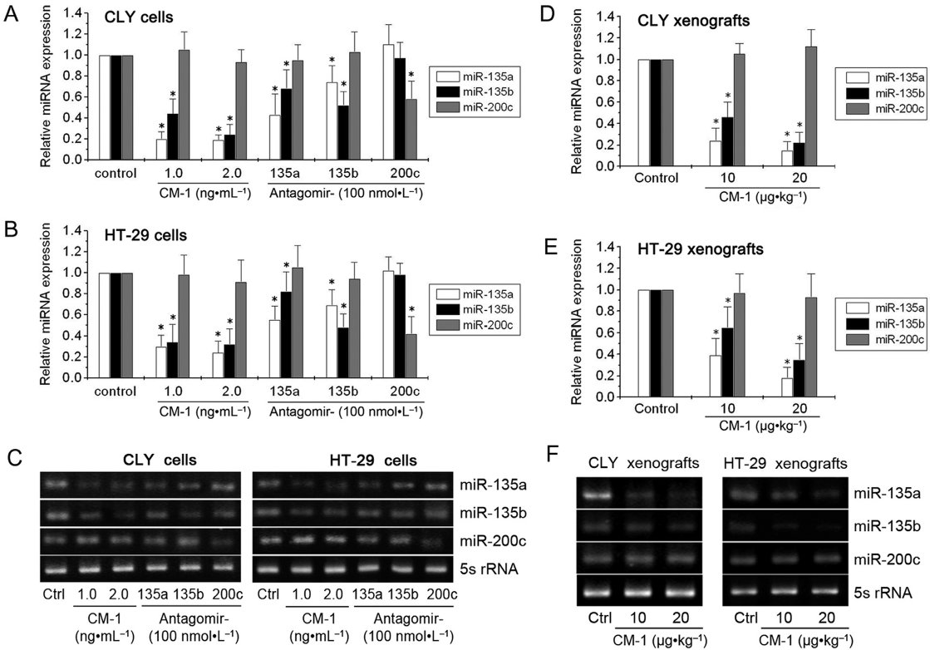
From L-N Li et al. Br J Pharmacol 2010
doi:10.1111/j.1476-5381.2010.01042.x/bph.1042
British Journal of Pharmacology © 2010 The British Pharmacological Society

Slide 3
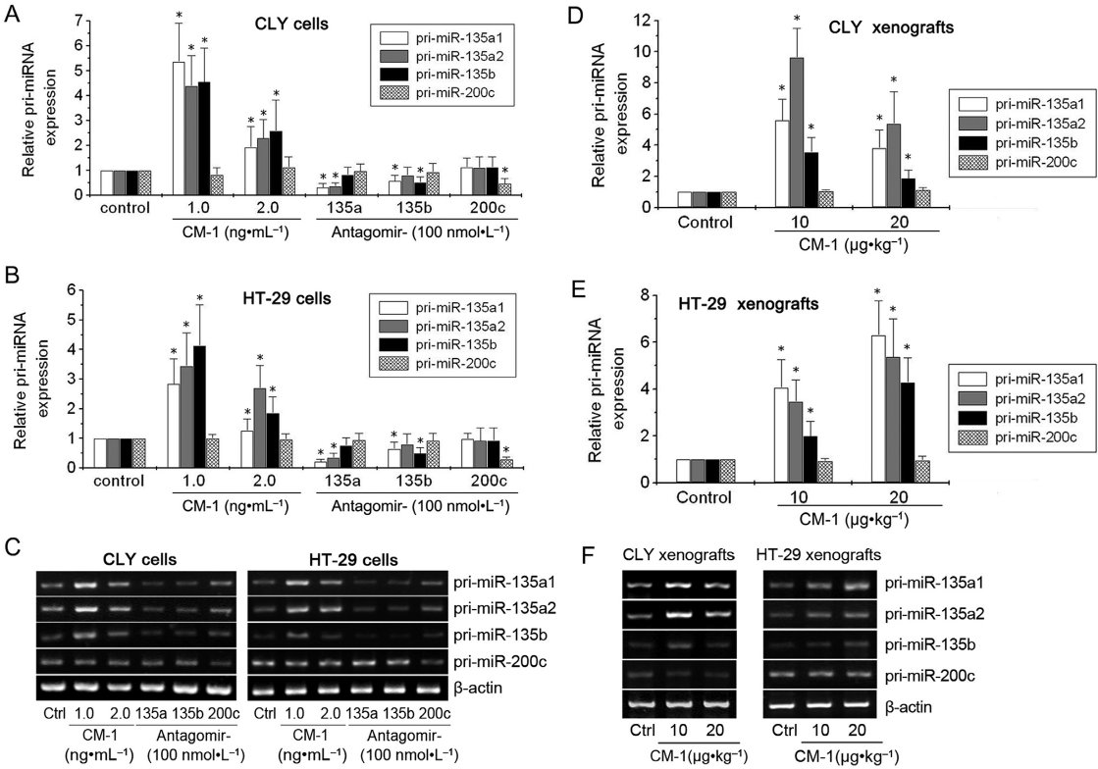
From L-N Li et al. Br J Pharmacol 2010
doi:10.1111/j.1476-5381.2010.01042.x/bph.1042
British Journal of Pharmacology © 2010 The British Pharmacological Society

Slide 4
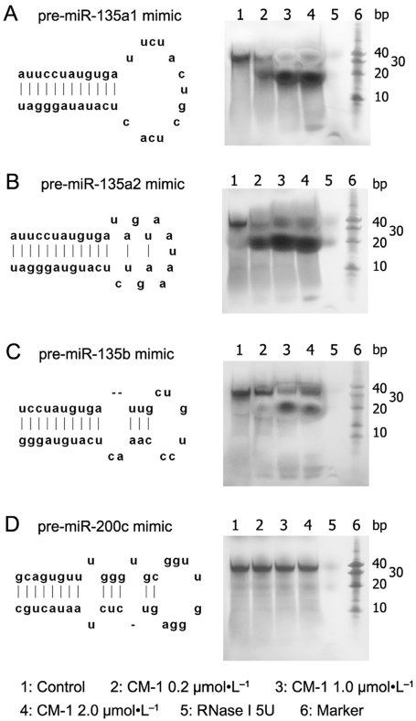
From L-N Li et al. Br J Pharmacol 2010
doi:10.1111/j.1476-5381.2010.01042.x/bph.1042
British Journal of Pharmacology © 2010 The British Pharmacological Society

Slide 5
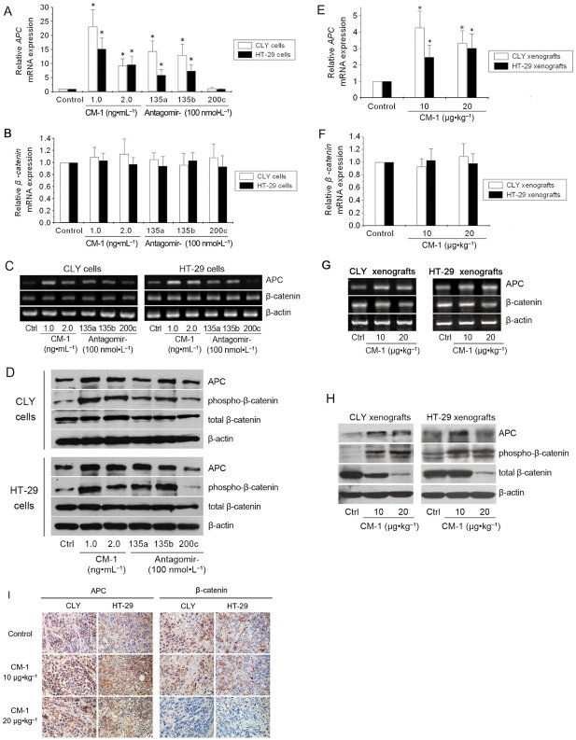
From L-N Li et al. Br J Pharmacol 2010
doi:10.1111/j.1476-5381.2010.01042.x/bph.1042
British Journal of Pharmacology © 2010 The British Pharmacological Society

Slide 6
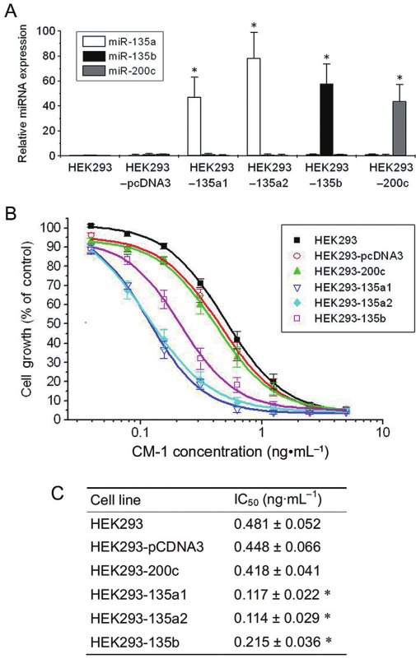
From L-N Li et al. Br J Pharmacol 2010
doi:10.1111/j.1476-5381.2010.01042.x/bph.1042
British Journal of Pharmacology © 2010 The British Pharmacological Society

Slide 7
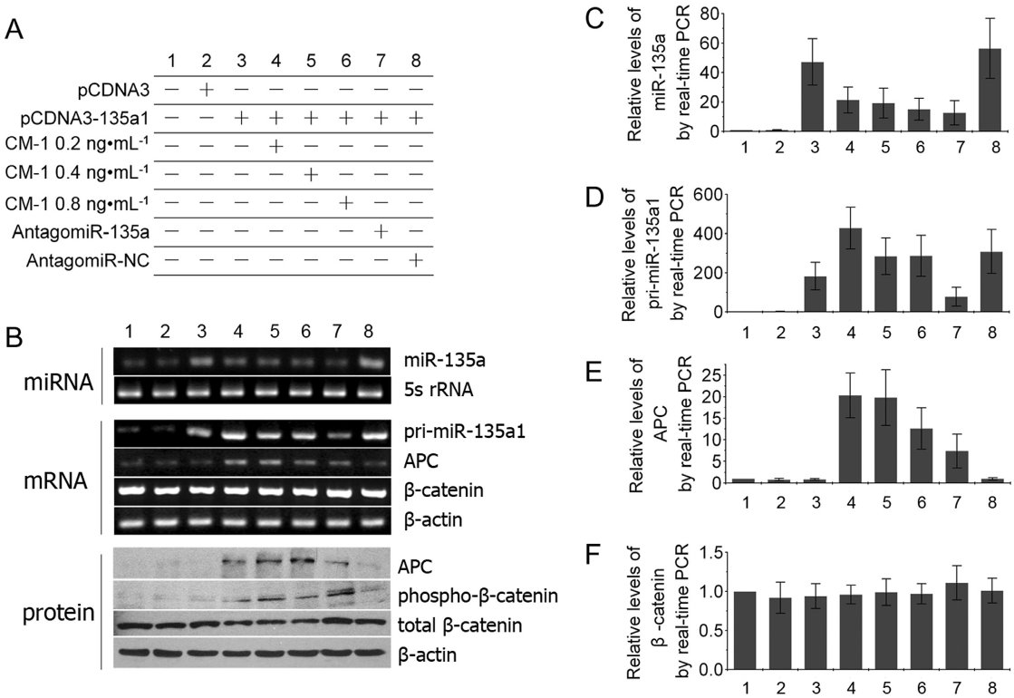
From L-N Li et al. Br J Pharmacol 2010
doi:10.1111/j.1476-5381.2010.01042.x/bph.1042
British Journal of Pharmacology © 2010 The British Pharmacological Society

