Slide 1
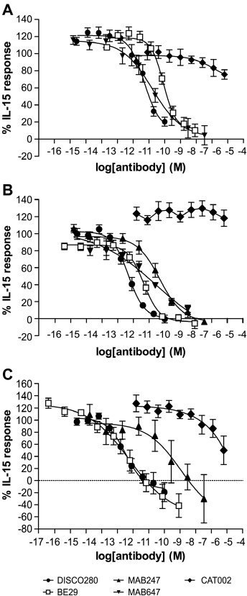
From DK Finch et al. Br J Pharmacol 2010
doi:10.1111/j.1476-5381.2010.01061.x/bph.1061
British Journal of Pharmacology © 2010 The British Pharmacological Society

Slide 2
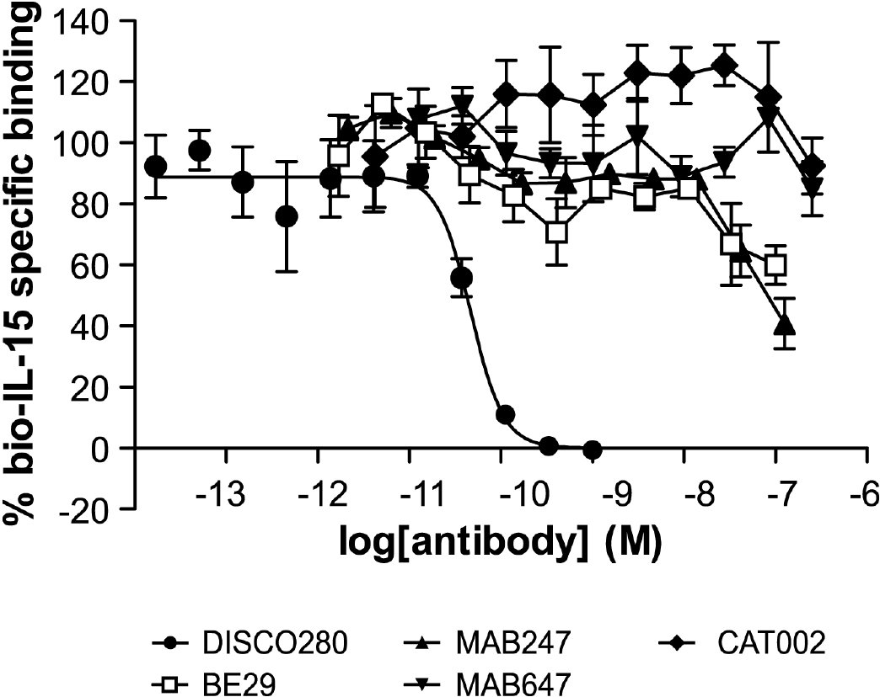
From DK Finch et al. Br J Pharmacol 2010
doi:10.1111/j.1476-5381.2010.01061.x/bph.1061
British Journal of Pharmacology © 2010 The British Pharmacological Society

Slide 3
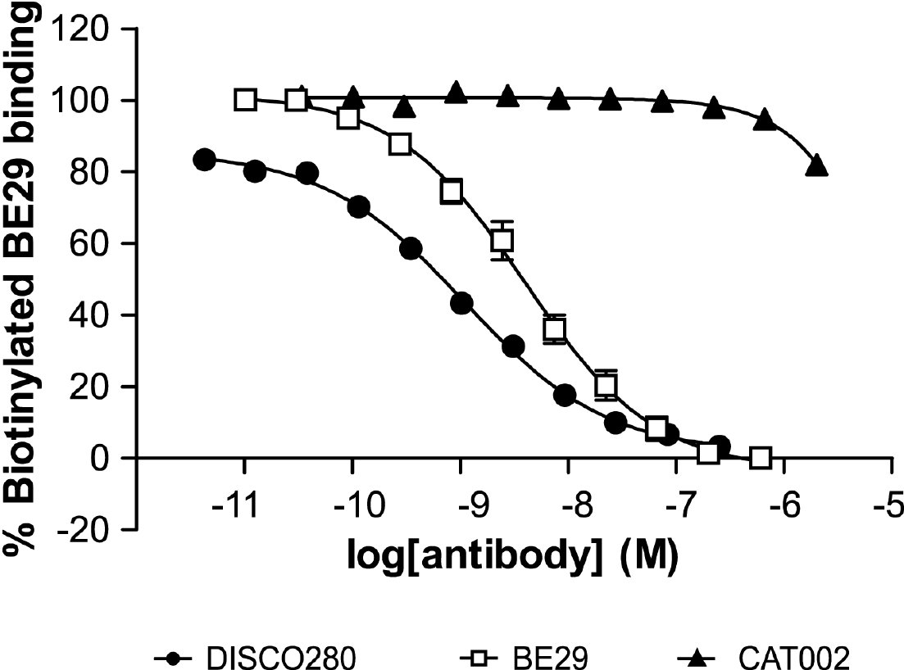
From DK Finch et al. Br J Pharmacol 2010
doi:10.1111/j.1476-5381.2010.01061.x/bph.1061
British Journal of Pharmacology © 2010 The British Pharmacological Society

Slide 4
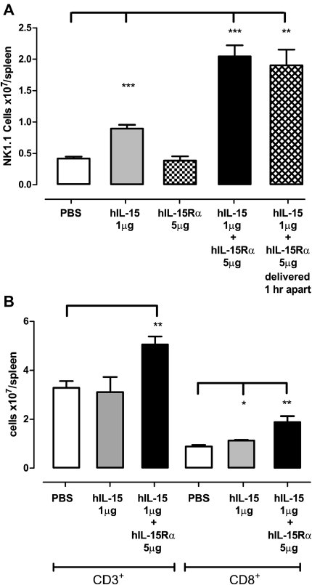
From DK Finch et al. Br J Pharmacol 2010
doi:10.1111/j.1476-5381.2010.01061.x/bph.1061
British Journal of Pharmacology © 2010 The British Pharmacological Society

Slide 5
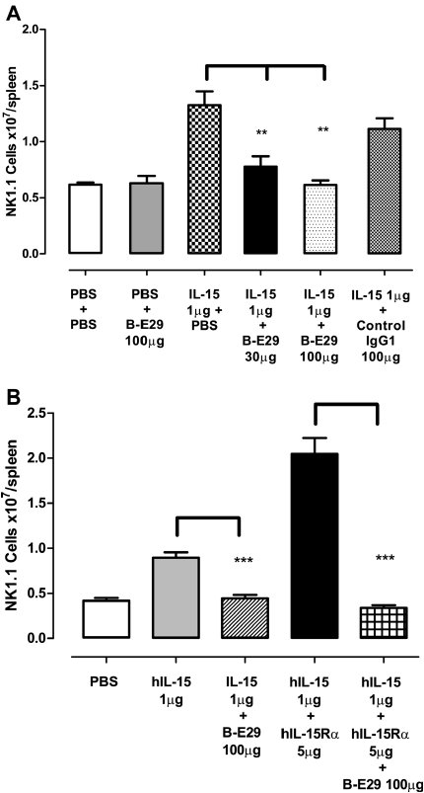
From DK Finch et al. Br J Pharmacol 2010
doi:10.1111/j.1476-5381.2010.01061.x/bph.1061
British Journal of Pharmacology © 2010 The British Pharmacological Society

Slide 6
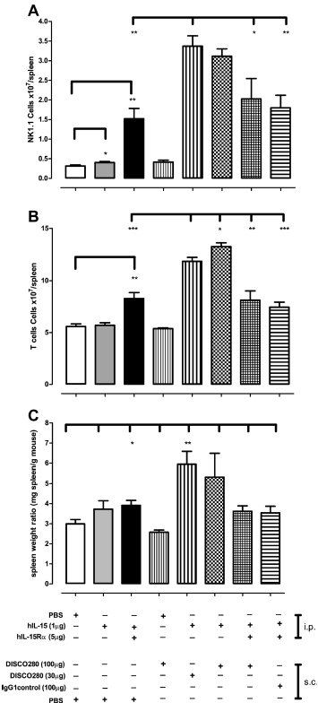
From DK Finch et al. Br J Pharmacol 2010
doi:10.1111/j.1476-5381.2010.01061.x/bph.1061
British Journal of Pharmacology © 2010 The British Pharmacological Society

Slide 7
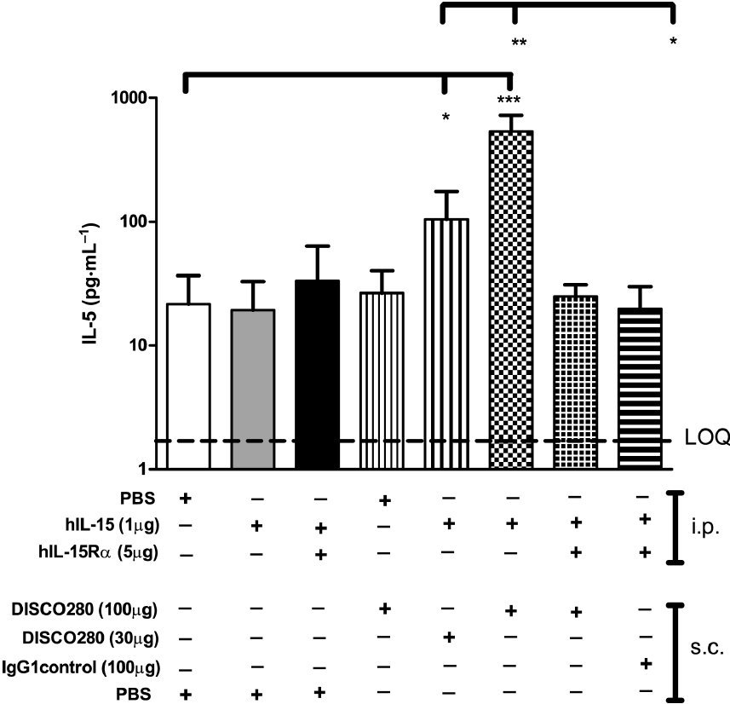
From DK Finch et al. Br J Pharmacol 2010
doi:10.1111/j.1476-5381.2010.01061.x/bph.1061
British Journal of Pharmacology © 2010 The British Pharmacological Society

