Slide 1
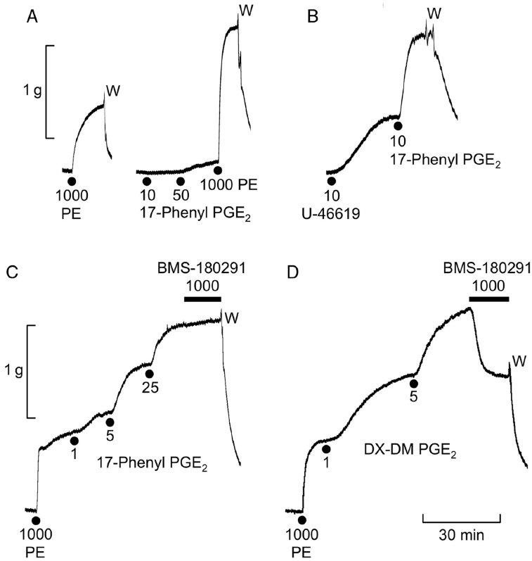
From RL Jones and DF Woodward. Br J Pharmacol 2010
doi:10.1111/j.1476-5381.2010.01039.x/bph.1039
British Journal of Pharmacology © 2010 The British Pharmacological Society

Slide 2
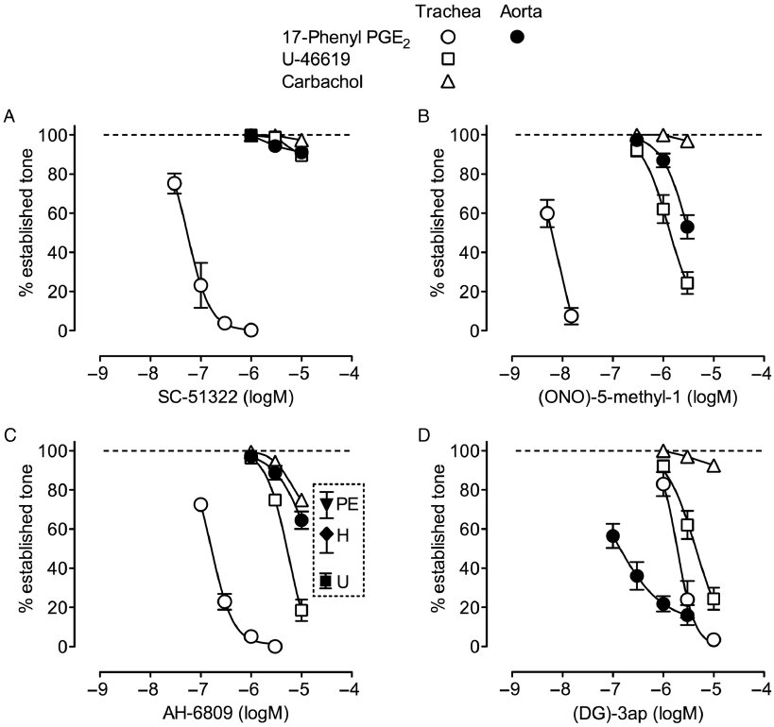
From RL Jones and DF Woodward. Br J Pharmacol 2010
doi:10.1111/j.1476-5381.2010.01039.x/bph.1039
British Journal of Pharmacology © 2010 The British Pharmacological Society

Slide 3
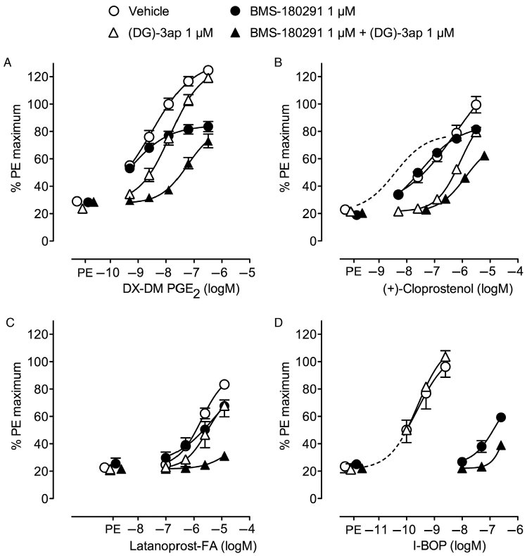
From RL Jones and DF Woodward. Br J Pharmacol 2010
doi:10.1111/j.1476-5381.2010.01039.x/bph.1039
British Journal of Pharmacology © 2010 The British Pharmacological Society

Slide 4
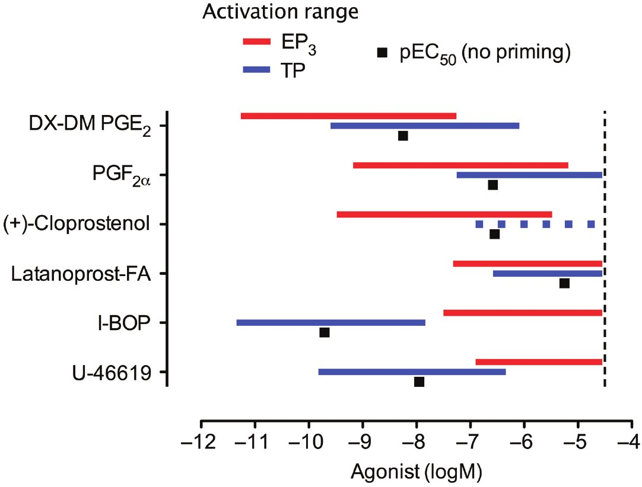
From RL Jones and DF Woodward. Br J Pharmacol 2010
doi:10.1111/j.1476-5381.2010.01039.x/bph.1039
British Journal of Pharmacology © 2010 The British Pharmacological Society

Slide 5
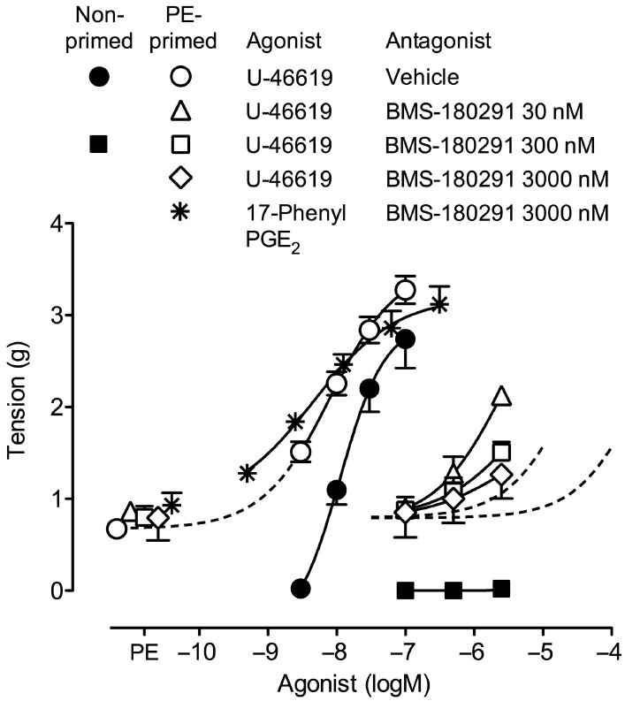
From RL Jones and DF Woodward. Br J Pharmacol 2010
doi:10.1111/j.1476-5381.2010.01039.x/bph.1039
British Journal of Pharmacology © 2010 The British Pharmacological Society

