Slide 1
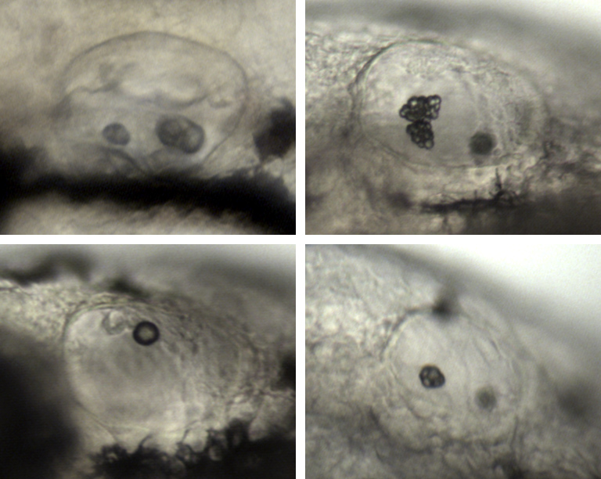
A
B
ctrl
BPA
C
D
1a1 MO
1a1 MO+BPA
Gibert et al., Fig.S7

