Slide 1
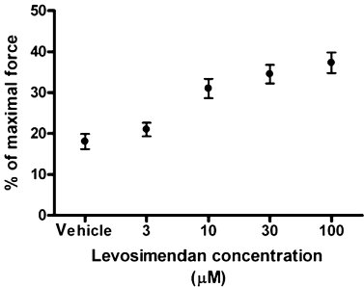
From HWH van Hees et al. Br J Pharmacol 2011
doi:10.1111/j.1476-5381.2010.01048.x/bph.1048
British Journal of Pharmacology © 2011 The British Pharmacological Society

Slide 2
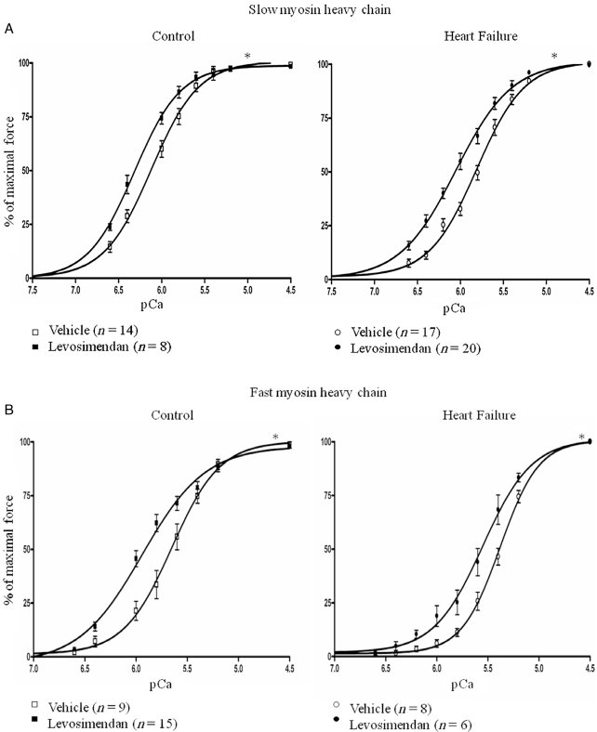
From HWH van Hees et al. Br J Pharmacol 2011
doi:10.1111/j.1476-5381.2010.01048.x/bph.1048
British Journal of Pharmacology © 2011 The British Pharmacological Society

Slide 3
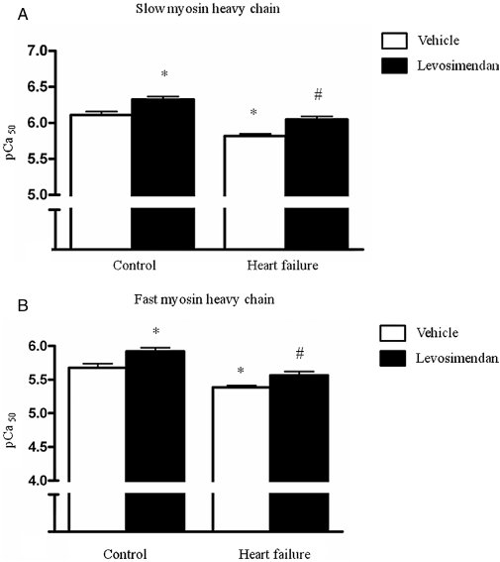
From HWH van Hees et al. Br J Pharmacol 2011
doi:10.1111/j.1476-5381.2010.01048.x/bph.1048
British Journal of Pharmacology © 2011 The British Pharmacological Society

Slide 4
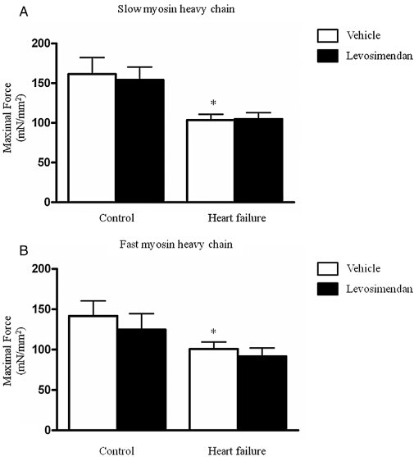
From HWH van Hees et al. Br J Pharmacol 2011
doi:10.1111/j.1476-5381.2010.01048.x/bph.1048
British Journal of Pharmacology © 2011 The British Pharmacological Society

