Slide 1
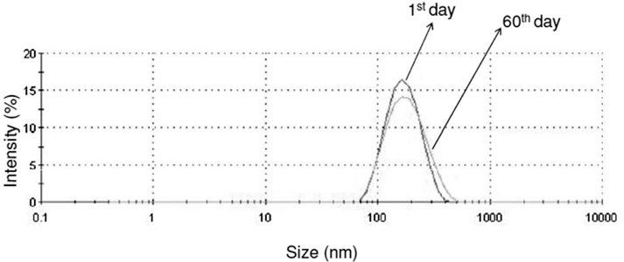
From CF Alves et al. Br J Pharmacol 2011
doi:10.1111/j.1476-5381.2010.01057.x/bph.1057
British Journal of Pharmacology © 2011 The British Pharmacological Society

Slide 2
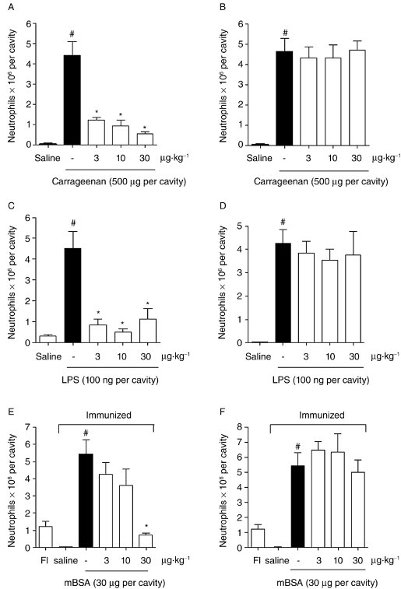
From CF Alves et al. Br J Pharmacol 2011
doi:10.1111/j.1476-5381.2010.01057.x/bph.1057
British Journal of Pharmacology © 2011 The British Pharmacological Society

Slide 3
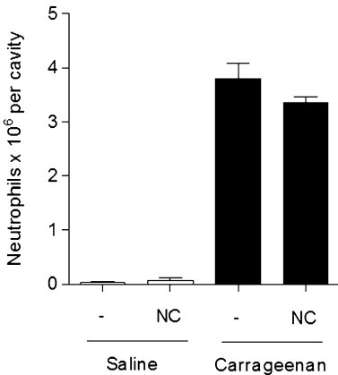
From CF Alves et al. Br J Pharmacol 2011
doi:10.1111/j.1476-5381.2010.01057.x/bph.1057
British Journal of Pharmacology © 2011 The British Pharmacological Society

Slide 4
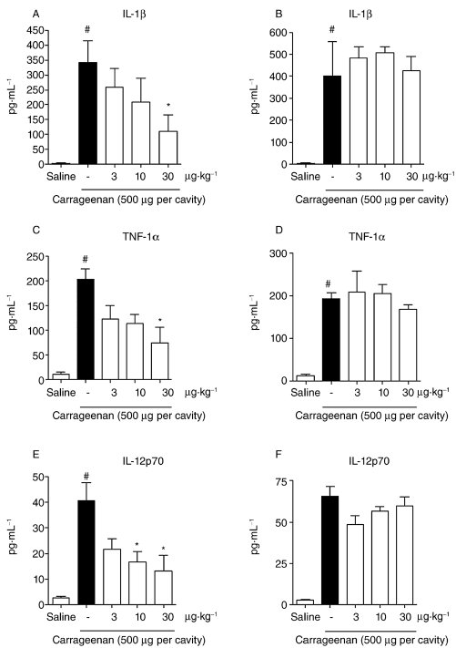
From CF Alves et al. Br J Pharmacol 2011
doi:10.1111/j.1476-5381.2010.01057.x/bph.1057
British Journal of Pharmacology © 2011 The British Pharmacological Society

Slide 5
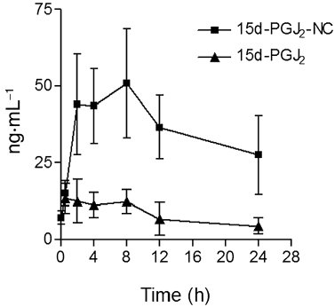
From CF Alves et al. Br J Pharmacol 2011
doi:10.1111/j.1476-5381.2010.01057.x/bph.1057
British Journal of Pharmacology © 2011 The British Pharmacological Society

Slide 6
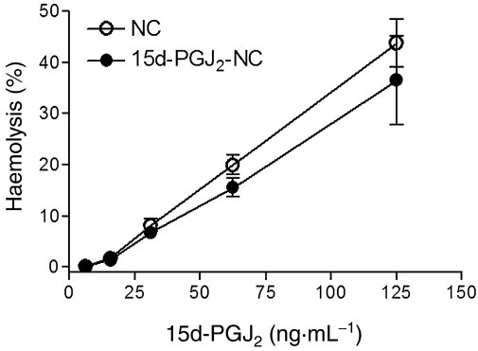
From CF Alves et al. Br J Pharmacol 2011
doi:10.1111/j.1476-5381.2010.01057.x/bph.1057
British Journal of Pharmacology © 2011 The British Pharmacological Society

