Slide 1
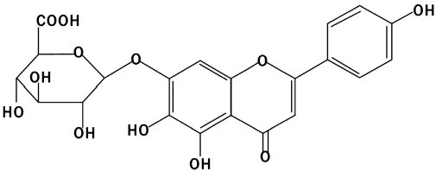
From Z Pan et al. Br J Pharmacol 2011
doi:10.1111/j.1476-5381.2010.01070.x/bph.1070
British Journal of Pharmacology © 2011 The British Pharmacological Society

Slide 2
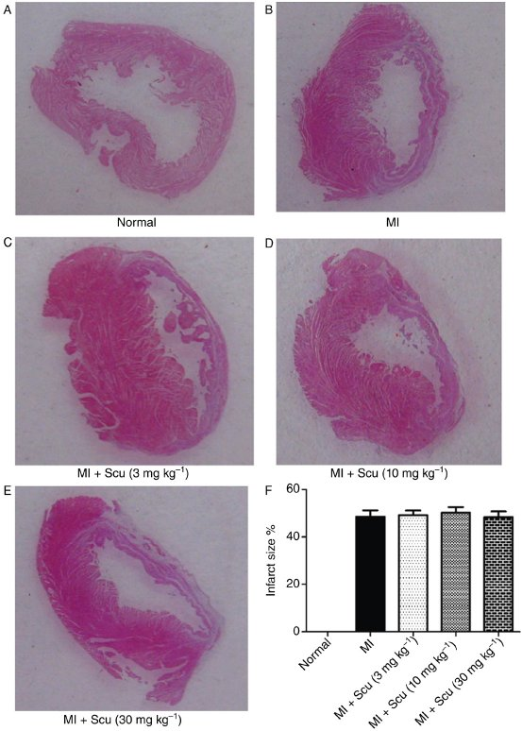
From Z Pan et al. Br J Pharmacol 2011
doi:10.1111/j.1476-5381.2010.01070.x/bph.1070
British Journal of Pharmacology © 2011 The British Pharmacological Society

Slide 3
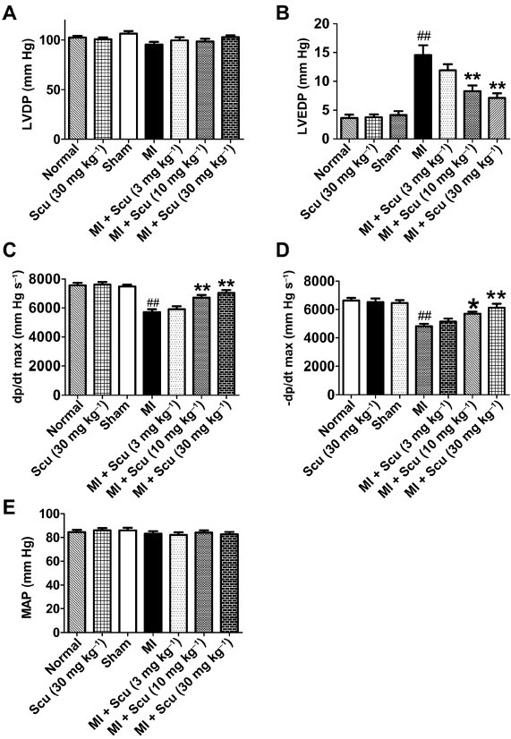
From Z Pan et al. Br J Pharmacol 2011
doi:10.1111/j.1476-5381.2010.01070.x/bph.1070
British Journal of Pharmacology © 2011 The British Pharmacological Society

Slide 4
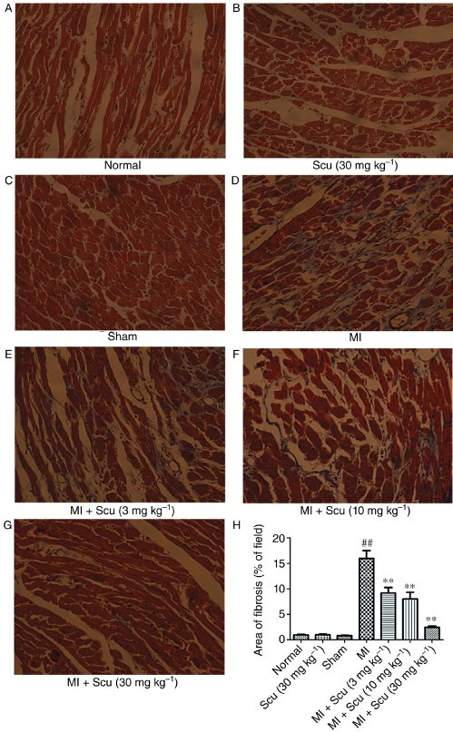
From Z Pan et al. Br J Pharmacol 2011
doi:10.1111/j.1476-5381.2010.01070.x/bph.1070
British Journal of Pharmacology © 2011 The British Pharmacological Society

Slide 5
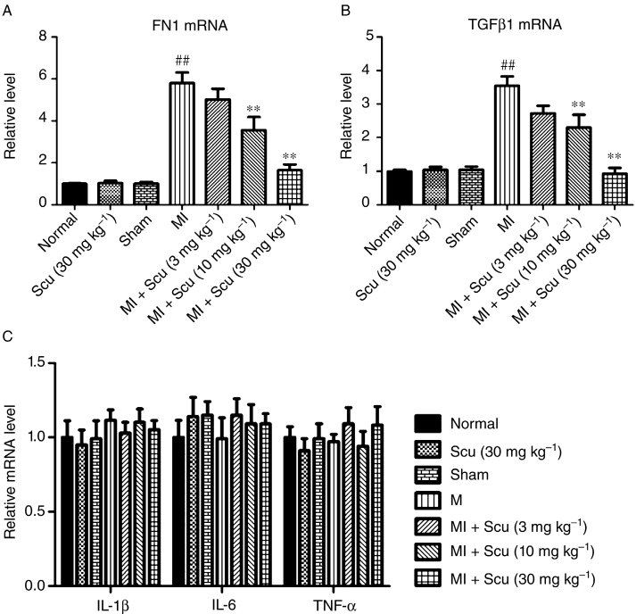
From Z Pan et al. Br J Pharmacol 2011
doi:10.1111/j.1476-5381.2010.01070.x/bph.1070
British Journal of Pharmacology © 2011 The British Pharmacological Society

Slide 6
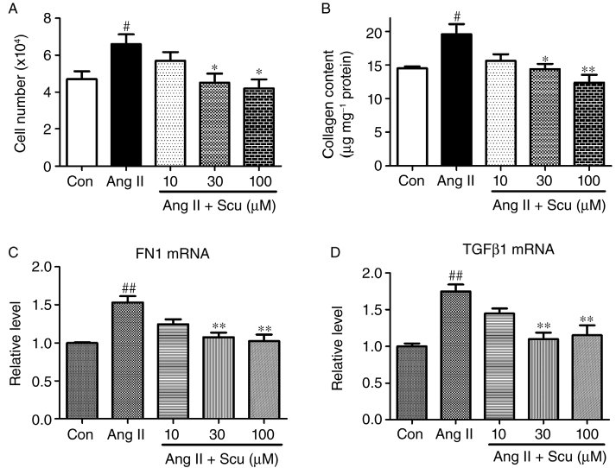
From Z Pan et al. Br J Pharmacol 2011
doi:10.1111/j.1476-5381.2010.01070.x/bph.1070
British Journal of Pharmacology © 2011 The British Pharmacological Society

Slide 7
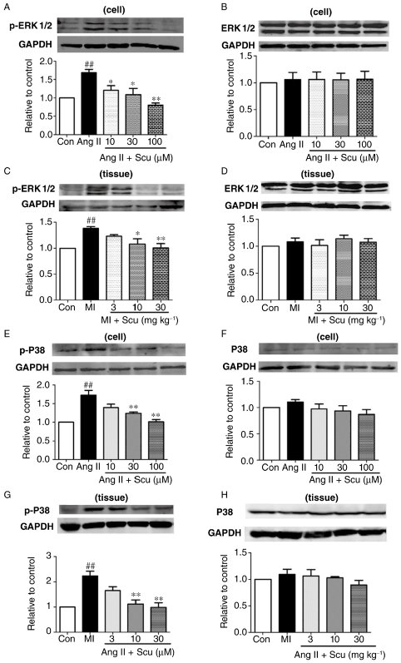
From Z Pan et al. Br J Pharmacol 2011
doi:10.1111/j.1476-5381.2010.01070.x/bph.1070
British Journal of Pharmacology © 2011 The British Pharmacological Society

