Slide 1

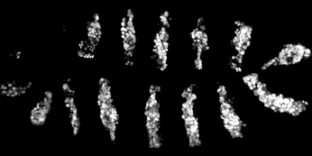
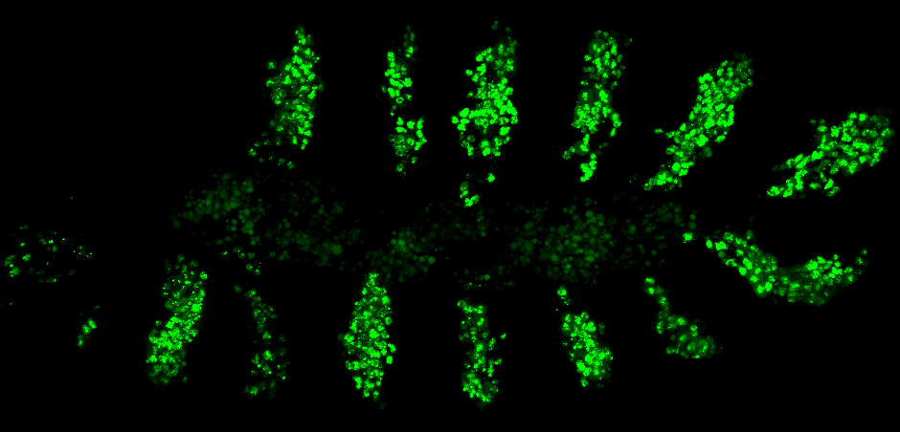
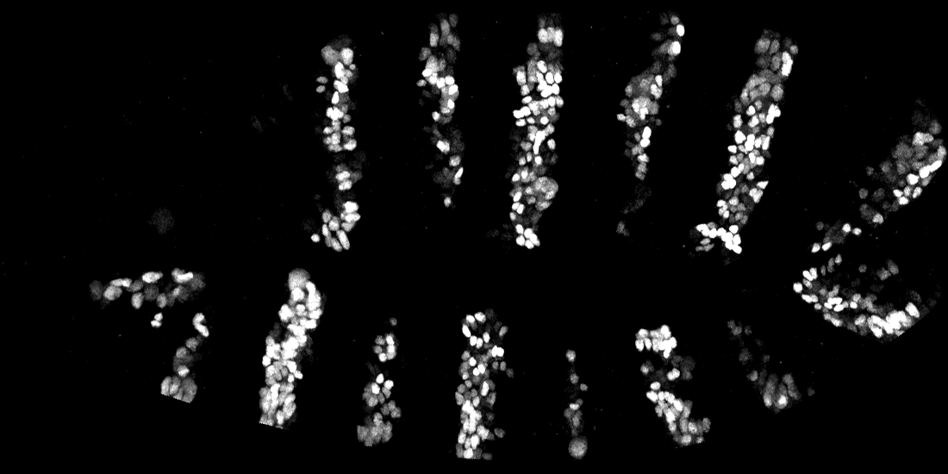
A
B
enGal4 >
C
enGal4 >
Exd
PBCA
HD
HthVN VCE
γGFP
VNE
VCE
VCHth VNE
HthVN
Hth
HM
HD
γGFP
HthVN
VCHth
VCHth
Additional File 3

