Slide 1
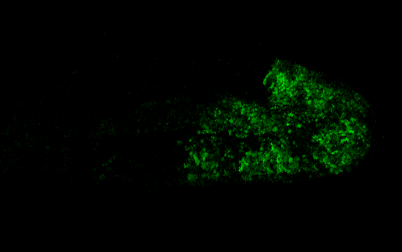
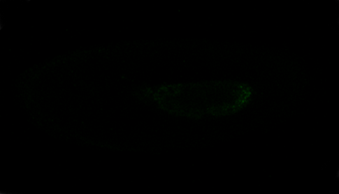

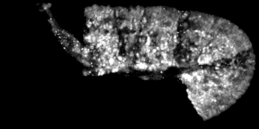
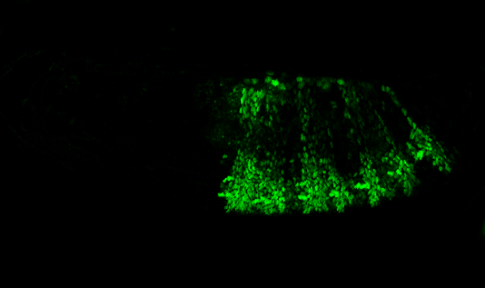
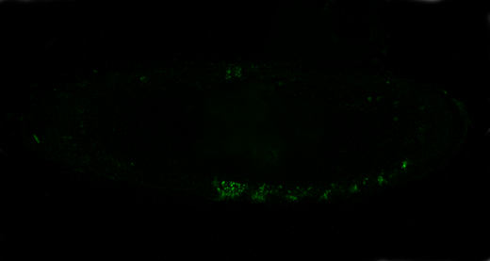
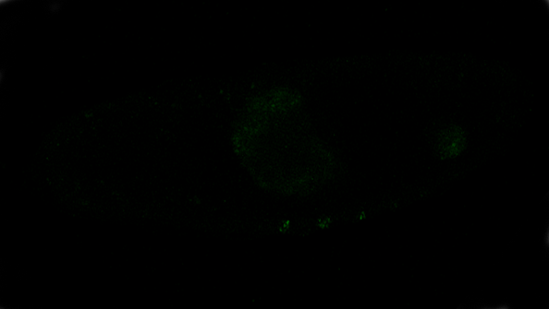
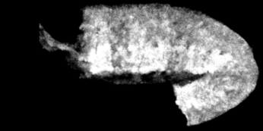
A
PabdAGal4 > VN VC
PabdAGal4 > VN VCA
PabdAGal4 > VC VNA
B
PabdAGal4 >
γGFP
Stage 11
2h/28H 4°C
28h 4°C
28h 4°C
VN
γGFP
Stage 14
28h 4°C
28h 4°C
28h 4°C
VC
Additional File 4

