Slide 1
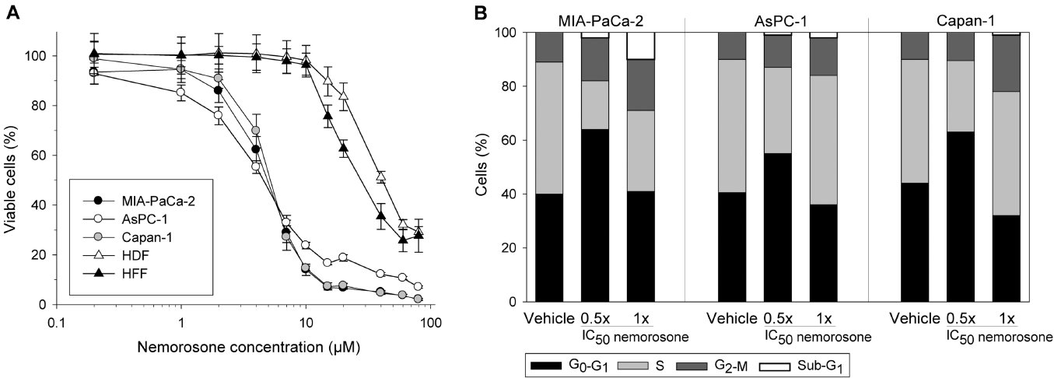
From F Holtrup et al. Br J Pharmacol 2011
doi:10.1111/j.1476-5381.2010.01125.x/bph.1125
British Journal of Pharmacology © 2011 The British Pharmacological Society

Slide 2
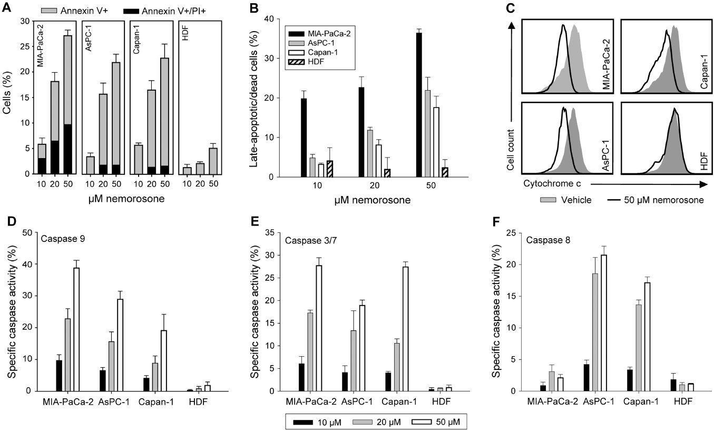
From F Holtrup et al. Br J Pharmacol 2011
doi:10.1111/j.1476-5381.2010.01125.x/bph.1125
British Journal of Pharmacology © 2011 The British Pharmacological Society

Slide 3
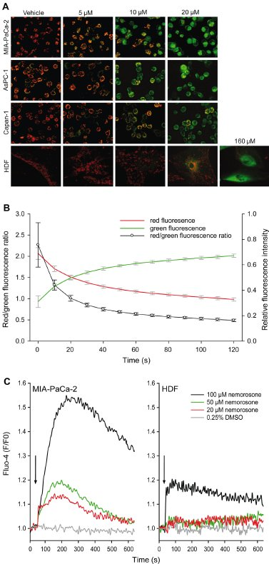
From F Holtrup et al. Br J Pharmacol 2011
doi:10.1111/j.1476-5381.2010.01125.x/bph.1125
British Journal of Pharmacology © 2011 The British Pharmacological Society

Slide 4
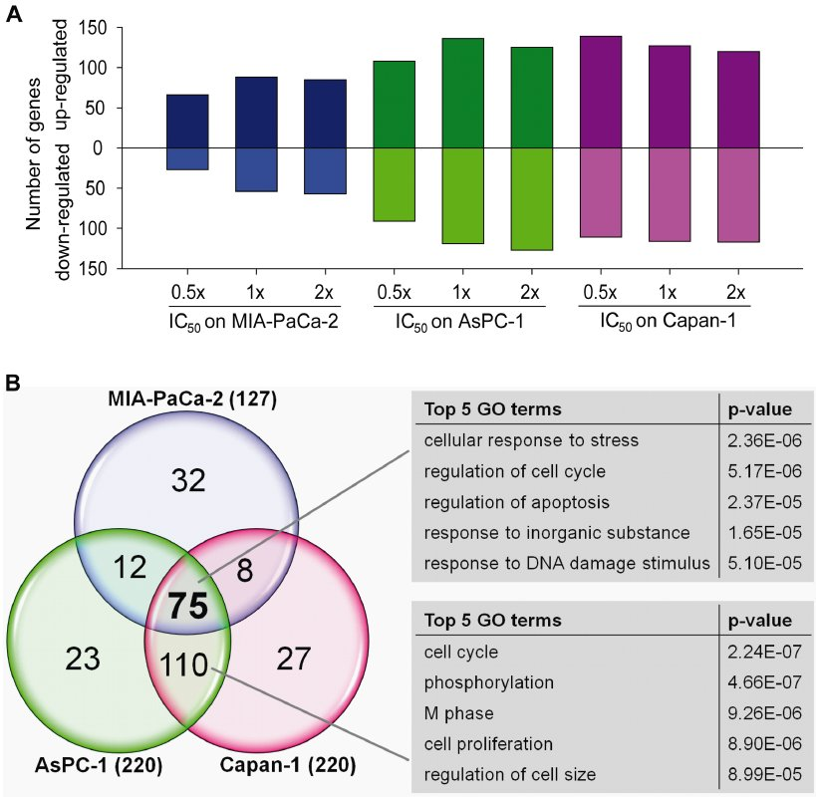
From F Holtrup et al. Br J Pharmacol 2011
doi:10.1111/j.1476-5381.2010.01125.x/bph.1125
British Journal of Pharmacology © 2011 The British Pharmacological Society

Slide 5
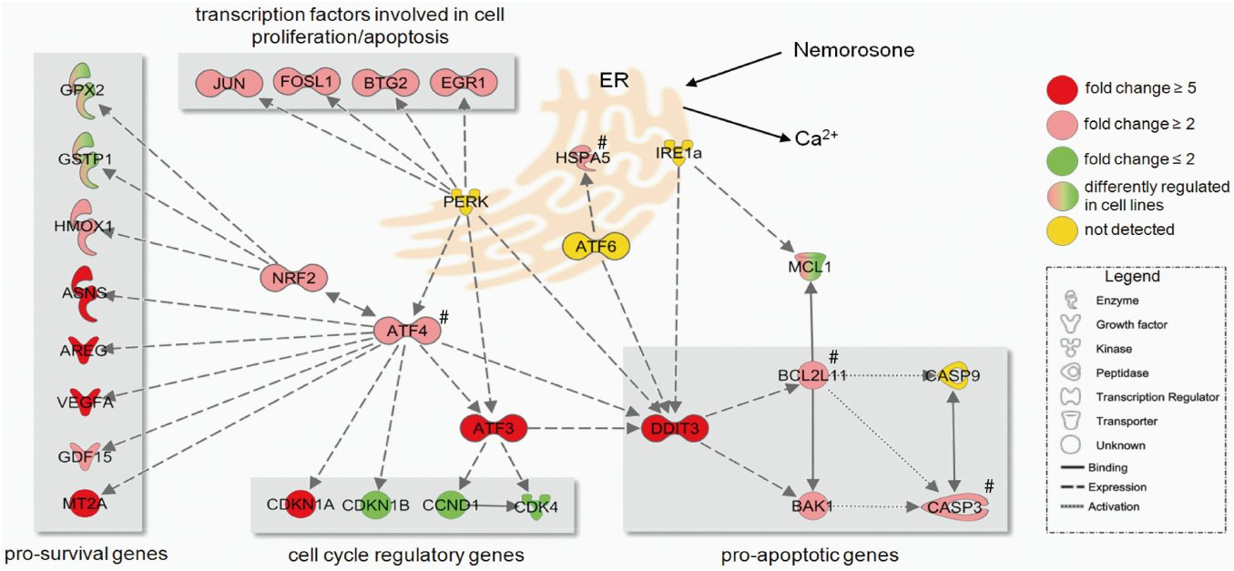
From F Holtrup et al. Br J Pharmacol 2011
doi:10.1111/j.1476-5381.2010.01125.x/bph.1125
British Journal of Pharmacology © 2011 The British Pharmacological Society

Slide 6
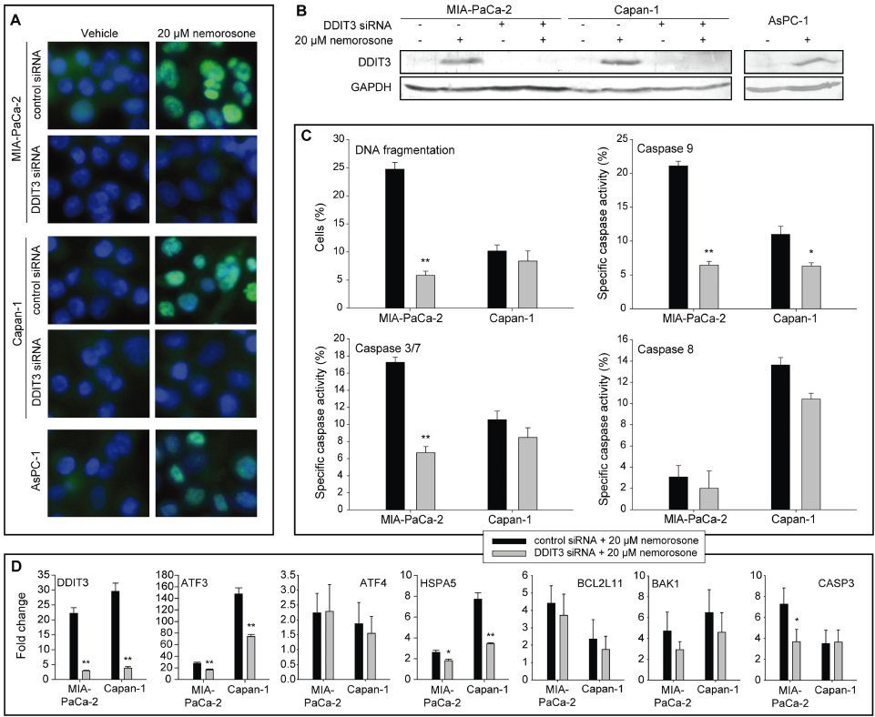
From F Holtrup et al. Br J Pharmacol 2011
doi:10.1111/j.1476-5381.2010.01125.x/bph.1125
British Journal of Pharmacology © 2011 The British Pharmacological Society

