Slide 1
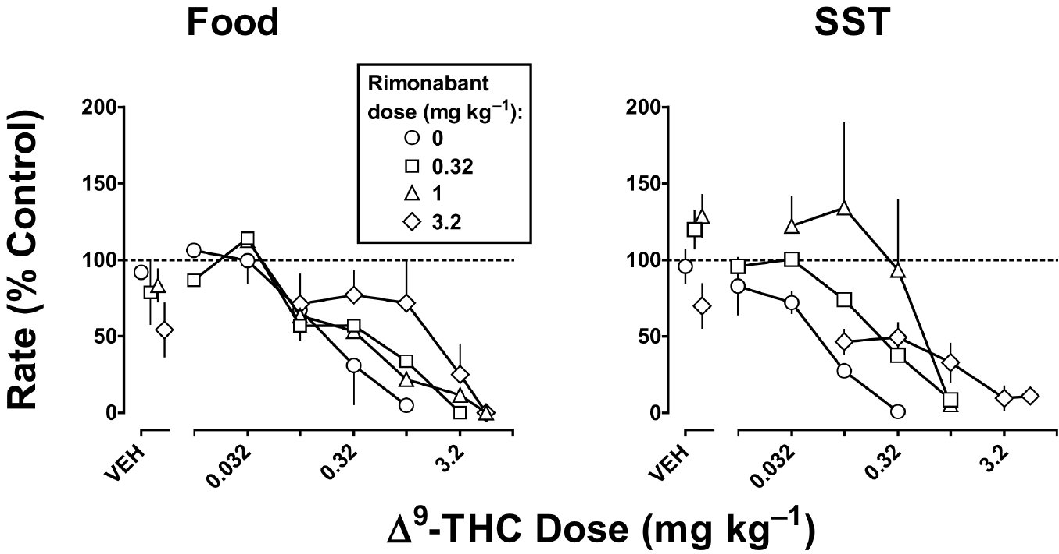
From LR McMahon. Br J Pharmacol 2011
doi:10.1111/j.1476-5381.2010.01116.x/bph.1116
British Journal of Pharmacology © 2011 The British Pharmacological Society

Slide 2
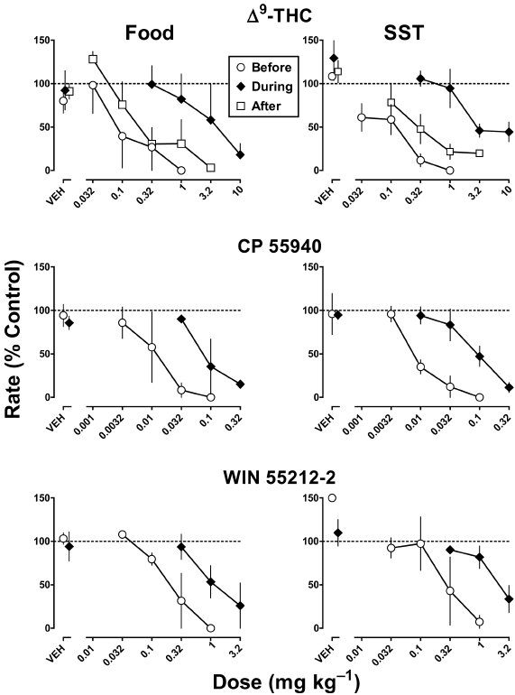
From LR McMahon. Br J Pharmacol 2011
doi:10.1111/j.1476-5381.2010.01116.x/bph.1116
British Journal of Pharmacology © 2011 The British Pharmacological Society

Slide 3
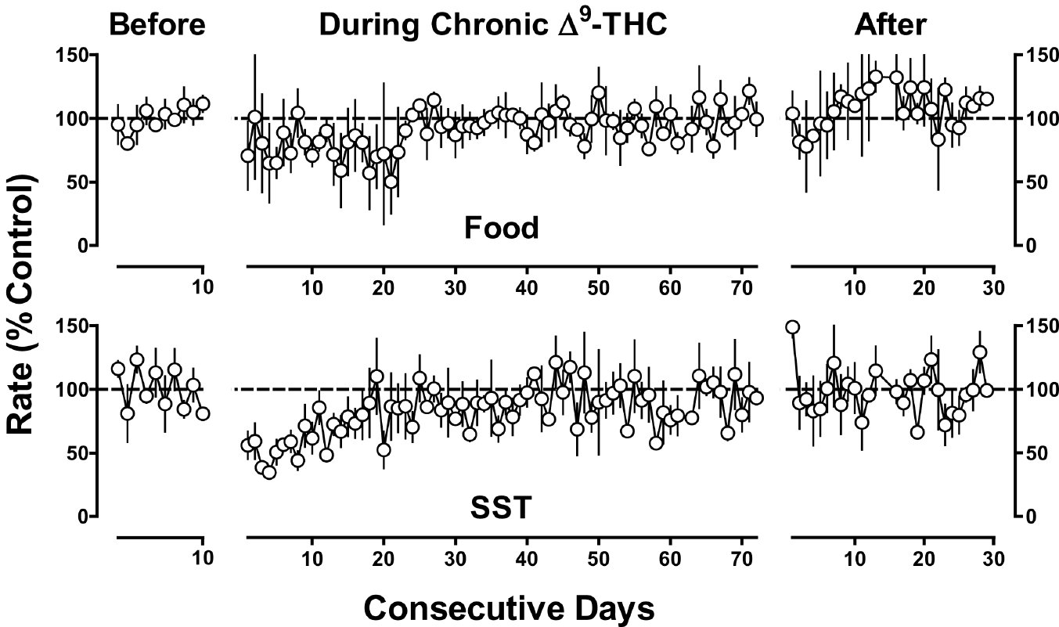
From LR McMahon. Br J Pharmacol 2011
doi:10.1111/j.1476-5381.2010.01116.x/bph.1116
British Journal of Pharmacology © 2011 The British Pharmacological Society

Slide 4
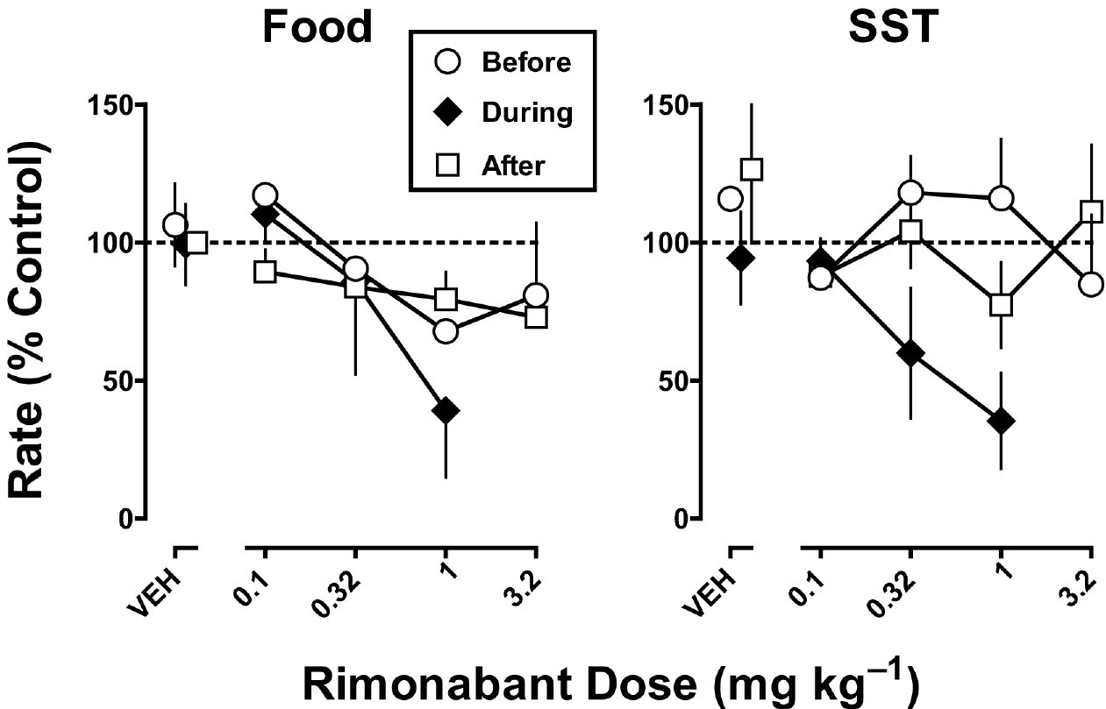
From LR McMahon. Br J Pharmacol 2011
doi:10.1111/j.1476-5381.2010.01116.x/bph.1116
British Journal of Pharmacology © 2011 The British Pharmacological Society

Slide 5
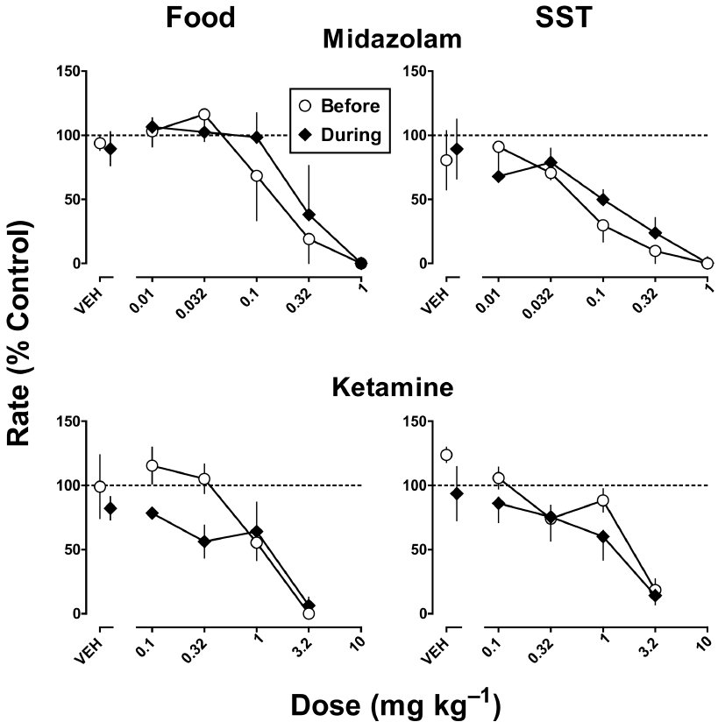
From LR McMahon. Br J Pharmacol 2011
doi:10.1111/j.1476-5381.2010.01116.x/bph.1116
British Journal of Pharmacology © 2011 The British Pharmacological Society

Slide 6
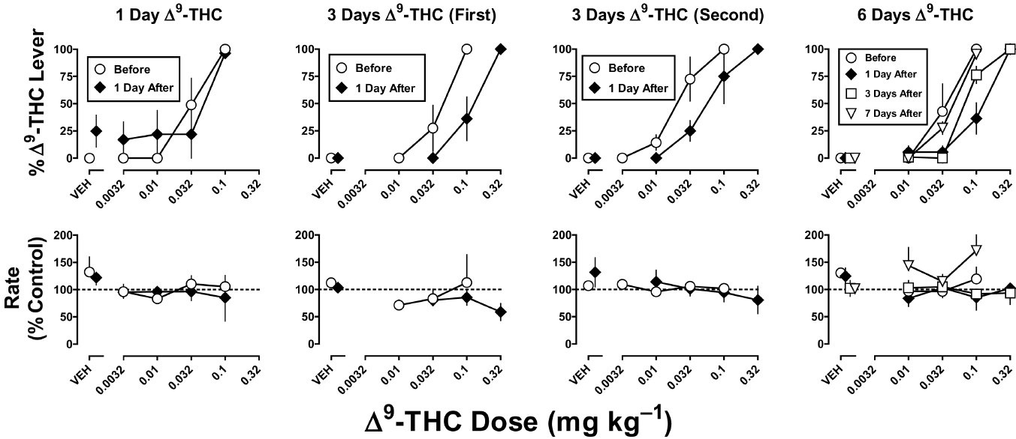
From LR McMahon. Br J Pharmacol 2011
doi:10.1111/j.1476-5381.2010.01116.x/bph.1116
British Journal of Pharmacology © 2011 The British Pharmacological Society

Slide 7
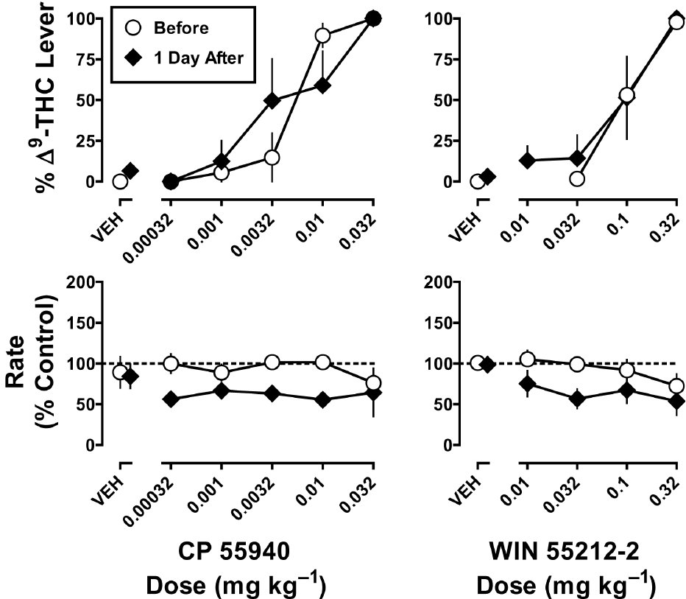
From LR McMahon. Br J Pharmacol 2011
doi:10.1111/j.1476-5381.2010.01116.x/bph.1116
British Journal of Pharmacology © 2011 The British Pharmacological Society

