Slide 1
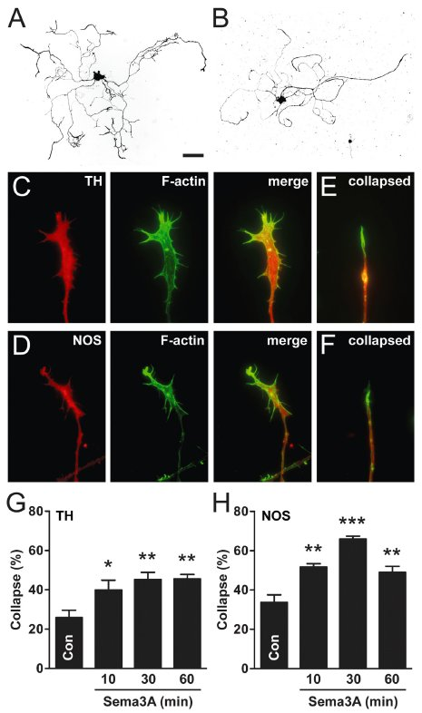
From MR Nangle and JR Keast. Br J Pharmacol 2011
doi:10.1111/j.1476-5381.2010.01108.x/bph.1108
British Journal of Pharmacology © 2011 The British Pharmacological Society

Slide 2
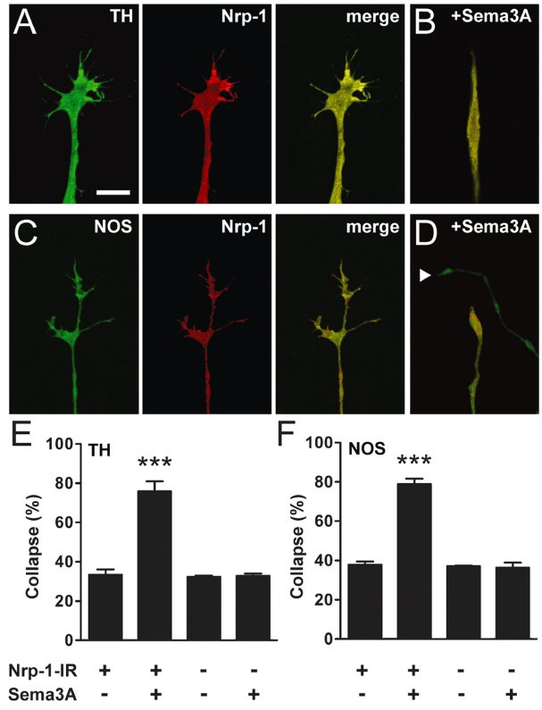
From MR Nangle and JR Keast. Br J Pharmacol 2011
doi:10.1111/j.1476-5381.2010.01108.x/bph.1108
British Journal of Pharmacology © 2011 The British Pharmacological Society

Slide 3
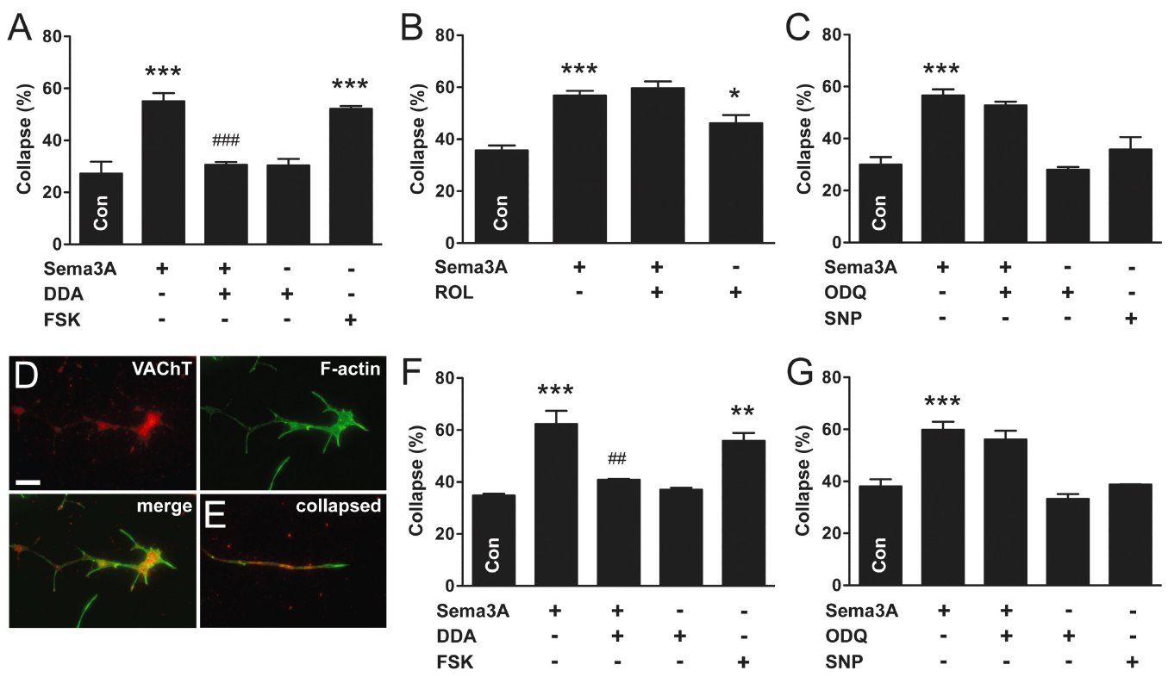
From MR Nangle and JR Keast. Br J Pharmacol 2011
doi:10.1111/j.1476-5381.2010.01108.x/bph.1108
British Journal of Pharmacology © 2011 The British Pharmacological Society

Slide 4
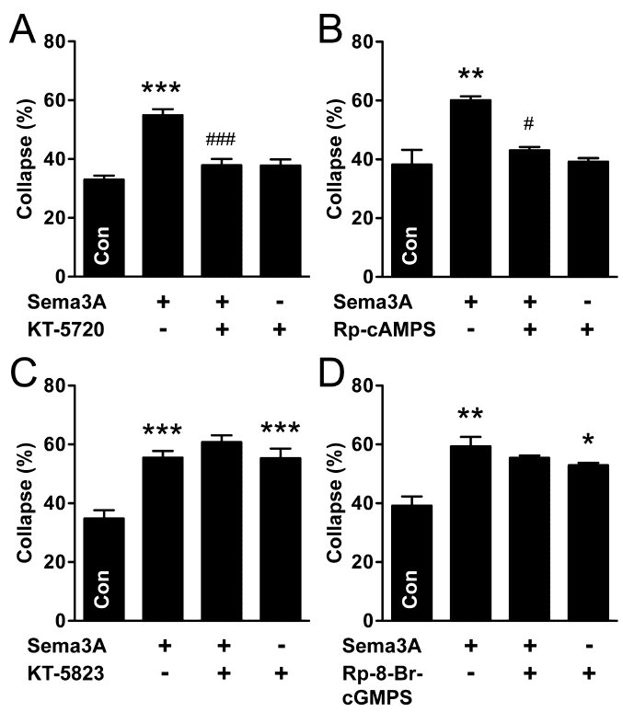
From MR Nangle and JR Keast. Br J Pharmacol 2011
doi:10.1111/j.1476-5381.2010.01108.x/bph.1108
British Journal of Pharmacology © 2011 The British Pharmacological Society

Slide 5
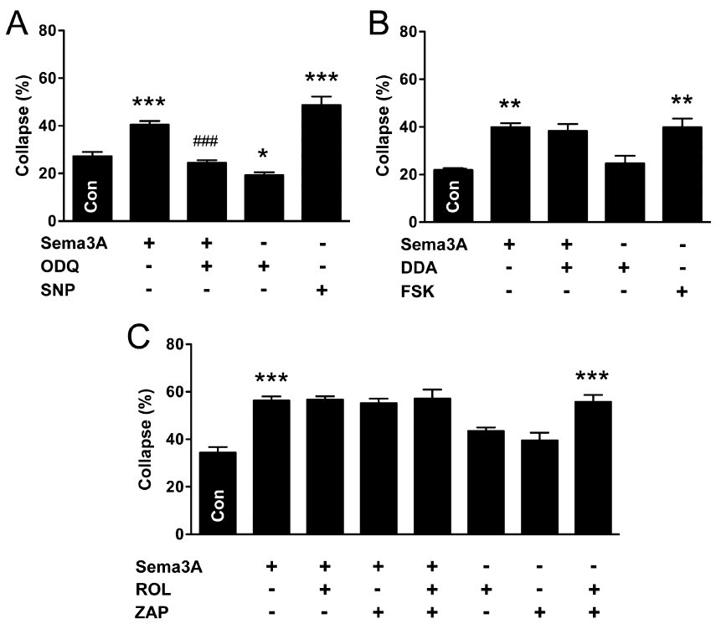
From MR Nangle and JR Keast. Br J Pharmacol 2011
doi:10.1111/j.1476-5381.2010.01108.x/bph.1108
British Journal of Pharmacology © 2011 The British Pharmacological Society

Slide 6
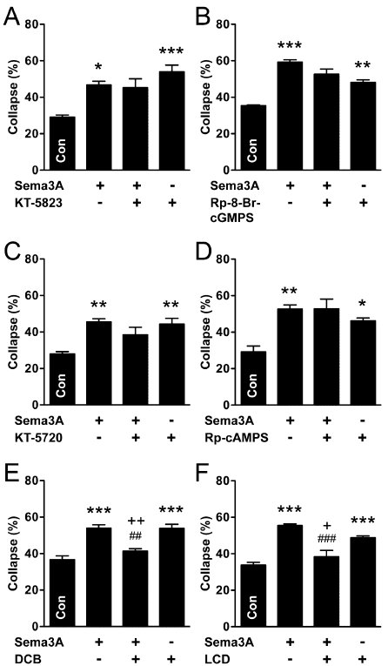
From MR Nangle and JR Keast. Br J Pharmacol 2011
doi:10.1111/j.1476-5381.2010.01108.x/bph.1108
British Journal of Pharmacology © 2011 The British Pharmacological Society

Slide 7
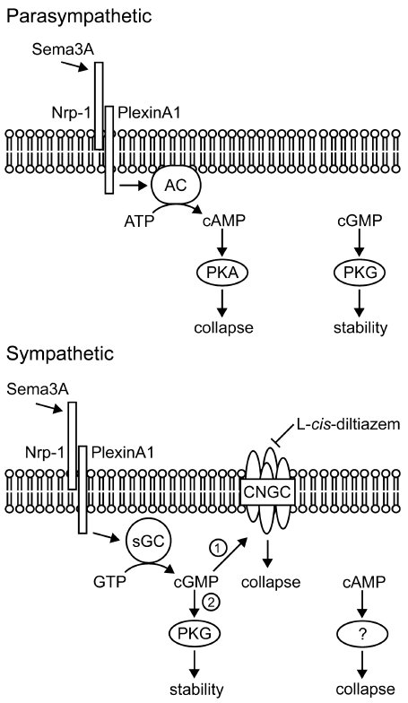
From MR Nangle and JR Keast. Br J Pharmacol 2011
doi:10.1111/j.1476-5381.2010.01108.x/bph.1108
British Journal of Pharmacology © 2011 The British Pharmacological Society

