Slide 1
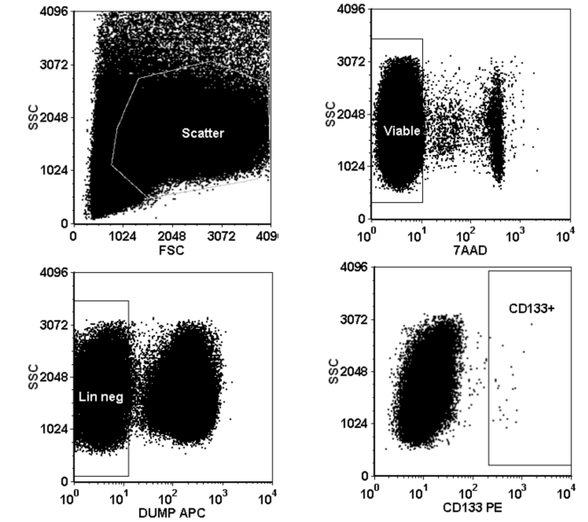
Characterization of CD 133 positive Cells by Flow Cytometry

