Slide 1
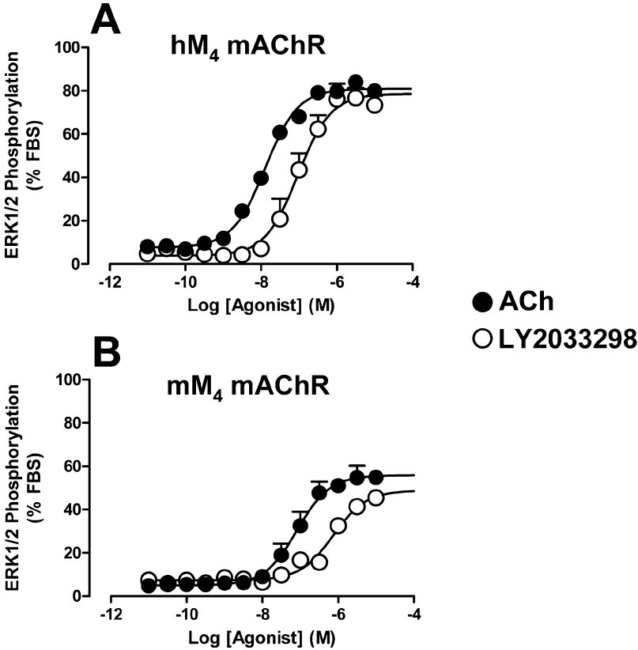
From S Suratman et al. Br J Pharmacol 2011
doi:10.1111/j.1476-5381.2010.01184.x/bph.1184
British Journal of Pharmacology © 2011 The British Pharmacological Society

Slide 2
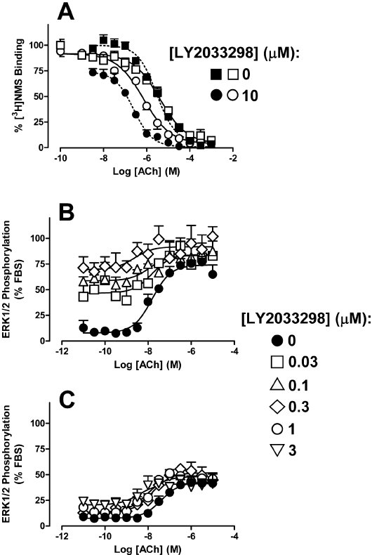
From S Suratman et al. Br J Pharmacol 2011
doi:10.1111/j.1476-5381.2010.01184.x/bph.1184
British Journal of Pharmacology © 2011 The British Pharmacological Society

Slide 3
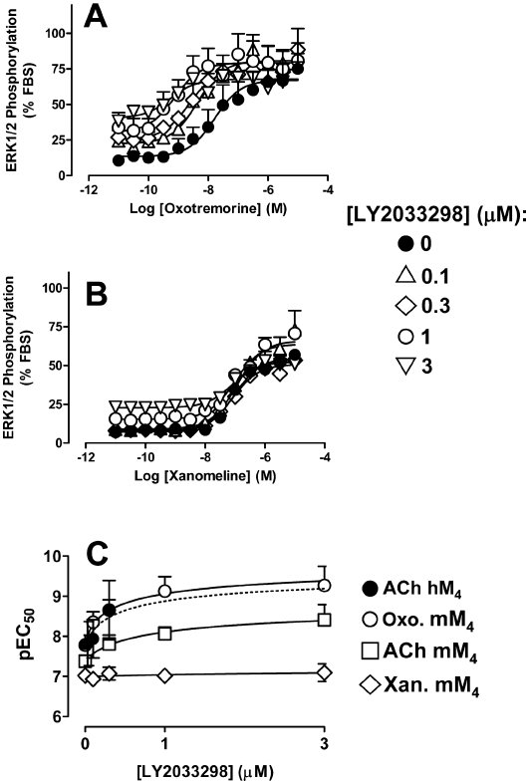
From S Suratman et al. Br J Pharmacol 2011
doi:10.1111/j.1476-5381.2010.01184.x/bph.1184
British Journal of Pharmacology © 2011 The British Pharmacological Society

Slide 4
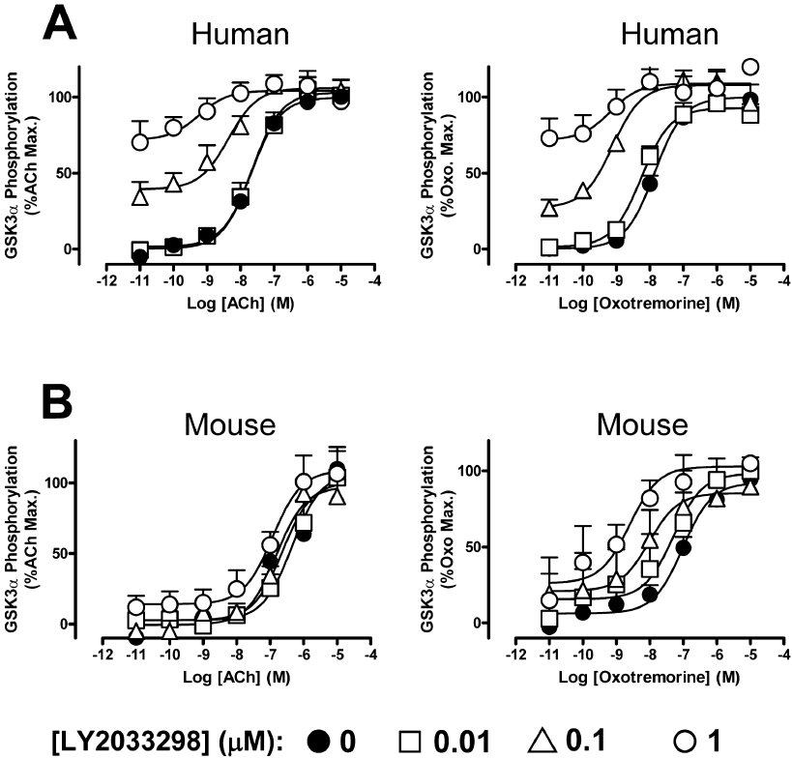
From S Suratman et al. Br J Pharmacol 2011
doi:10.1111/j.1476-5381.2010.01184.x/bph.1184
British Journal of Pharmacology © 2011 The British Pharmacological Society

Slide 5
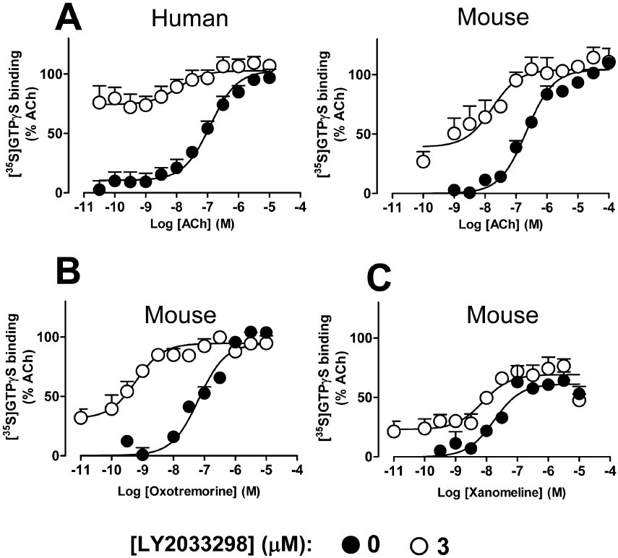
From S Suratman et al. Br J Pharmacol 2011
doi:10.1111/j.1476-5381.2010.01184.x/bph.1184
British Journal of Pharmacology © 2011 The British Pharmacological Society

Slide 6
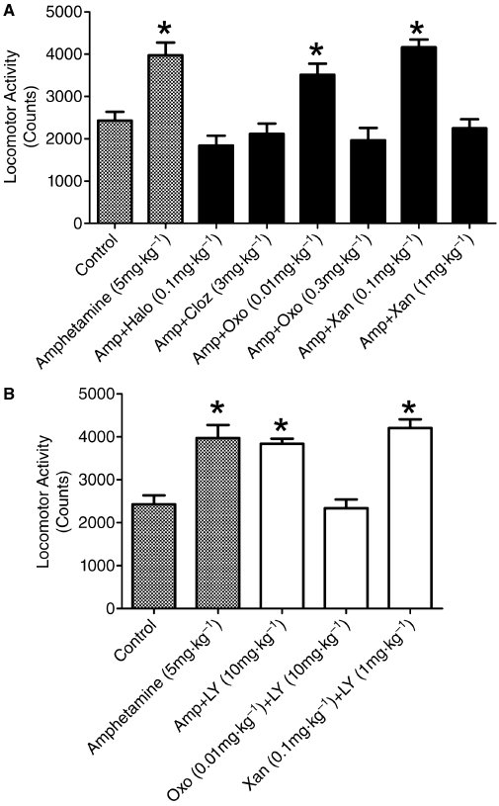
From S Suratman et al. Br J Pharmacol 2011
doi:10.1111/j.1476-5381.2010.01184.x/bph.1184
British Journal of Pharmacology © 2011 The British Pharmacological Society

