Slide 1
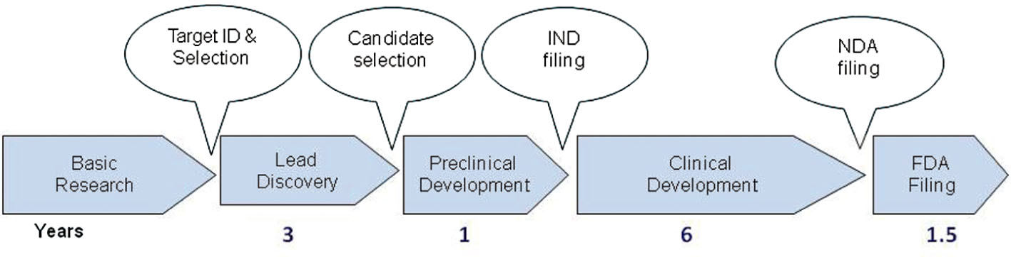
From JP Hughes et al. Br J Pharmacol 2011
doi:10.1111/j.1476-5381.2010.01127.x/bph.1127
British Journal of Pharmacology © 2011 The British Pharmacological Society

Slide 2
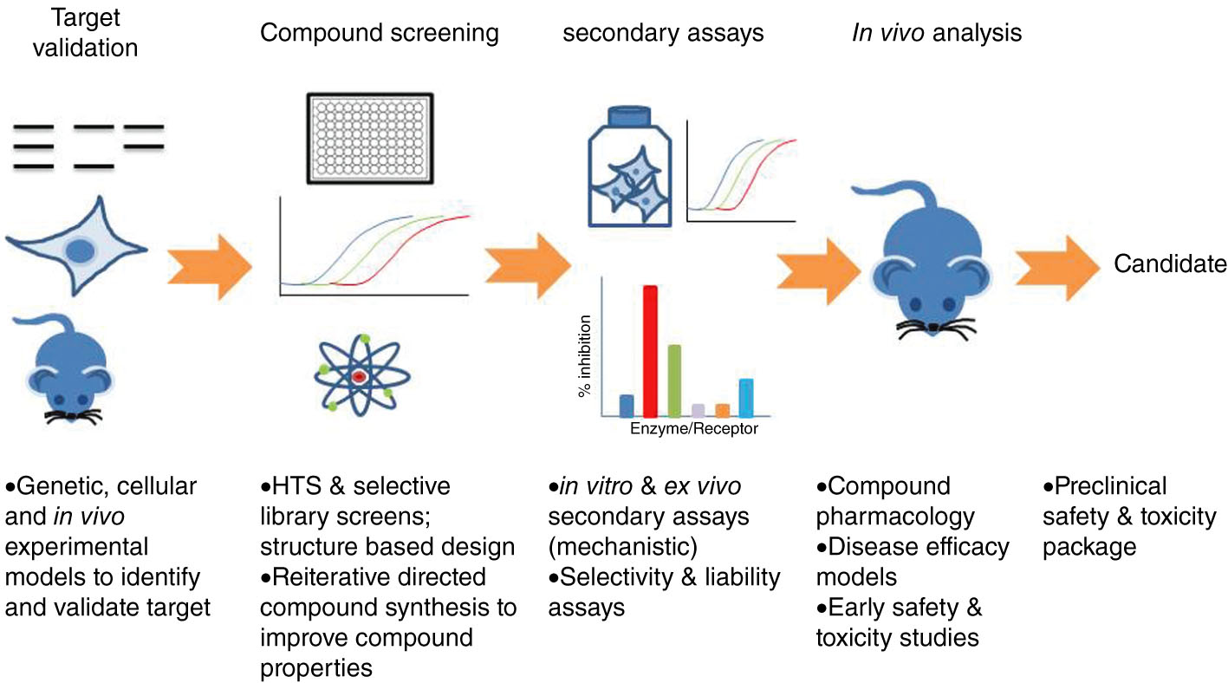
From JP Hughes et al. Br J Pharmacol 2011
doi:10.1111/j.1476-5381.2010.01127.x/bph.1127
British Journal of Pharmacology © 2011 The British Pharmacological Society

Slide 3
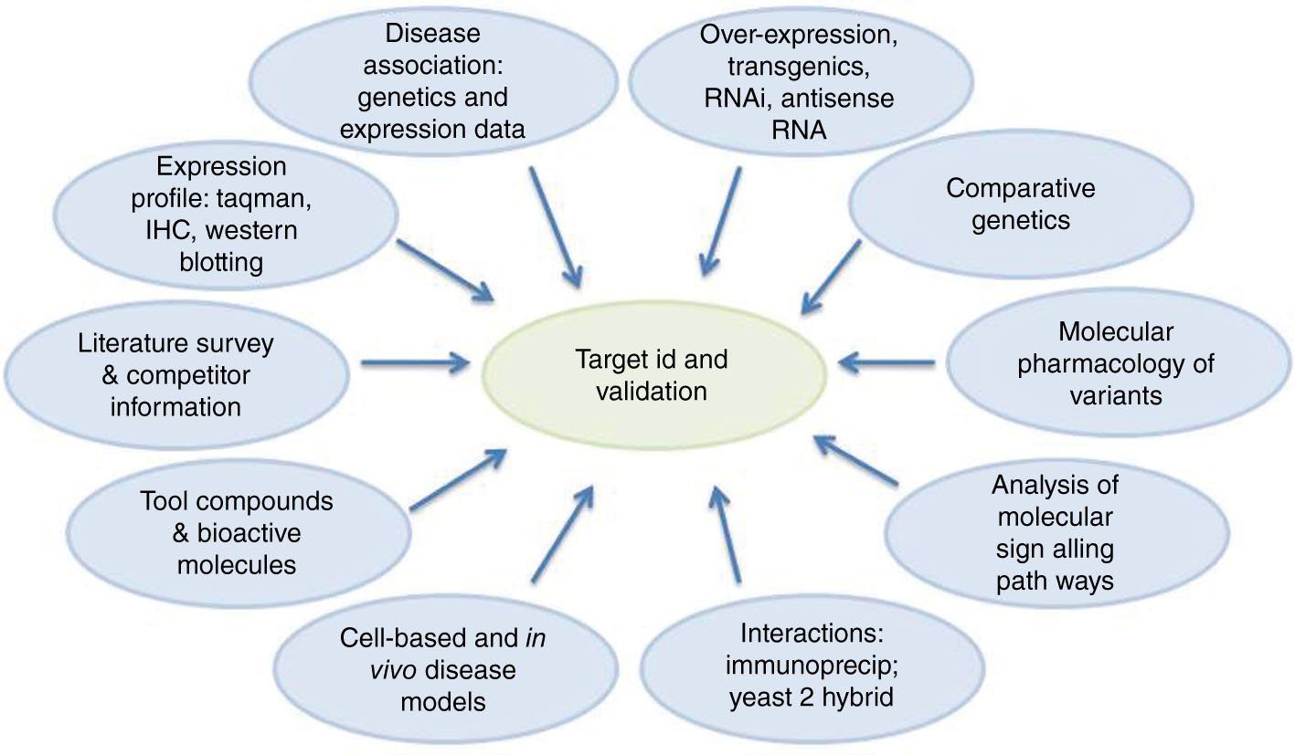
From JP Hughes et al. Br J Pharmacol 2011
doi:10.1111/j.1476-5381.2010.01127.x/bph.1127
British Journal of Pharmacology © 2011 The British Pharmacological Society

Slide 4
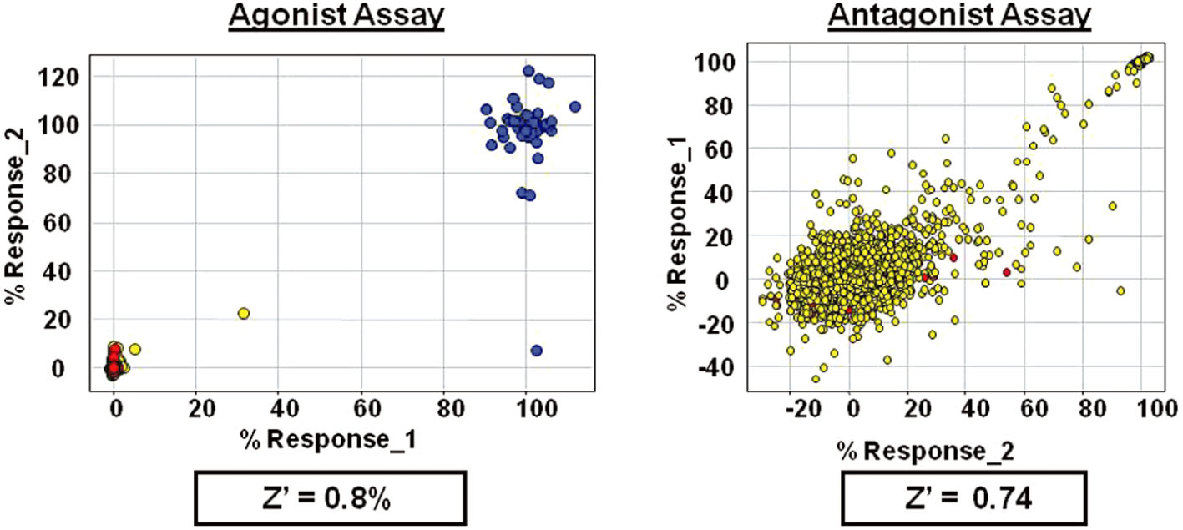
From JP Hughes et al. Br J Pharmacol 2011
doi:10.1111/j.1476-5381.2010.01127.x/bph.1127
British Journal of Pharmacology © 2011 The British Pharmacological Society

Slide 5
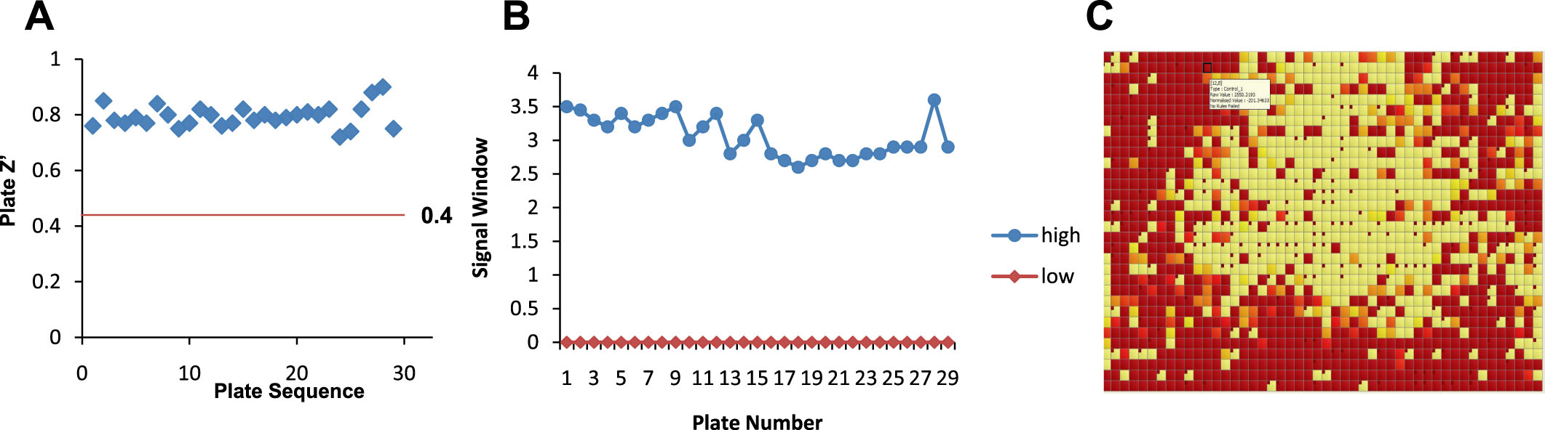
From JP Hughes et al. Br J Pharmacol 2011
doi:10.1111/j.1476-5381.2010.01127.x/bph.1127
British Journal of Pharmacology © 2011 The British Pharmacological Society

Slide 6
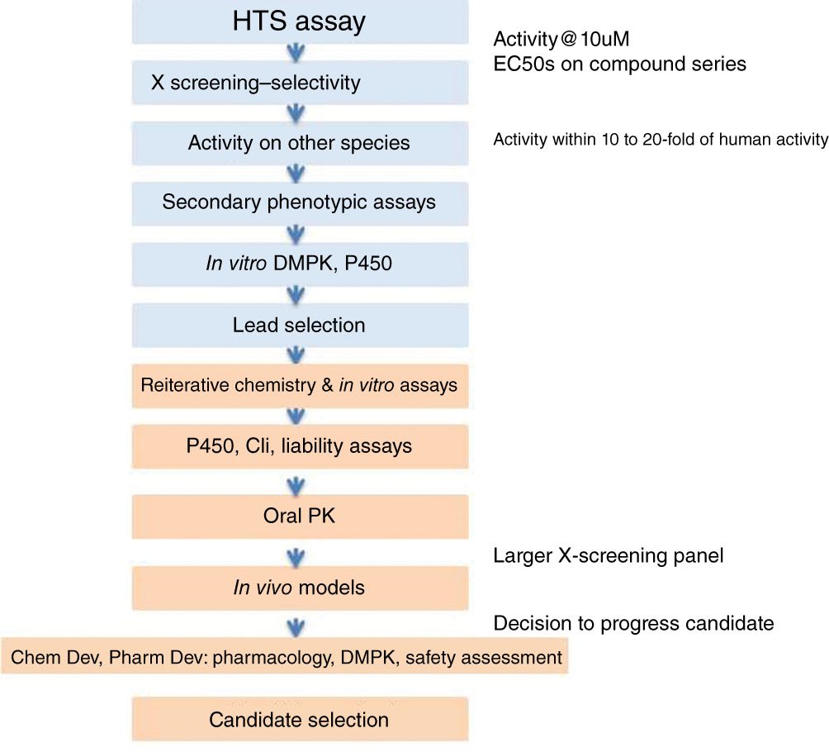
From JP Hughes et al. Br J Pharmacol 2011
doi:10.1111/j.1476-5381.2010.01127.x/bph.1127
British Journal of Pharmacology © 2011 The British Pharmacological Society

