Slide 1
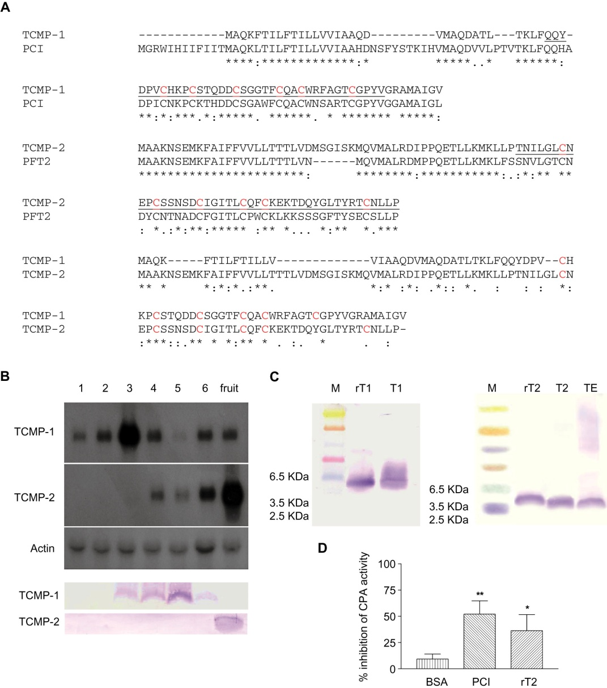
From C Cavallini et al. Br J Pharmacol 2011
doi:10.1111/j.1476-5381.2010.01154.x/bph.1154
British Journal of Pharmacology © 2011 The British Pharmacological Society

Slide 2
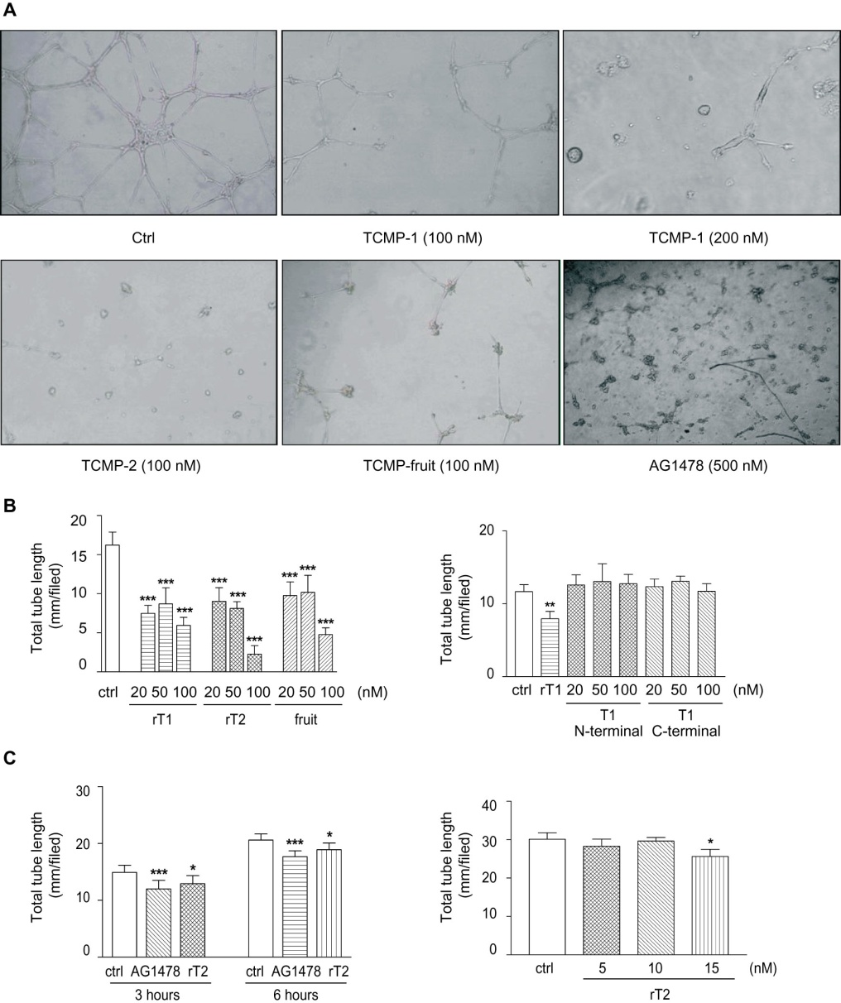
From C Cavallini et al. Br J Pharmacol 2011
doi:10.1111/j.1476-5381.2010.01154.x/bph.1154
British Journal of Pharmacology © 2011 The British Pharmacological Society

Slide 3
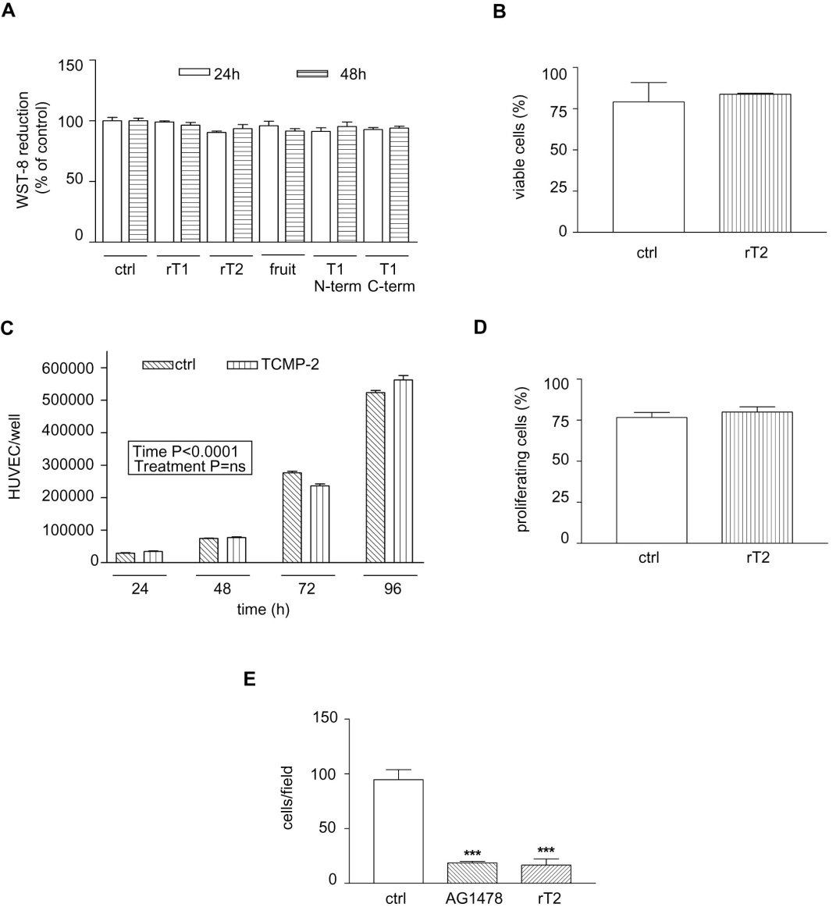
From C Cavallini et al. Br J Pharmacol 2011
doi:10.1111/j.1476-5381.2010.01154.x/bph.1154
British Journal of Pharmacology © 2011 The British Pharmacological Society

Slide 4
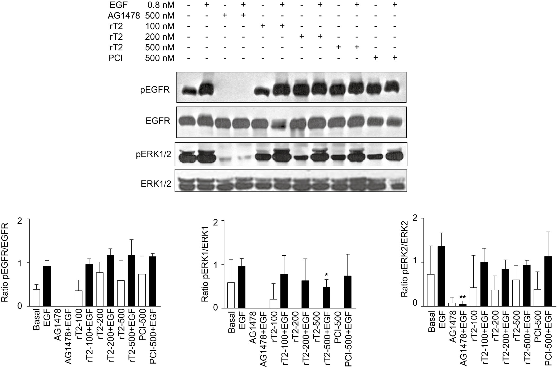
From C Cavallini et al. Br J Pharmacol 2011
doi:10.1111/j.1476-5381.2010.01154.x/bph.1154
British Journal of Pharmacology © 2011 The British Pharmacological Society

Slide 5
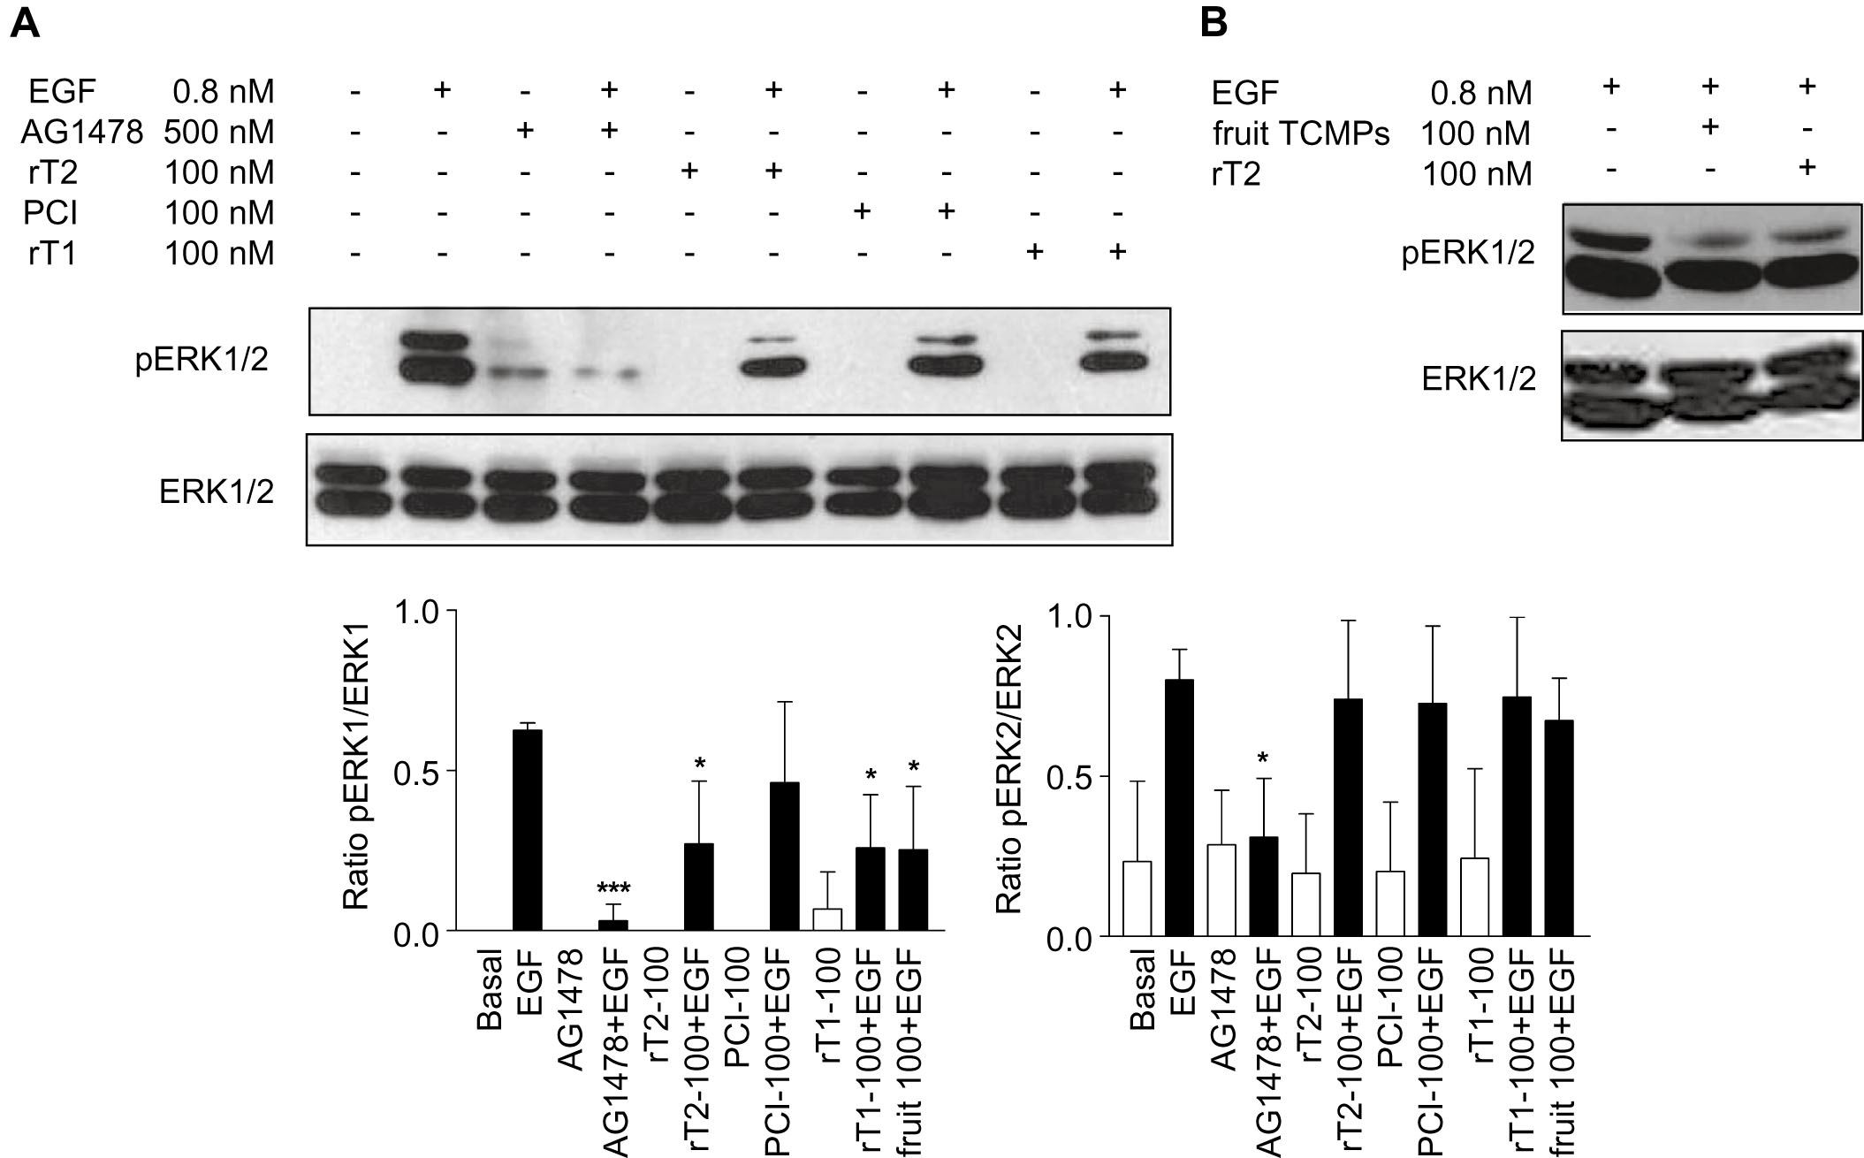
From C Cavallini et al. Br J Pharmacol 2011
doi:10.1111/j.1476-5381.2010.01154.x/bph.1154
British Journal of Pharmacology © 2011 The British Pharmacological Society

