Slide 1
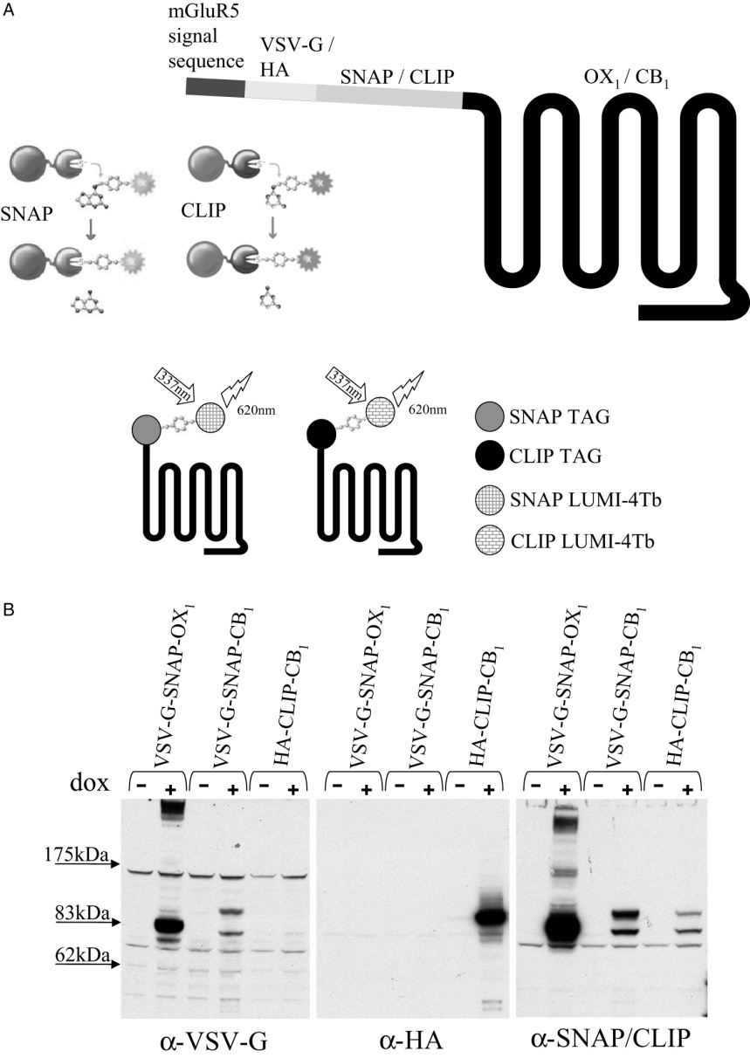
From RJ Ward et al. Br J Pharmacol 2011
doi:10.1111/j.1476-5381.2010.01156.x/bph.1156
British Journal of Pharmacology © 2011 The British Pharmacological Society

Slide 2
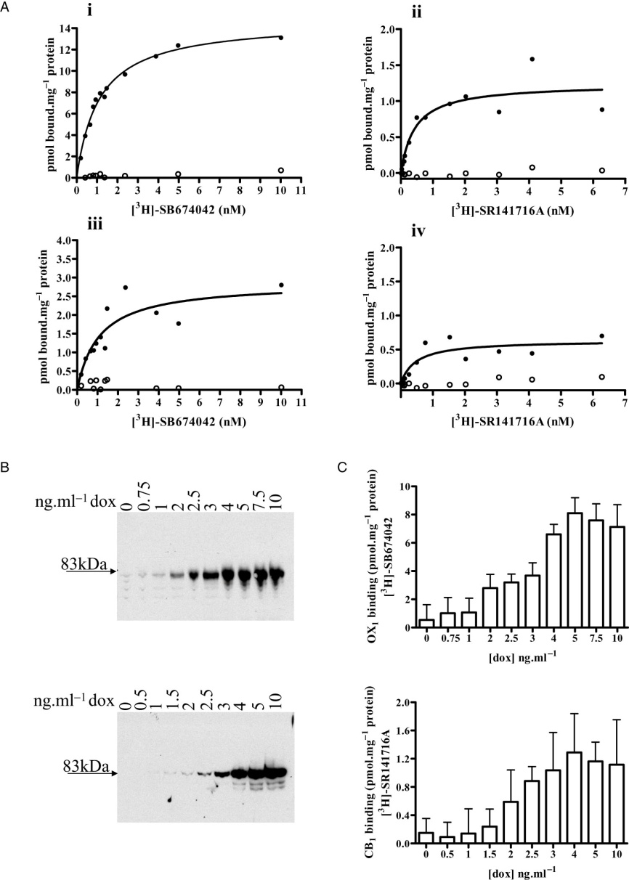
From RJ Ward et al. Br J Pharmacol 2011
doi:10.1111/j.1476-5381.2010.01156.x/bph.1156
British Journal of Pharmacology © 2011 The British Pharmacological Society

Slide 3
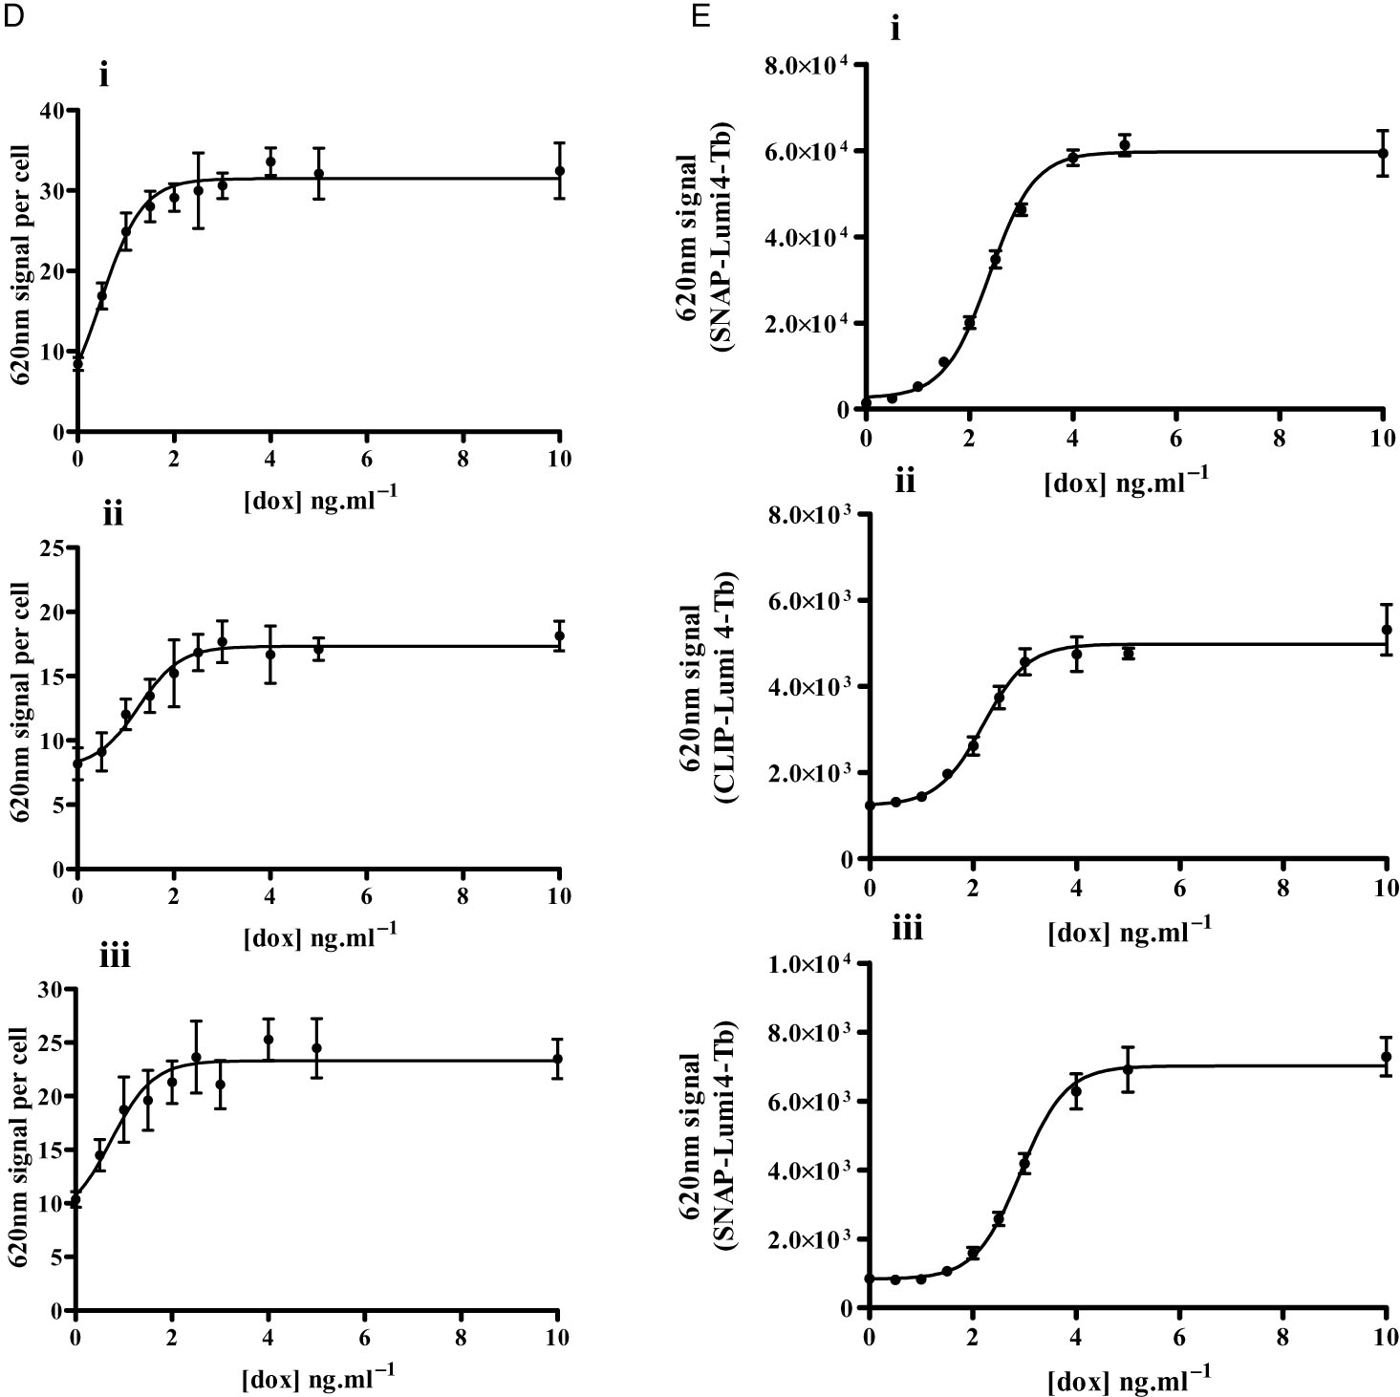
From RJ Ward et al. Br J Pharmacol 2011
doi:10.1111/j.1476-5381.2010.01156.x/bph.1156
British Journal of Pharmacology © 2011 The British Pharmacological Society

Slide 4
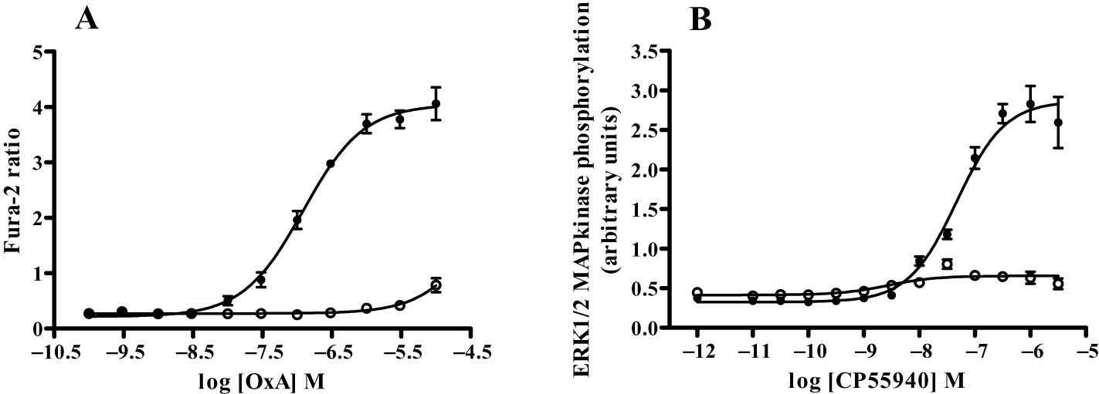
From RJ Ward et al. Br J Pharmacol 2011
doi:10.1111/j.1476-5381.2010.01156.x/bph.1156
British Journal of Pharmacology © 2011 The British Pharmacological Society

Slide 5
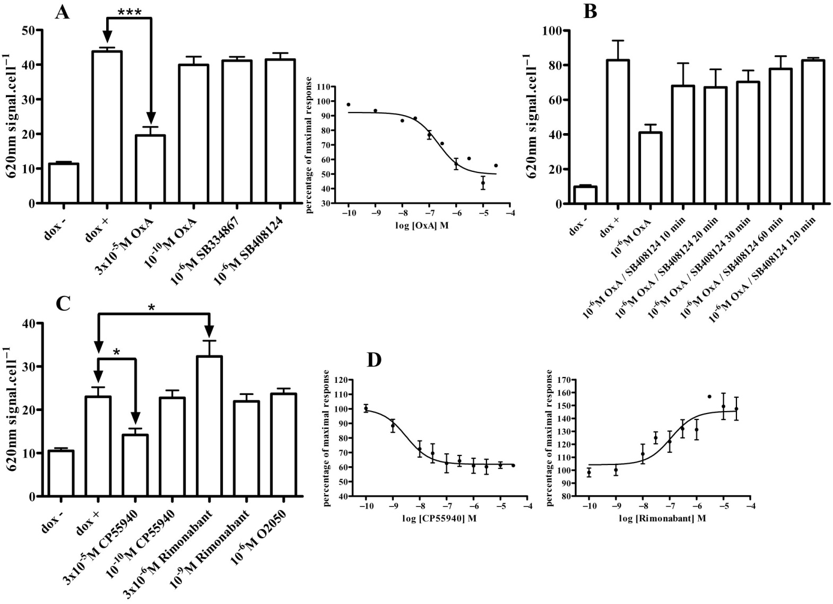
From RJ Ward et al. Br J Pharmacol 2011
doi:10.1111/j.1476-5381.2010.01156.x/bph.1156
British Journal of Pharmacology © 2011 The British Pharmacological Society

Slide 6
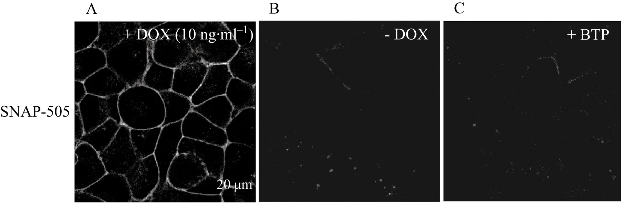
From RJ Ward et al. Br J Pharmacol 2011
doi:10.1111/j.1476-5381.2010.01156.x/bph.1156
British Journal of Pharmacology © 2011 The British Pharmacological Society

Slide 7
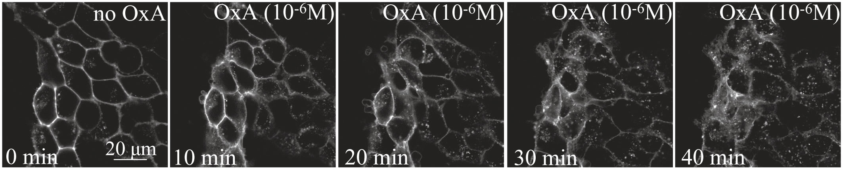
From RJ Ward et al. Br J Pharmacol 2011
doi:10.1111/j.1476-5381.2010.01156.x/bph.1156
British Journal of Pharmacology © 2011 The British Pharmacological Society

Slide 8
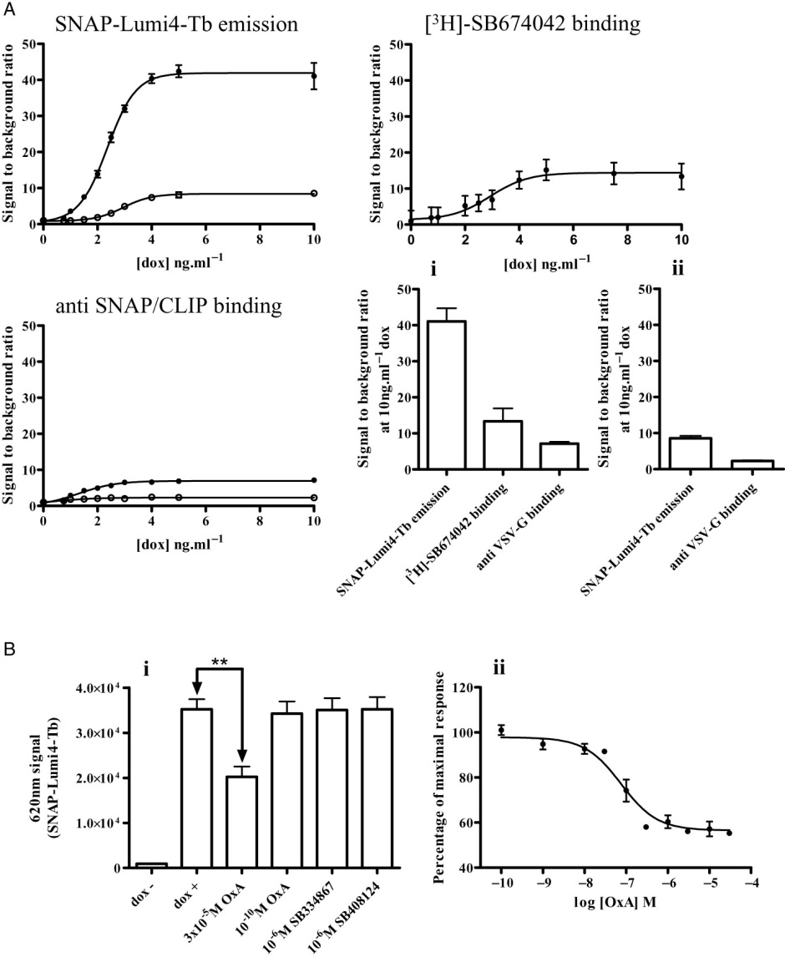
From RJ Ward et al. Br J Pharmacol 2011
doi:10.1111/j.1476-5381.2010.01156.x/bph.1156
British Journal of Pharmacology © 2011 The British Pharmacological Society

Slide 9
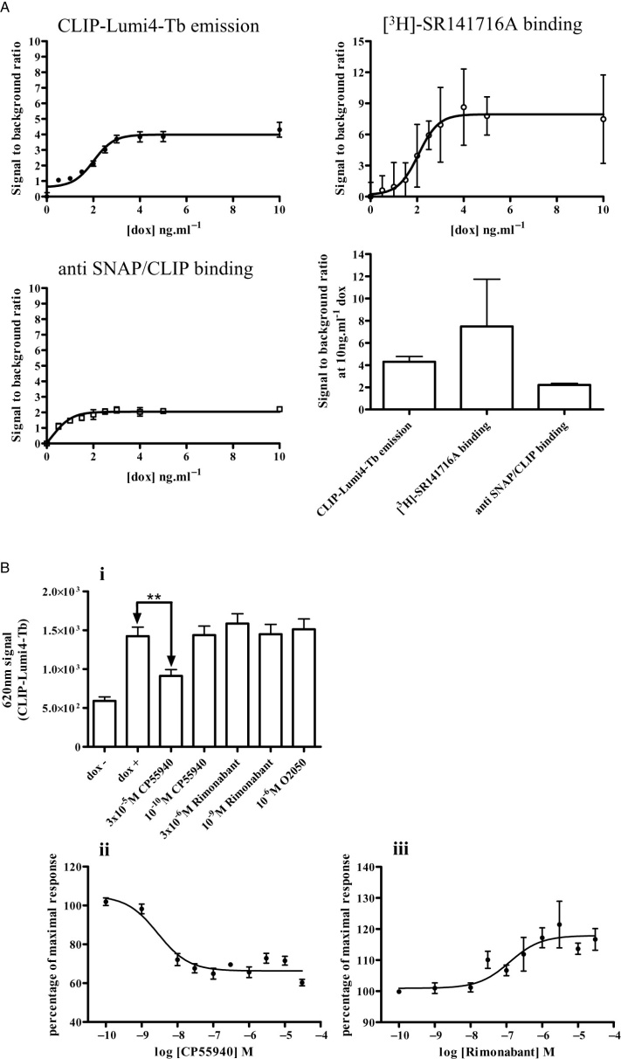
From RJ Ward et al. Br J Pharmacol 2011
doi:10.1111/j.1476-5381.2010.01156.x/bph.1156
British Journal of Pharmacology © 2011 The British Pharmacological Society

