Slide 1
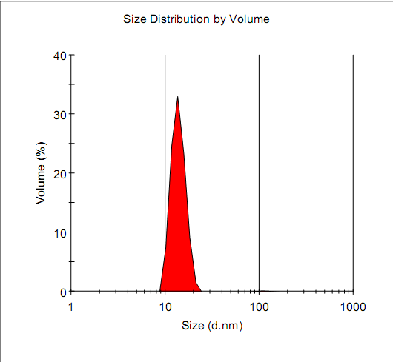
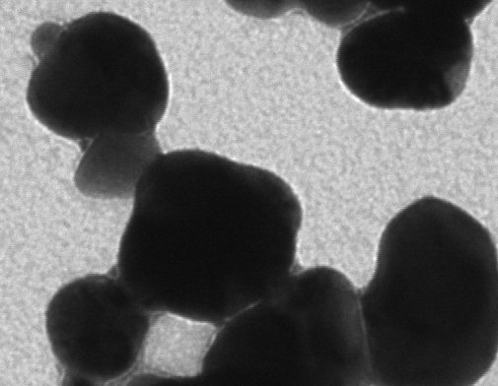
a.
b.
Antibody-Au
Vickers Figure S2

