Slide 1
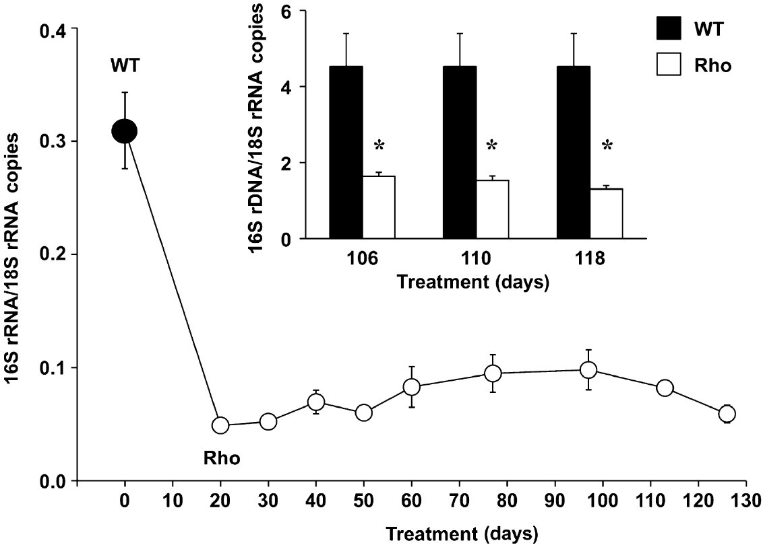
From MJ Perez et al. Br J Pharmacol 2011
doi:10.1111/j.1476-5381.2010.01174.x/bph.1174
British Journal of Pharmacology © 2011 The British Pharmacological Society

Slide 2
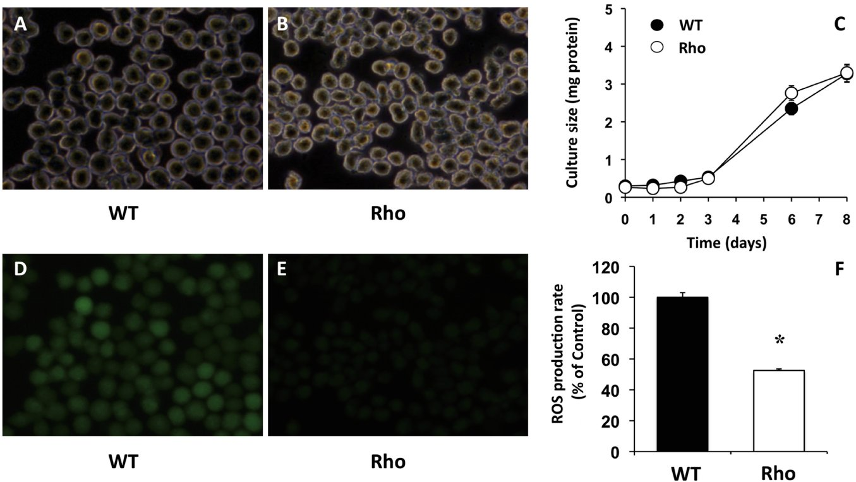
From MJ Perez et al. Br J Pharmacol 2011
doi:10.1111/j.1476-5381.2010.01174.x/bph.1174
British Journal of Pharmacology © 2011 The British Pharmacological Society

Slide 3
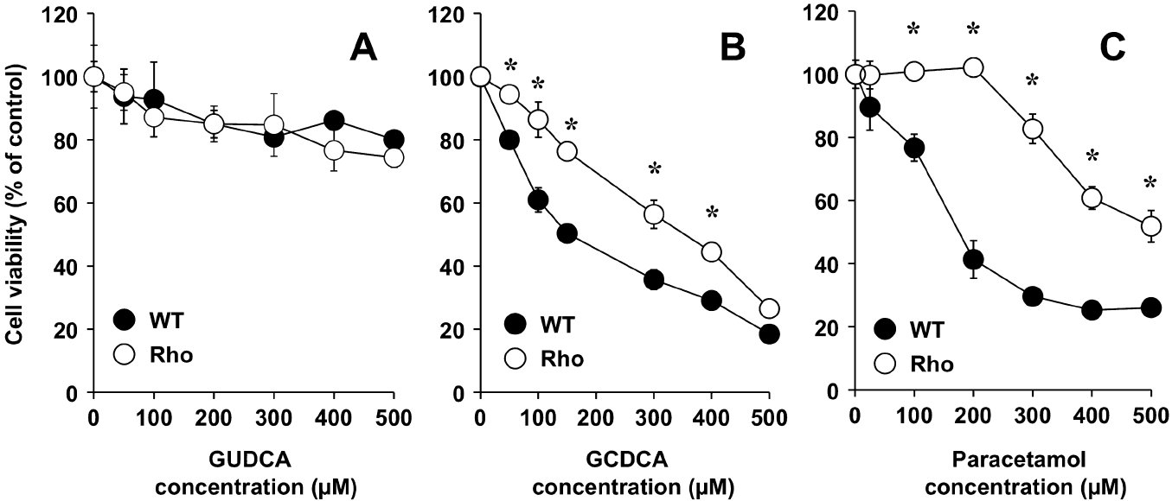
From MJ Perez et al. Br J Pharmacol 2011
doi:10.1111/j.1476-5381.2010.01174.x/bph.1174
British Journal of Pharmacology © 2011 The British Pharmacological Society

Slide 4
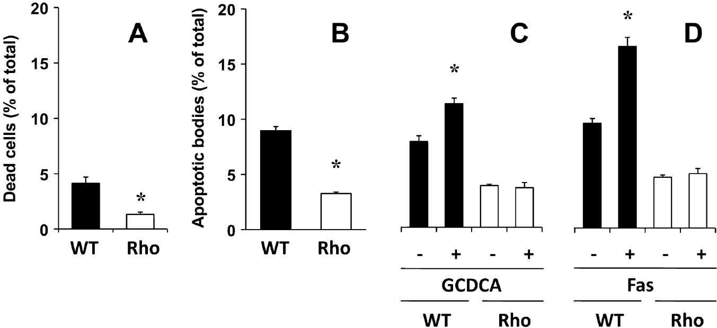
From MJ Perez et al. Br J Pharmacol 2011
doi:10.1111/j.1476-5381.2010.01174.x/bph.1174
British Journal of Pharmacology © 2011 The British Pharmacological Society

Slide 5
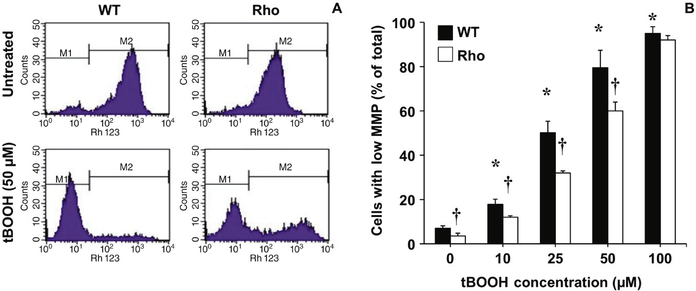
From MJ Perez et al. Br J Pharmacol 2011
doi:10.1111/j.1476-5381.2010.01174.x/bph.1174
British Journal of Pharmacology © 2011 The British Pharmacological Society

Slide 6
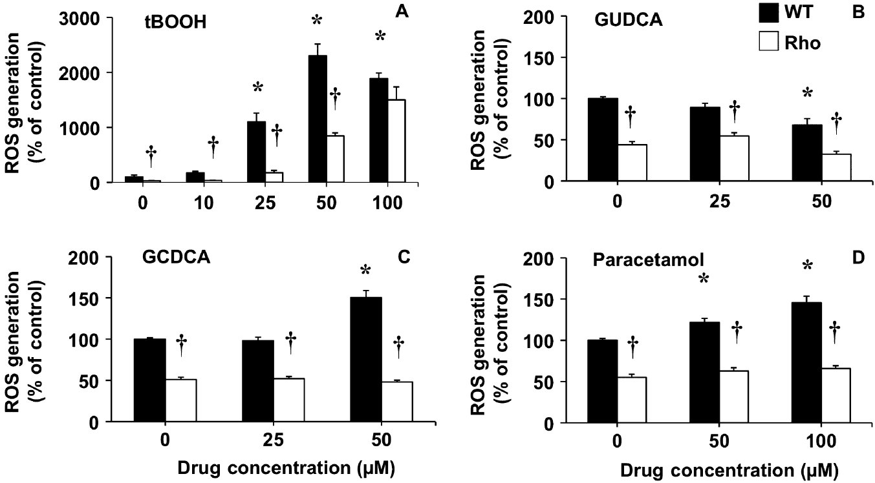
From MJ Perez et al. Br J Pharmacol 2011
doi:10.1111/j.1476-5381.2010.01174.x/bph.1174
British Journal of Pharmacology © 2011 The British Pharmacological Society

Slide 7
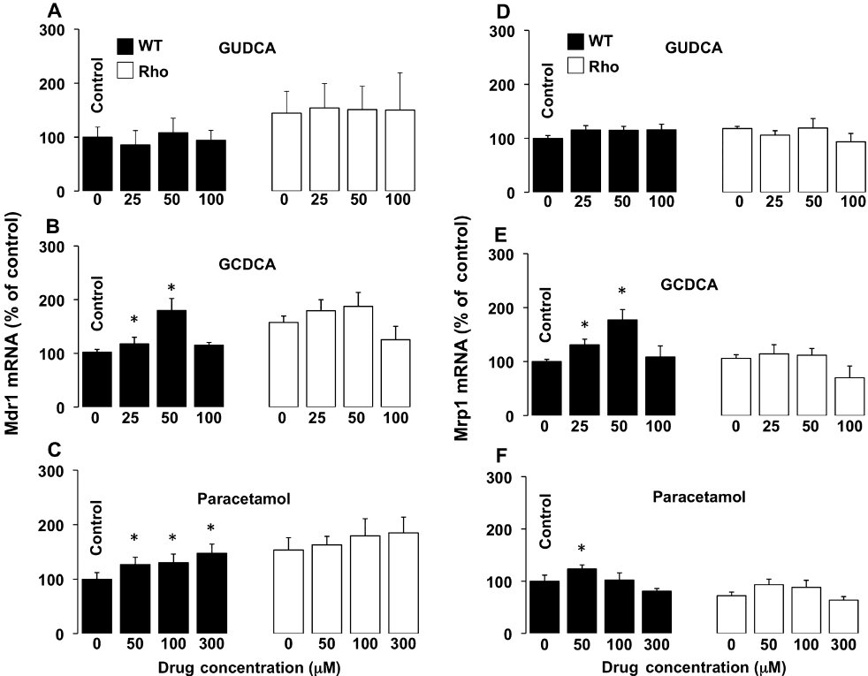
From MJ Perez et al. Br J Pharmacol 2011
doi:10.1111/j.1476-5381.2010.01174.x/bph.1174
British Journal of Pharmacology © 2011 The British Pharmacological Society

Slide 8
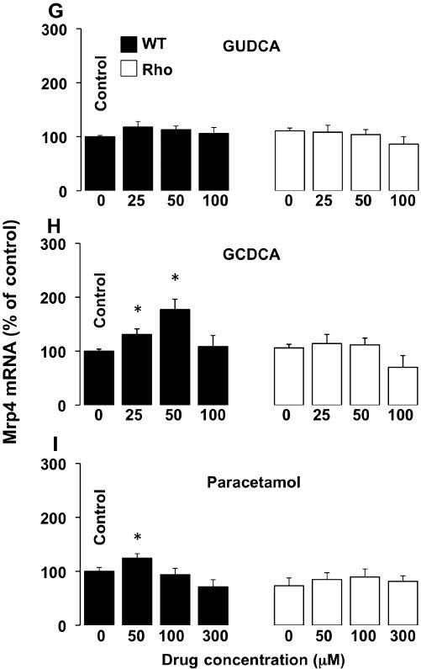
From MJ Perez et al. Br J Pharmacol 2011
doi:10.1111/j.1476-5381.2010.01174.x/bph.1174
British Journal of Pharmacology © 2011 The British Pharmacological Society

Slide 9
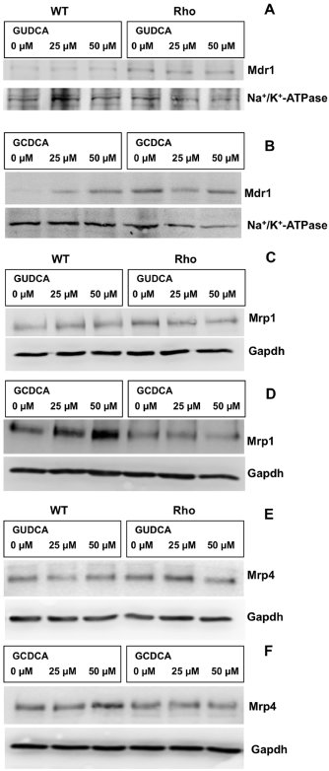
From MJ Perez et al. Br J Pharmacol 2011
doi:10.1111/j.1476-5381.2010.01174.x/bph.1174
British Journal of Pharmacology © 2011 The British Pharmacological Society

Slide 10
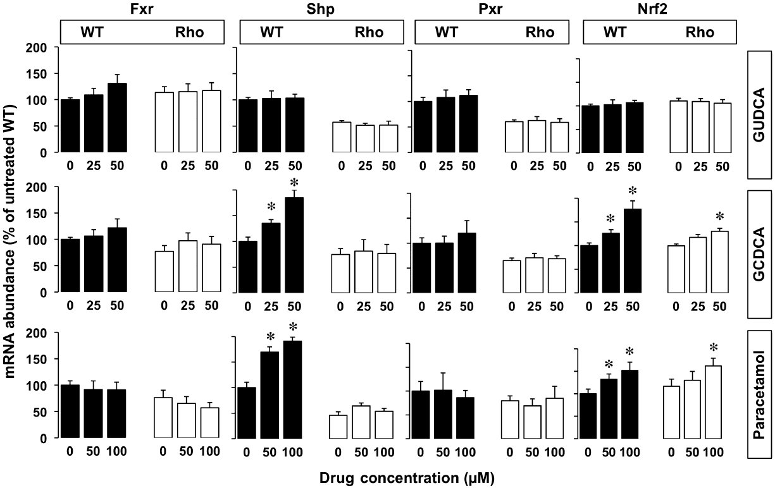
From MJ Perez et al. Br J Pharmacol 2011
doi:10.1111/j.1476-5381.2010.01174.x/bph.1174
British Journal of Pharmacology © 2011 The British Pharmacological Society

Slide 11
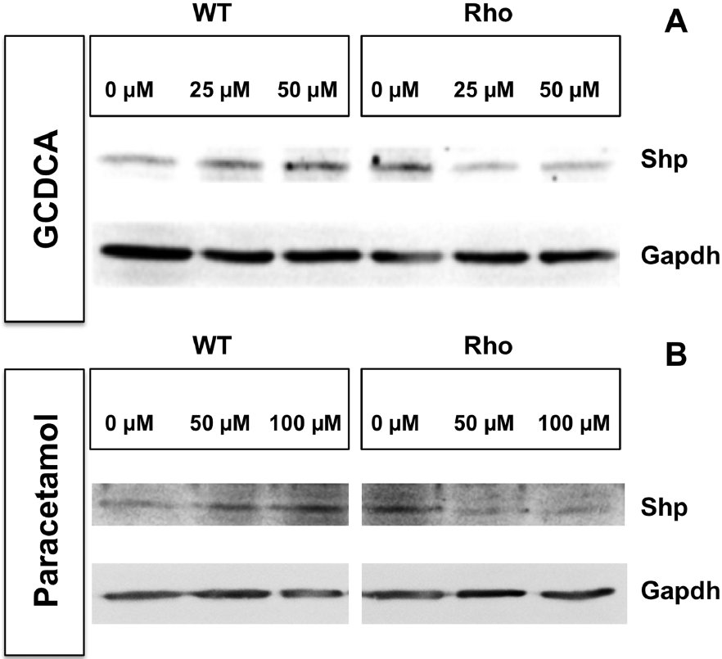
From MJ Perez et al. Br J Pharmacol 2011
doi:10.1111/j.1476-5381.2010.01174.x/bph.1174
British Journal of Pharmacology © 2011 The British Pharmacological Society

Slide 12
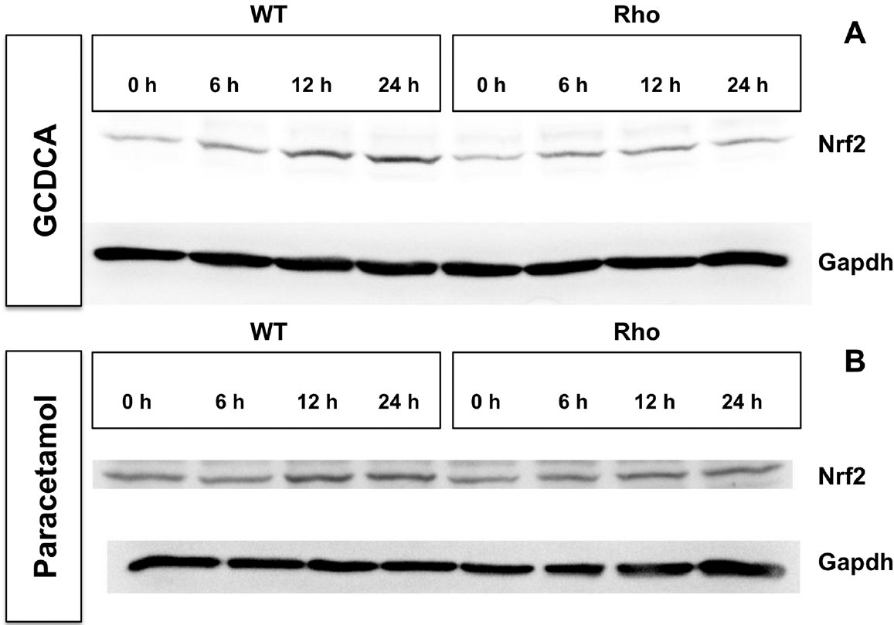
From MJ Perez et al. Br J Pharmacol 2011
doi:10.1111/j.1476-5381.2010.01174.x/bph.1174
British Journal of Pharmacology © 2011 The British Pharmacological Society

Slide 13
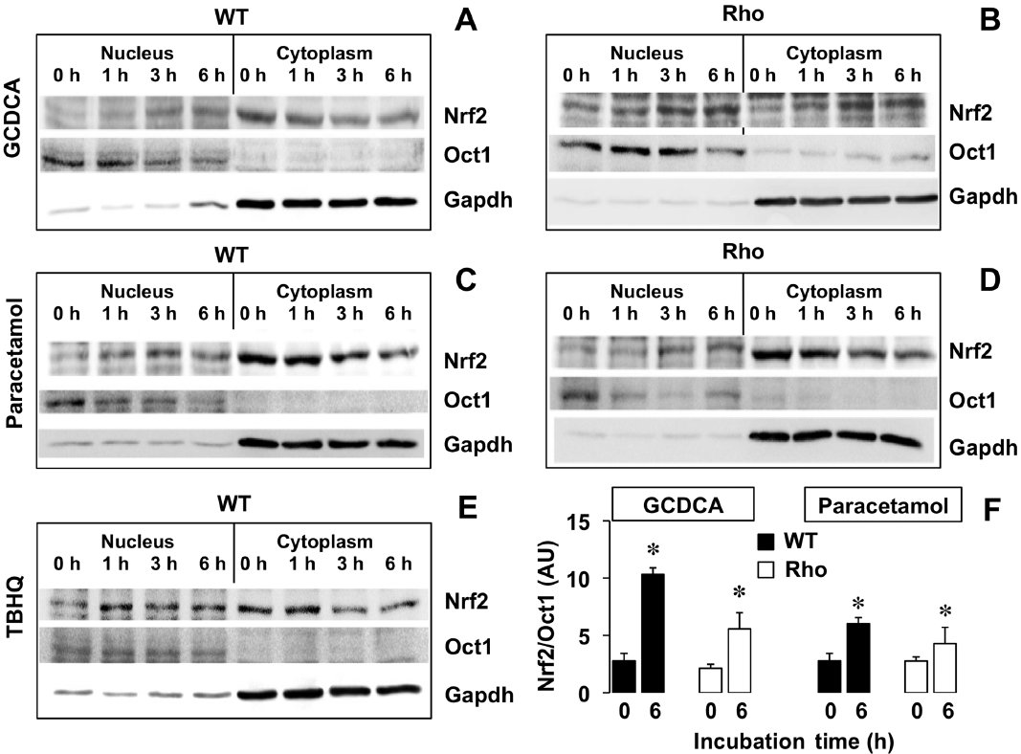
From MJ Perez et al. Br J Pharmacol 2011
doi:10.1111/j.1476-5381.2010.01174.x/bph.1174
British Journal of Pharmacology © 2011 The British Pharmacological Society

Slide 14
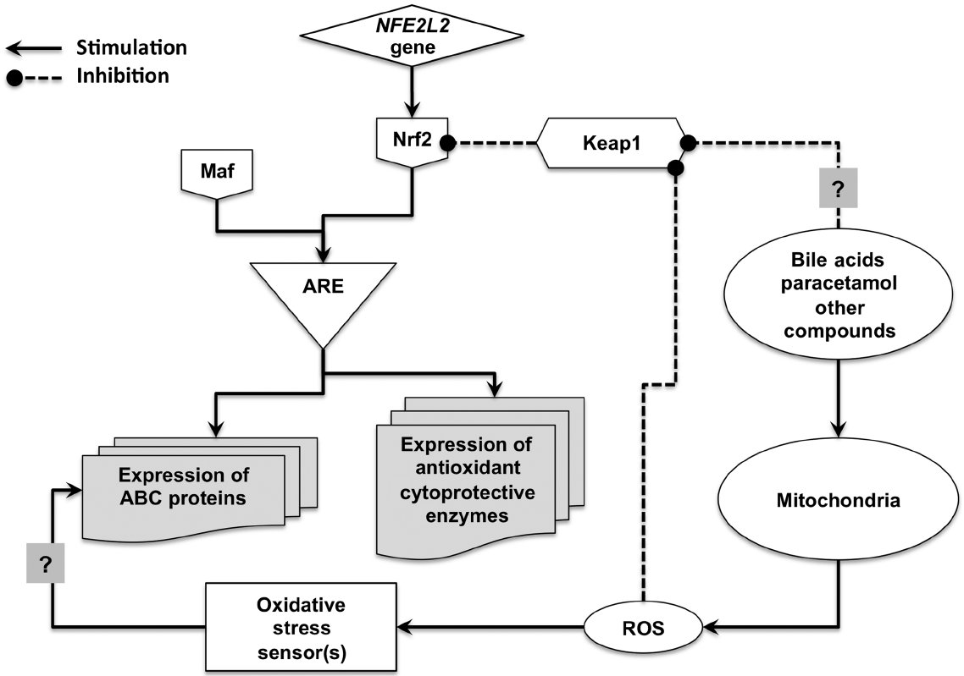
From MJ Perez et al. Br J Pharmacol 2011
doi:10.1111/j.1476-5381.2010.01174.x/bph.1174
British Journal of Pharmacology © 2011 The British Pharmacological Society

