Slide 1
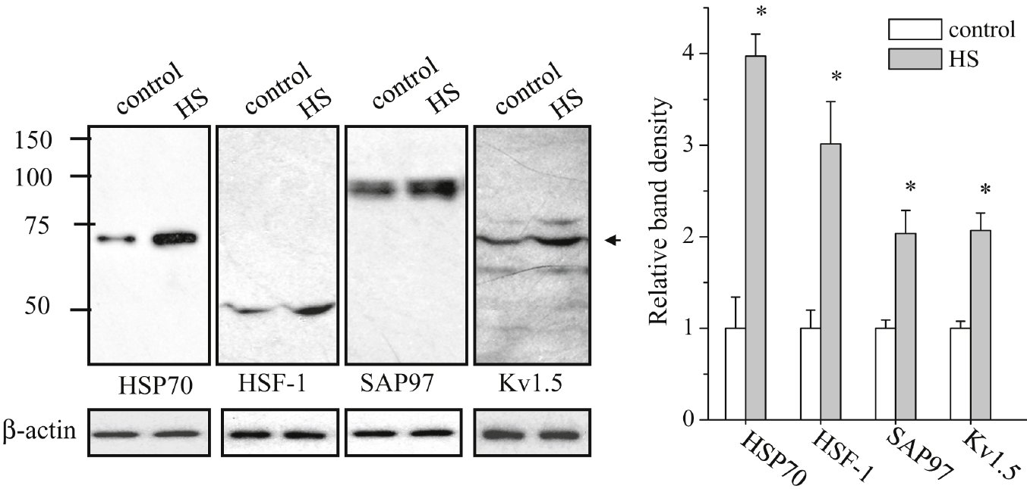
From YK Ting et al. Br J Pharmacol 2011
doi:10.1111/j.1476-5381.2011.01204.x/bph.1204
British Journal of Pharmacology © 2011 The British Pharmacological Society

Slide 2
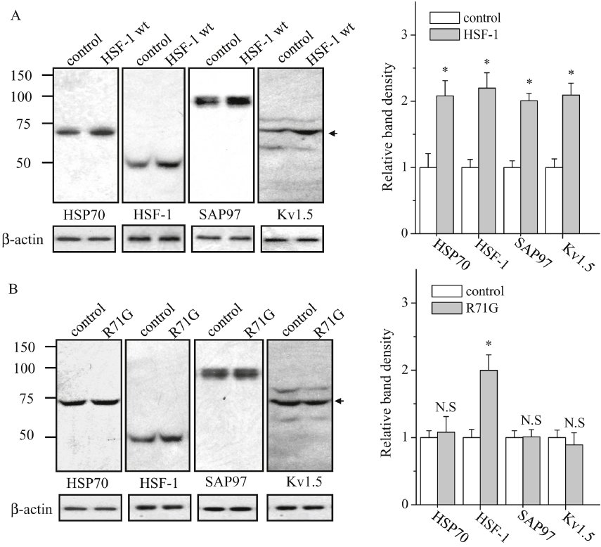
From YK Ting et al. Br J Pharmacol 2011
doi:10.1111/j.1476-5381.2011.01204.x/bph.1204
British Journal of Pharmacology © 2011 The British Pharmacological Society

Slide 3
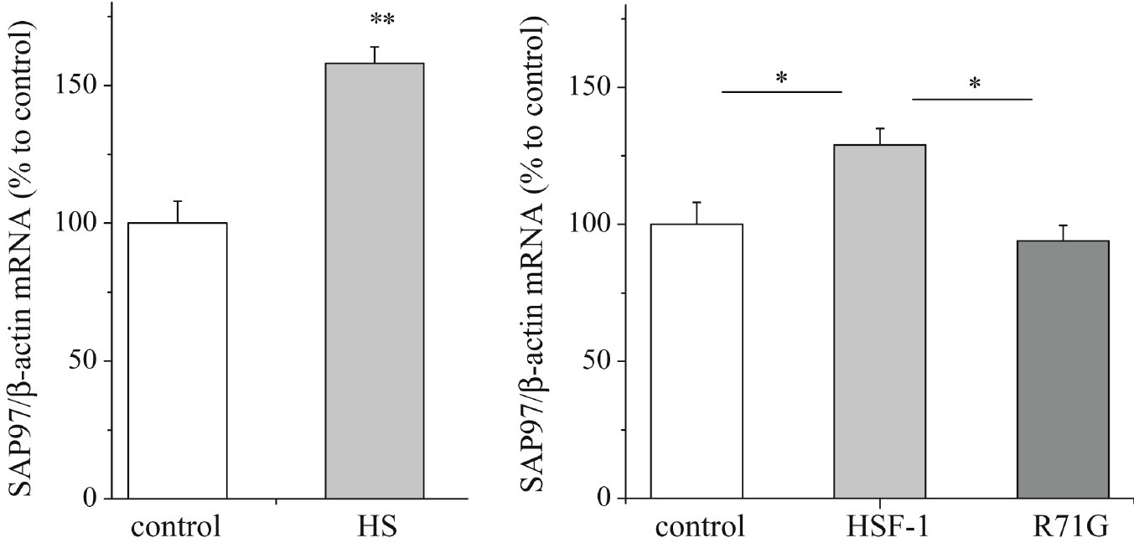
From YK Ting et al. Br J Pharmacol 2011
doi:10.1111/j.1476-5381.2011.01204.x/bph.1204
British Journal of Pharmacology © 2011 The British Pharmacological Society

Slide 4
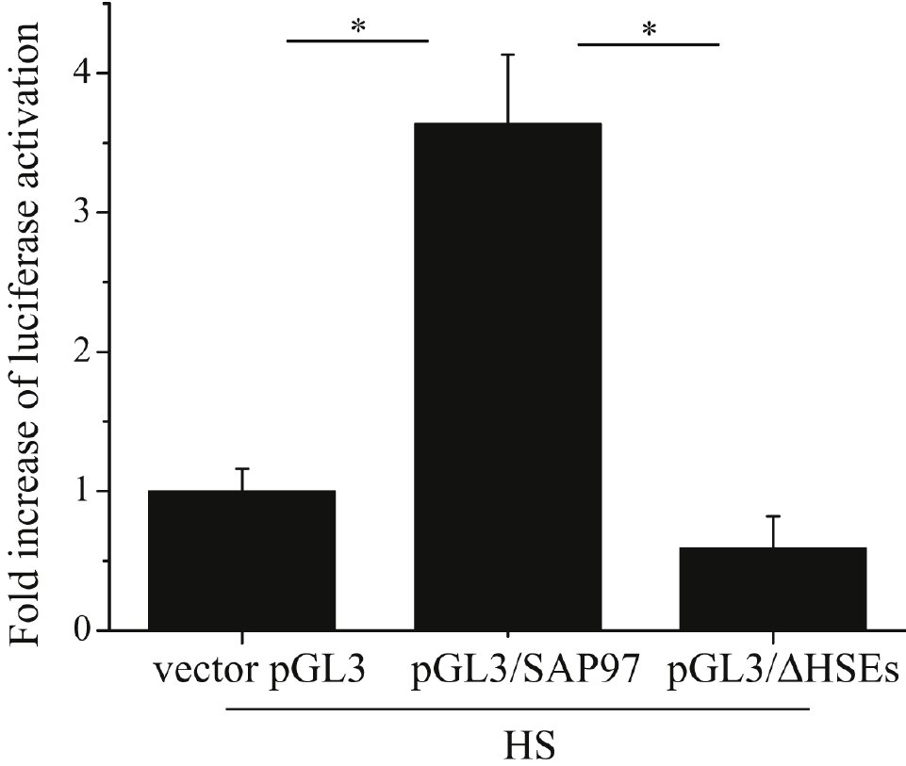
From YK Ting et al. Br J Pharmacol 2011
doi:10.1111/j.1476-5381.2011.01204.x/bph.1204
British Journal of Pharmacology © 2011 The British Pharmacological Society

Slide 5
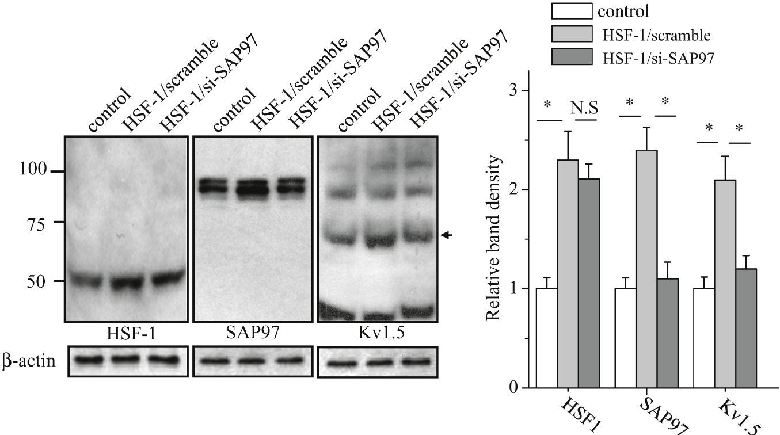
From YK Ting et al. Br J Pharmacol 2011
doi:10.1111/j.1476-5381.2011.01204.x/bph.1204
British Journal of Pharmacology © 2011 The British Pharmacological Society

Slide 6
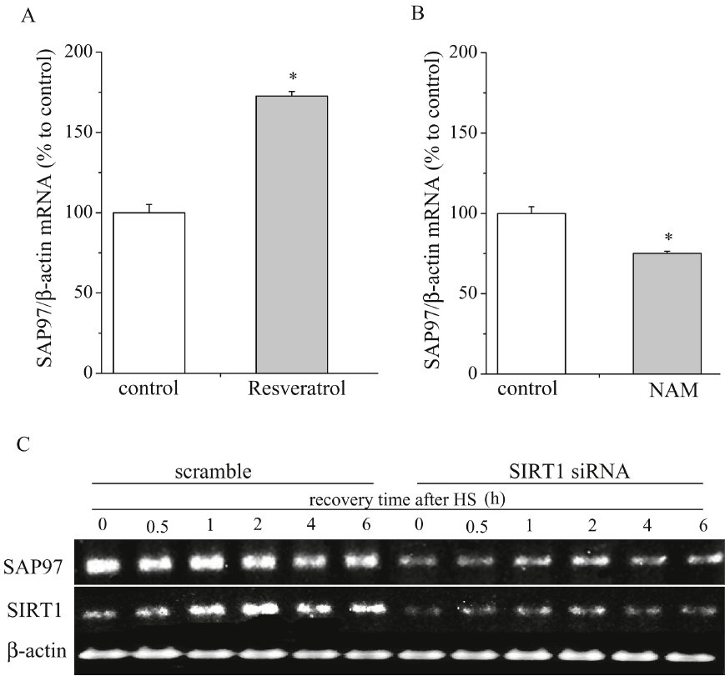
From YK Ting et al. Br J Pharmacol 2011
doi:10.1111/j.1476-5381.2011.01204.x/bph.1204
British Journal of Pharmacology © 2011 The British Pharmacological Society

Slide 7
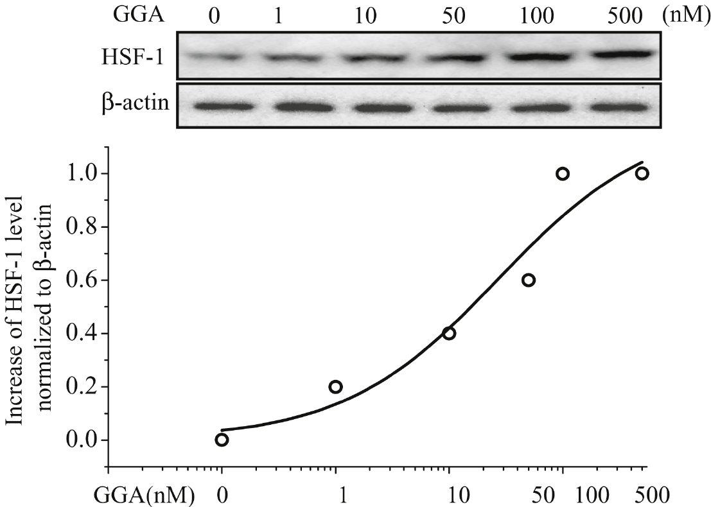
From YK Ting et al. Br J Pharmacol 2011
doi:10.1111/j.1476-5381.2011.01204.x/bph.1204
British Journal of Pharmacology © 2011 The British Pharmacological Society

Slide 8
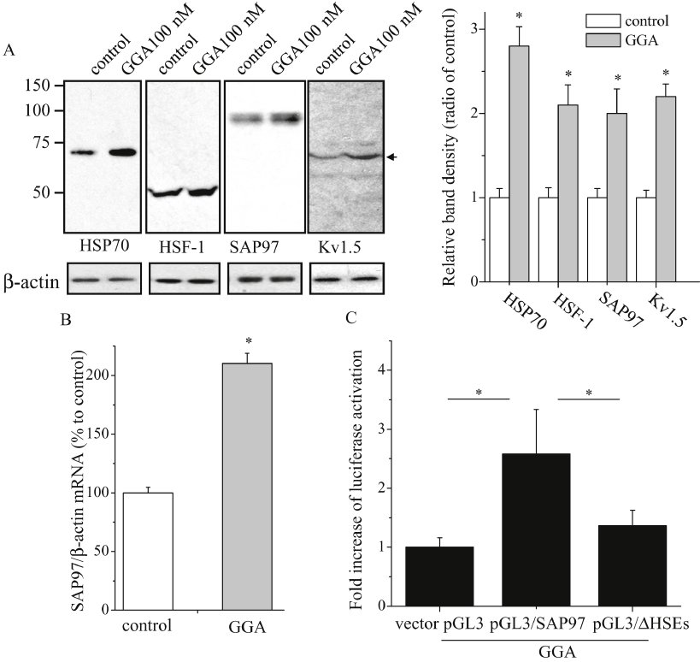
From YK Ting et al. Br J Pharmacol 2011
doi:10.1111/j.1476-5381.2011.01204.x/bph.1204
British Journal of Pharmacology © 2011 The British Pharmacological Society

Slide 9
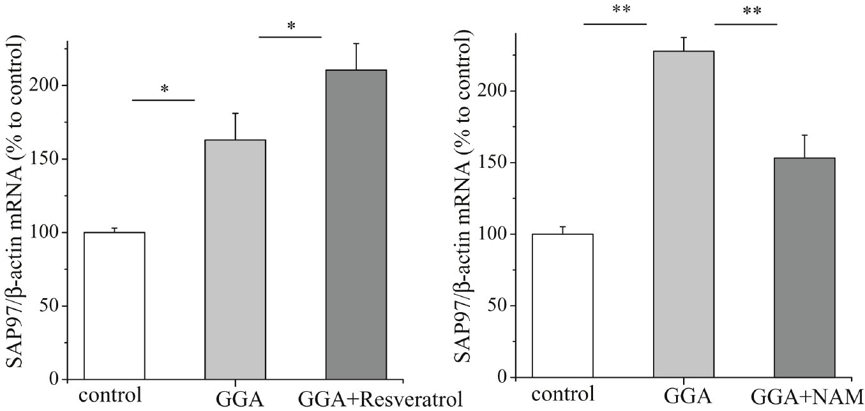
From YK Ting et al. Br J Pharmacol 2011
doi:10.1111/j.1476-5381.2011.01204.x/bph.1204
British Journal of Pharmacology © 2011 The British Pharmacological Society

Slide 10
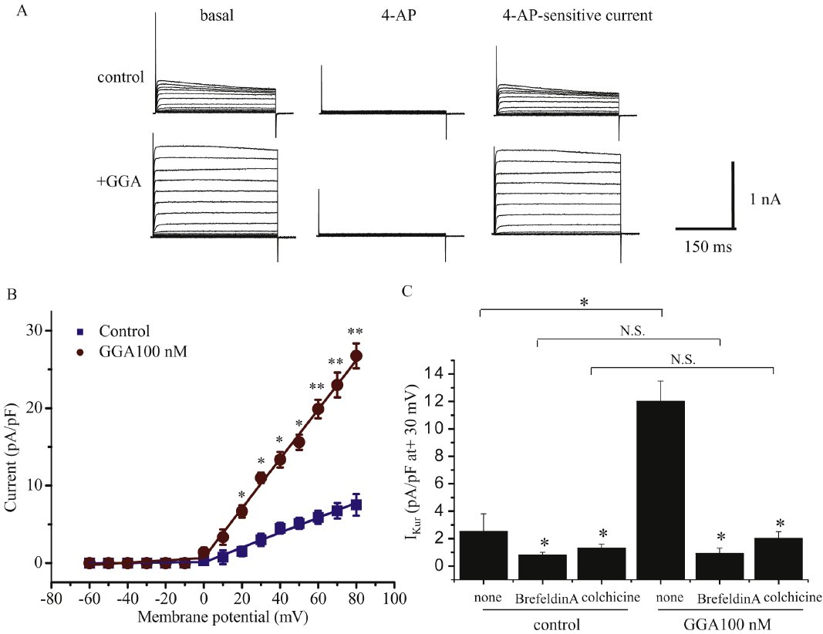
From YK Ting et al. Br J Pharmacol 2011
doi:10.1111/j.1476-5381.2011.01204.x/bph.1204
British Journal of Pharmacology © 2011 The British Pharmacological Society

