Slide 1
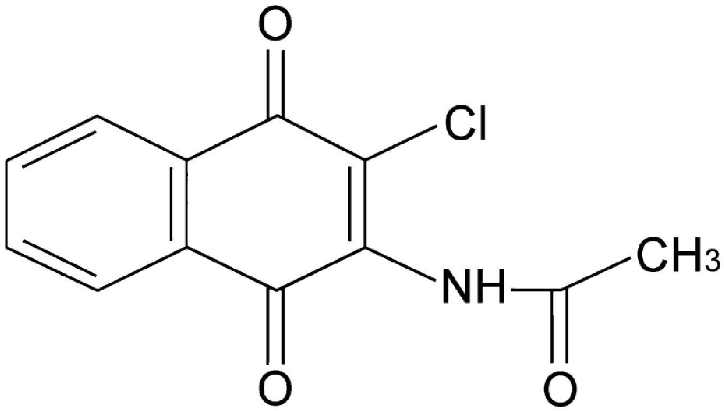
From H-L Kuo et al. Br J Pharmacol 2011
doi:10.1111/j.1476-5381.2011.01200.x/bph.1200
British Journal of Pharmacology © 2011 The British Pharmacological Society

Slide 2
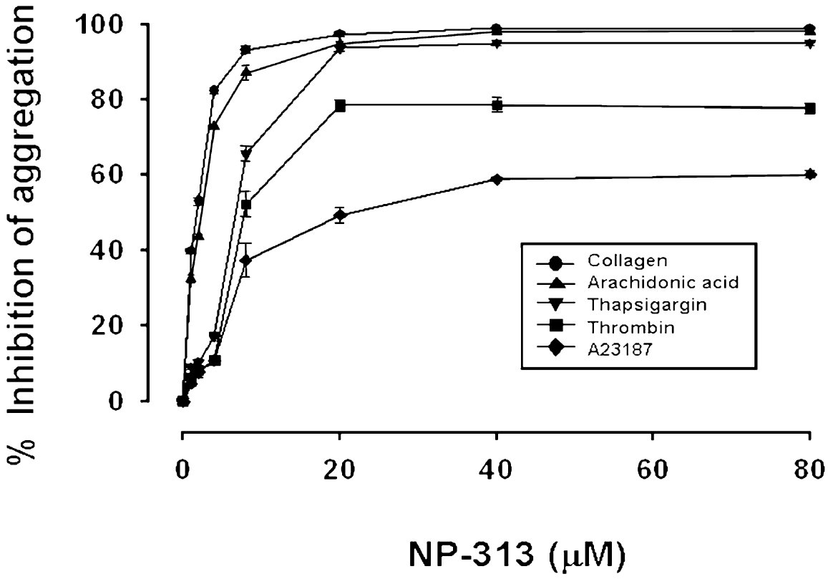
From H-L Kuo et al. Br J Pharmacol 2011
doi:10.1111/j.1476-5381.2011.01200.x/bph.1200
British Journal of Pharmacology © 2011 The British Pharmacological Society

Slide 3
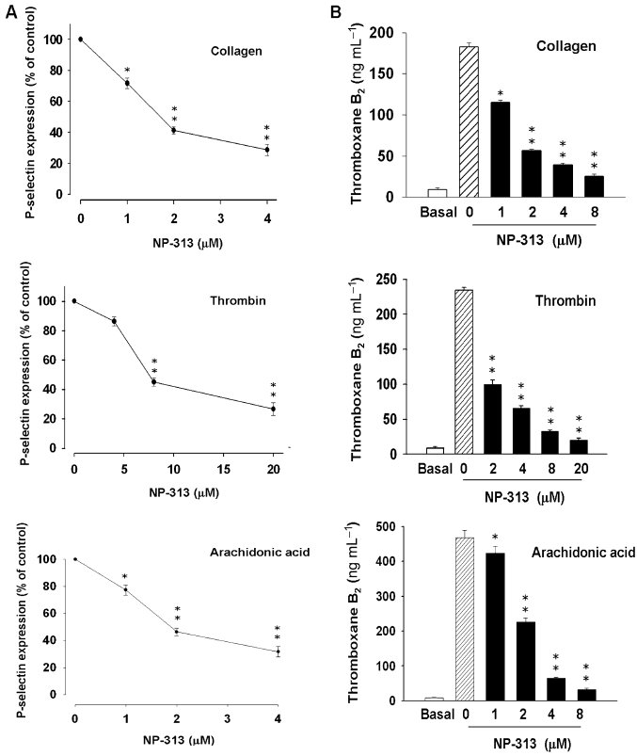
From H-L Kuo et al. Br J Pharmacol 2011
doi:10.1111/j.1476-5381.2011.01200.x/bph.1200
British Journal of Pharmacology © 2011 The British Pharmacological Society

Slide 4
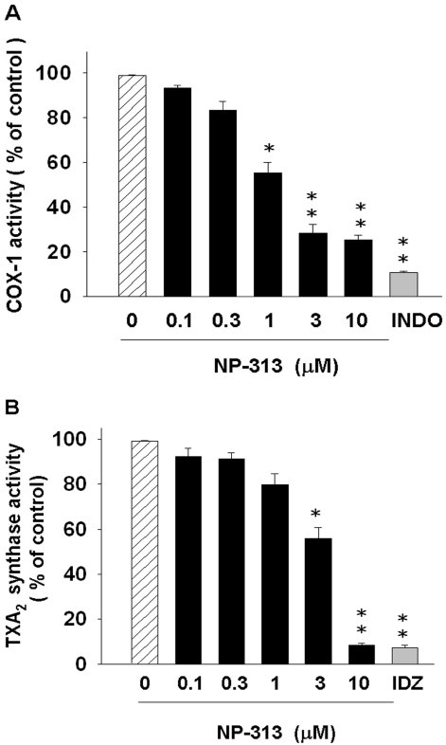
From H-L Kuo et al. Br J Pharmacol 2011
doi:10.1111/j.1476-5381.2011.01200.x/bph.1200
British Journal of Pharmacology © 2011 The British Pharmacological Society

Slide 5
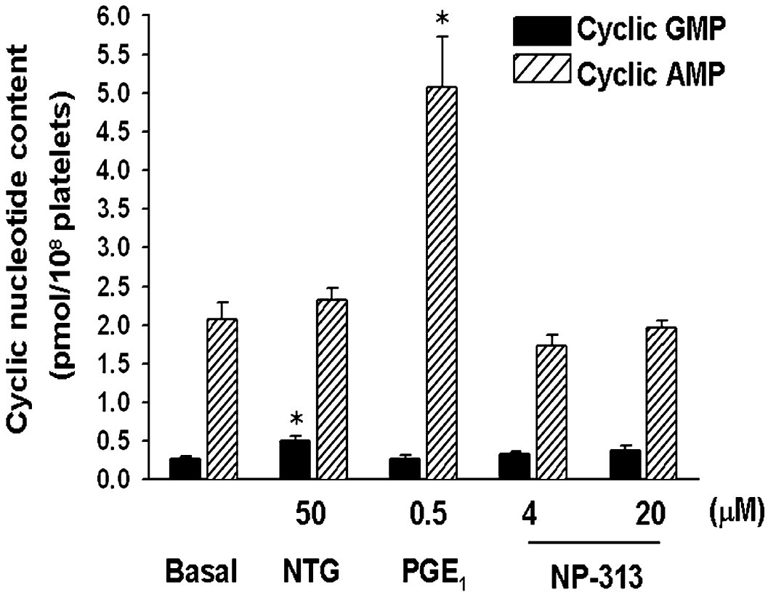
From H-L Kuo et al. Br J Pharmacol 2011
doi:10.1111/j.1476-5381.2011.01200.x/bph.1200
British Journal of Pharmacology © 2011 The British Pharmacological Society

Slide 6
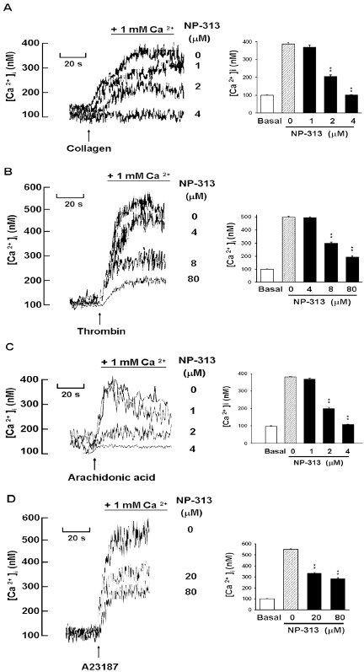
From H-L Kuo et al. Br J Pharmacol 2011
doi:10.1111/j.1476-5381.2011.01200.x/bph.1200
British Journal of Pharmacology © 2011 The British Pharmacological Society

Slide 7
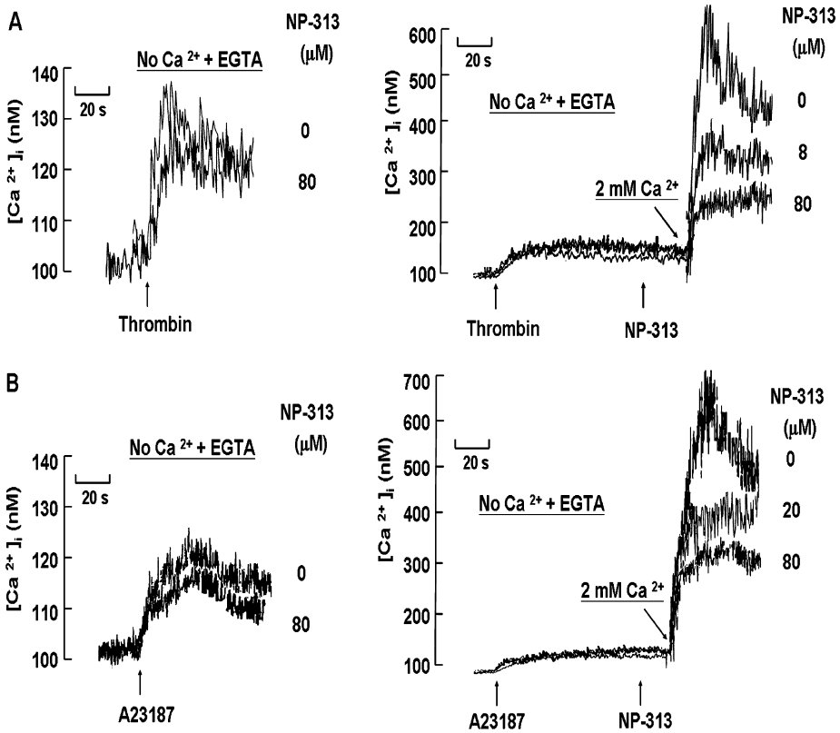
From H-L Kuo et al. Br J Pharmacol 2011
doi:10.1111/j.1476-5381.2011.01200.x/bph.1200
British Journal of Pharmacology © 2011 The British Pharmacological Society

Slide 8
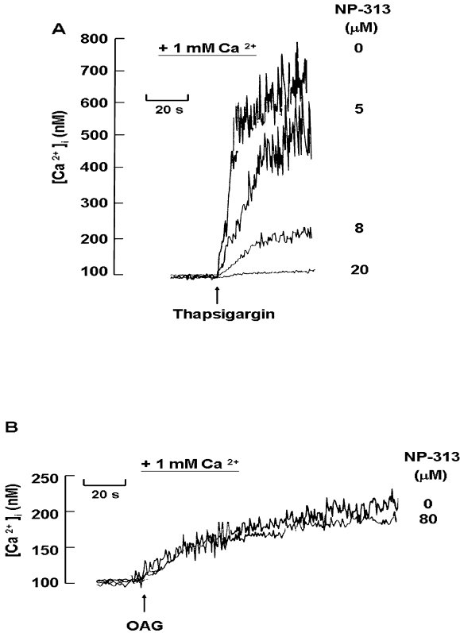
From H-L Kuo et al. Br J Pharmacol 2011
doi:10.1111/j.1476-5381.2011.01200.x/bph.1200
British Journal of Pharmacology © 2011 The British Pharmacological Society

Slide 9
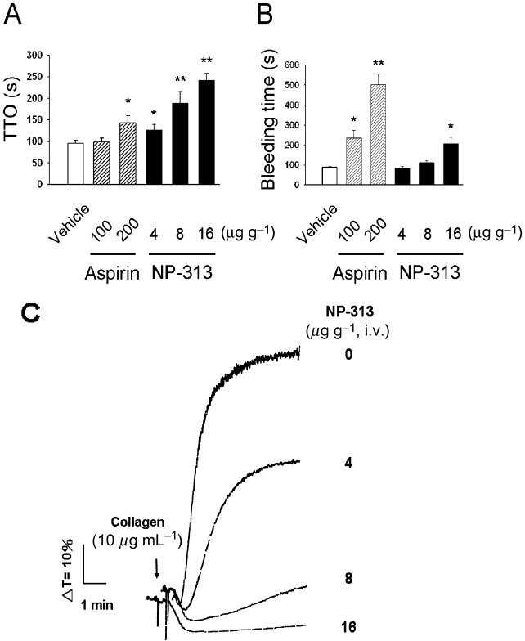
From H-L Kuo et al. Br J Pharmacol 2011
doi:10.1111/j.1476-5381.2011.01200.x/bph.1200
British Journal of Pharmacology © 2011 The British Pharmacological Society

