Slide 1
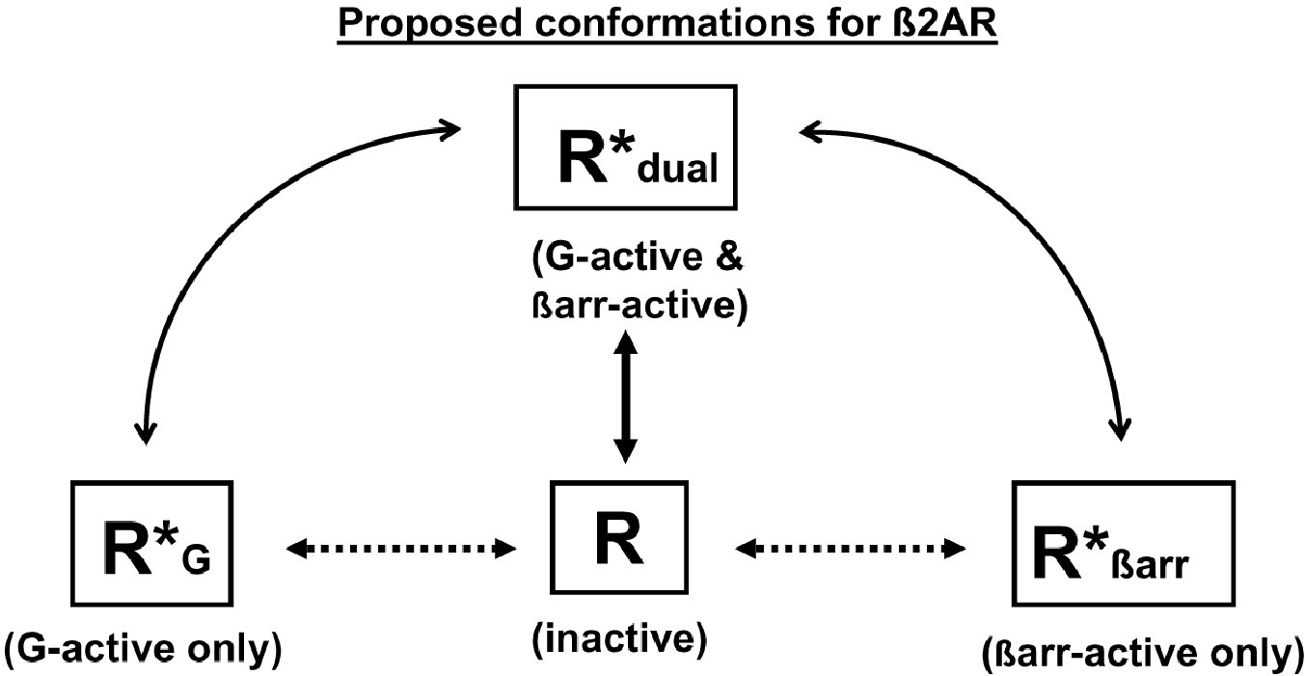
From JKL Walker et al. Br J Pharmacol 2011
doi:10.1111/j.1476-5381.2010.01178.x/bph.1178
British Journal of Pharmacology © 2011 The British Pharmacological Society

Slide 2
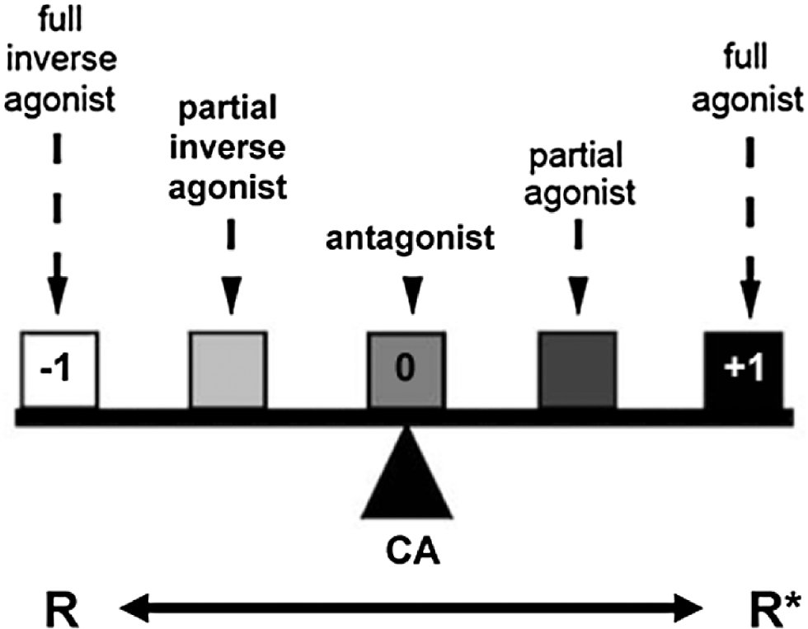
From JKL Walker et al. Br J Pharmacol 2011
doi:10.1111/j.1476-5381.2010.01178.x/bph.1178
British Journal of Pharmacology © 2011 The British Pharmacological Society

