Slide 1
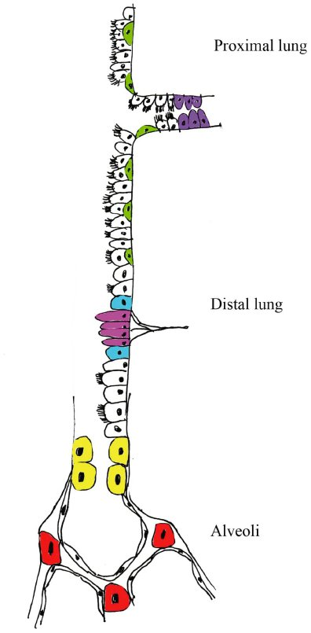
From M Hind and M Maden. Br J Pharmacol 2011
doi:10.1111/j.1476-5381.2011.01246.x/bph.1246
British Journal of Pharmacology © 2011 The British Pharmacological Society

