Slide 1
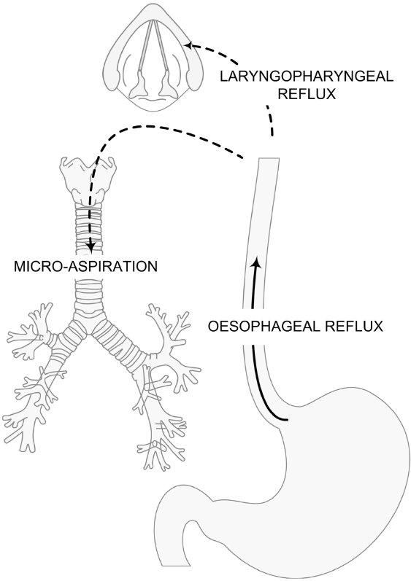
From PV Dicpinigaitis. Br J Pharmacol 2011
doi:10.1111/j.1476-5381.2010.01198.x/bph.1198
British Journal of Pharmacology © 2011 The British Pharmacological Society

