Slide 1
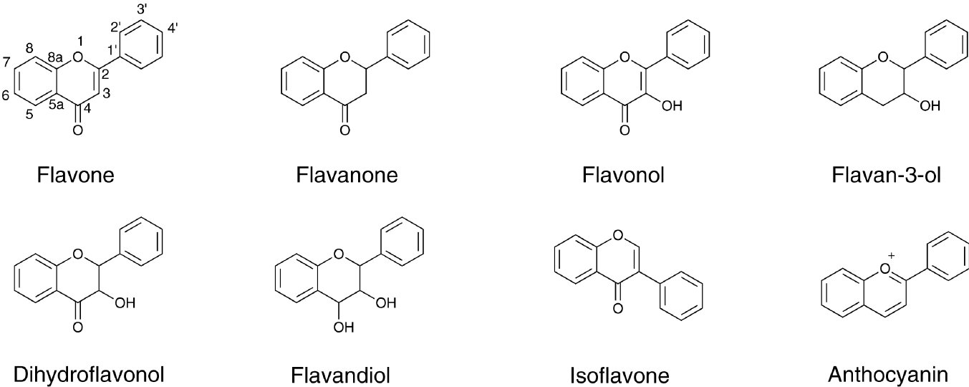
From JR Hanrahan et al. Br J Pharmacol 2011
doi:10.1111/j.1476-5381.2011.01228.x/bph.1228
British Journal of Pharmacology © 2011 The British Pharmacological Society

Slide 2
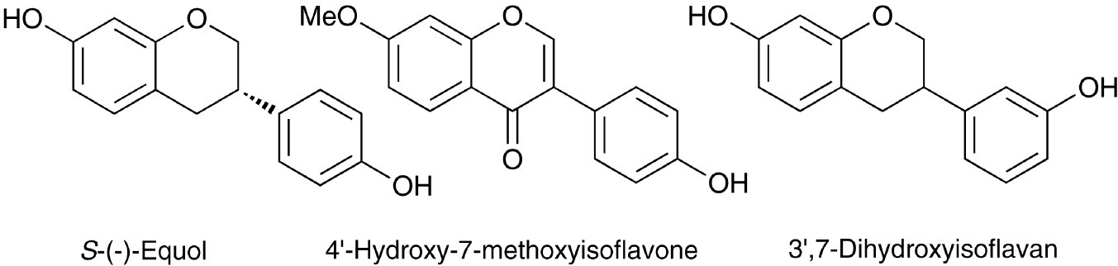
From JR Hanrahan et al. Br J Pharmacol 2011
doi:10.1111/j.1476-5381.2011.01228.x/bph.1228
British Journal of Pharmacology © 2011 The British Pharmacological Society

Slide 3
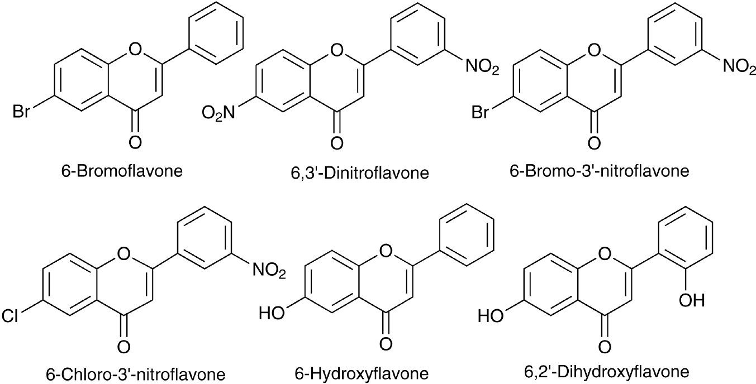
From JR Hanrahan et al. Br J Pharmacol 2011
doi:10.1111/j.1476-5381.2011.01228.x/bph.1228
British Journal of Pharmacology © 2011 The British Pharmacological Society

Slide 4
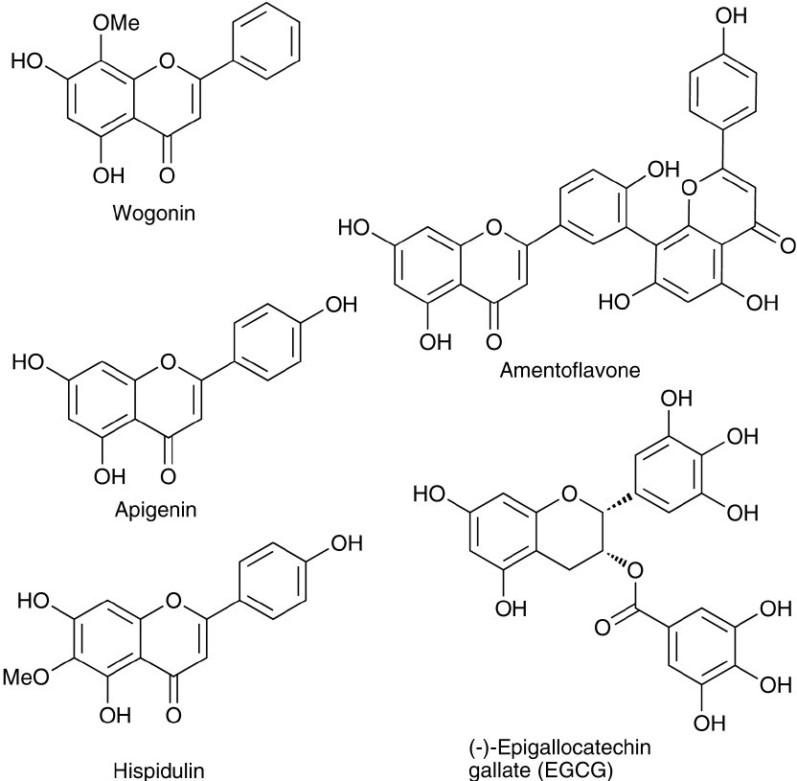
From JR Hanrahan et al. Br J Pharmacol 2011
doi:10.1111/j.1476-5381.2011.01228.x/bph.1228
British Journal of Pharmacology © 2011 The British Pharmacological Society

Slide 5
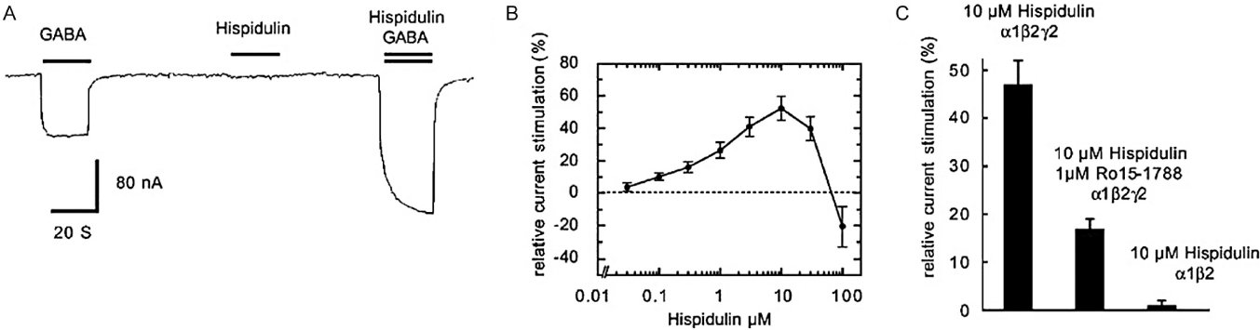
From JR Hanrahan et al. Br J Pharmacol 2011
doi:10.1111/j.1476-5381.2011.01228.x/bph.1228
British Journal of Pharmacology © 2011 The British Pharmacological Society

Slide 6
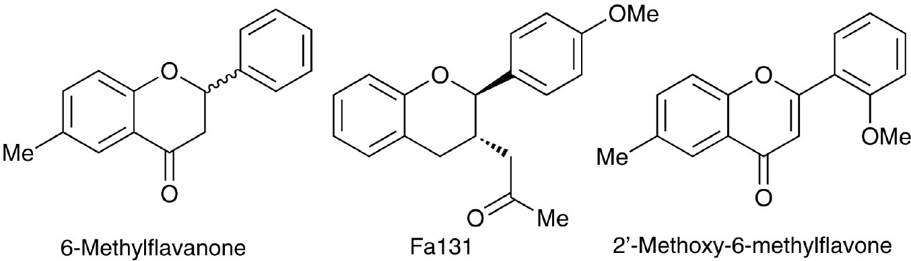
From JR Hanrahan et al. Br J Pharmacol 2011
doi:10.1111/j.1476-5381.2011.01228.x/bph.1228
British Journal of Pharmacology © 2011 The British Pharmacological Society

Slide 7
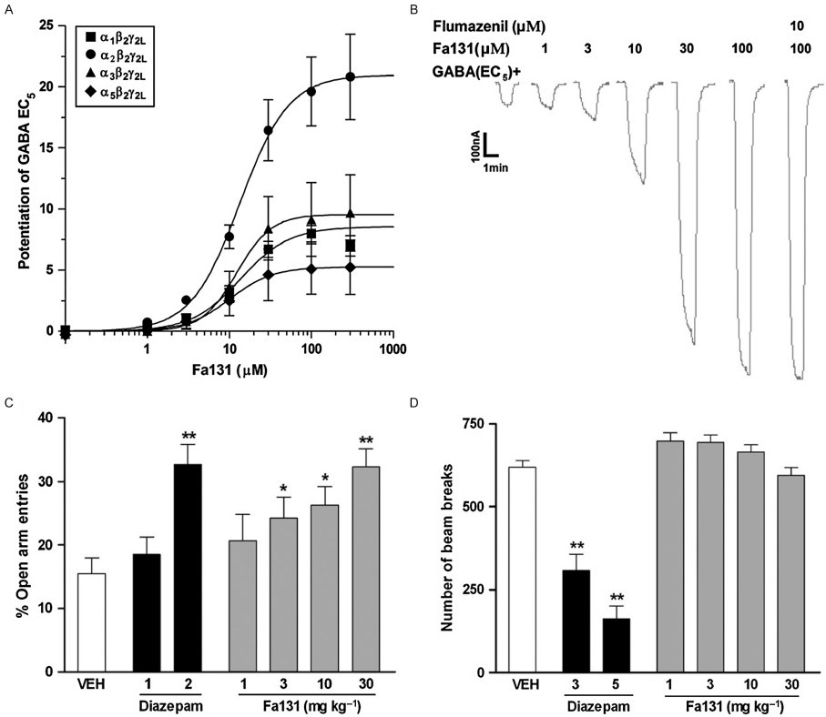
From JR Hanrahan et al. Br J Pharmacol 2011
doi:10.1111/j.1476-5381.2011.01228.x/bph.1228
British Journal of Pharmacology © 2011 The British Pharmacological Society

