Slide 1
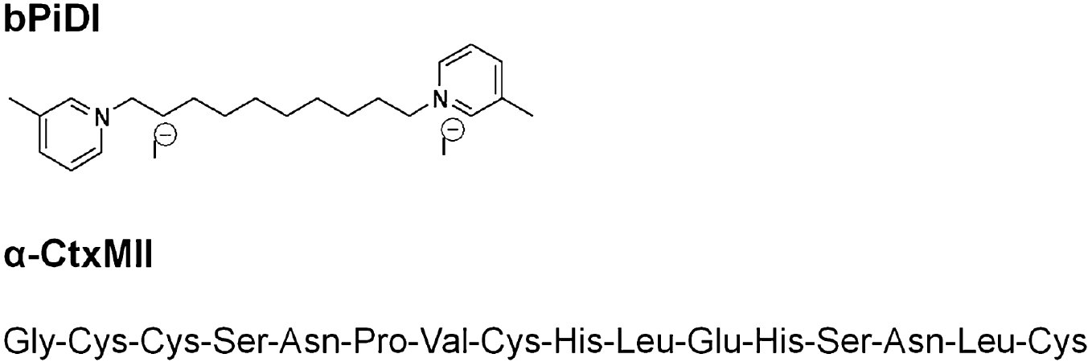
From TE Wooters et al. Br J Pharmacol 2011
doi:10.1111/j.1476-5381.2011.01220.x/bph.1220
British Journal of Pharmacology © 2011 The British Pharmacological Society

Slide 2
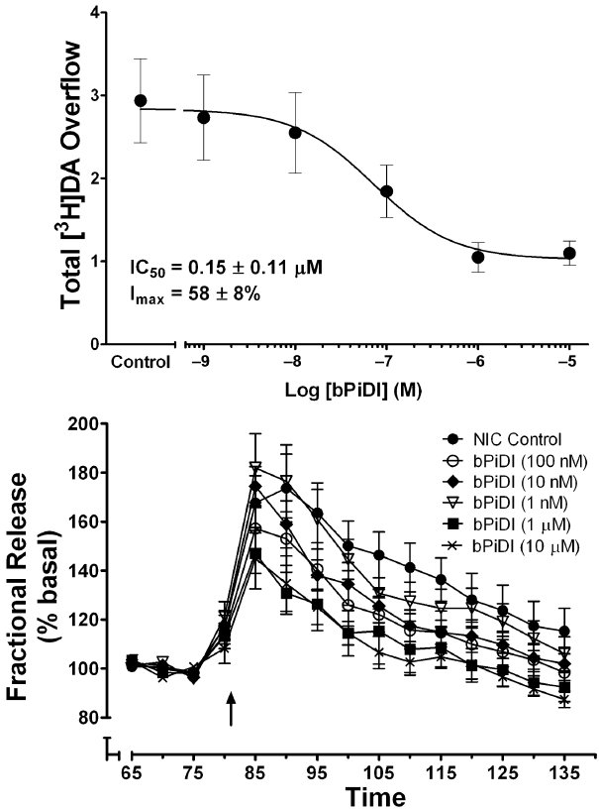
From TE Wooters et al. Br J Pharmacol 2011
doi:10.1111/j.1476-5381.2011.01220.x/bph.1220
British Journal of Pharmacology © 2011 The British Pharmacological Society

Slide 3
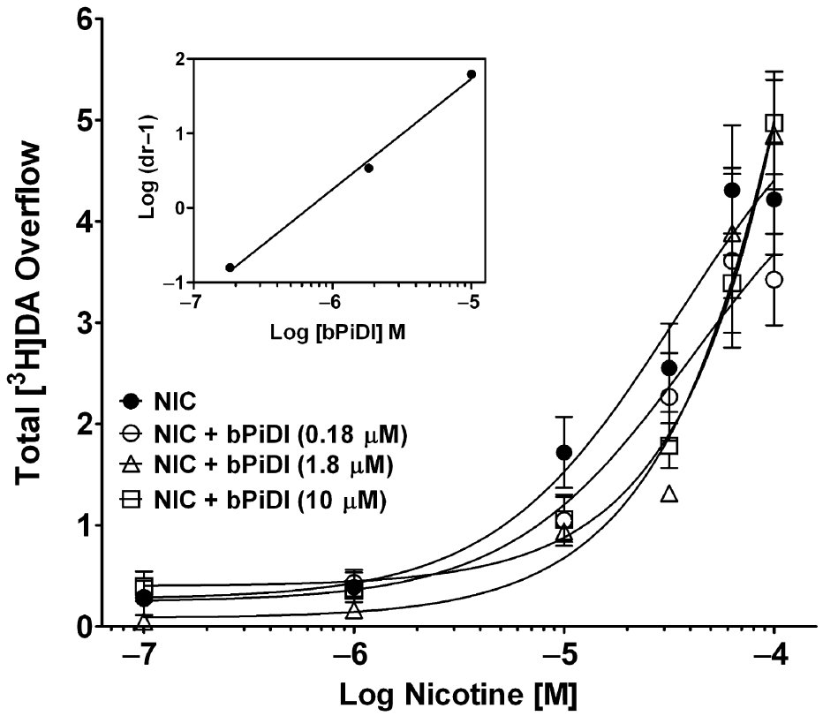
From TE Wooters et al. Br J Pharmacol 2011
doi:10.1111/j.1476-5381.2011.01220.x/bph.1220
British Journal of Pharmacology © 2011 The British Pharmacological Society

Slide 4
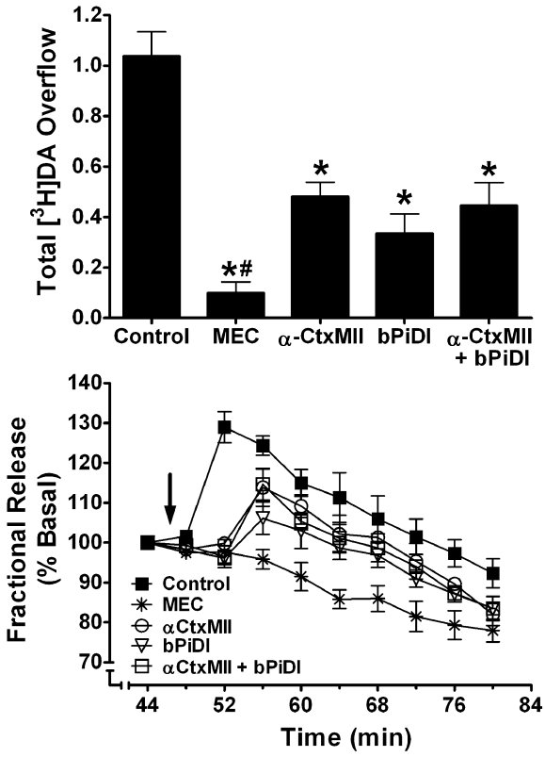
From TE Wooters et al. Br J Pharmacol 2011
doi:10.1111/j.1476-5381.2011.01220.x/bph.1220
British Journal of Pharmacology © 2011 The British Pharmacological Society

Slide 5
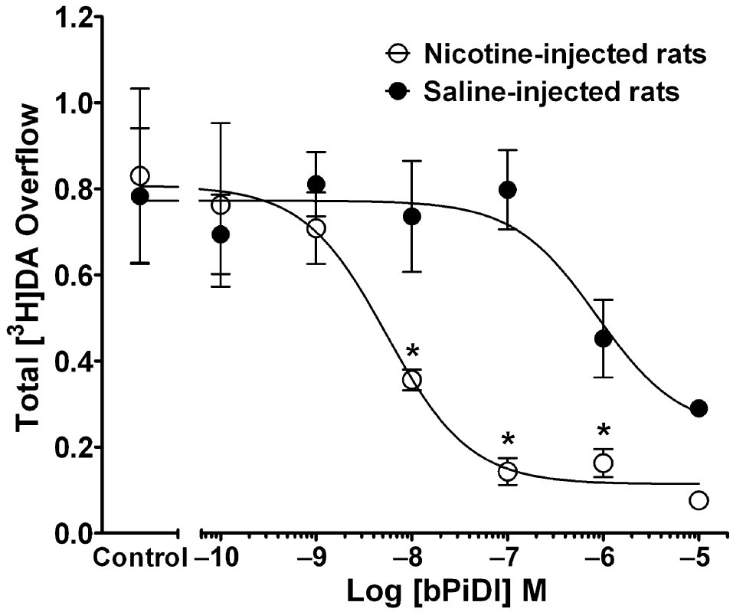
From TE Wooters et al. Br J Pharmacol 2011
doi:10.1111/j.1476-5381.2011.01220.x/bph.1220
British Journal of Pharmacology © 2011 The British Pharmacological Society

Slide 6
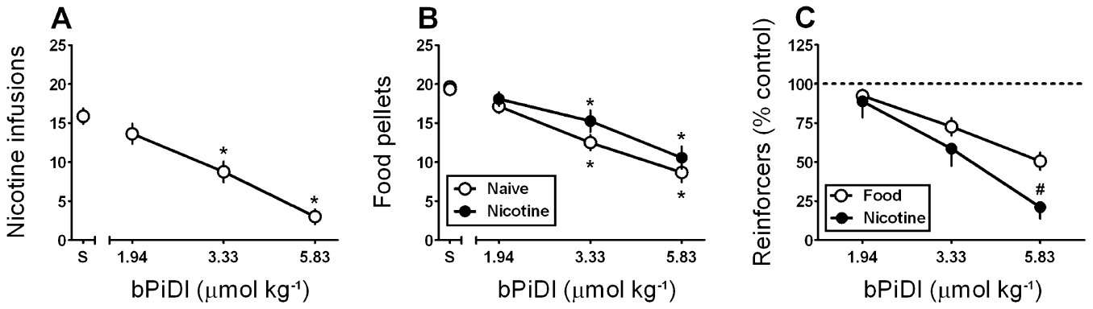
From TE Wooters et al. Br J Pharmacol 2011
doi:10.1111/j.1476-5381.2011.01220.x/bph.1220
British Journal of Pharmacology © 2011 The British Pharmacological Society

Slide 7
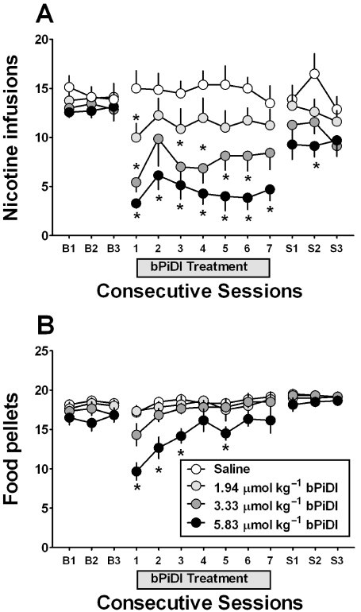
From TE Wooters et al. Br J Pharmacol 2011
doi:10.1111/j.1476-5381.2011.01220.x/bph.1220
British Journal of Pharmacology © 2011 The British Pharmacological Society

