Slide 1
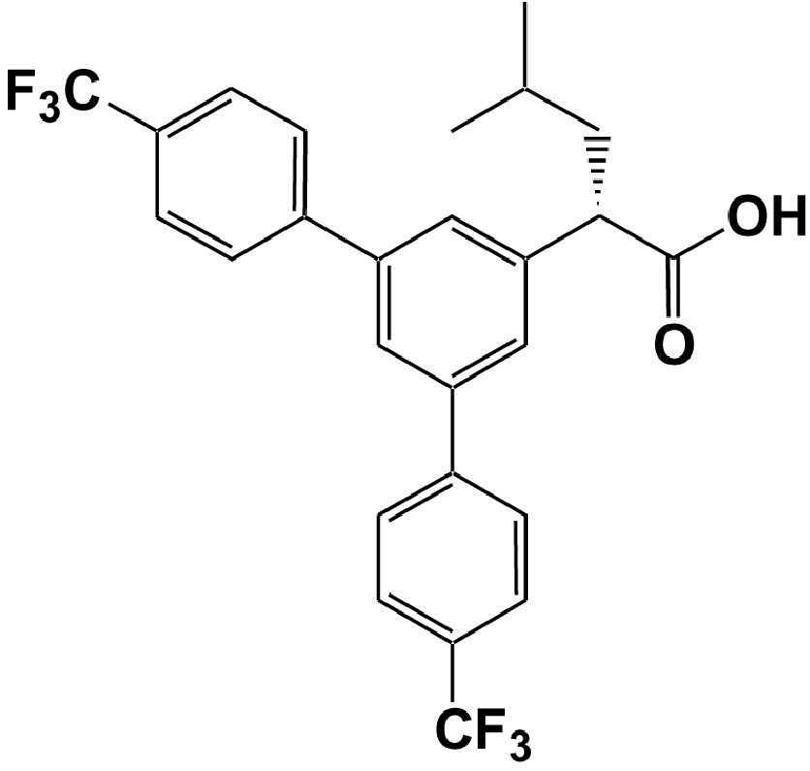
From B Van Broeck et al. Br J Pharmacol 2011
doi:10.1111/j.1476-5381.2011.01207.x/bph.1207
British Journal of Pharmacology © 2011 The British Pharmacological Society

Slide 2
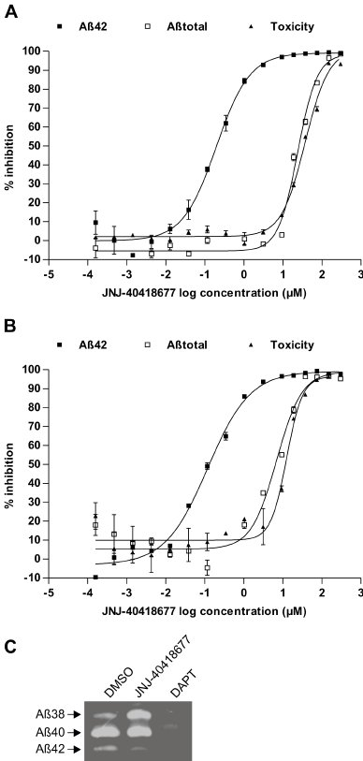
From B Van Broeck et al. Br J Pharmacol 2011
doi:10.1111/j.1476-5381.2011.01207.x/bph.1207
British Journal of Pharmacology © 2011 The British Pharmacological Society

Slide 3
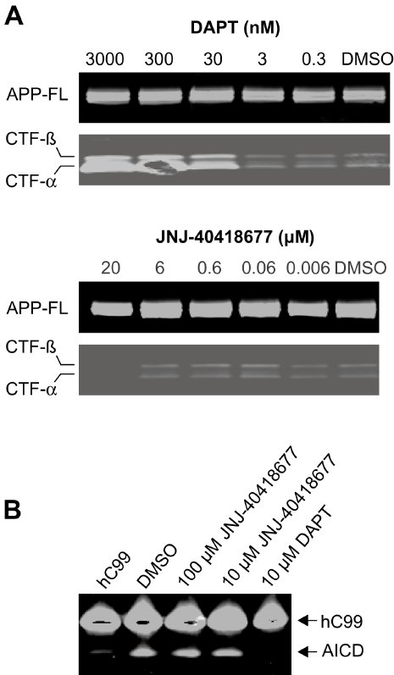
From B Van Broeck et al. Br J Pharmacol 2011
doi:10.1111/j.1476-5381.2011.01207.x/bph.1207
British Journal of Pharmacology © 2011 The British Pharmacological Society

Slide 4
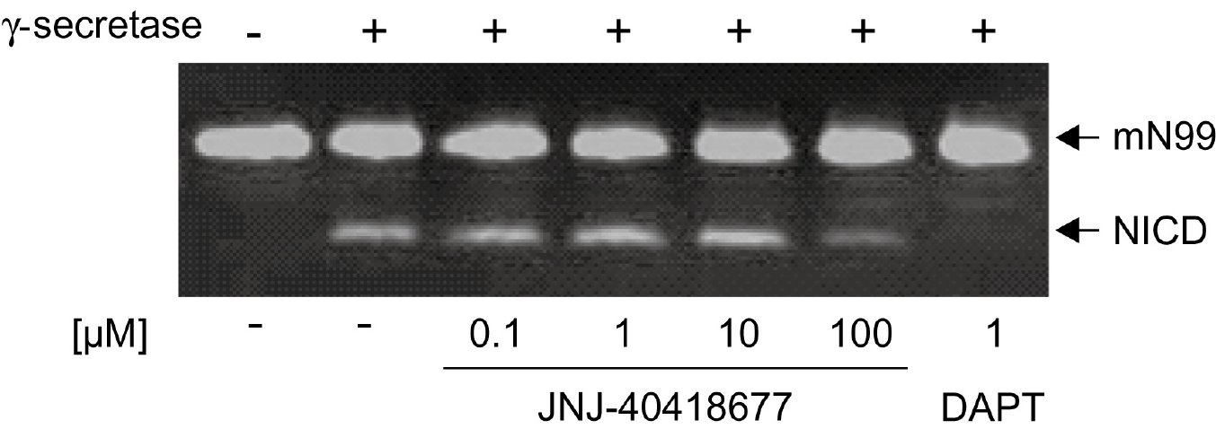
From B Van Broeck et al. Br J Pharmacol 2011
doi:10.1111/j.1476-5381.2011.01207.x/bph.1207
British Journal of Pharmacology © 2011 The British Pharmacological Society

Slide 5
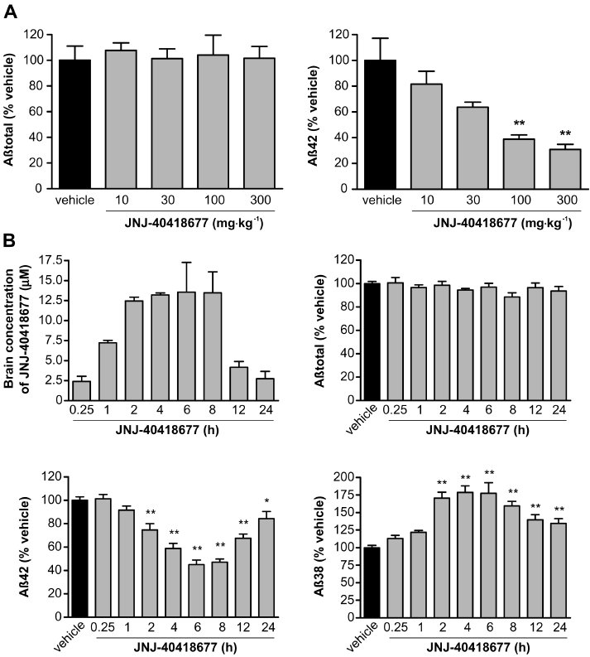
From B Van Broeck et al. Br J Pharmacol 2011
doi:10.1111/j.1476-5381.2011.01207.x/bph.1207
British Journal of Pharmacology © 2011 The British Pharmacological Society

Slide 6
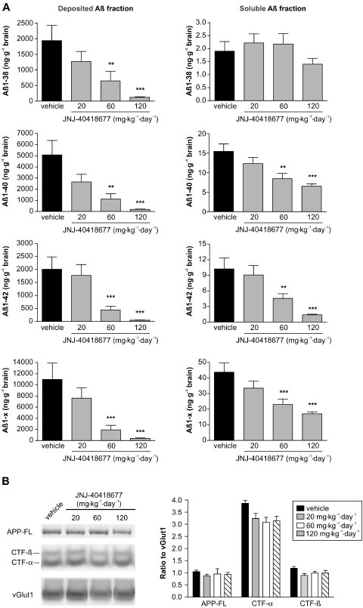
From B Van Broeck et al. Br J Pharmacol 2011
doi:10.1111/j.1476-5381.2011.01207.x/bph.1207
British Journal of Pharmacology © 2011 The British Pharmacological Society

Slide 7
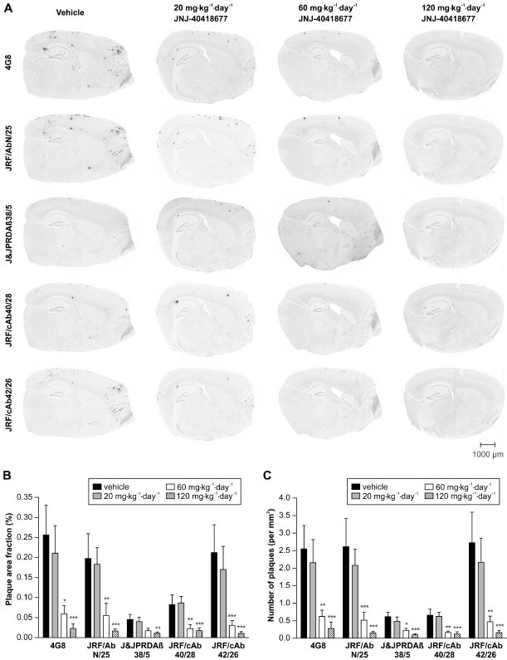
From B Van Broeck et al. Br J Pharmacol 2011
doi:10.1111/j.1476-5381.2011.01207.x/bph.1207
British Journal of Pharmacology © 2011 The British Pharmacological Society

