Slide 1
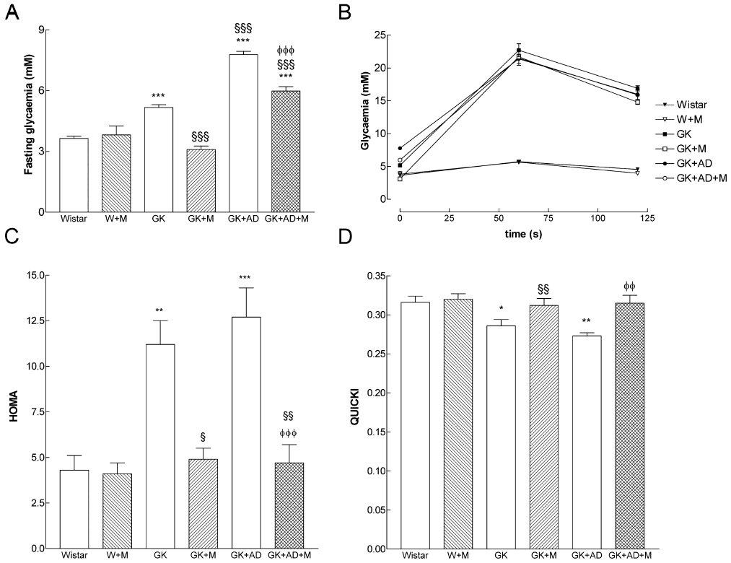
From CM Sena et al. Br J Pharmacol 2011
doi:10.1111/j.1476-5381.2011.01230.x/bph.1230
British Journal of Pharmacology © 2011 The British Pharmacological Society

Slide 2
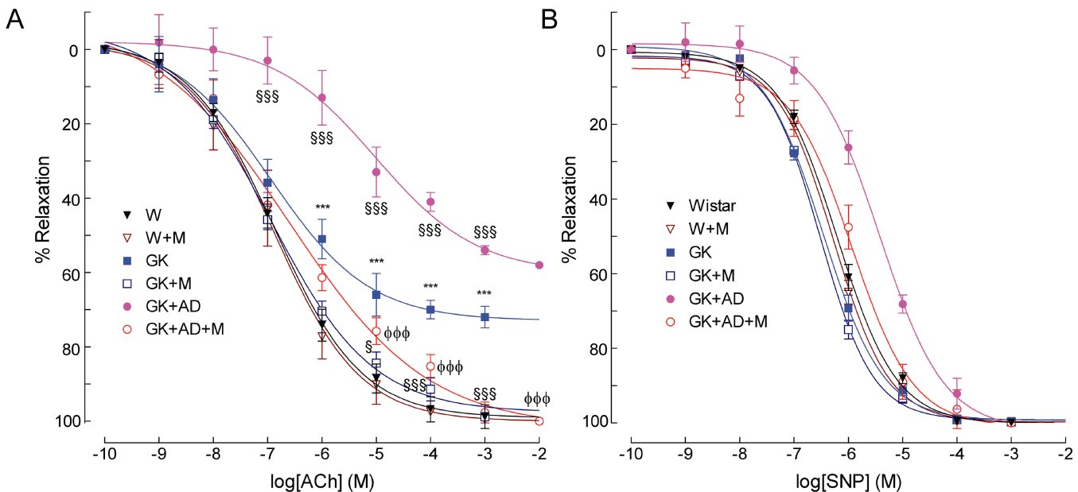
From CM Sena et al. Br J Pharmacol 2011
doi:10.1111/j.1476-5381.2011.01230.x/bph.1230
British Journal of Pharmacology © 2011 The British Pharmacological Society

Slide 3
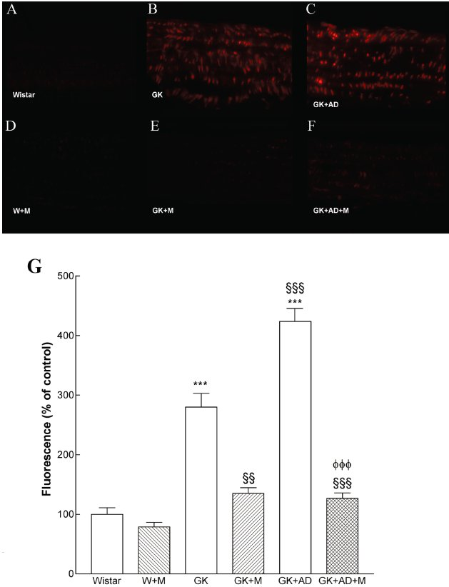
From CM Sena et al. Br J Pharmacol 2011
doi:10.1111/j.1476-5381.2011.01230.x/bph.1230
British Journal of Pharmacology © 2011 The British Pharmacological Society

Slide 4
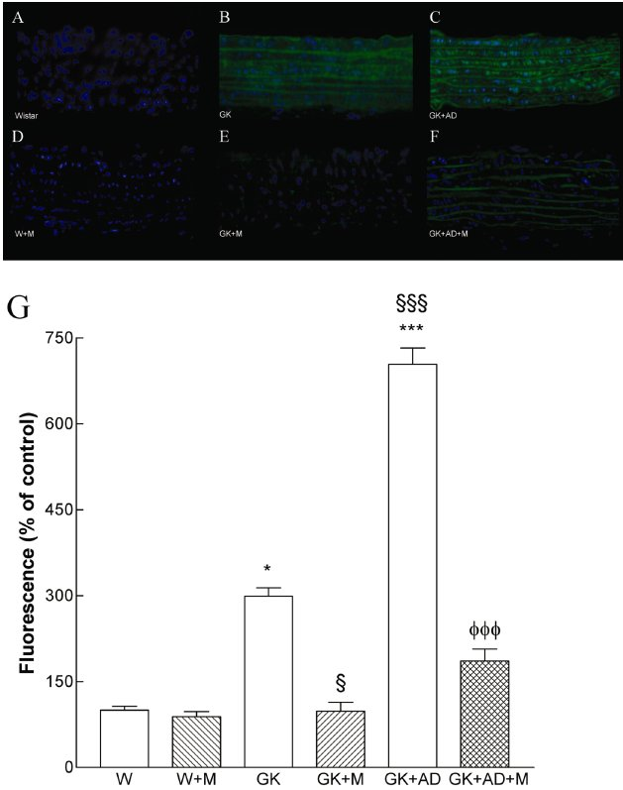
From CM Sena et al. Br J Pharmacol 2011
doi:10.1111/j.1476-5381.2011.01230.x/bph.1230
British Journal of Pharmacology © 2011 The British Pharmacological Society

Slide 5
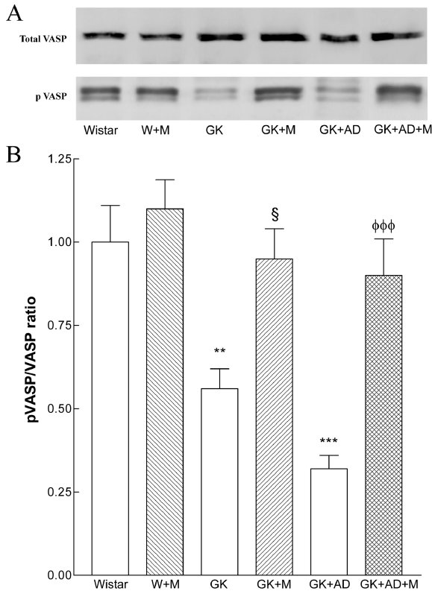
From CM Sena et al. Br J Pharmacol 2011
doi:10.1111/j.1476-5381.2011.01230.x/bph.1230
British Journal of Pharmacology © 2011 The British Pharmacological Society

Slide 6
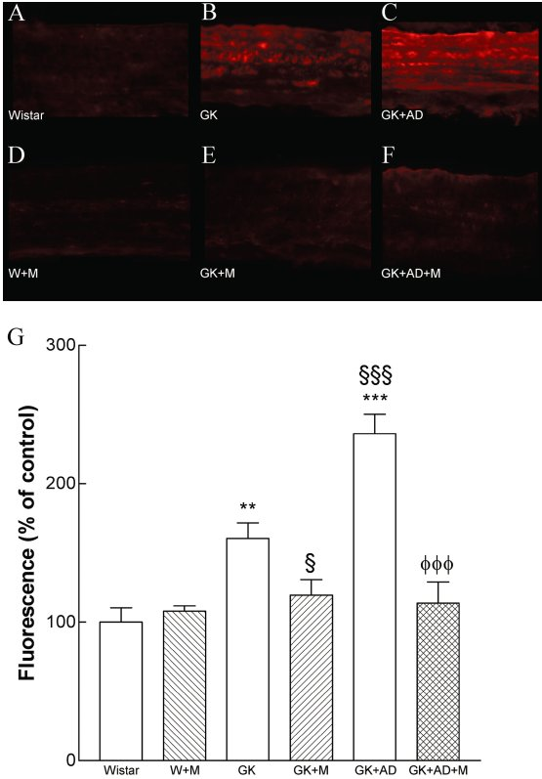
From CM Sena et al. Br J Pharmacol 2011
doi:10.1111/j.1476-5381.2011.01230.x/bph.1230
British Journal of Pharmacology © 2011 The British Pharmacological Society

Slide 7
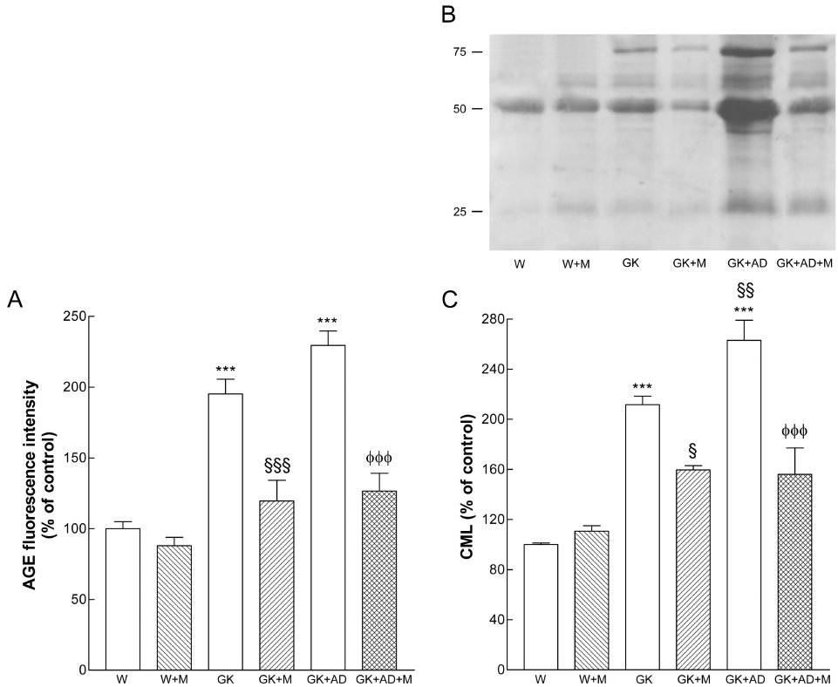
From CM Sena et al. Br J Pharmacol 2011
doi:10.1111/j.1476-5381.2011.01230.x/bph.1230
British Journal of Pharmacology © 2011 The British Pharmacological Society

Slide 8
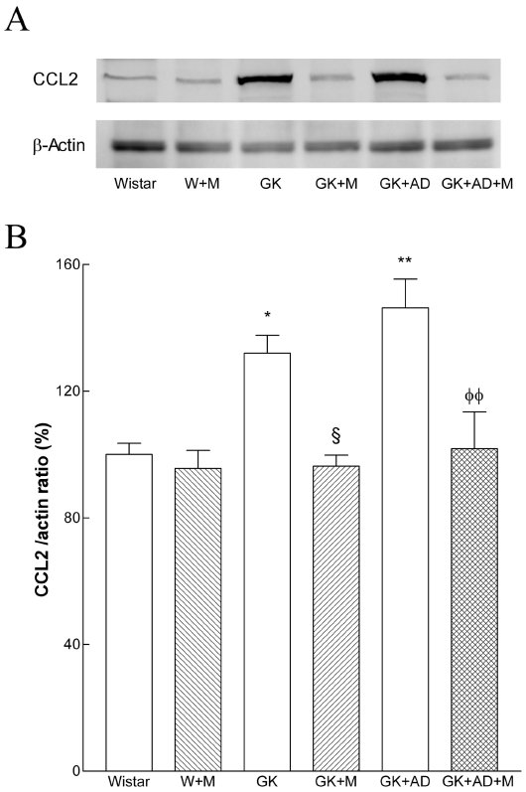
From CM Sena et al. Br J Pharmacol 2011
doi:10.1111/j.1476-5381.2011.01230.x/bph.1230
British Journal of Pharmacology © 2011 The British Pharmacological Society

Slide 9
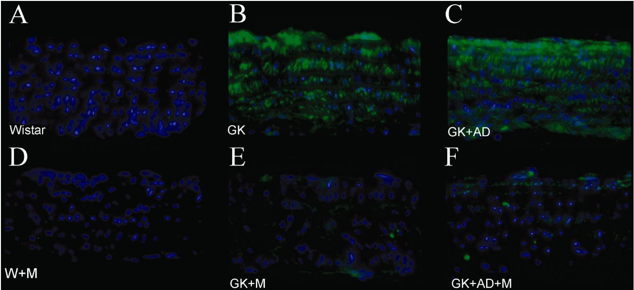
From CM Sena et al. Br J Pharmacol 2011
doi:10.1111/j.1476-5381.2011.01230.x/bph.1230
British Journal of Pharmacology © 2011 The British Pharmacological Society

