Slide 1
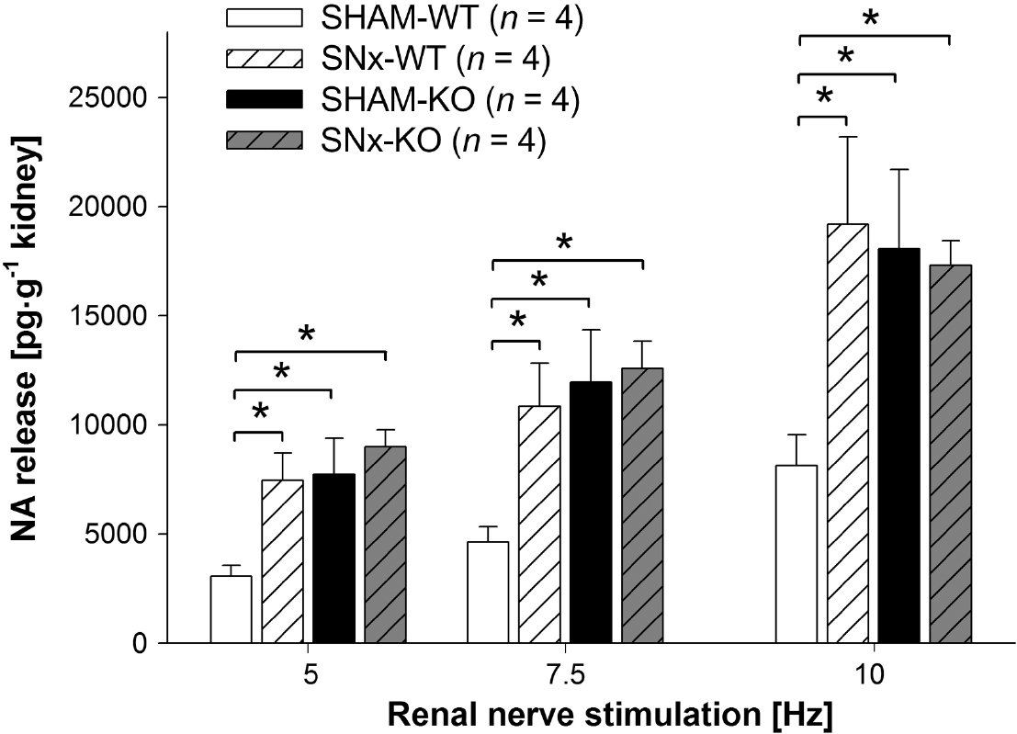
From H Hoch et al. Br J Pharmacol 2011
doi:10.1111/j.1476-5381.2011.01223.x/bph.1223
British Journal of Pharmacology © 2011 The British Pharmacological Society

Slide 2
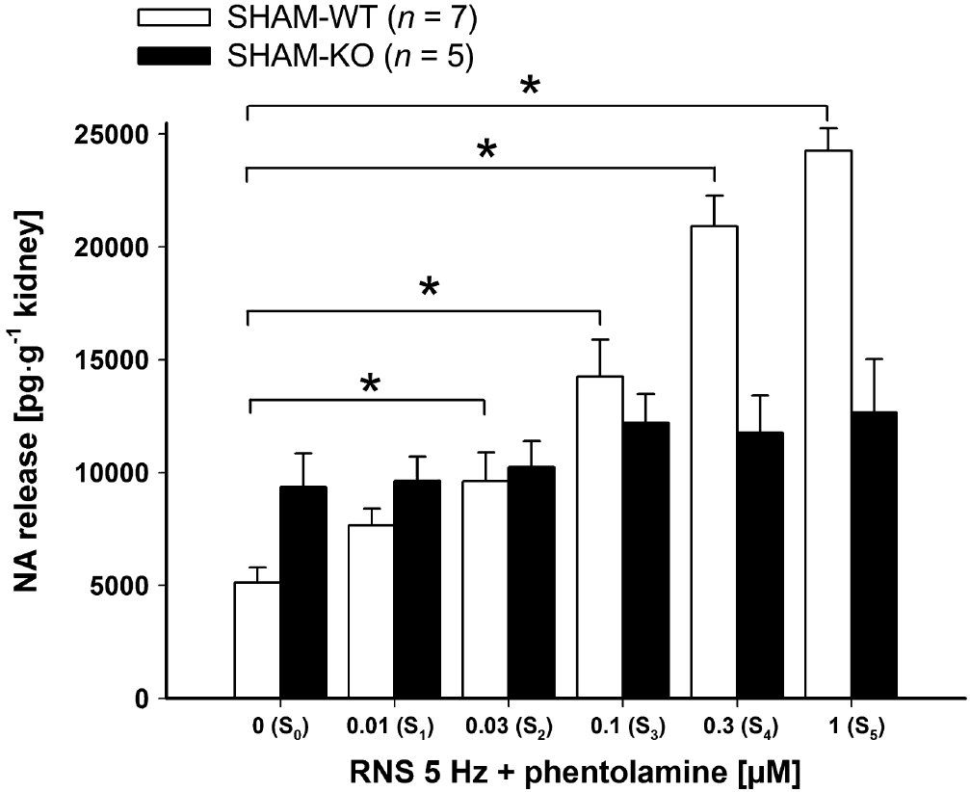
From H Hoch et al. Br J Pharmacol 2011
doi:10.1111/j.1476-5381.2011.01223.x/bph.1223
British Journal of Pharmacology © 2011 The British Pharmacological Society

Slide 3
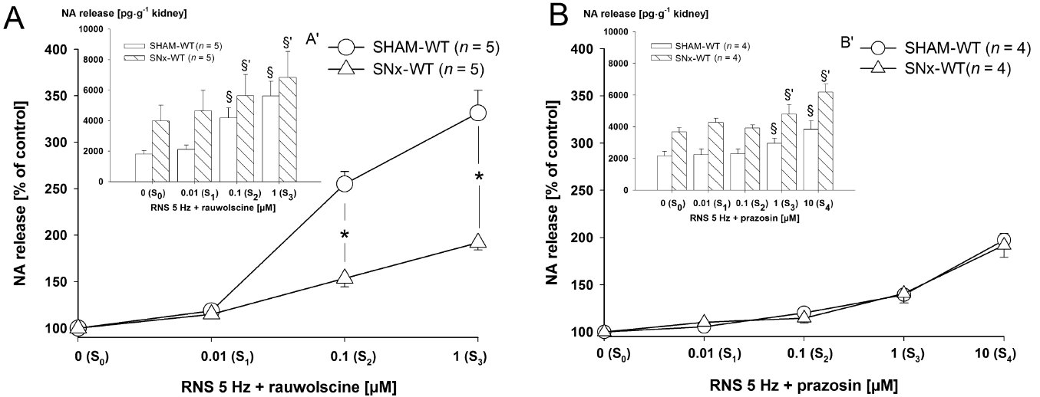
From H Hoch et al. Br J Pharmacol 2011
doi:10.1111/j.1476-5381.2011.01223.x/bph.1223
British Journal of Pharmacology © 2011 The British Pharmacological Society

Slide 4
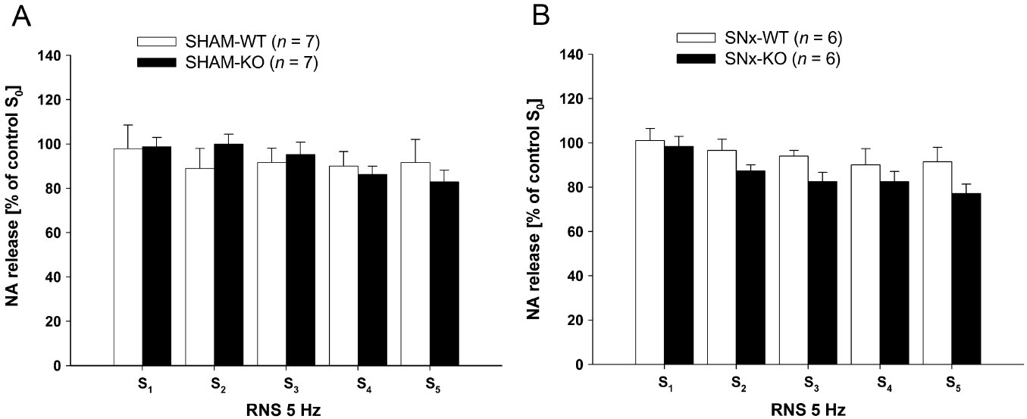
From H Hoch et al. Br J Pharmacol 2011
doi:10.1111/j.1476-5381.2011.01223.x/bph.1223
British Journal of Pharmacology © 2011 The British Pharmacological Society

Slide 5
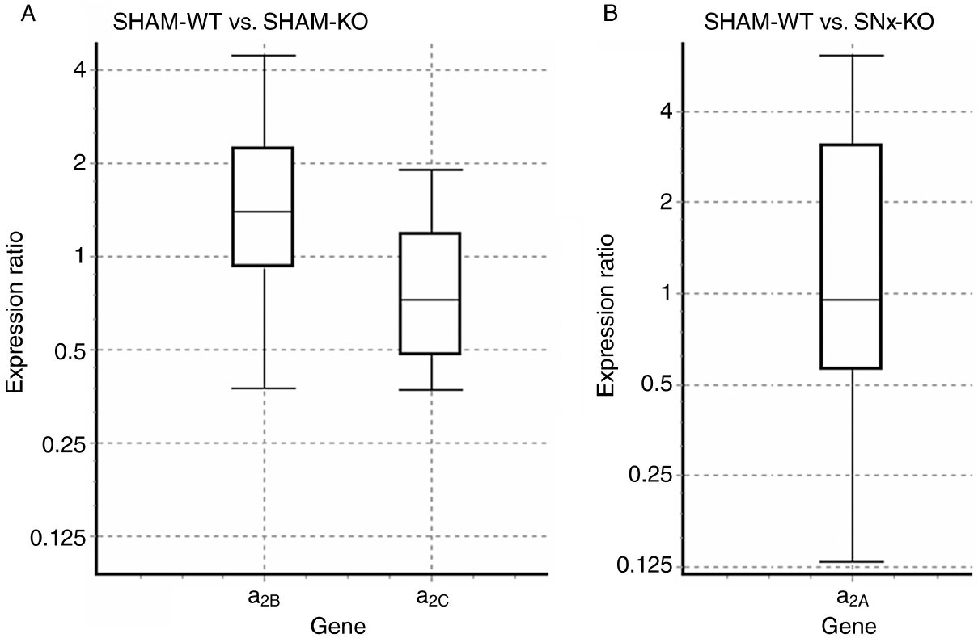
From H Hoch et al. Br J Pharmacol 2011
doi:10.1111/j.1476-5381.2011.01223.x/bph.1223
British Journal of Pharmacology © 2011 The British Pharmacological Society

Slide 6
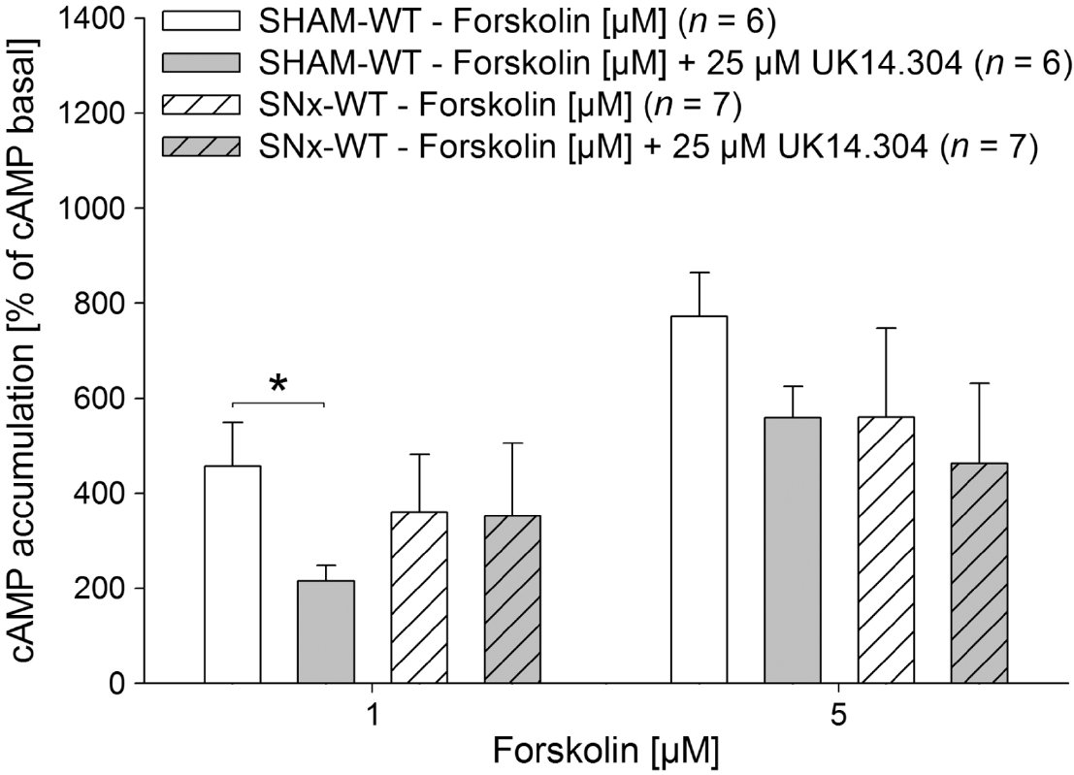
From H Hoch et al. Br J Pharmacol 2011
doi:10.1111/j.1476-5381.2011.01223.x/bph.1223
British Journal of Pharmacology © 2011 The British Pharmacological Society

Slide 7
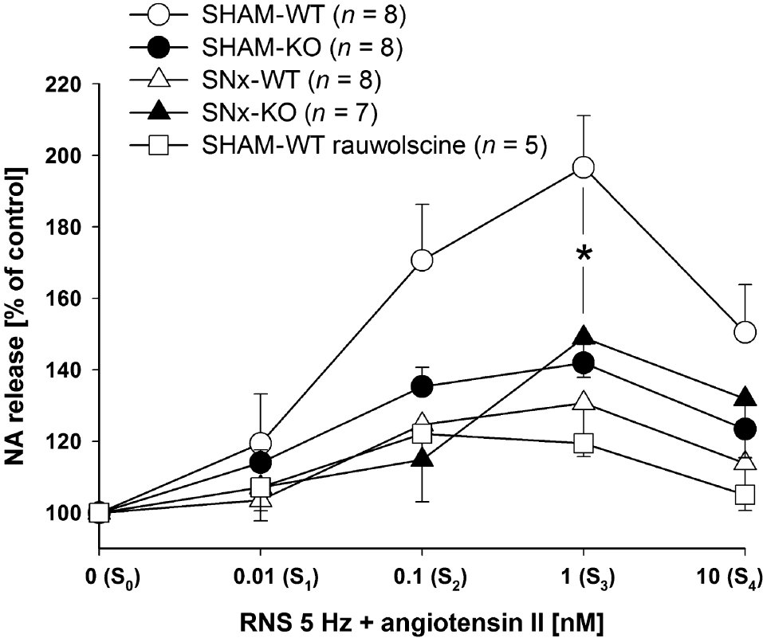
From H Hoch et al. Br J Pharmacol 2011
doi:10.1111/j.1476-5381.2011.01223.x/bph.1223
British Journal of Pharmacology © 2011 The British Pharmacological Society

