Slide 1
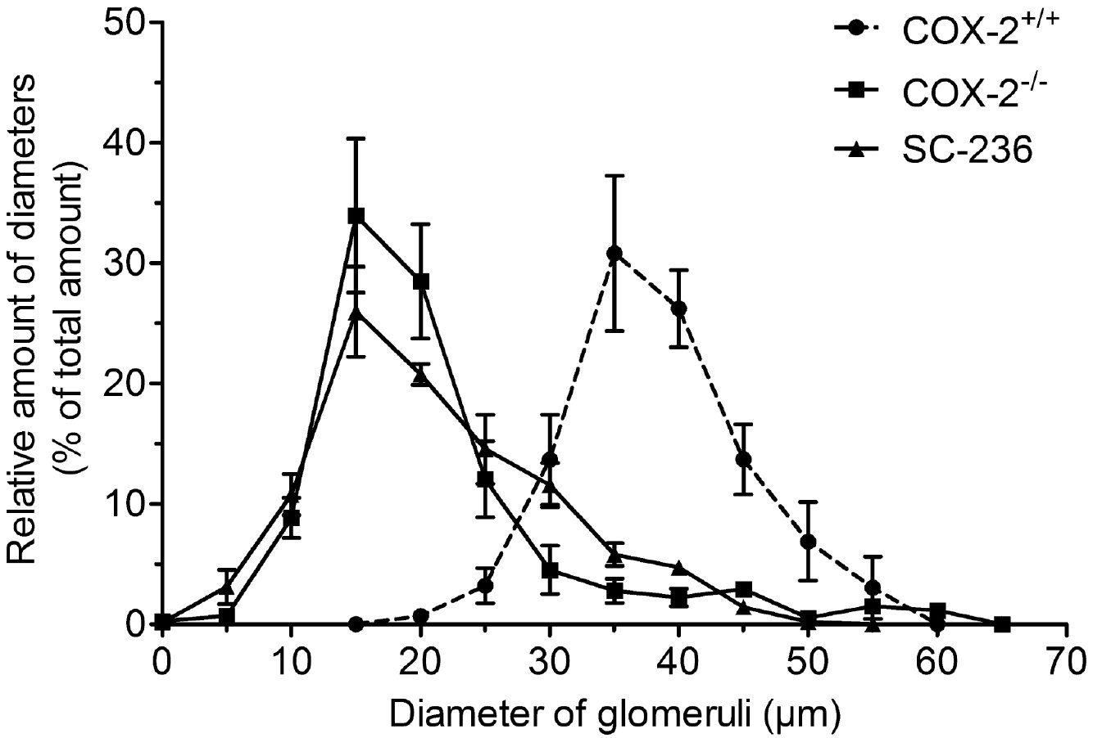
From A Olliges et al. Br J Pharmacol 2011
doi:10.1111/j.1476-5381.2011.01313.x/bph.1313
British Journal of Pharmacology © 2011 The British Pharmacological Society

Slide 2
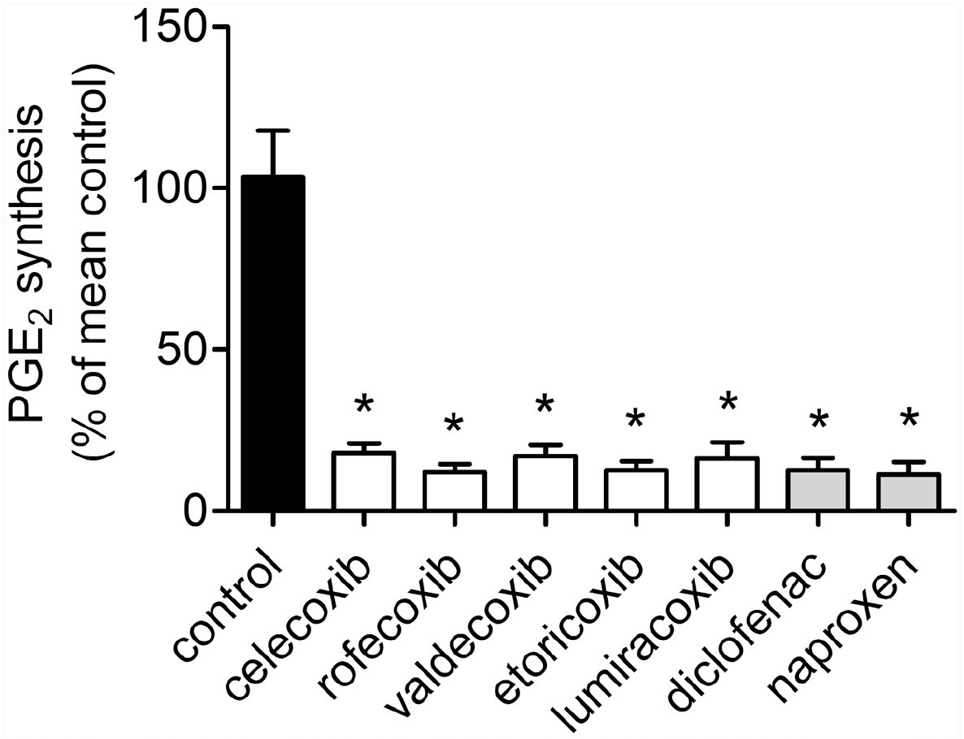
From A Olliges et al. Br J Pharmacol 2011
doi:10.1111/j.1476-5381.2011.01313.x/bph.1313
British Journal of Pharmacology © 2011 The British Pharmacological Society

Slide 3
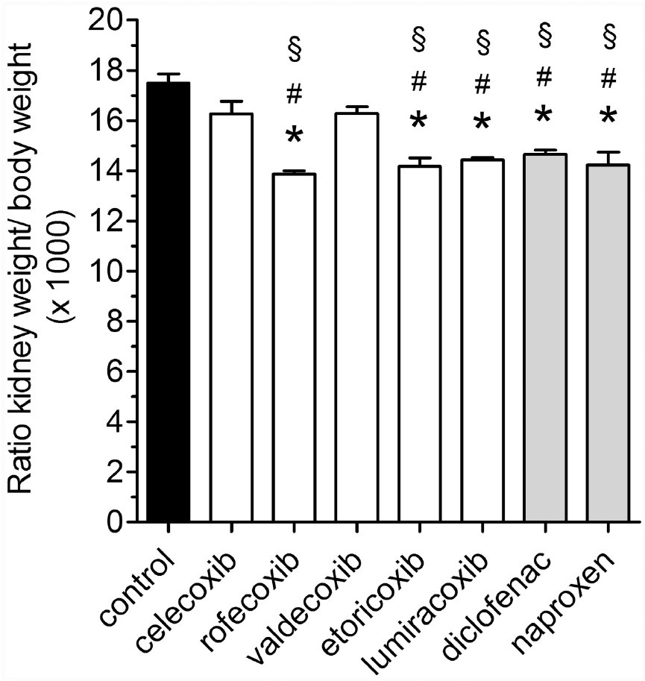
From A Olliges et al. Br J Pharmacol 2011
doi:10.1111/j.1476-5381.2011.01313.x/bph.1313
British Journal of Pharmacology © 2011 The British Pharmacological Society

Slide 4
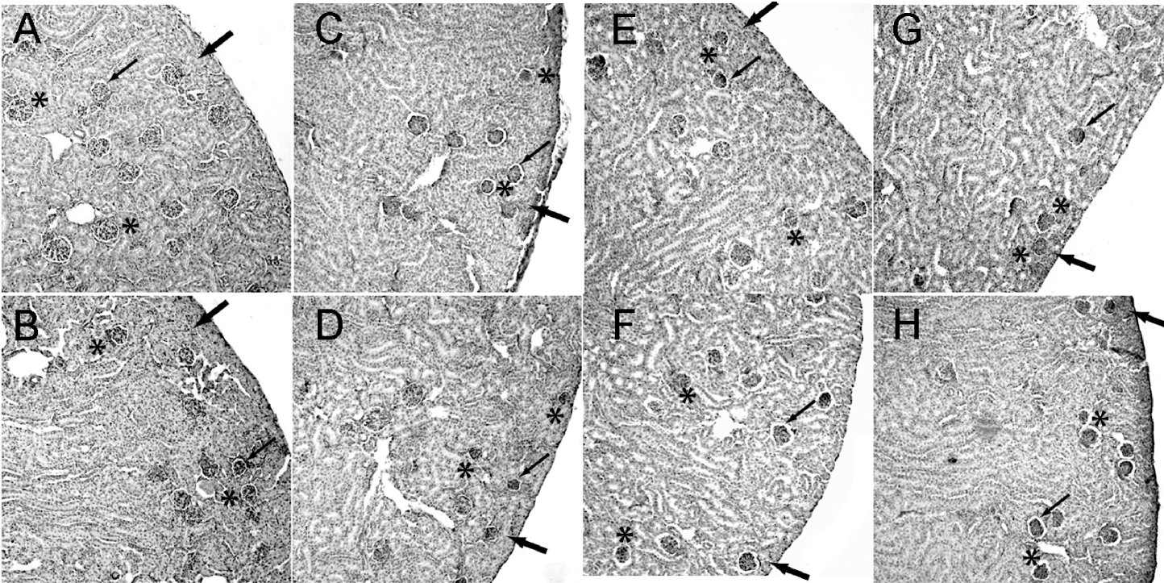
From A Olliges et al. Br J Pharmacol 2011
doi:10.1111/j.1476-5381.2011.01313.x/bph.1313
British Journal of Pharmacology © 2011 The British Pharmacological Society

Slide 5
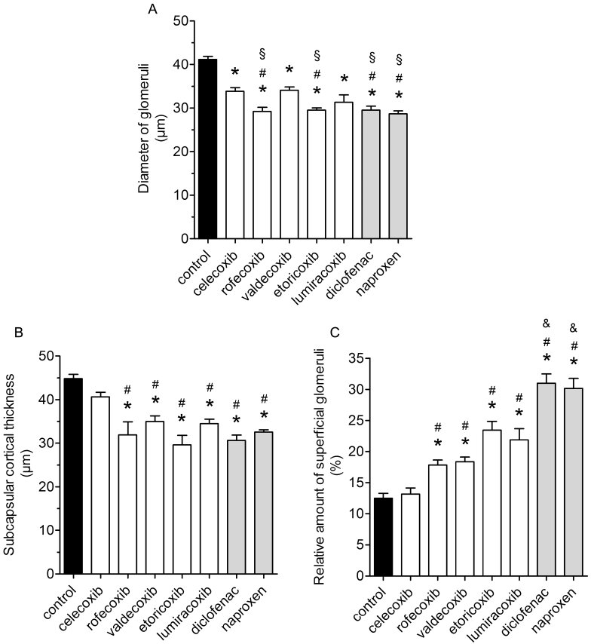
From A Olliges et al. Br J Pharmacol 2011
doi:10.1111/j.1476-5381.2011.01313.x/bph.1313
British Journal of Pharmacology © 2011 The British Pharmacological Society

Slide 6
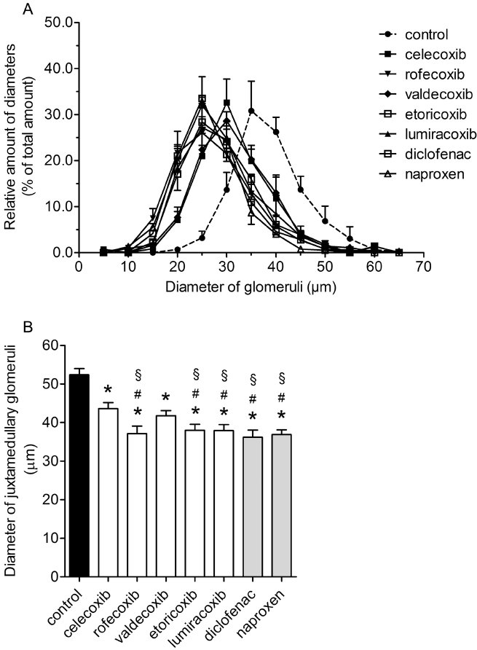
From A Olliges et al. Br J Pharmacol 2011
doi:10.1111/j.1476-5381.2011.01313.x/bph.1313
British Journal of Pharmacology © 2011 The British Pharmacological Society

