Slide 1
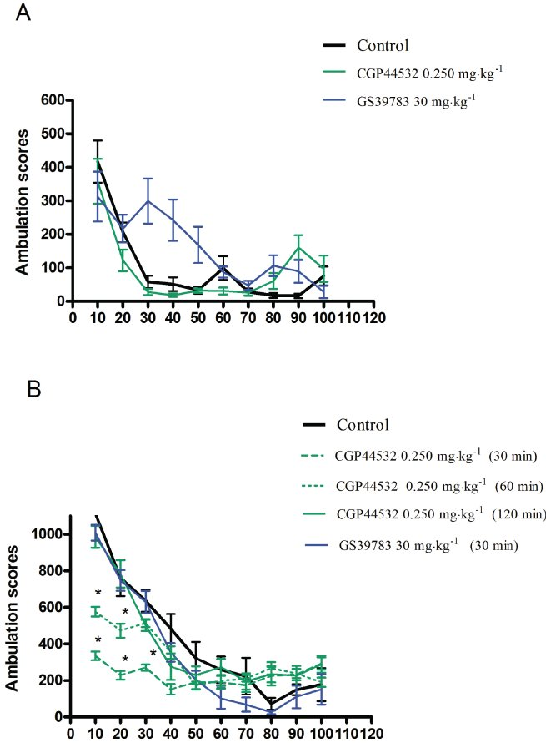
From JM Wieron´ ska et al. Br J Pharmacol 2011
doi:10.1111/j.1476-5381.2011.01301.x/bph.1301
British Journal of Pharmacology © 2011 The British Pharmacological Society

Slide 2
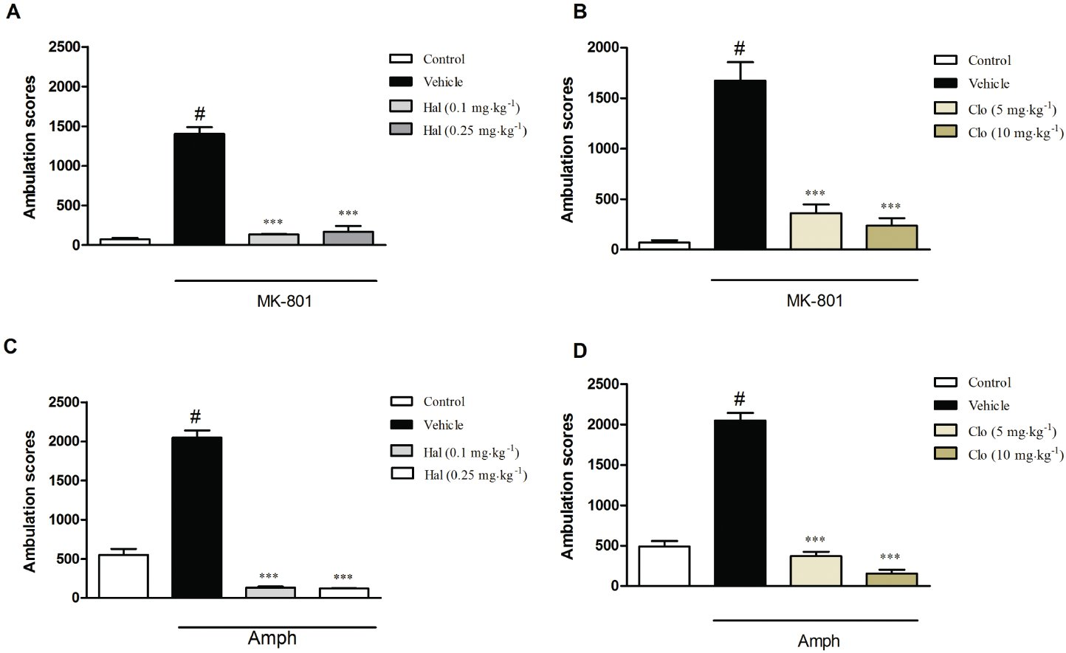
From JM Wieron´ ska et al. Br J Pharmacol 2011
doi:10.1111/j.1476-5381.2011.01301.x/bph.1301
British Journal of Pharmacology © 2011 The British Pharmacological Society

Slide 3
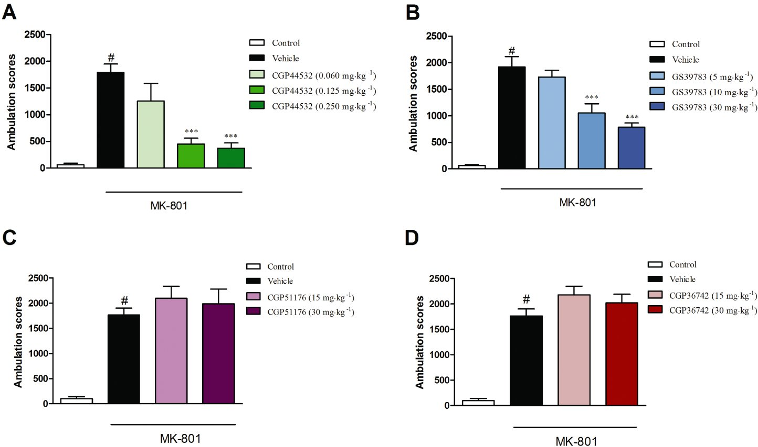
From JM Wieron´ ska et al. Br J Pharmacol 2011
doi:10.1111/j.1476-5381.2011.01301.x/bph.1301
British Journal of Pharmacology © 2011 The British Pharmacological Society

Slide 4
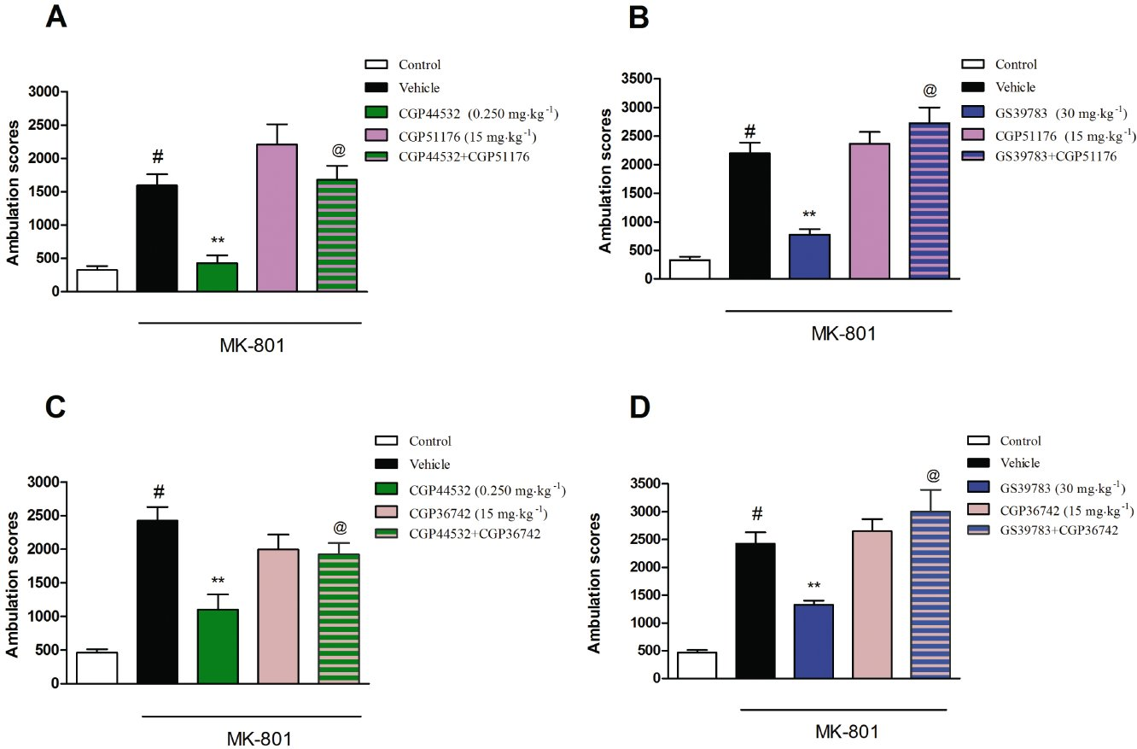
From JM Wieron´ ska et al. Br J Pharmacol 2011
doi:10.1111/j.1476-5381.2011.01301.x/bph.1301
British Journal of Pharmacology © 2011 The British Pharmacological Society

Slide 5
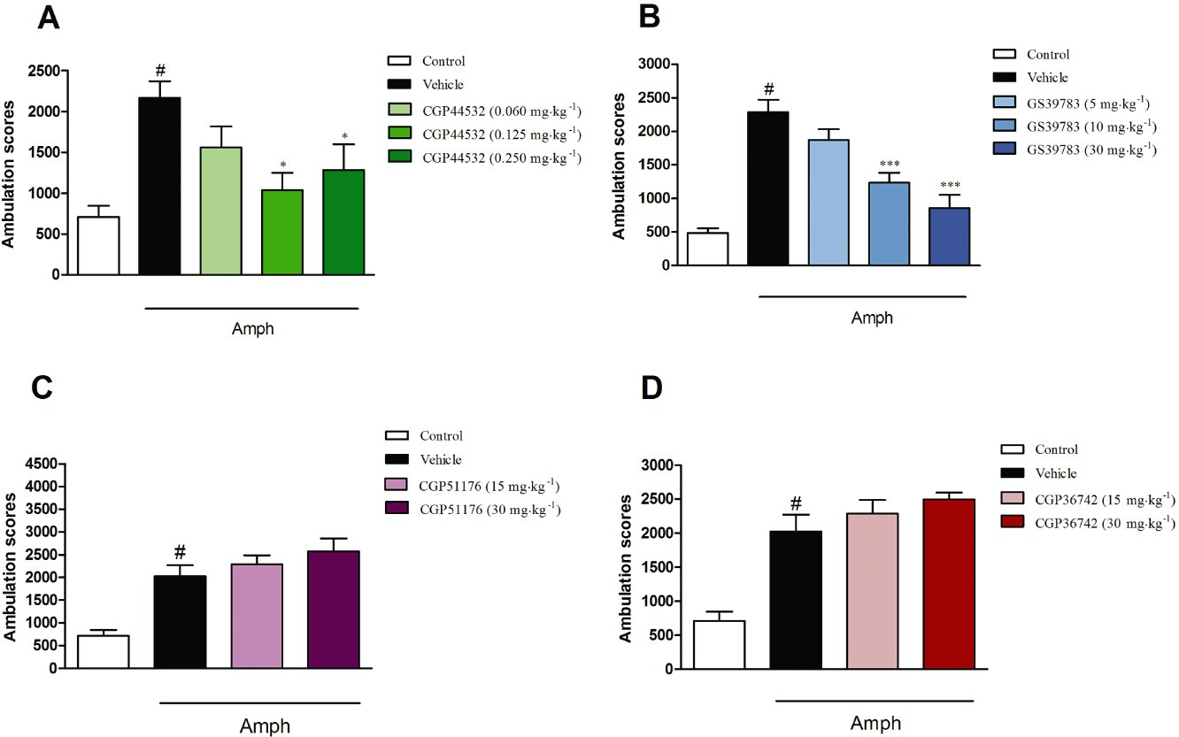
From JM Wieron´ ska et al. Br J Pharmacol 2011
doi:10.1111/j.1476-5381.2011.01301.x/bph.1301
British Journal of Pharmacology © 2011 The British Pharmacological Society

Slide 6
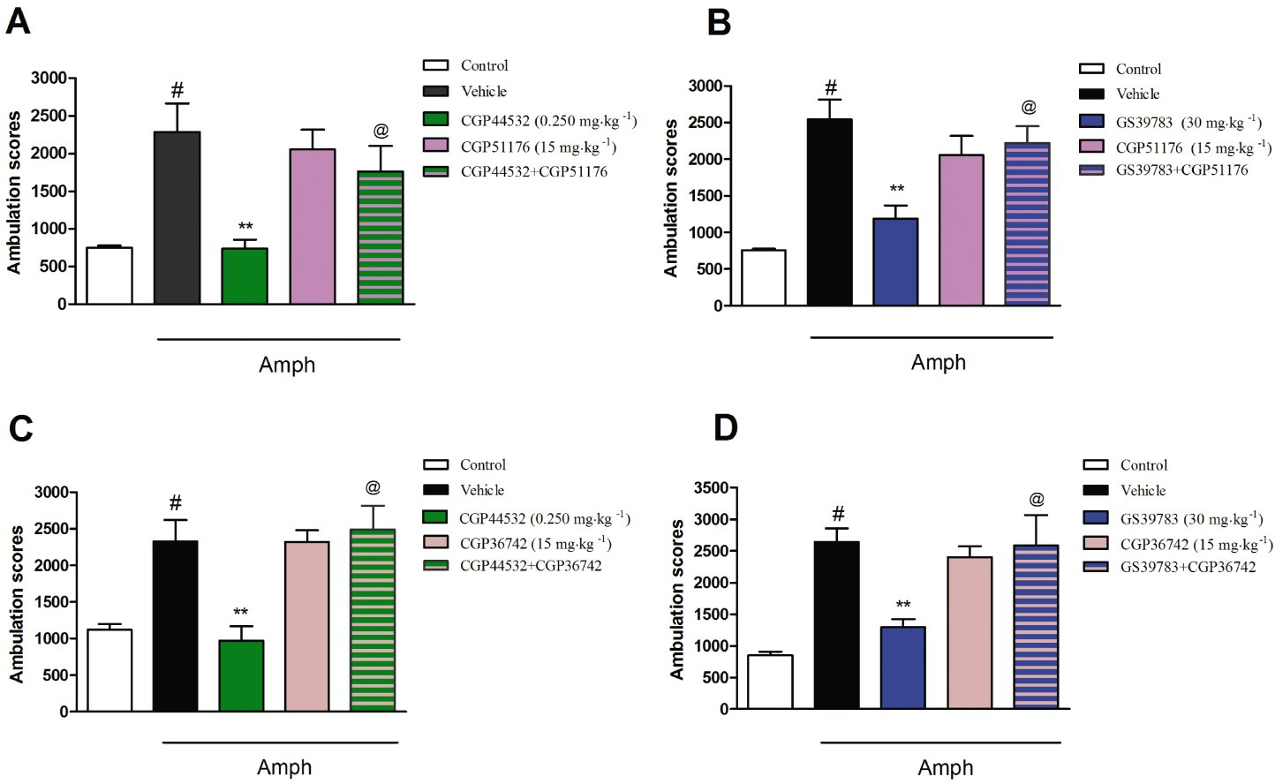
From JM Wieron´ ska et al. Br J Pharmacol 2011
doi:10.1111/j.1476-5381.2011.01301.x/bph.1301
British Journal of Pharmacology © 2011 The British Pharmacological Society

Slide 7
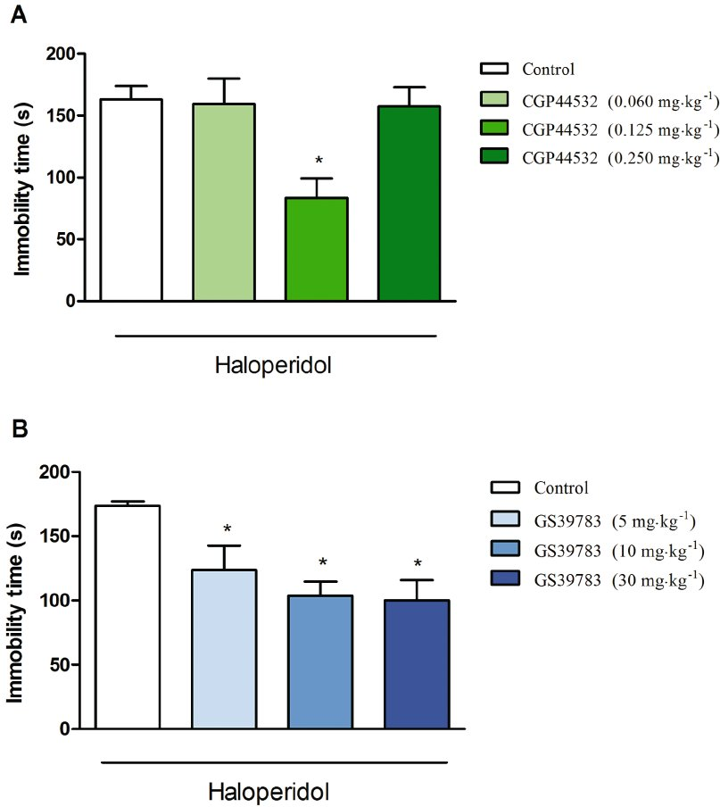
From JM Wieron´ ska et al. Br J Pharmacol 2011
doi:10.1111/j.1476-5381.2011.01301.x/bph.1301
British Journal of Pharmacology © 2011 The British Pharmacological Society

Slide 8
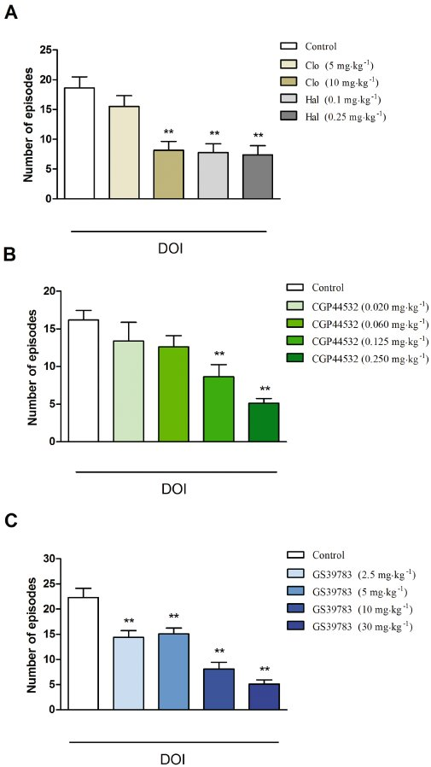
From JM Wieron´ ska et al. Br J Pharmacol 2011
doi:10.1111/j.1476-5381.2011.01301.x/bph.1301
British Journal of Pharmacology © 2011 The British Pharmacological Society

Slide 9
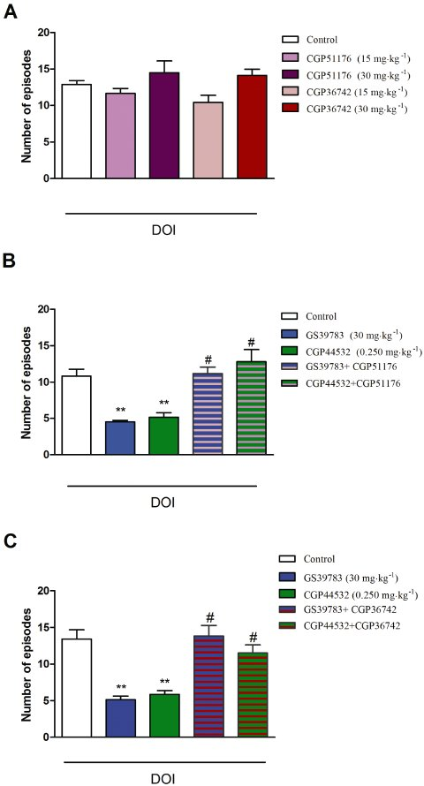
From JM Wieron´ ska et al. Br J Pharmacol 2011
doi:10.1111/j.1476-5381.2011.01301.x/bph.1301
British Journal of Pharmacology © 2011 The British Pharmacological Society

Slide 10
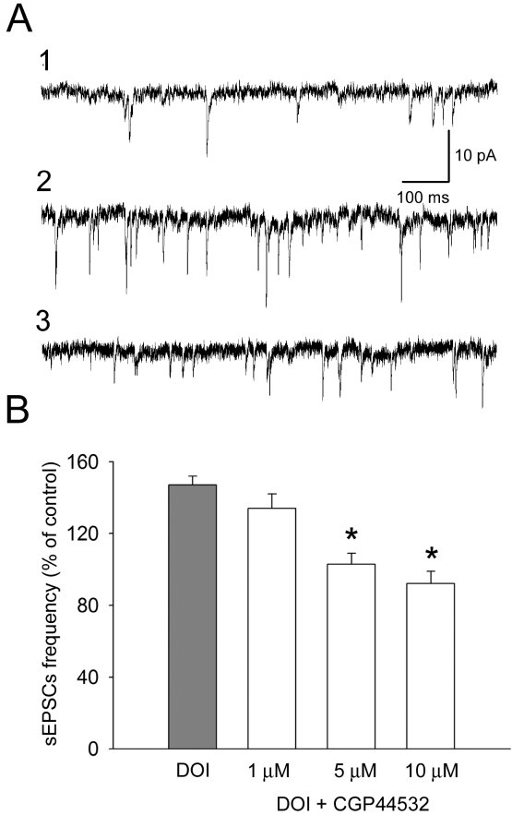
From JM Wieron´ ska et al. Br J Pharmacol 2011
doi:10.1111/j.1476-5381.2011.01301.x/bph.1301
British Journal of Pharmacology © 2011 The British Pharmacological Society

Slide 11
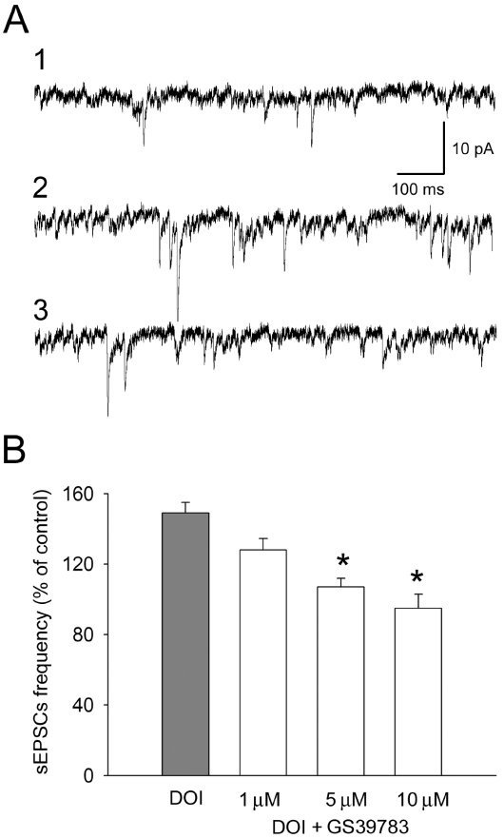
From JM Wieron´ ska et al. Br J Pharmacol 2011
doi:10.1111/j.1476-5381.2011.01301.x/bph.1301
British Journal of Pharmacology © 2011 The British Pharmacological Society

