Slide 1



Additional file 1
Chromosome I
Mycelia
Appressoria
A
Overall
B
Unique
C
Repeats

Slide 2
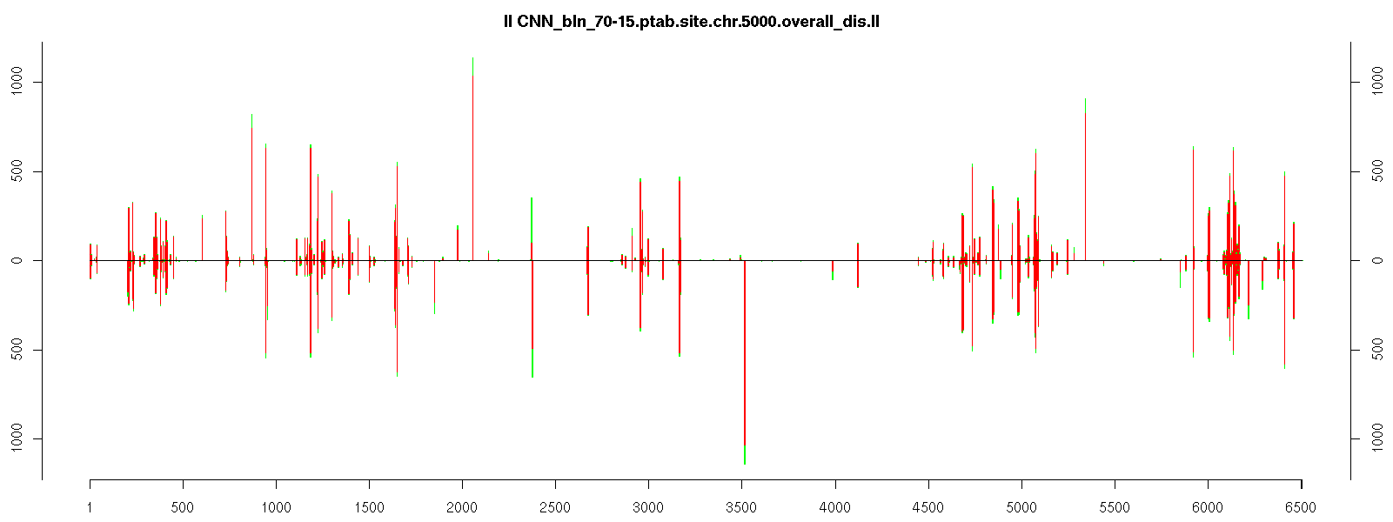
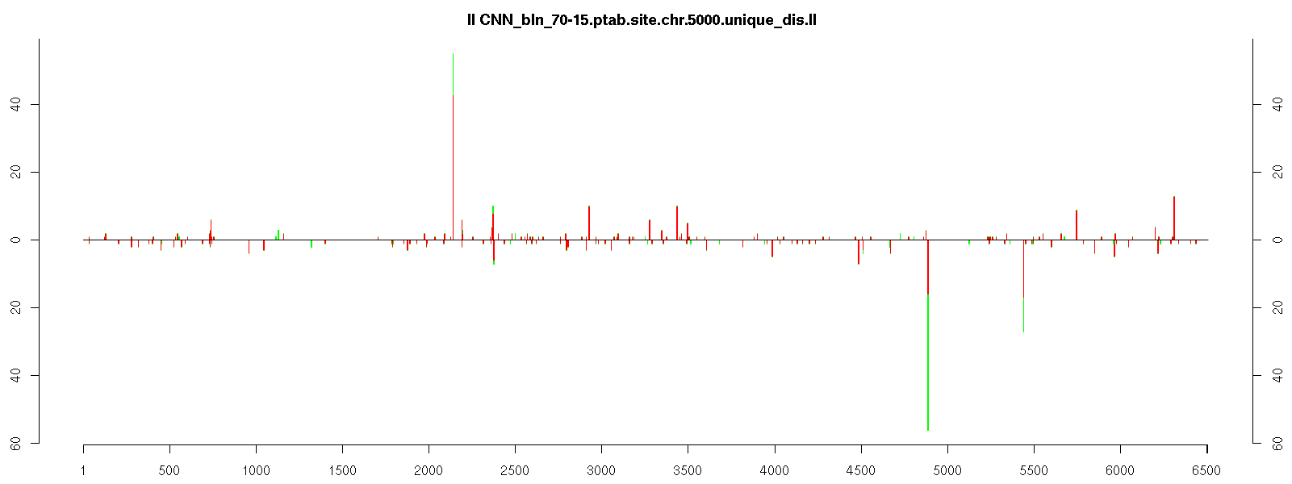
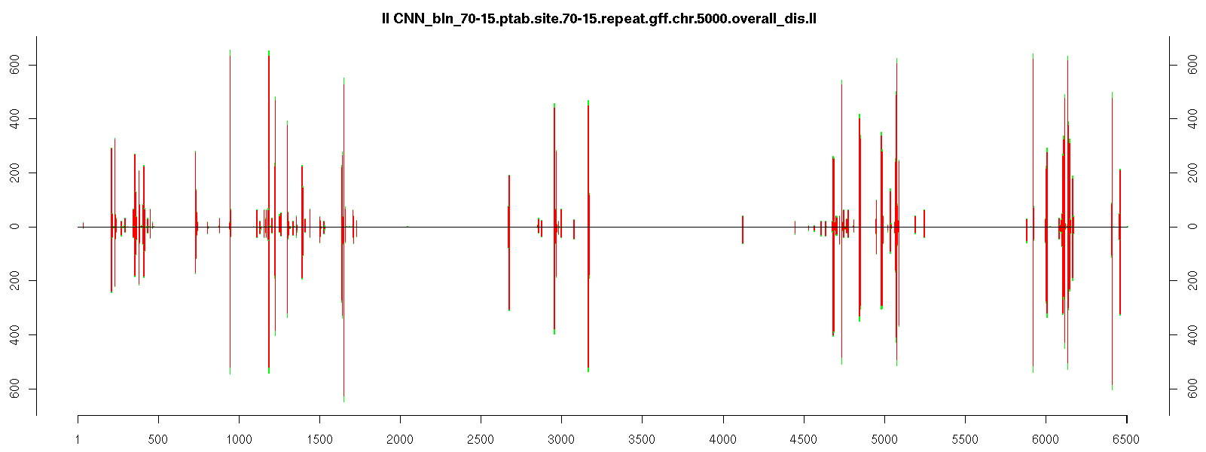
Chromosome II
Mycelia
Appressoria
A
Overall
B
Unique
C
Repeats

Slide 3
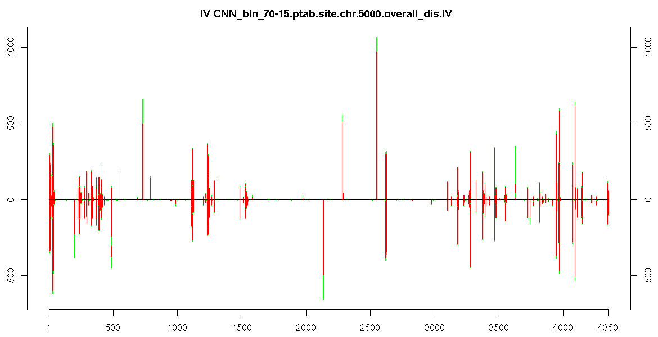
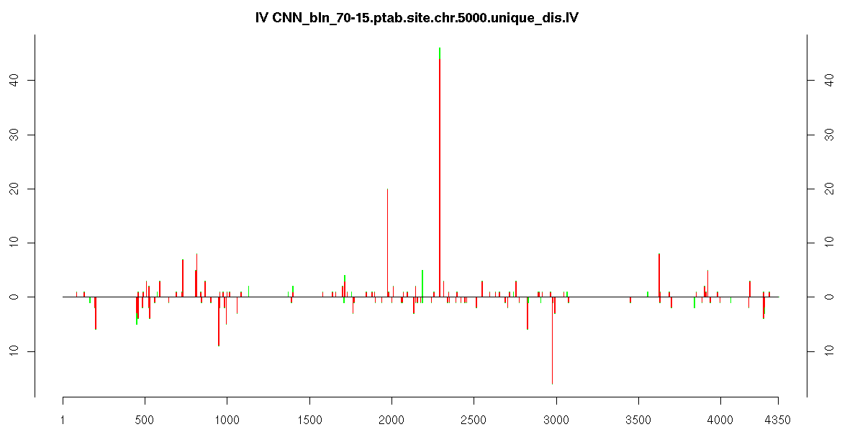
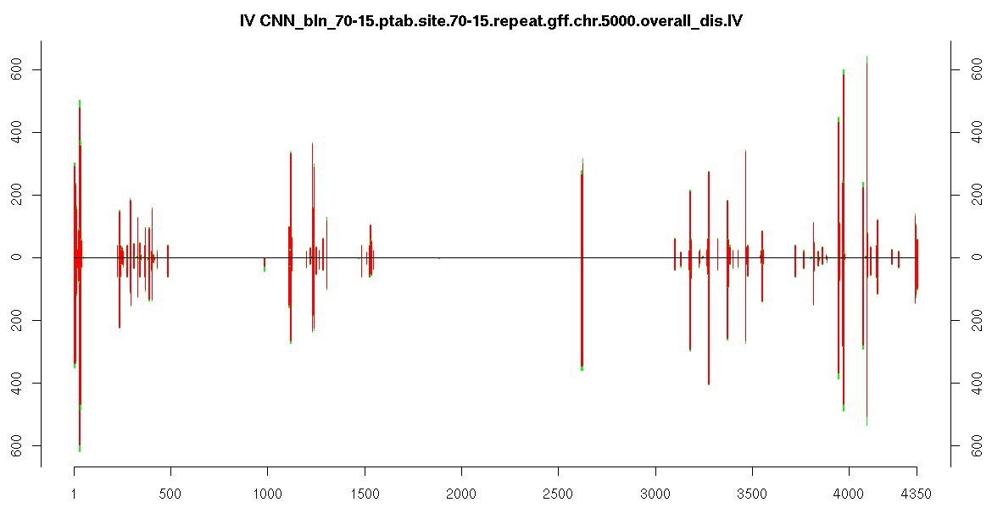
Chromosome IV
Mycelia
Appressoria
A
Overall
B
Unique
C
Repeats

Slide 4
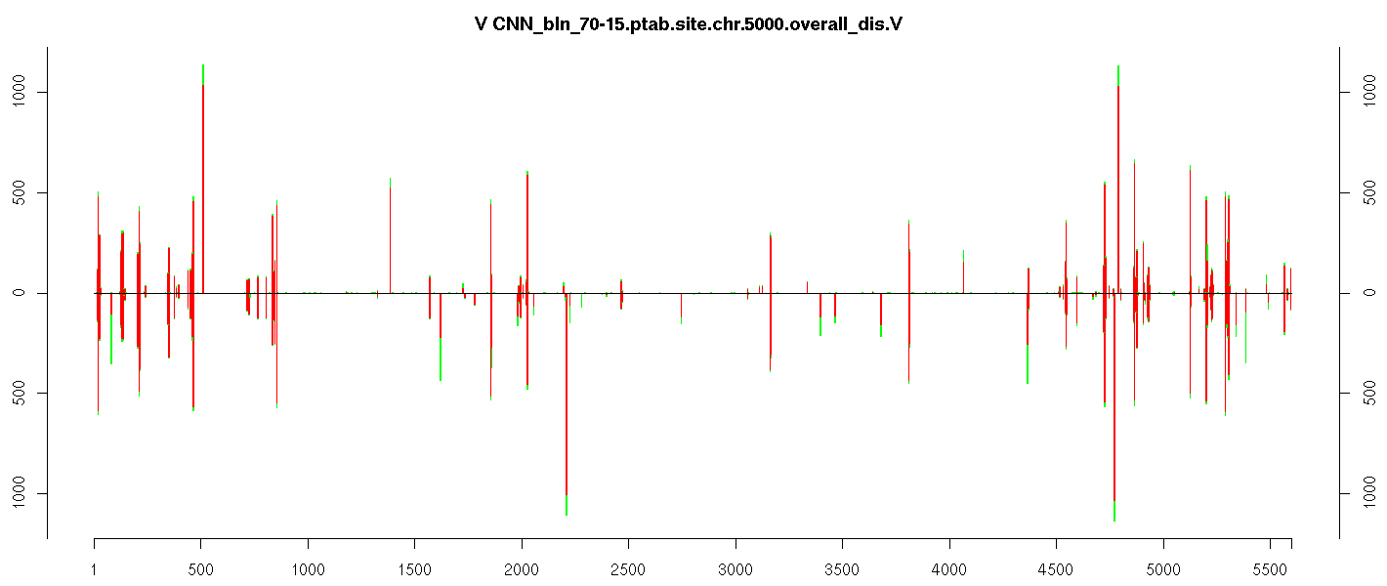
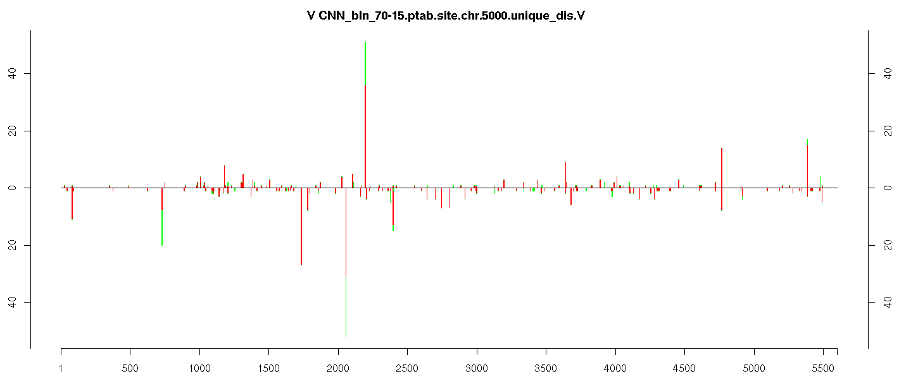
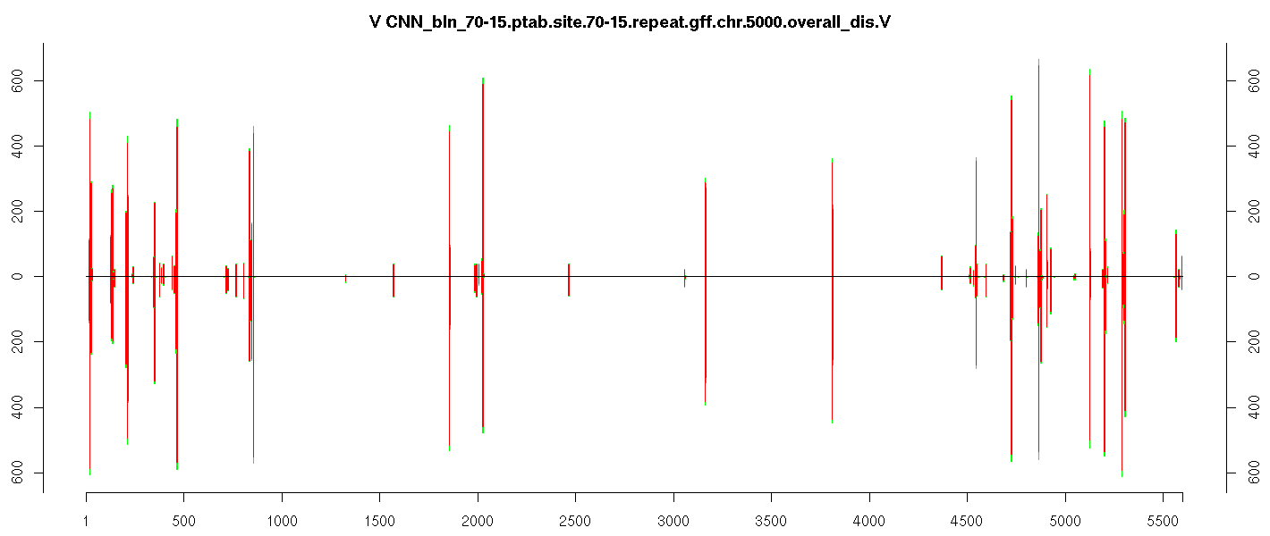
Chromosome V
Mycelia
Appressoria
A
Overall
B
Unique
C
Repeats

Slide 5
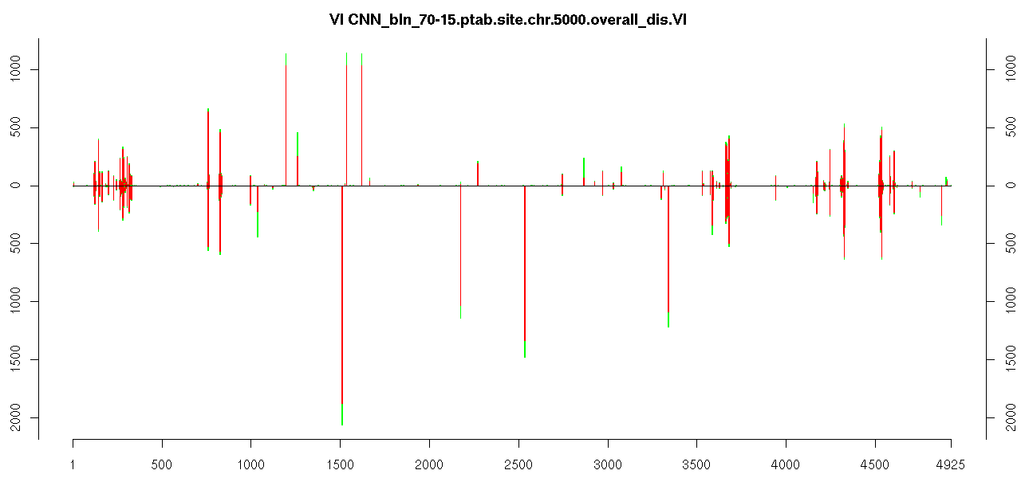
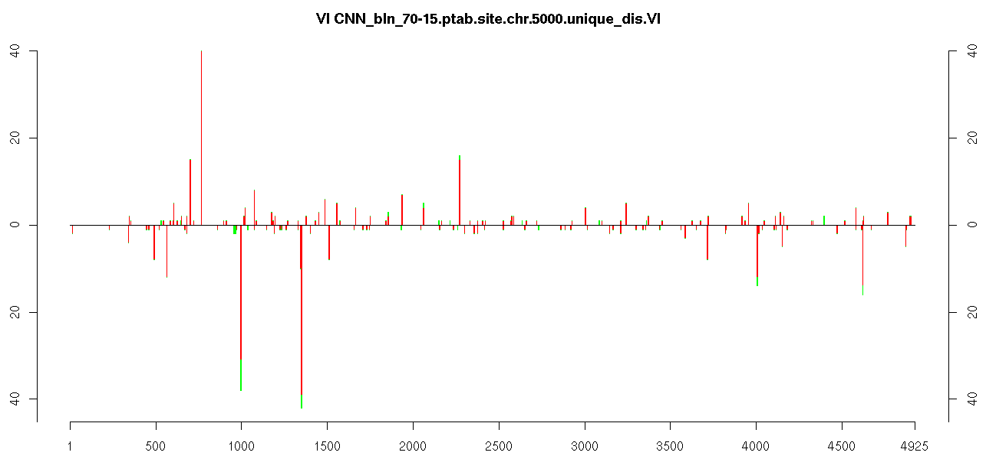
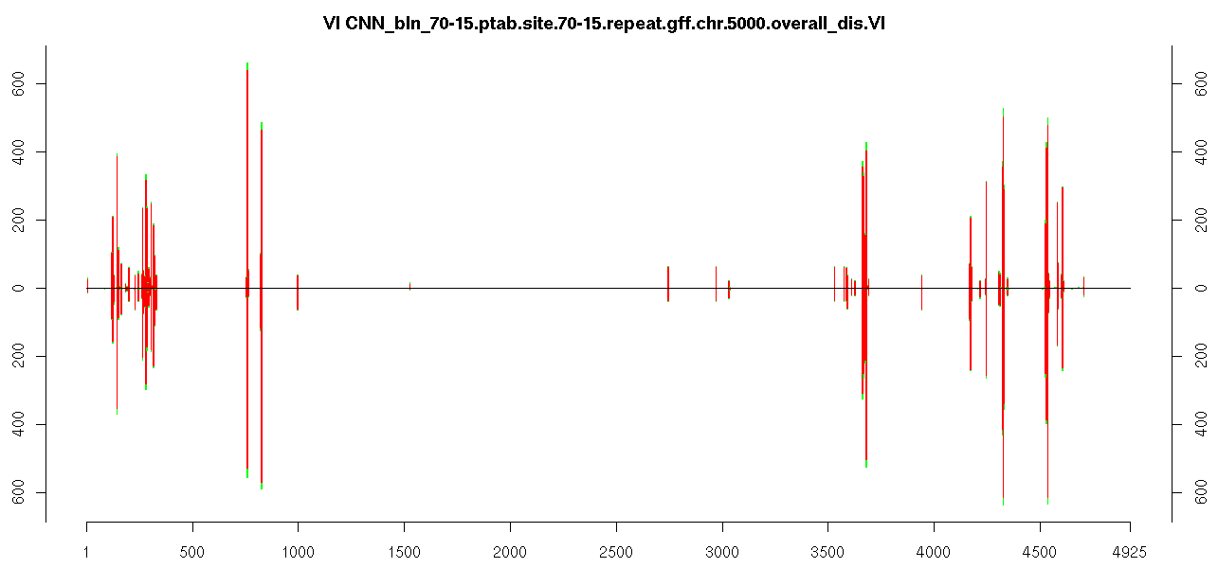
Chromosome VI
Mycelia
Appressoria
A
Overall
B
Unique
C
Repeats

Slide 6
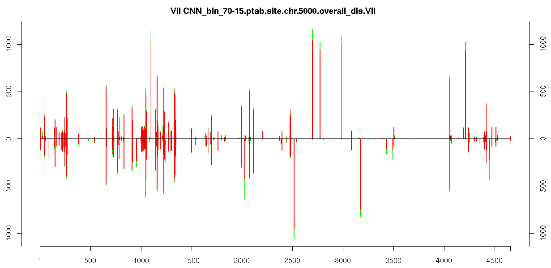
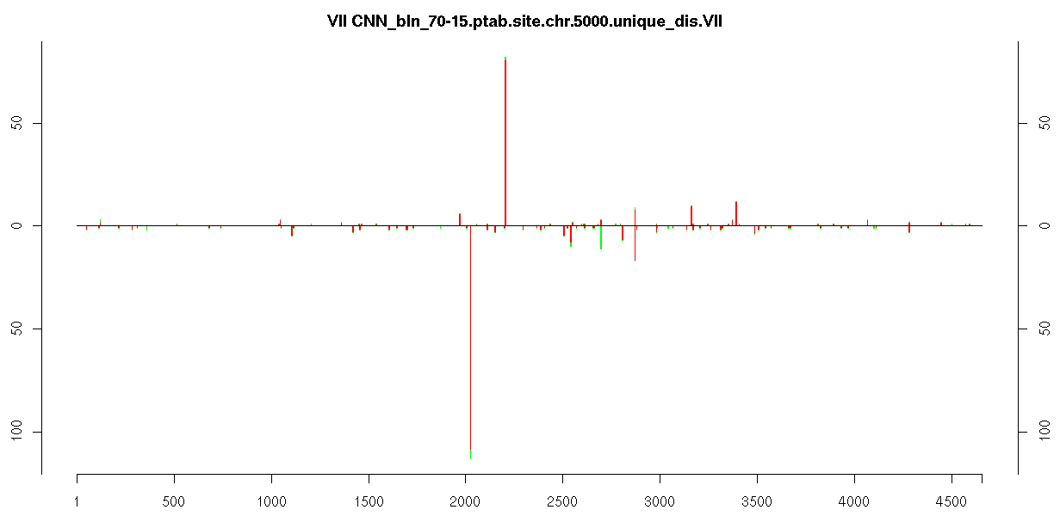
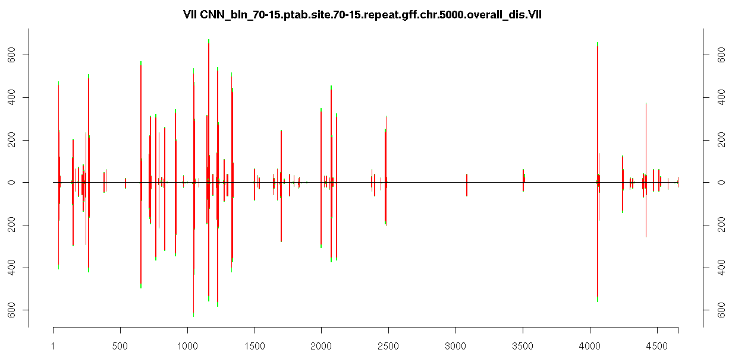
Chromosome VII
Mycelia
Appressoria
A
Overall
B
Unique
C
Repeats

Slide 7
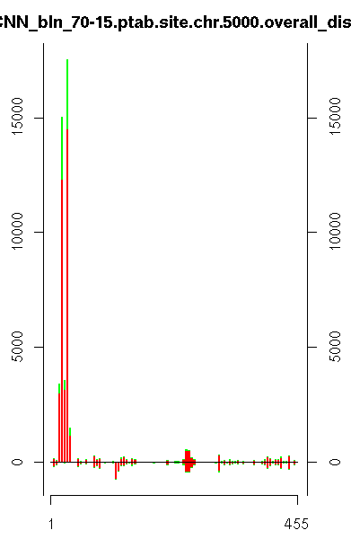
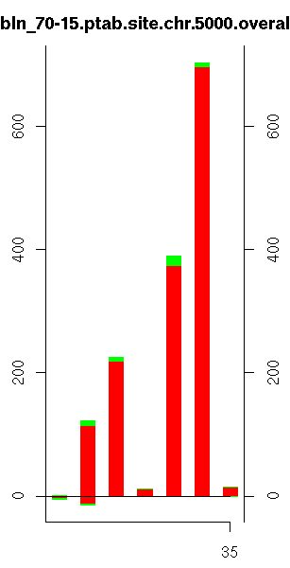
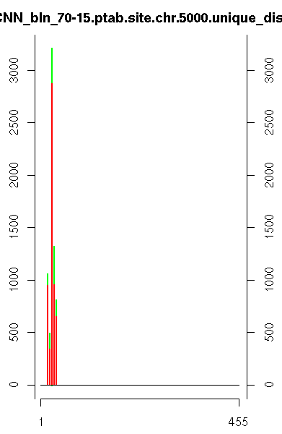
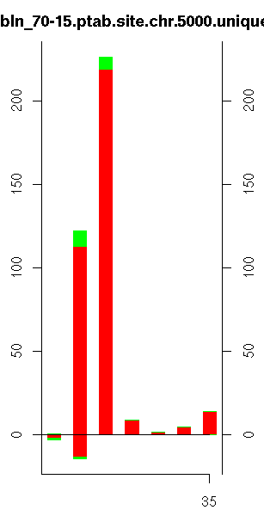
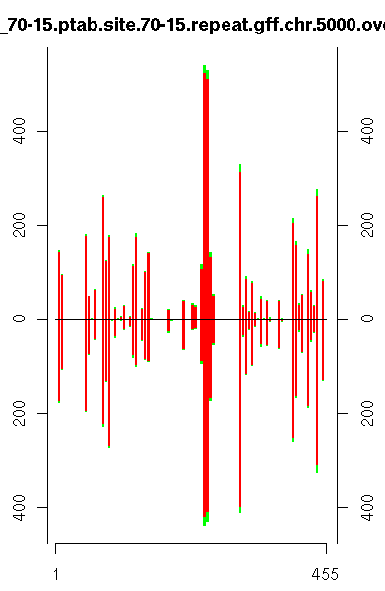
Unlinked
Mitochondria
A
A
Mycelia
Appressoria
Overall
Overall
B
B
Unique
Unique
C
Repeats

