Slide 1
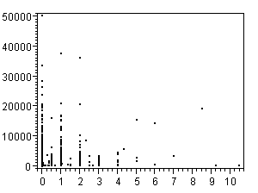
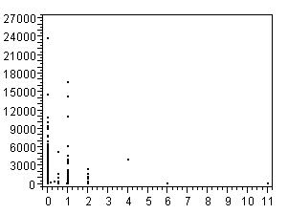
Additional file 10
A)
B)
Mycelia Microarray
Appressoria Microarray
Mycelia Small RNA
Appressoria Small RNA

