Slide 1
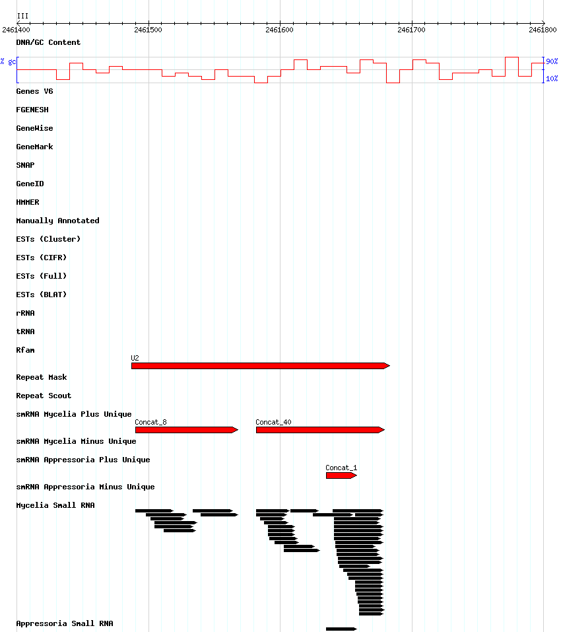
Additional file 2
III:2461400..2461800

Slide 2
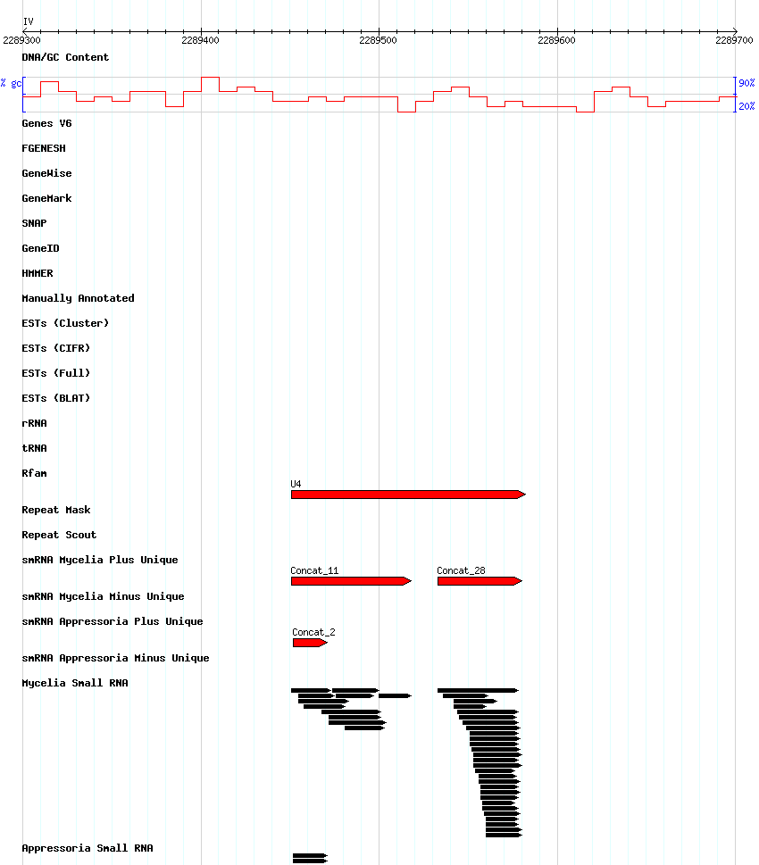
IV:2289300..2289700

Slide 3
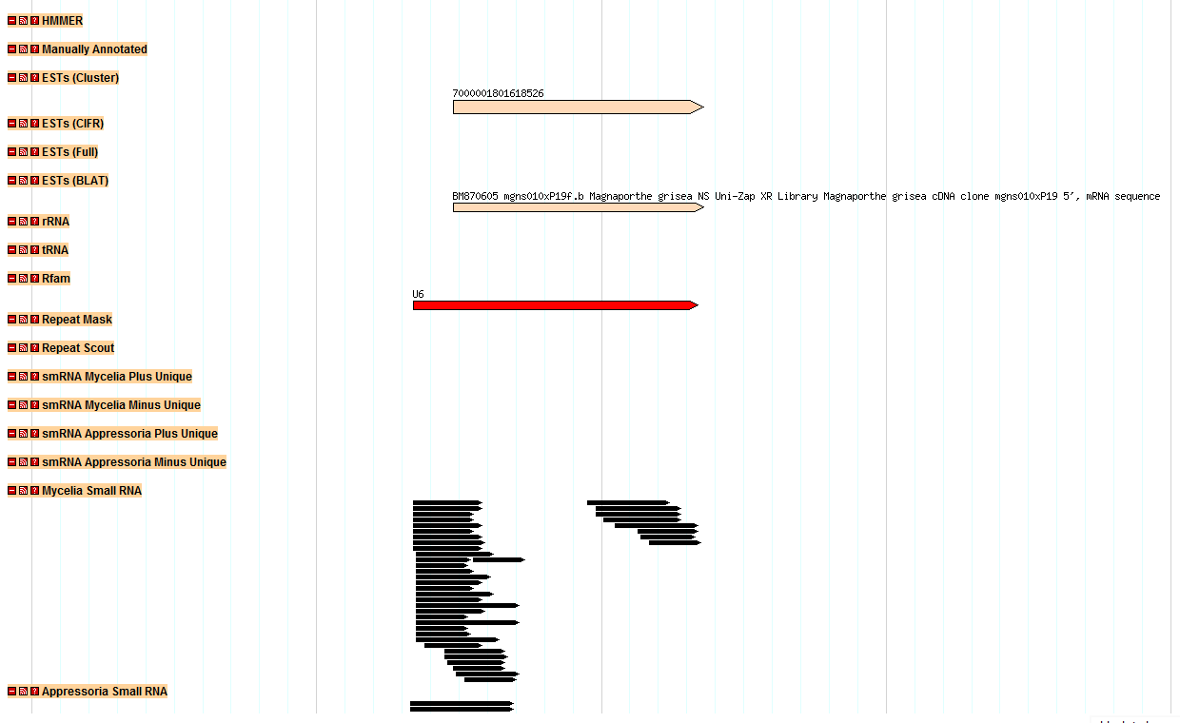
VI:3317789..3317631

