Slide 1
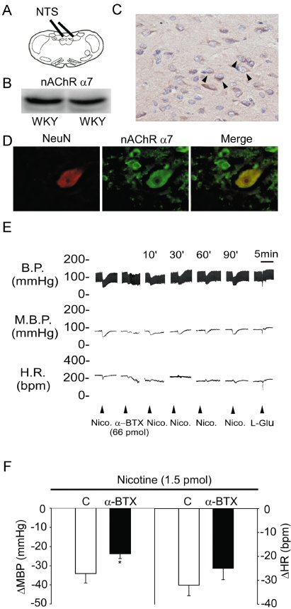
From P-W Cheng et al. Br J Pharmacol 2011
doi:10.1111/j.1476-5381.2010.01124.x/bph.1124
British Journal of Pharmacology © 2011 The British Pharmacological Society

Slide 2
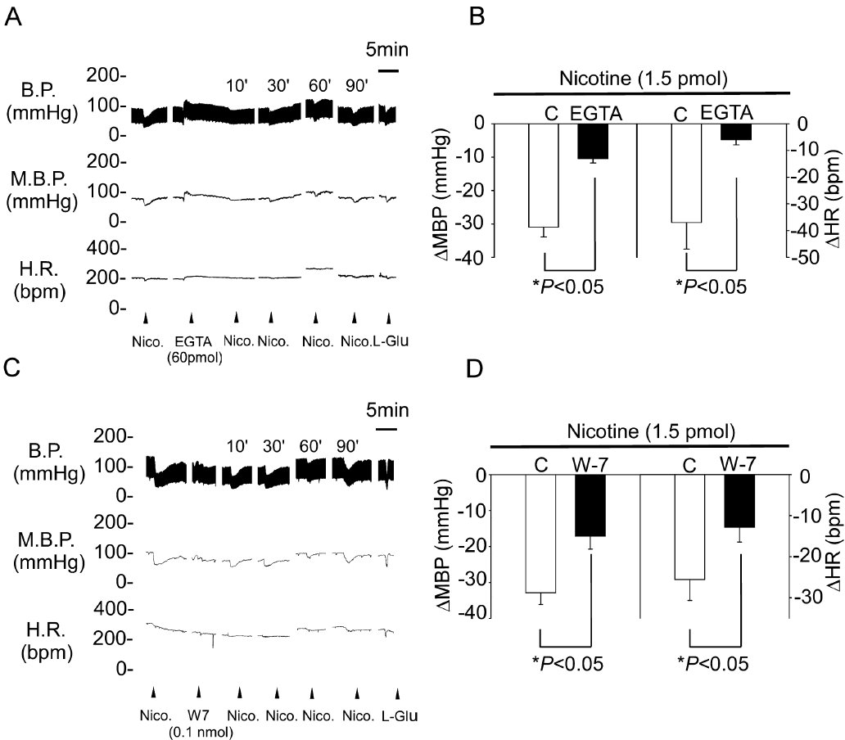
From P-W Cheng et al. Br J Pharmacol 2011
doi:10.1111/j.1476-5381.2010.01124.x/bph.1124
British Journal of Pharmacology © 2011 The British Pharmacological Society

Slide 3
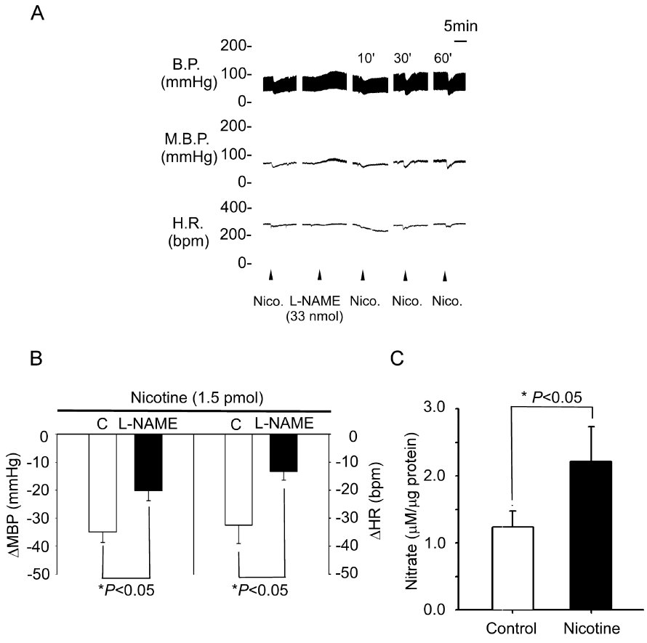
From P-W Cheng et al. Br J Pharmacol 2011
doi:10.1111/j.1476-5381.2010.01124.x/bph.1124
British Journal of Pharmacology © 2011 The British Pharmacological Society

Slide 4
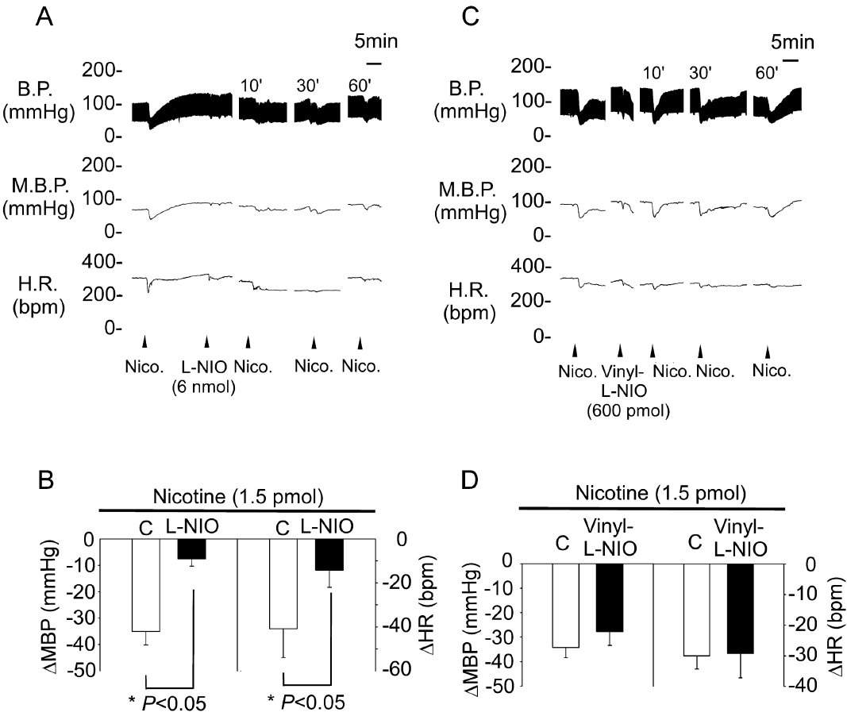
From P-W Cheng et al. Br J Pharmacol 2011
doi:10.1111/j.1476-5381.2010.01124.x/bph.1124
British Journal of Pharmacology © 2011 The British Pharmacological Society

Slide 5
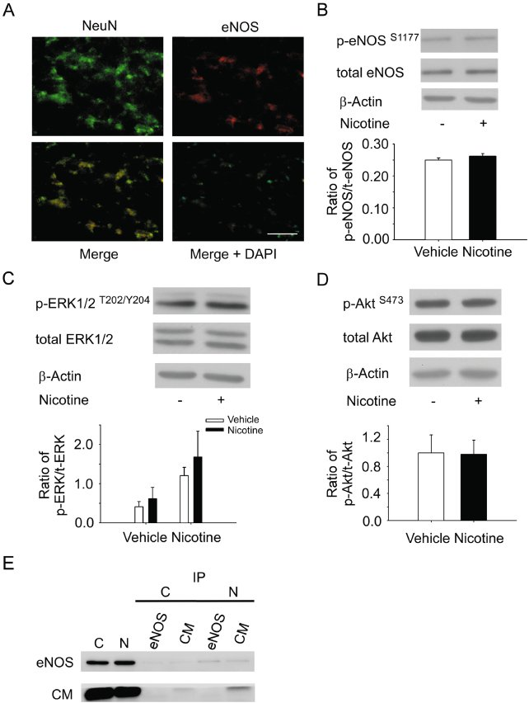
From P-W Cheng et al. Br J Pharmacol 2011
doi:10.1111/j.1476-5381.2010.01124.x/bph.1124
British Journal of Pharmacology © 2011 The British Pharmacological Society

Slide 6
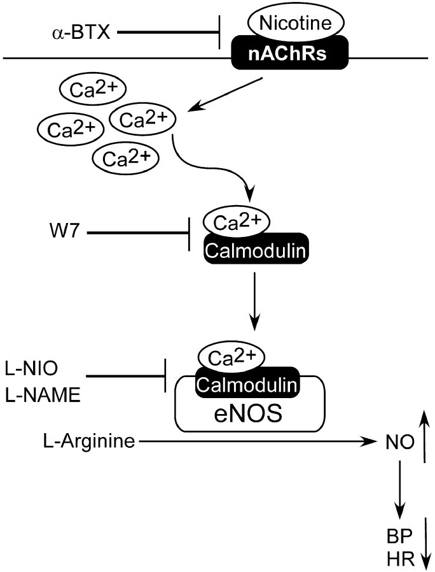
From P-W Cheng et al. Br J Pharmacol 2011
doi:10.1111/j.1476-5381.2010.01124.x/bph.1124
British Journal of Pharmacology © 2011 The British Pharmacological Society

