Slide 1
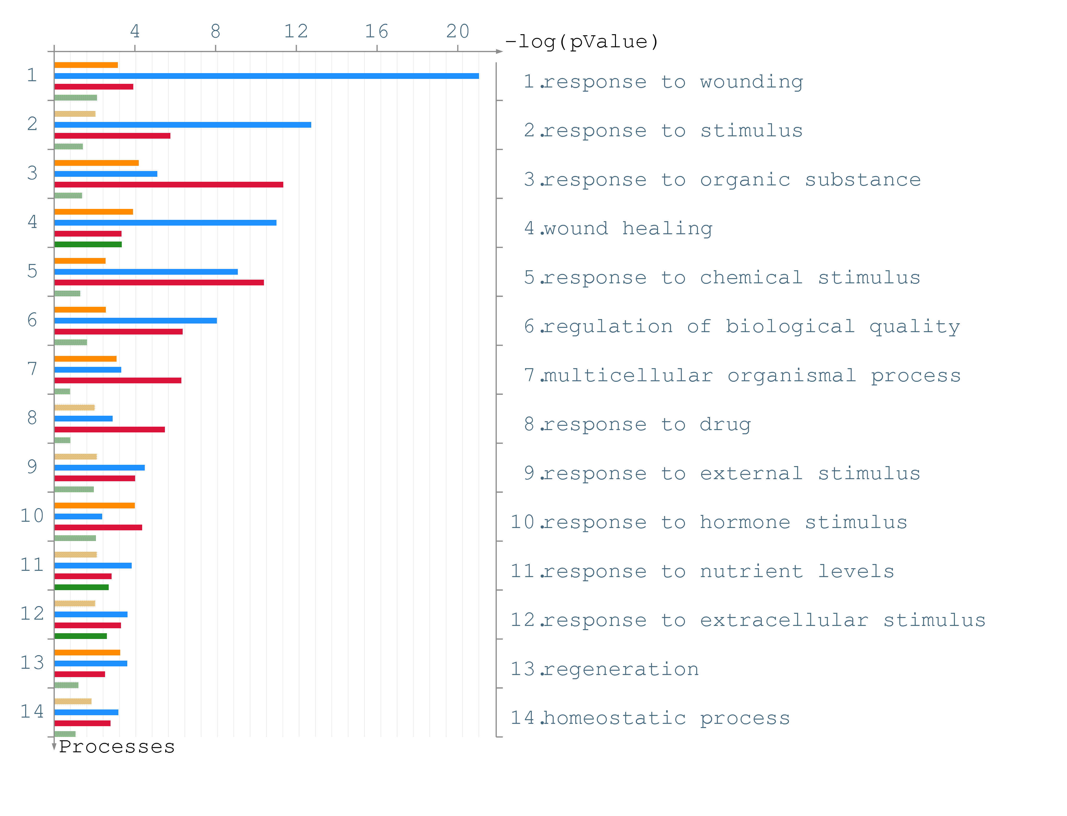
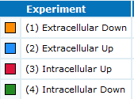
Supplementary Figure 1A

Slide 2
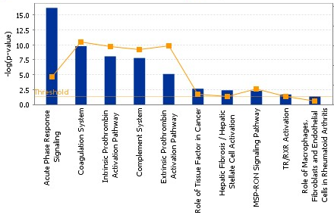
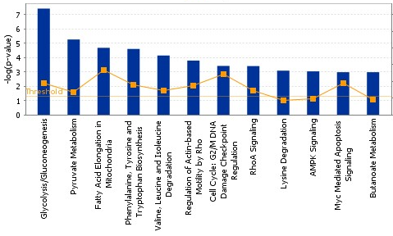
Supplementary Figure 1B
Extracellular Up-Regulated
Intracellular Up-Regulated

Slide 3
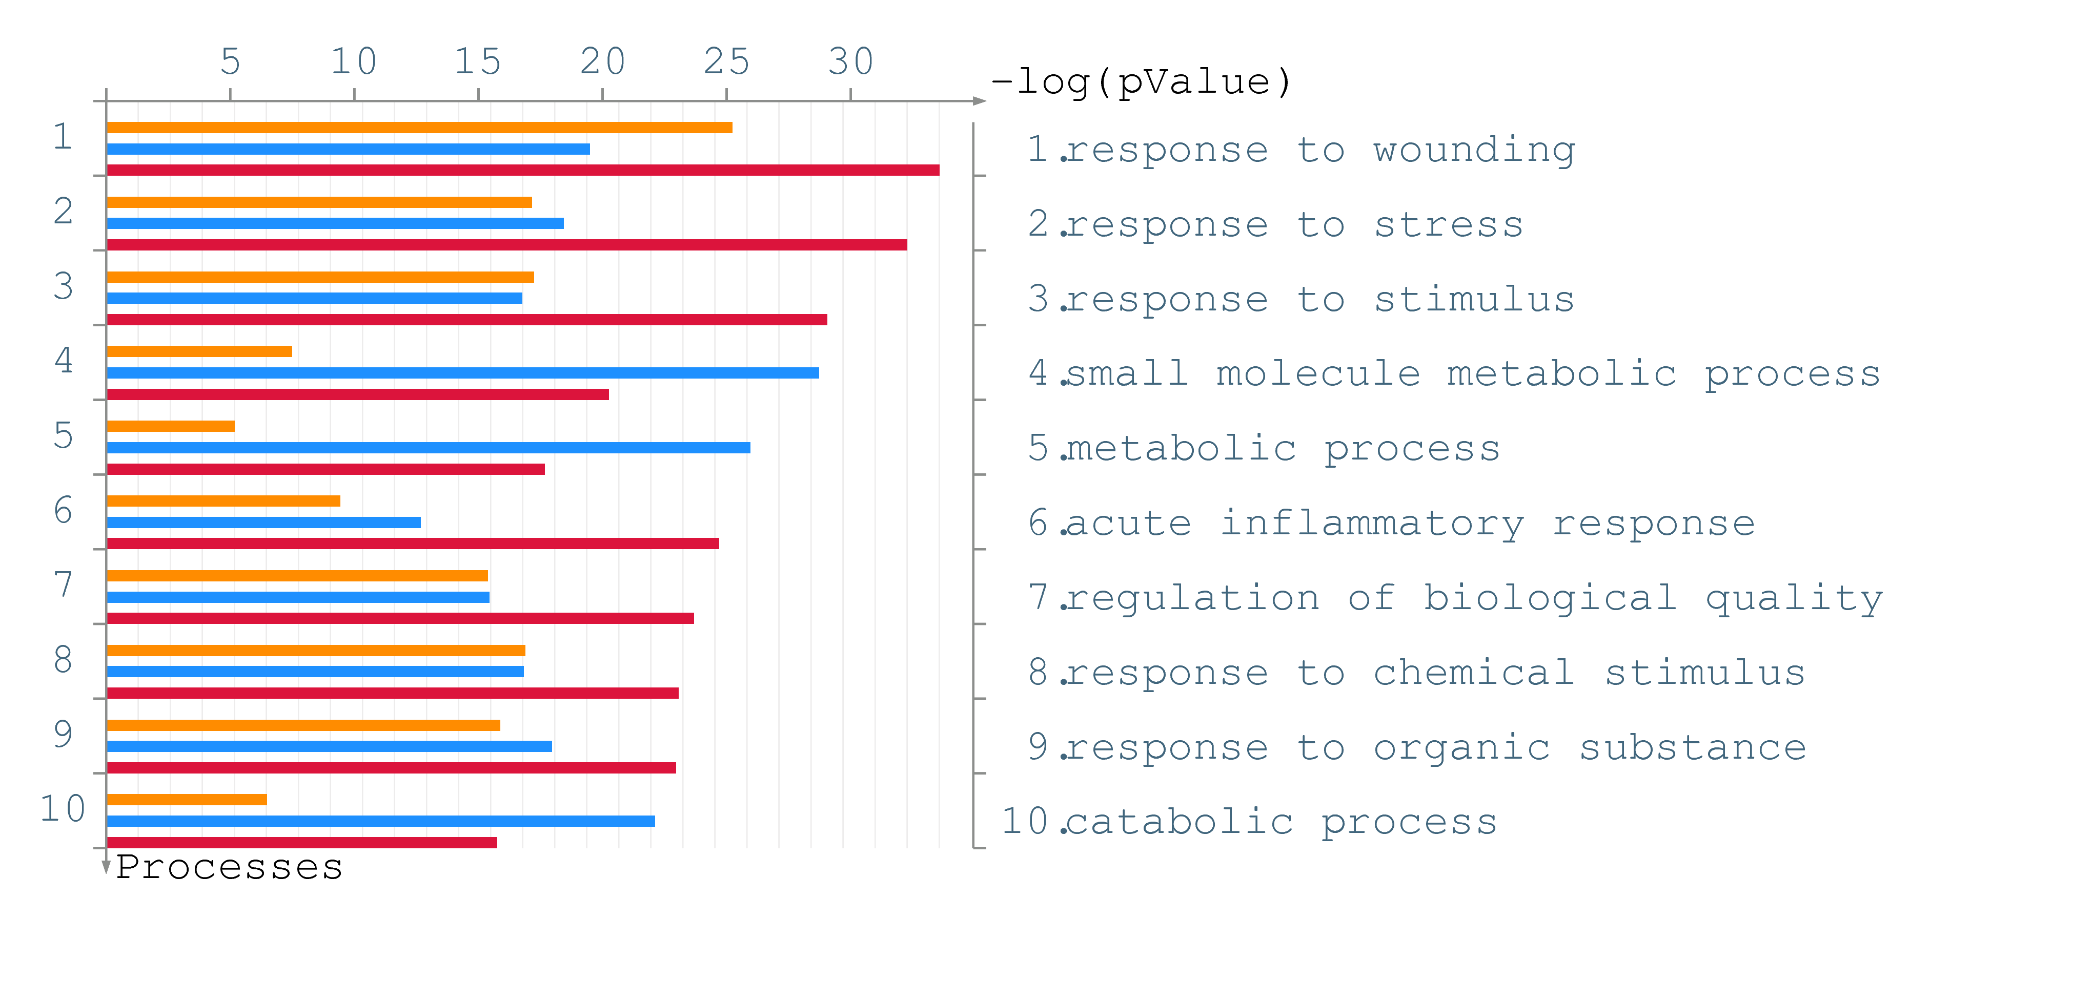
Supplementary Figure 2A. Gene Ontology (GO) Processes
 | Preclinical
 | 0.5 cm
 | 1.0 cm

Slide 4
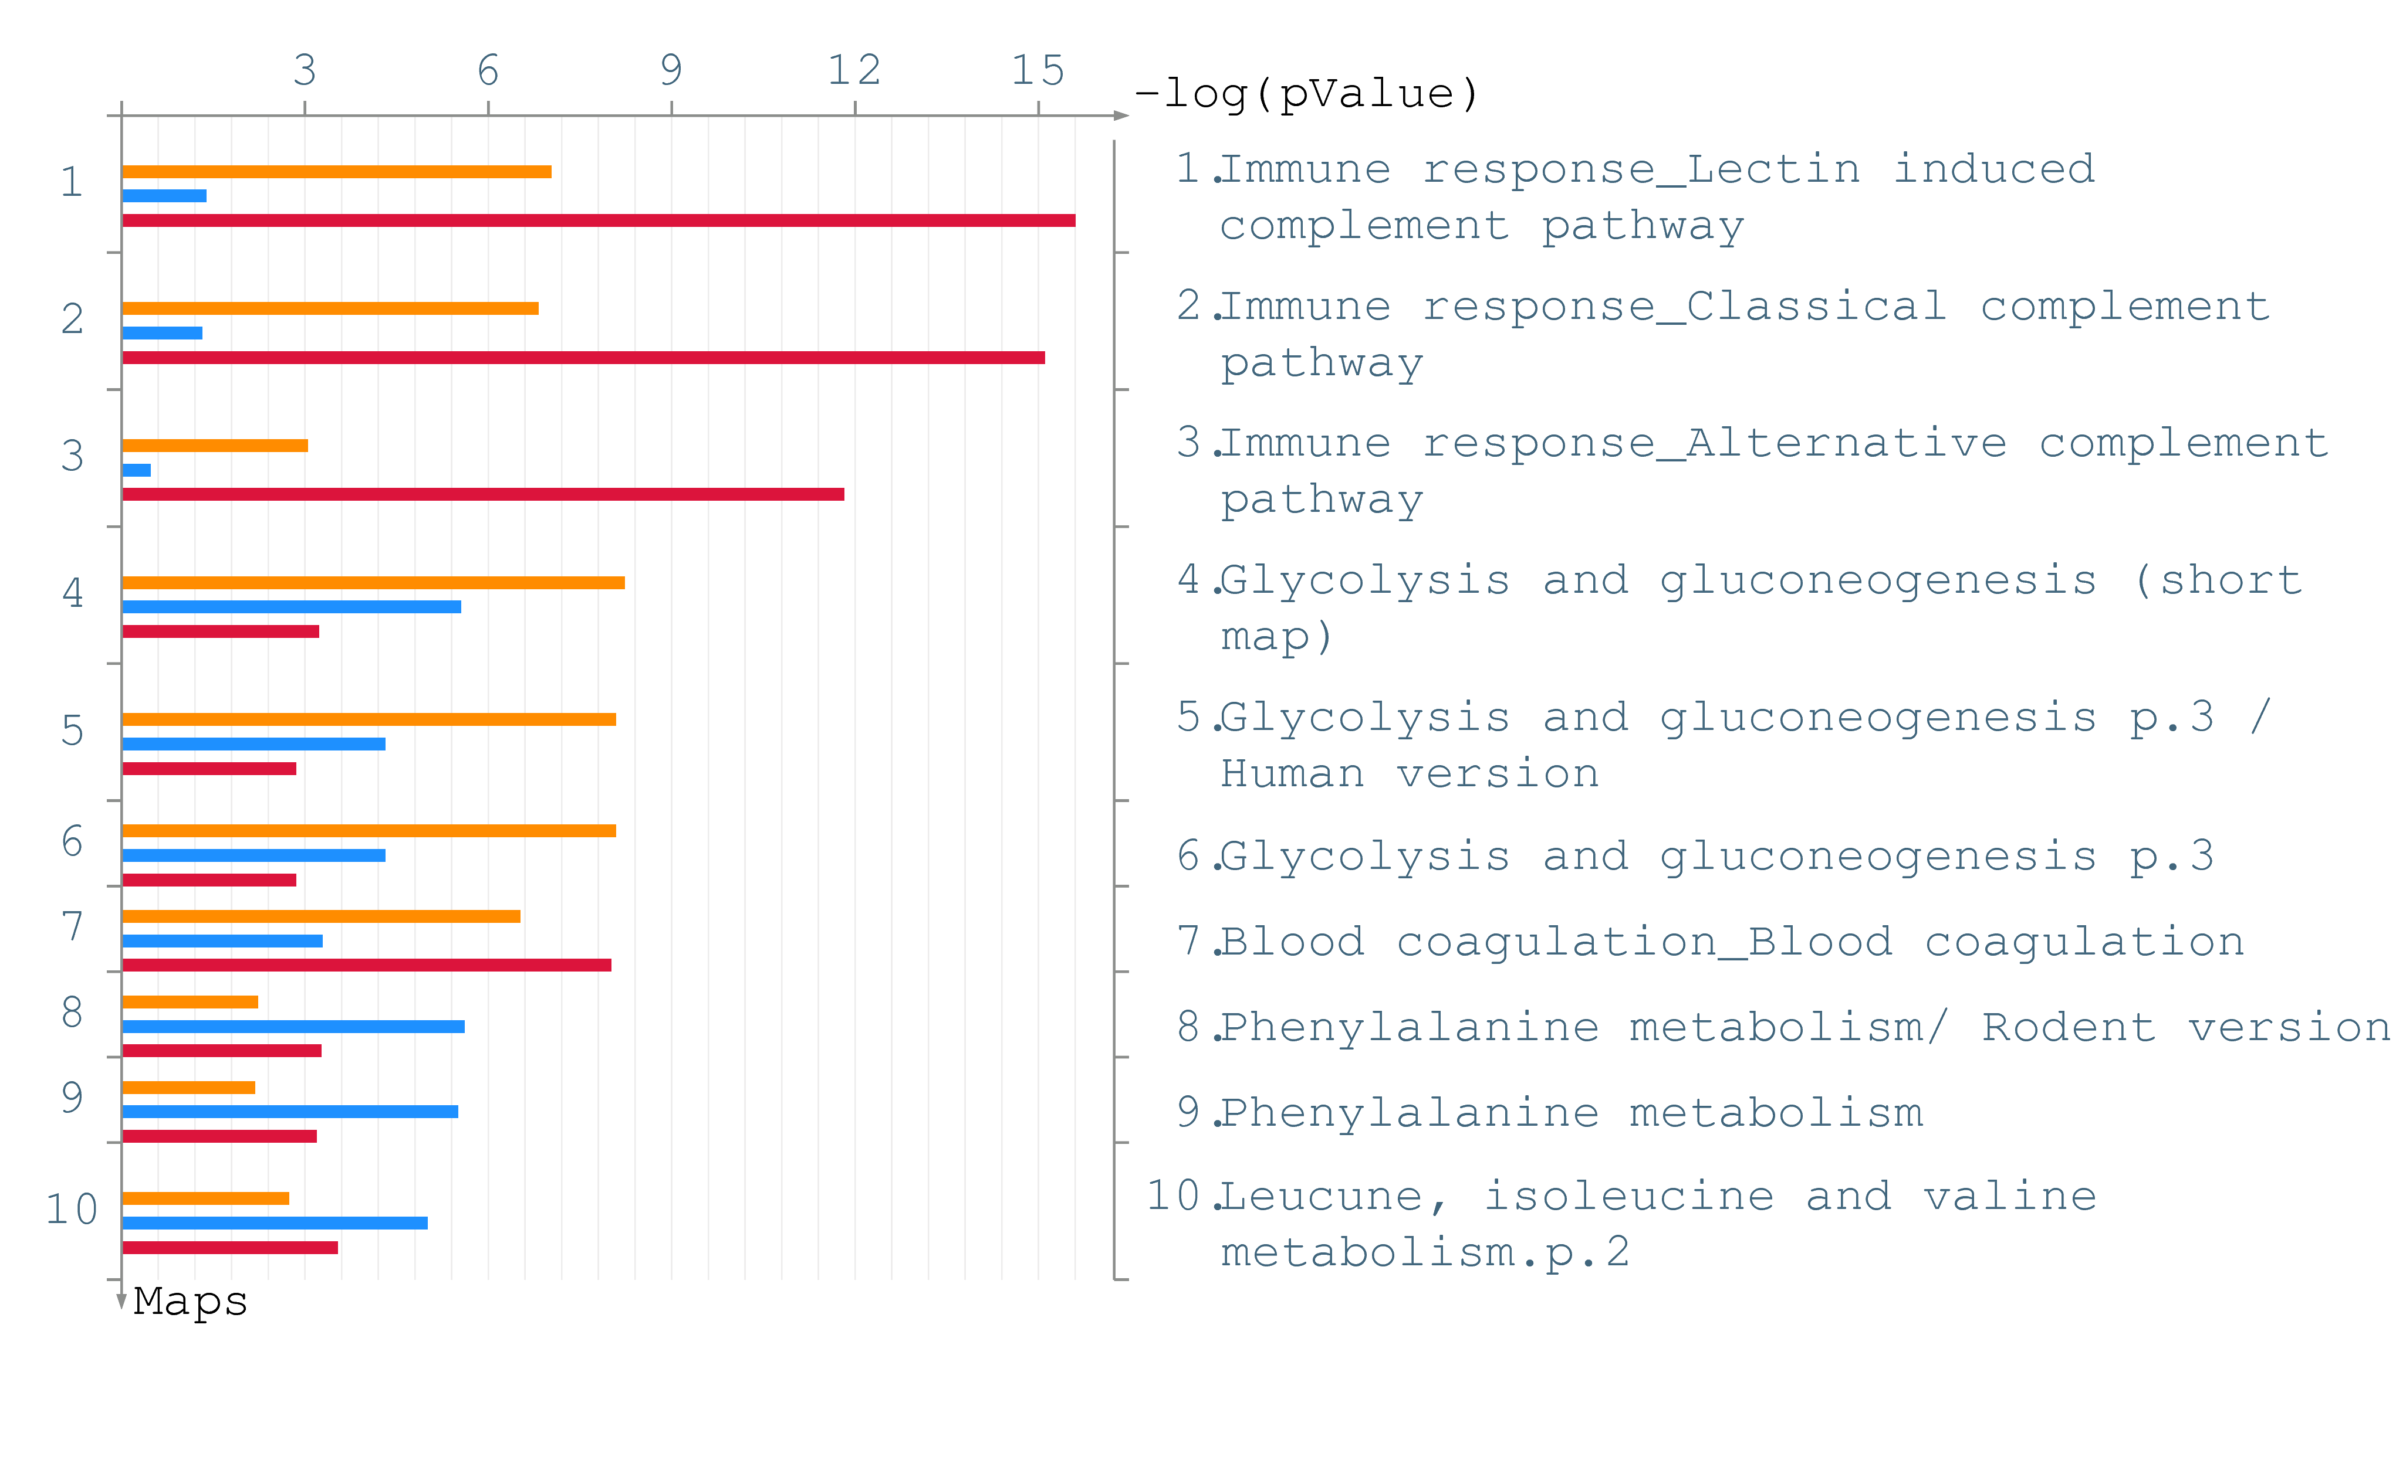
Supplementary Figure 2B. GeneGO Pathway Maps

Slide 5
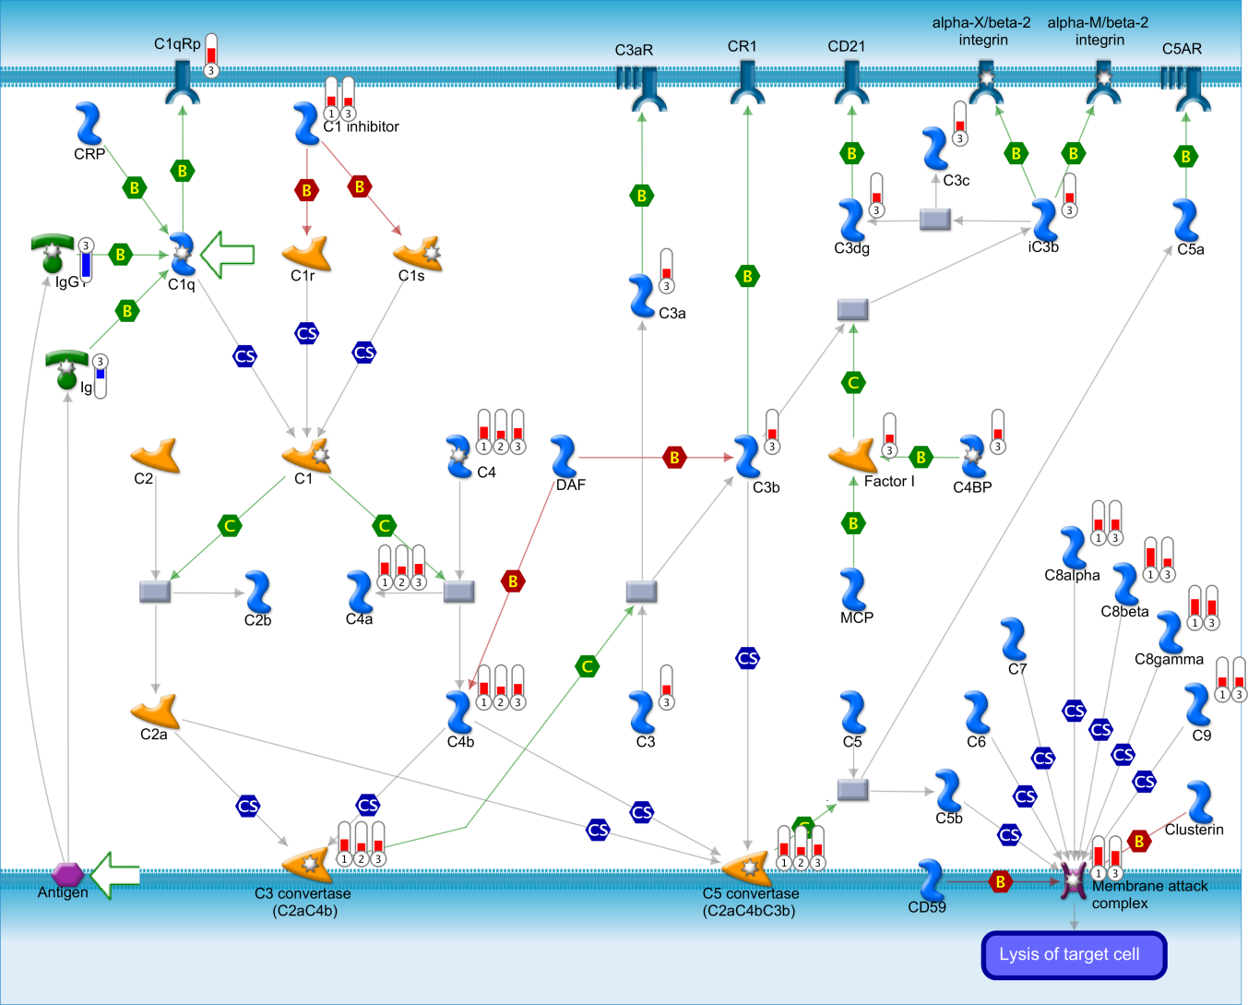
Supplementary Figure 2C. Immune response_Classical complement pathway
Notes:
2. Immune response_Classical complement pathway

Slide 6
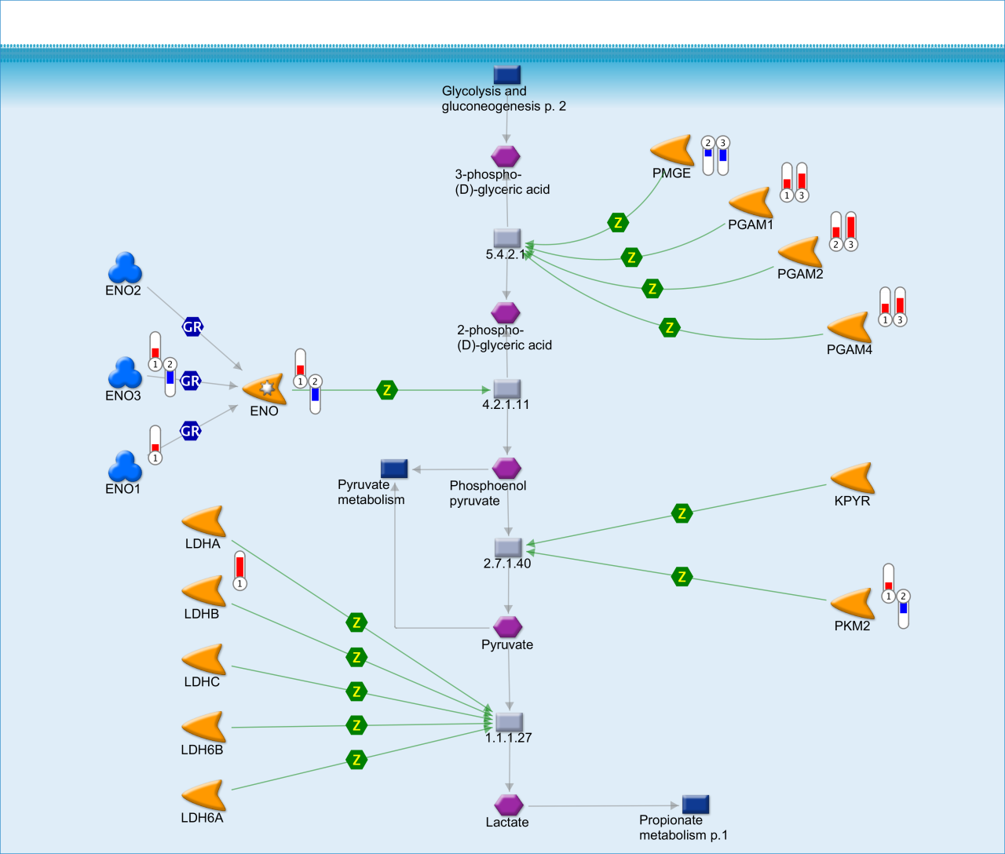
Supplementary Figure 2D. Glycolysis and gluconeogenesis p.3
Notes:
6. Glycolysis and gluconeogenesis p.3

Slide 7
Supplementary
Figure 3
6
5
4
3
2
1
0
-1
-2
-3
Ltf
Flna
Pfn1
Nol3
Cfh
Nov
Zyx
Ctsd
Vasp
Pxdn
Cnn2
Cap1
Dsg2
Cotl1
Anxa1
Igfbp5
Hspg2
Tpm4
Ltbp2
Aldoa
Fabp5
Qsox1
Tagln2
Hnrnpu
Txndc4
Coro1a
Pgam1
S100a9
S100a8
Col15a1
Rnase4

Slide 8
Supplementary Figure 4
5
A Plasma proteins from
1 cm tumor bearing mice
4
3
Case/Control Ratio Log2
2
1
0
Lcn2
S100a9
S100a8
Ngp
Ccl8
Ccl12*
Cd40l*
Mpo*
Pglyrp1
Cxcl10*
Ccl9*
Ccl7*
Cotl1
Treml1
Lcn2
S100a9
S100a8
Ngp
Ccl8
Ccl12*
Cd40l*
Mpo*
Pglyrp1
Cxcl10*
Ccl9*
Ccl7*
Cotl1
Treml1

Slide 9
Supplementary Figure 5
4
F7
Fibrinogen
2
GCP-2
HP
RBM Log2 Ratio
Mb
-4
-2
2
4
VCAM1
-2
TIMP1
-4
LC-MS Log2 Ratio

Slide 10
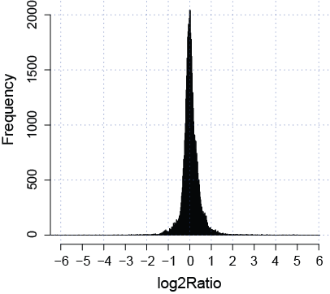
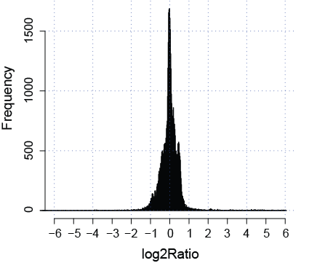
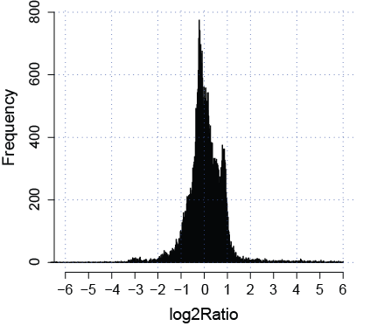
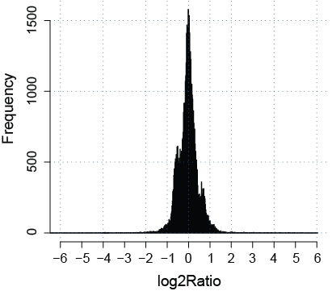
Supplementary
Figure 6
Preclinical (56251)
Progression
0.5 cm (47031)
Progression
1.0 cm (40413)
Regression
(56534)

