Slide 1
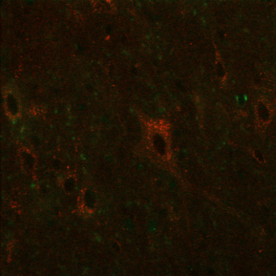
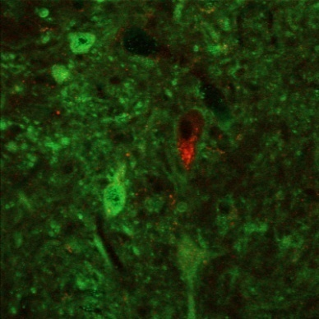
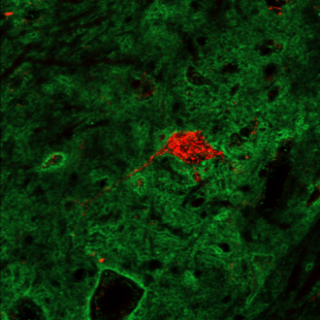
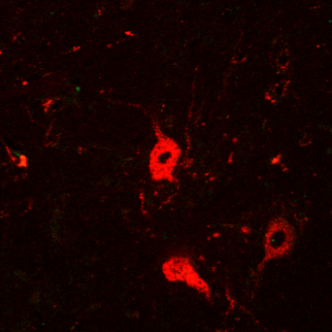
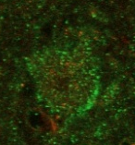
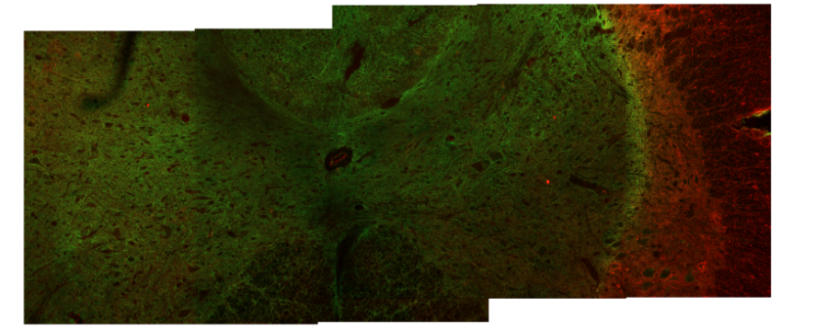
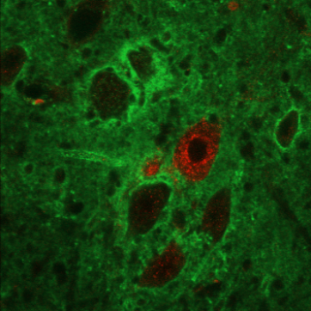
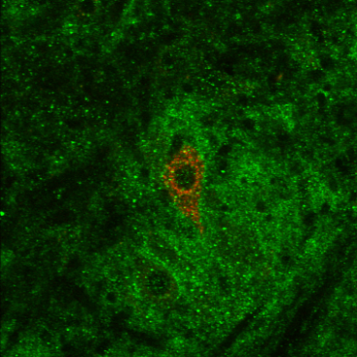
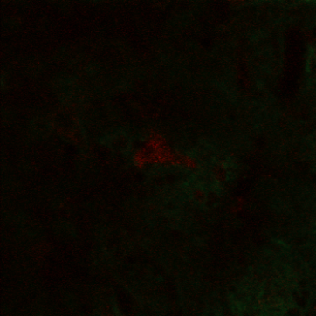
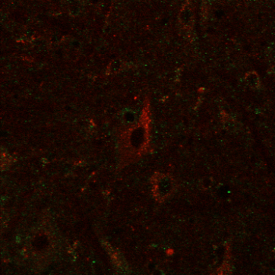
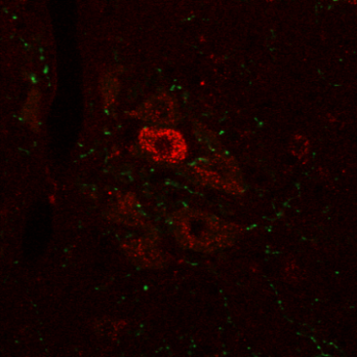
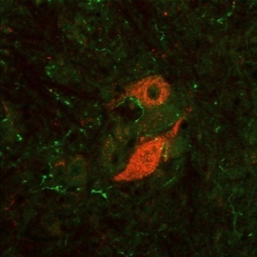
a
b
LC2H+saline
LC2H+ChABC
WFA/DTR PMN
CS56/DTR PMN
uninjured
2B6/DTR PMN
b’
LC2H+saline
2B6/WFA
CC
LC2H+ChABC
LC2H+ChABC
c
LC2H+saline
LC2H+ChABC
5HT/DTR PMN
Integrated pixel intensity
E
12
6
0
Sal
ChABC

Slide 2
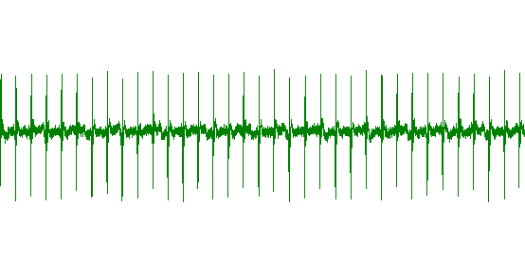
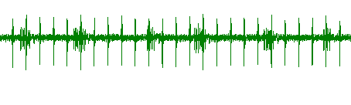
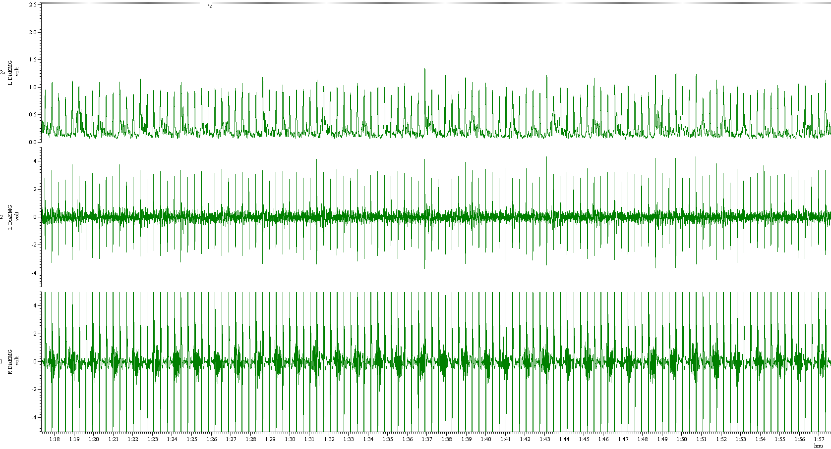
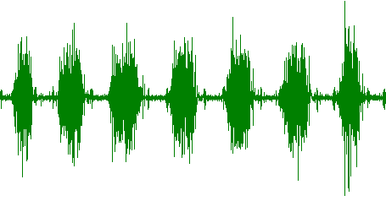
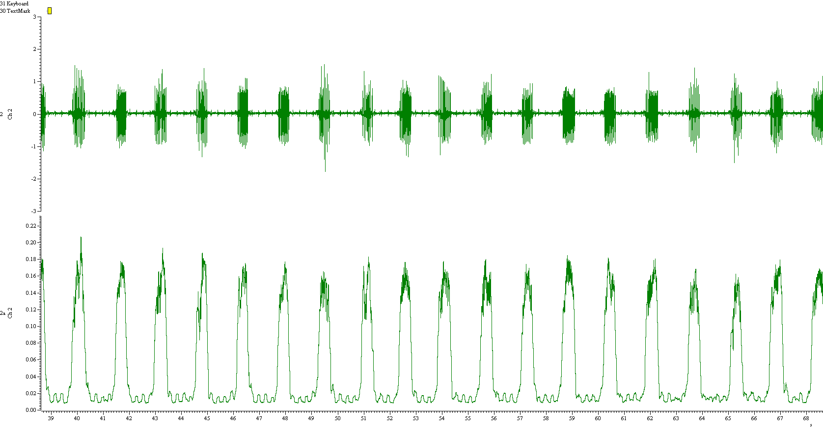
a
b
3 weeks post lesion and grafting
PN graft plus vehicle control treatment – 12 weeks
100 µV
100 µV
5 s
1 s
6 weeks post lesion and grafting
Unlesioned animal - normal breathing
100 µV
100 µV
5 s
12 weeks post lesion and grafting
1 s
100 µV
5 s
100 µV
c
1 s
Percentage of animals with recovered EMG activity
Frequency of breaths
80
n = 8/11
n = 9/11
60
60
n = 6/11
Breaths per minute
40
40
20
n = 2/11
20
0
Saline
ChABC
PNG/ saline
PNG/ ChABC
0
Saline
ChABC
PNG/ saline
PNG/ ChABC
Peak amplitude of inspiratory bursts
100
Duration of inspiratory bursts
**
140
*
80
% control
% control
120
60
80
40
40
20
0
Saline
ChABC
PNG/ saline
PNG/ ChABC
0
Saline
ChABC
PNG/ saline
PNG/ ChABC

Slide 3
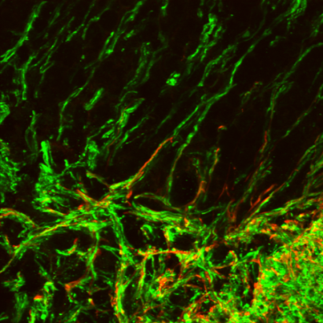
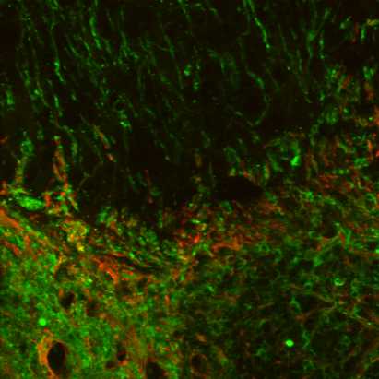
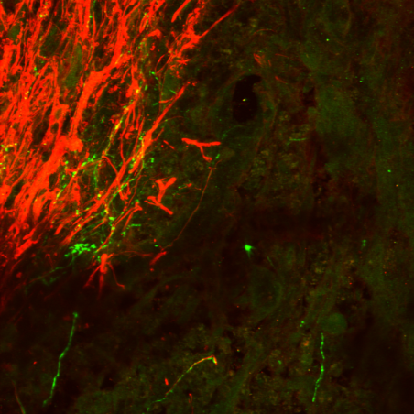
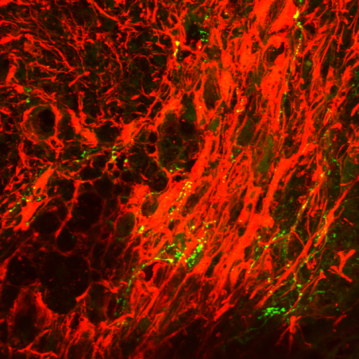
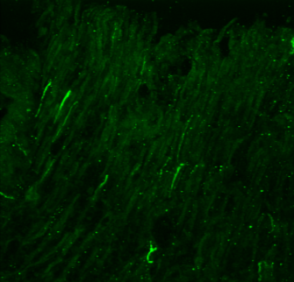
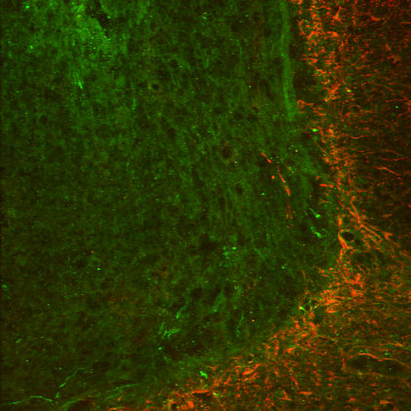
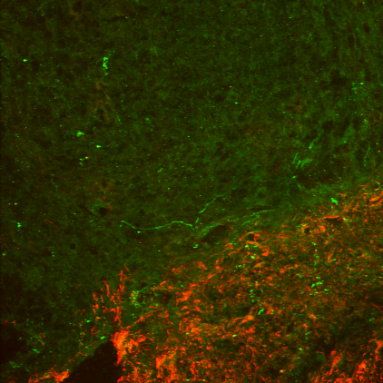
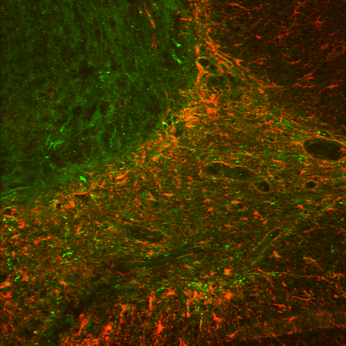
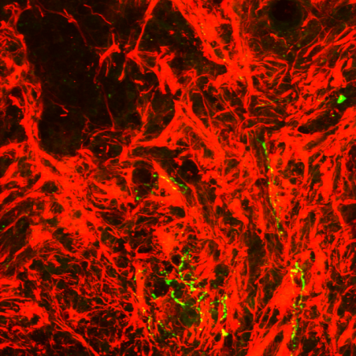
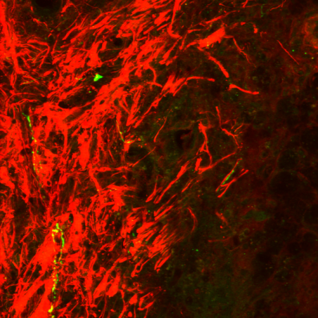
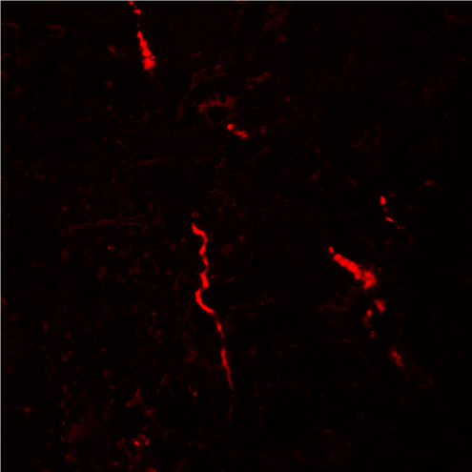
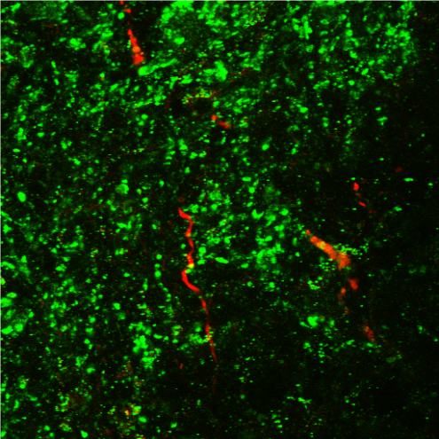
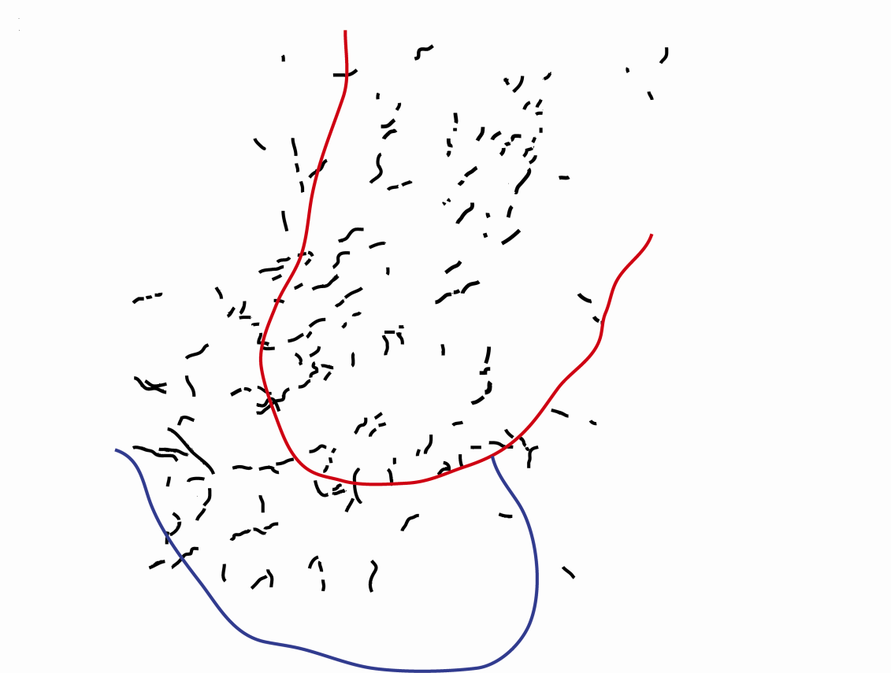
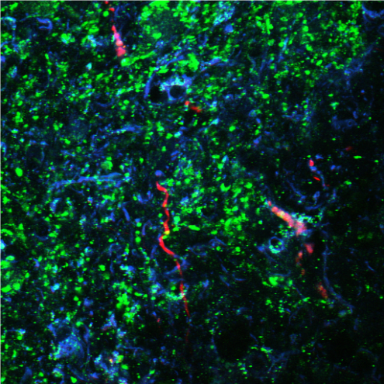
a
TAU GFAP
a'
TAU GFAP
c
C
ChABC treated
saline treated
b
5HT GFAP
b'
1
5HT GFAP
graft
ChABC treated
ChABC treated
d
e
Graft
BDA
SYN
BDA
BDA
SYN
GFAP
D
C4 ventral horn
L
V
R

Slide 4
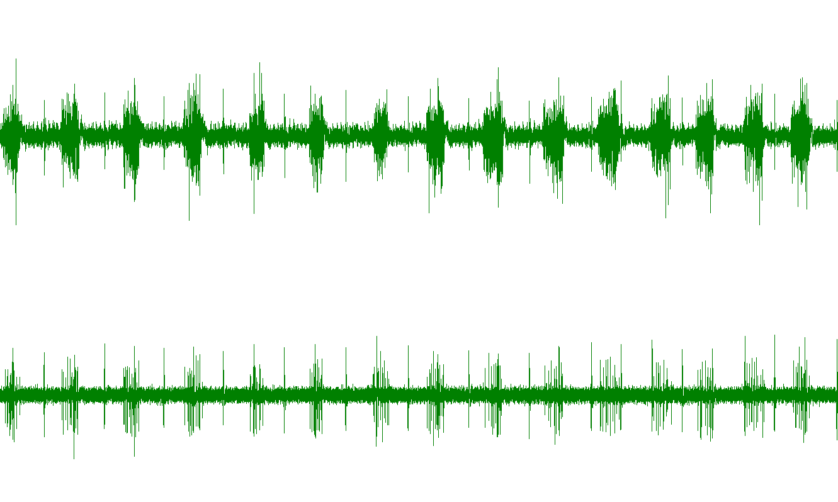
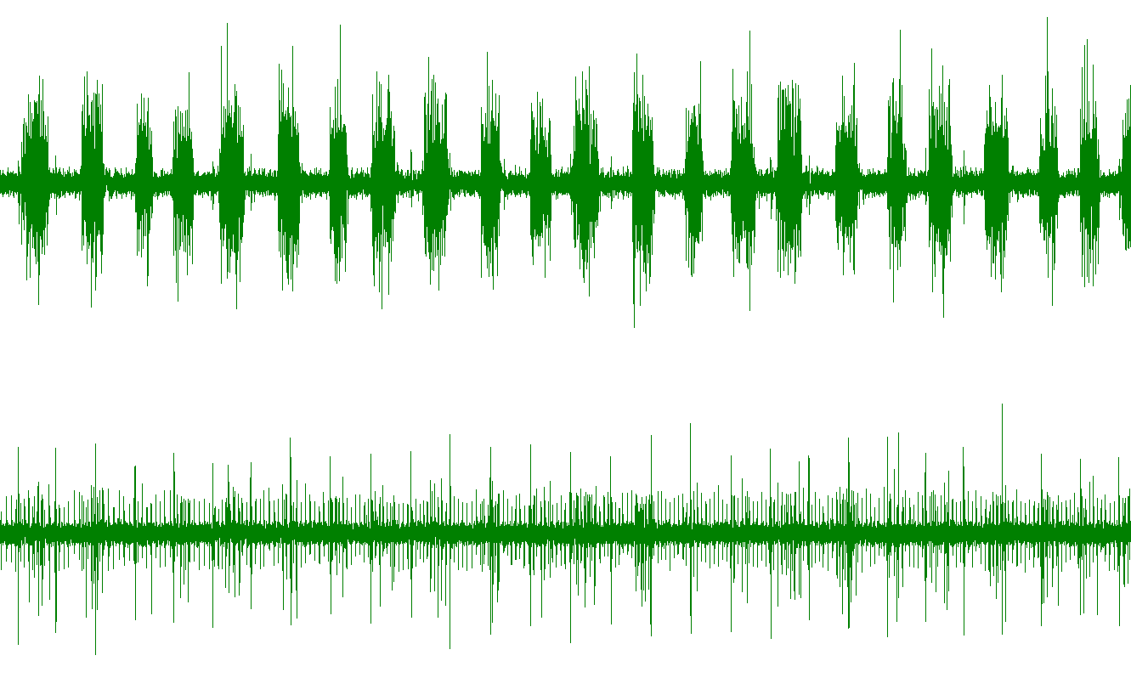
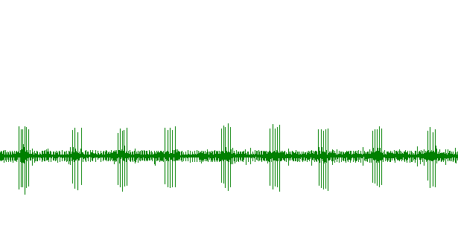
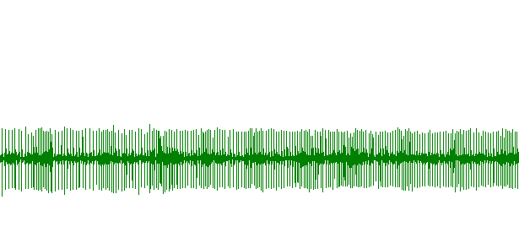
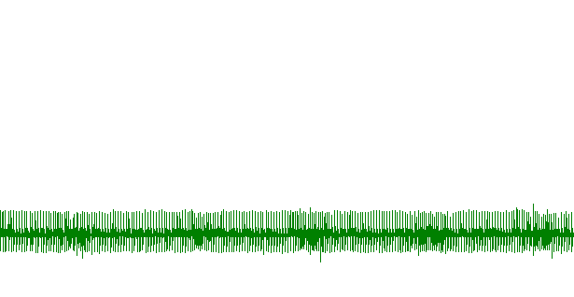
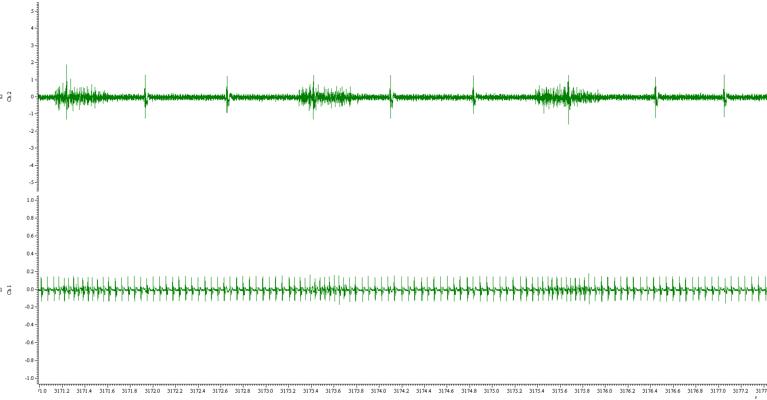
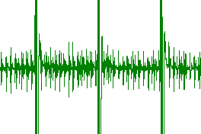
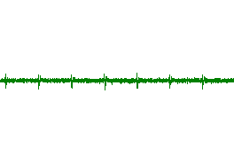
a
b
Before PNG transection
Immediately after PNG transection
Right hemidiaphragm contralateral to lesion
100 µV
Left hemidiaphragm ipsilateral to lesion
100 µV
5 s
c
Before PNG transection
d
Immediately after PNG transection
e
One hour after PNG transection
Left hemidiaphragm ipsilateral to lesion
100 µV
5 s
f
g
Right hemidiaphragm
Immediately after PNG transection
24 hrs after PNG transection
Left hemidiaphragm
1 s
h
Peripheral nerve graft activity:
PNG + ChABC Animal #1
Ventilator off
10 µV
i
1 min
Peripheral nerve graft activity:
PNG + ChABC Animal #2
Ventilator off
20 µV
10 µV
j
15 s
2 s
Phrenic nerve activity:
Before respiratory challenge
After respiratory challenge
20 µV
5 s

