Slide 1
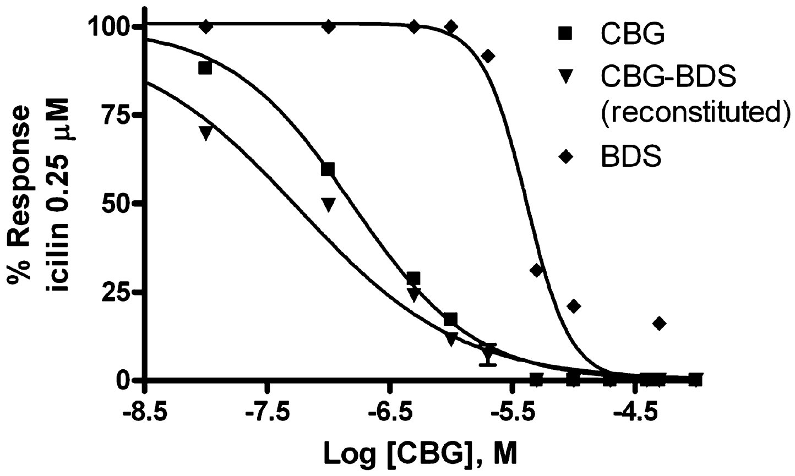
From L De Petrocellis et al. Br J Pharmacol 2011
doi:10.1111/j.1476-5381.2010.01166.x/bph.1166
British Journal of Pharmacology © 2011 The British Pharmacological Society

Slide 2
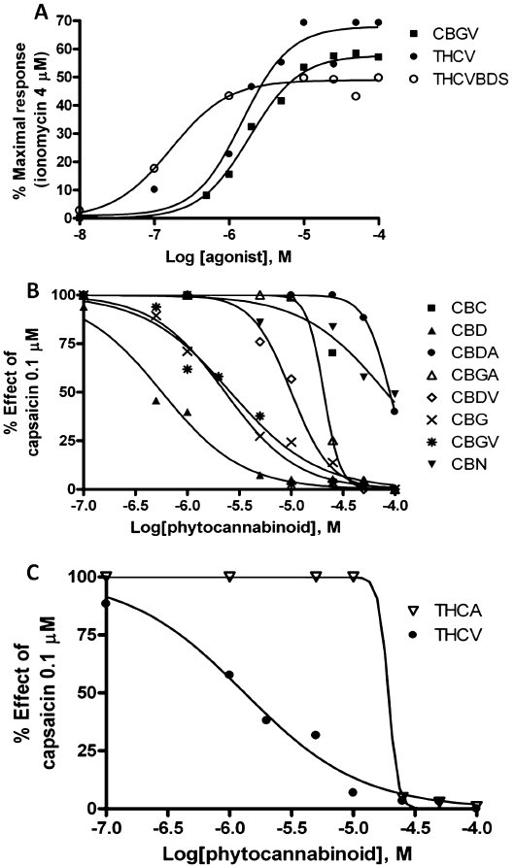
From L De Petrocellis et al. Br J Pharmacol 2011
doi:10.1111/j.1476-5381.2010.01166.x/bph.1166
British Journal of Pharmacology © 2011 The British Pharmacological Society

Slide 3
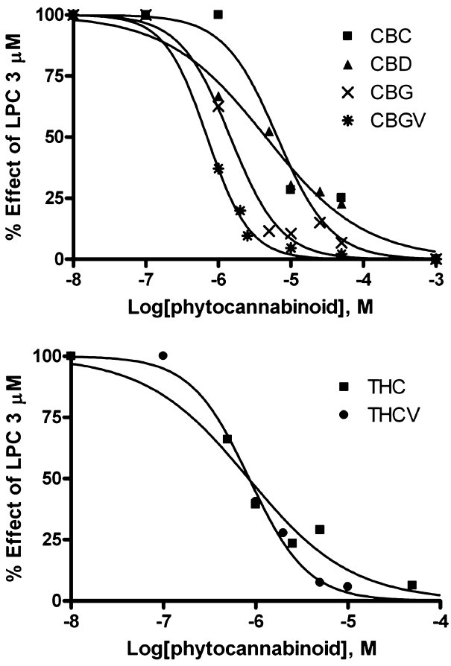
From L De Petrocellis et al. Br J Pharmacol 2011
doi:10.1111/j.1476-5381.2010.01166.x/bph.1166
British Journal of Pharmacology © 2011 The British Pharmacological Society

Slide 4
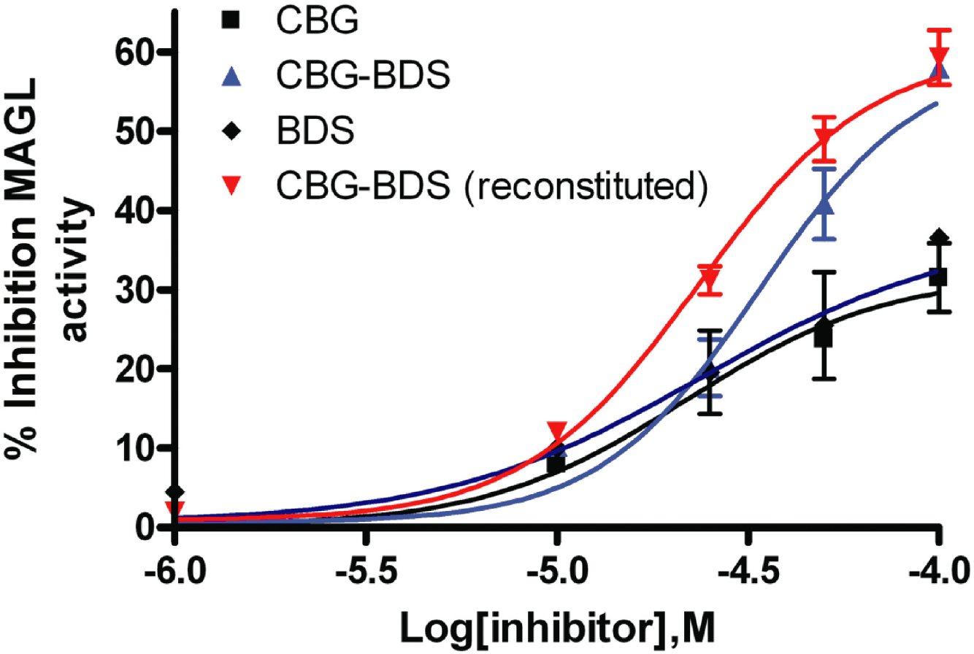
From L De Petrocellis et al. Br J Pharmacol 2011
doi:10.1111/j.1476-5381.2010.01166.x/bph.1166
British Journal of Pharmacology © 2011 The British Pharmacological Society

