Slide 1
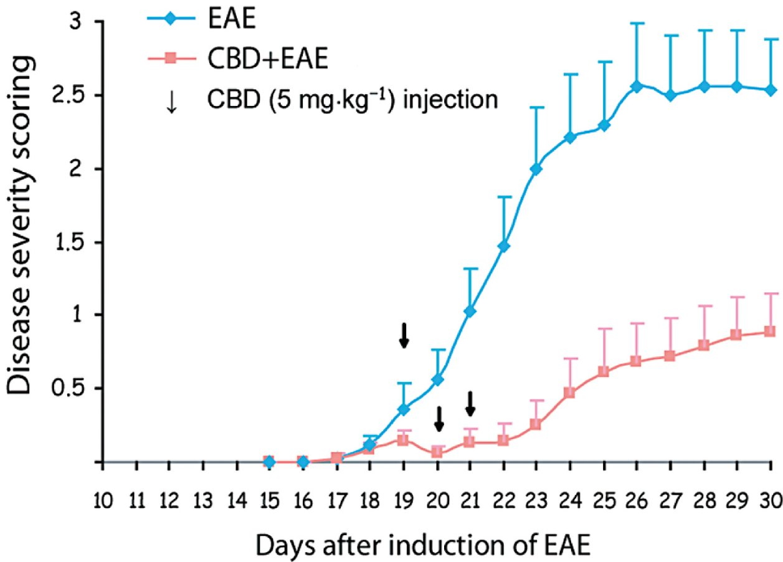
From E Kozela et al. Br J Pharmacol 2011
doi:10.1111/j.1476-5381.2011.01379.x/bph.1379
British Journal of Pharmacology © 2011 The British Pharmacological Society

Slide 2
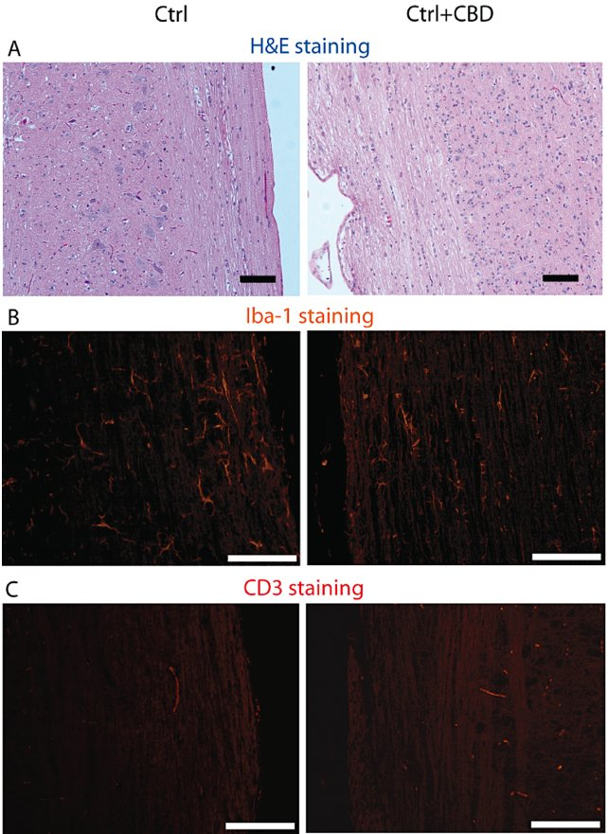
From E Kozela et al. Br J Pharmacol 2011
doi:10.1111/j.1476-5381.2011.01379.x/bph.1379
British Journal of Pharmacology © 2011 The British Pharmacological Society

Slide 3
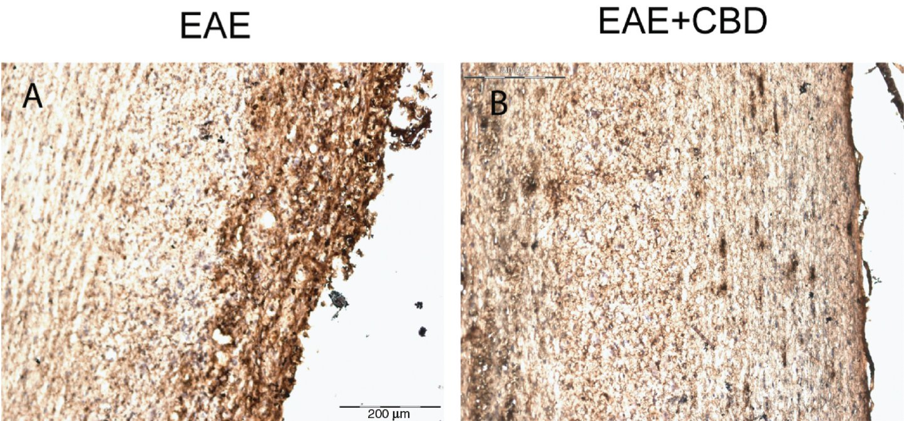
From E Kozela et al. Br J Pharmacol 2011
doi:10.1111/j.1476-5381.2011.01379.x/bph.1379
British Journal of Pharmacology © 2011 The British Pharmacological Society

Slide 4
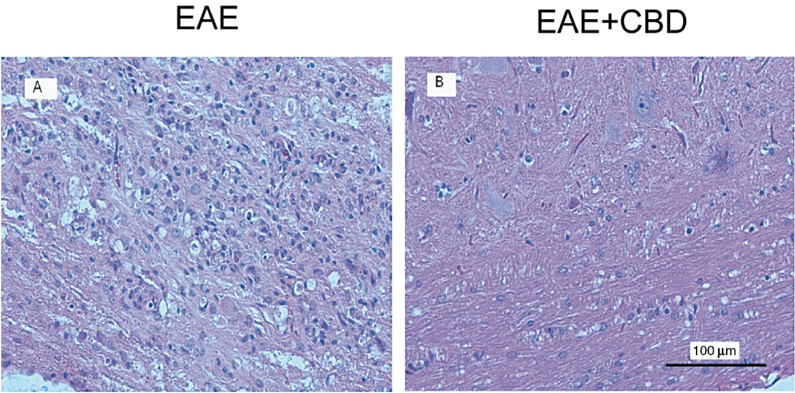
From E Kozela et al. Br J Pharmacol 2011
doi:10.1111/j.1476-5381.2011.01379.x/bph.1379
British Journal of Pharmacology © 2011 The British Pharmacological Society

Slide 5
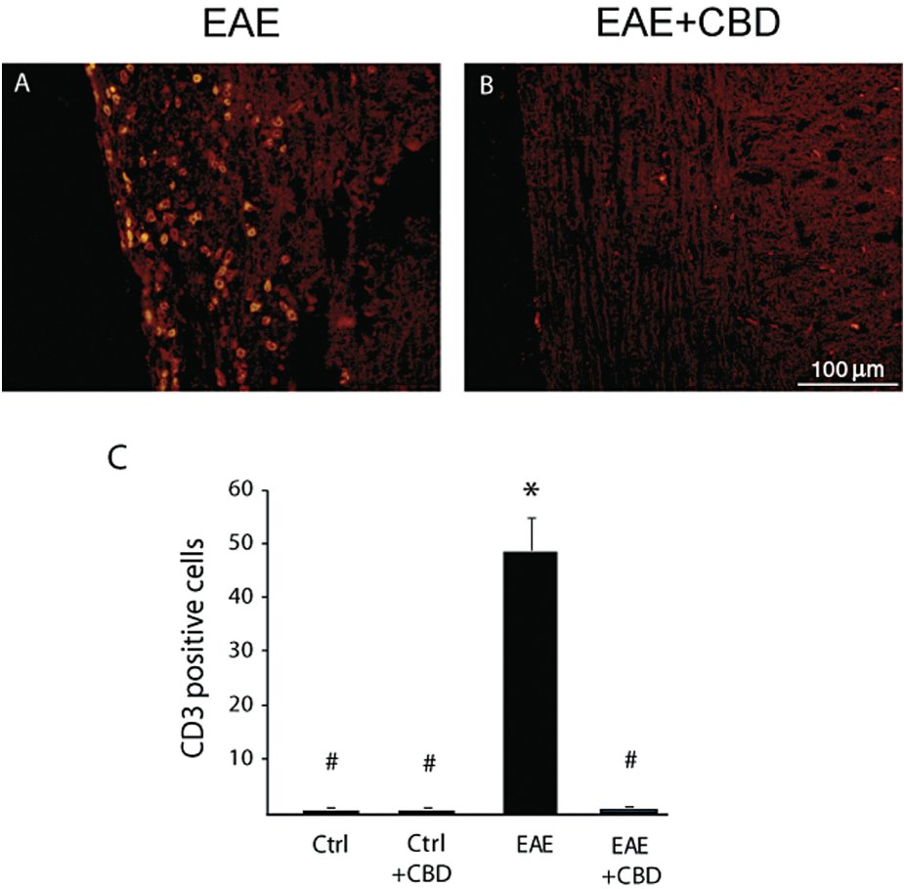
From E Kozela et al. Br J Pharmacol 2011
doi:10.1111/j.1476-5381.2011.01379.x/bph.1379
British Journal of Pharmacology © 2011 The British Pharmacological Society

Slide 6
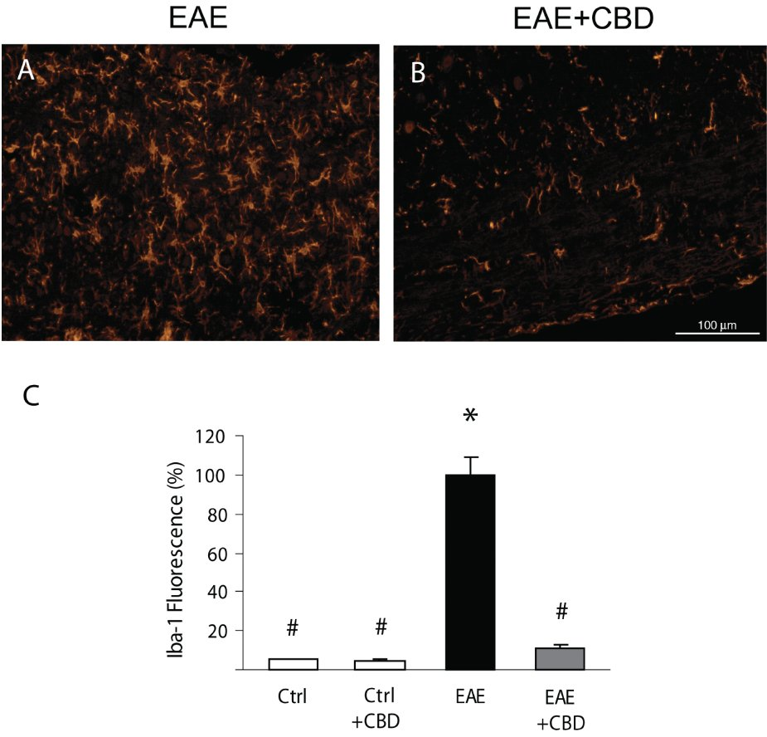
From E Kozela et al. Br J Pharmacol 2011
doi:10.1111/j.1476-5381.2011.01379.x/bph.1379
British Journal of Pharmacology © 2011 The British Pharmacological Society

Slide 7
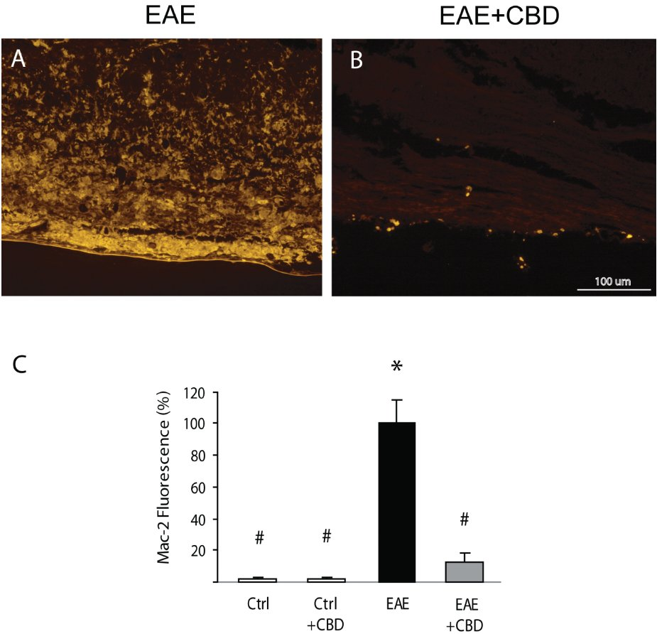
From E Kozela et al. Br J Pharmacol 2011
doi:10.1111/j.1476-5381.2011.01379.x/bph.1379
British Journal of Pharmacology © 2011 The British Pharmacological Society

Slide 8
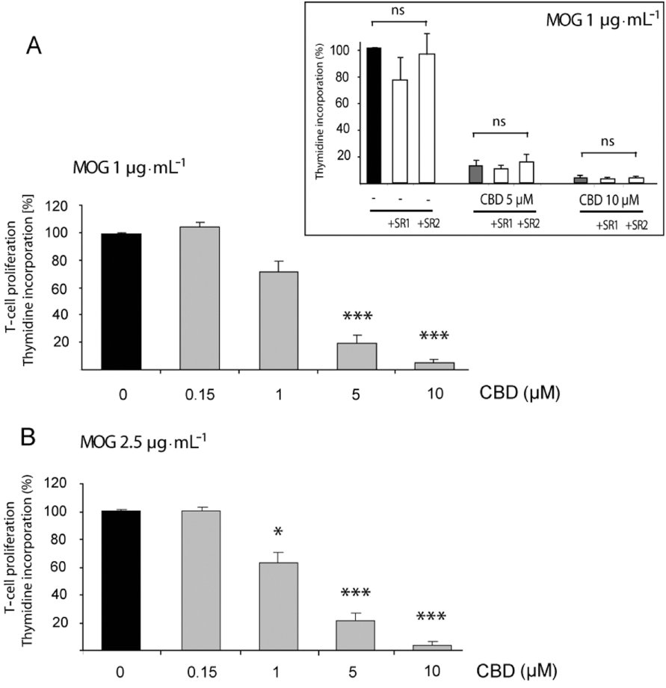
From E Kozela et al. Br J Pharmacol 2011
doi:10.1111/j.1476-5381.2011.01379.x/bph.1379
British Journal of Pharmacology © 2011 The British Pharmacological Society

