Slide 1
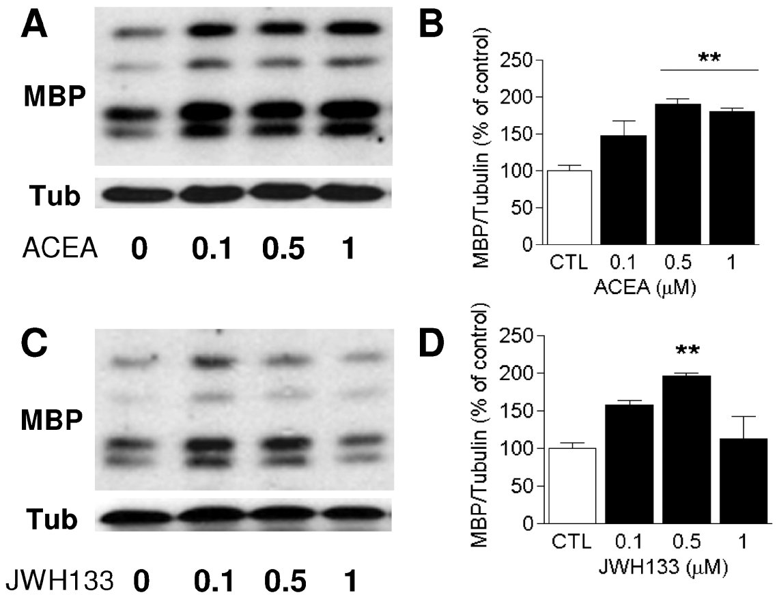
From O Gomez et al. Br J Pharmacol 2011
doi:10.1111/j.1476-5381.2011.01414.x/bph.1414
British Journal of Pharmacology © 2011 The British Pharmacological Society

Slide 2
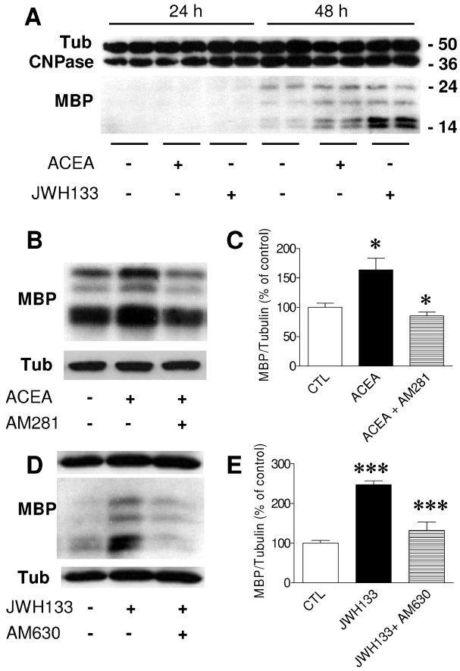
From O Gomez et al. Br J Pharmacol 2011
doi:10.1111/j.1476-5381.2011.01414.x/bph.1414
British Journal of Pharmacology © 2011 The British Pharmacological Society

Slide 3
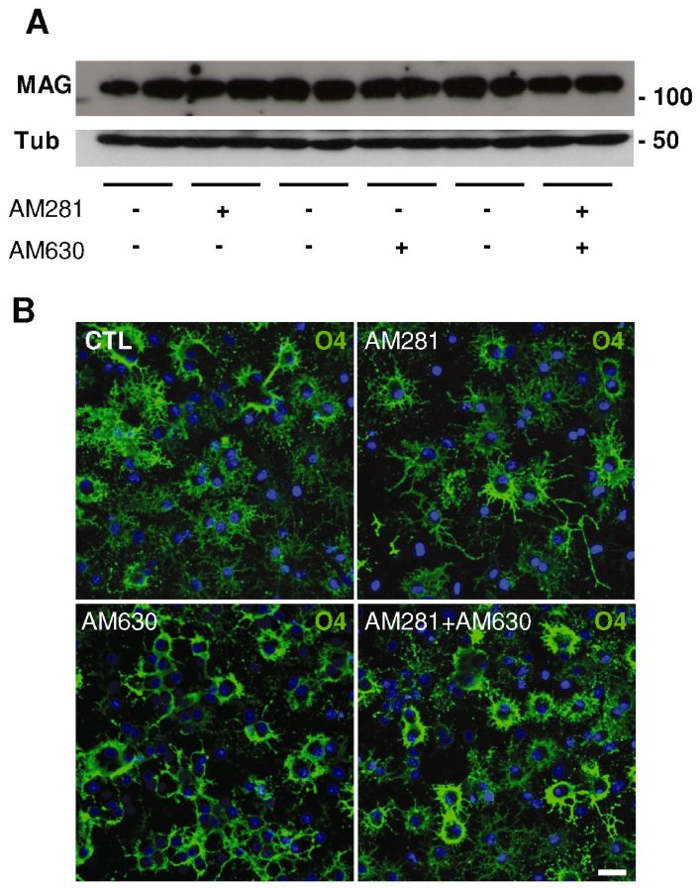
From O Gomez et al. Br J Pharmacol 2011
doi:10.1111/j.1476-5381.2011.01414.x/bph.1414
British Journal of Pharmacology © 2011 The British Pharmacological Society

Slide 4
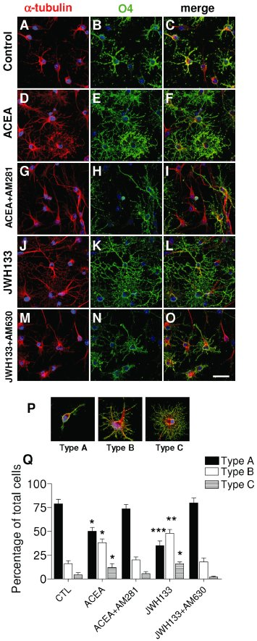
From O Gomez et al. Br J Pharmacol 2011
doi:10.1111/j.1476-5381.2011.01414.x/bph.1414
British Journal of Pharmacology © 2011 The British Pharmacological Society

Slide 5
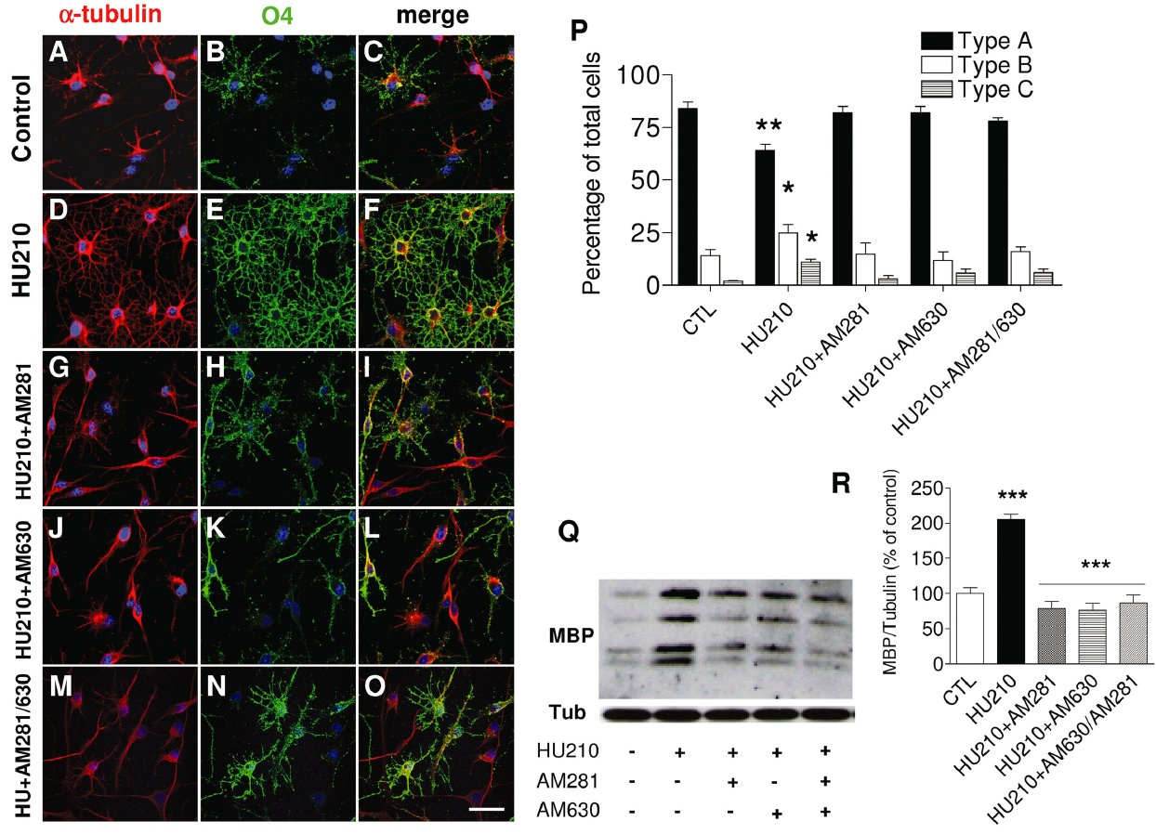
From O Gomez et al. Br J Pharmacol 2011
doi:10.1111/j.1476-5381.2011.01414.x/bph.1414
British Journal of Pharmacology © 2011 The British Pharmacological Society

Slide 6
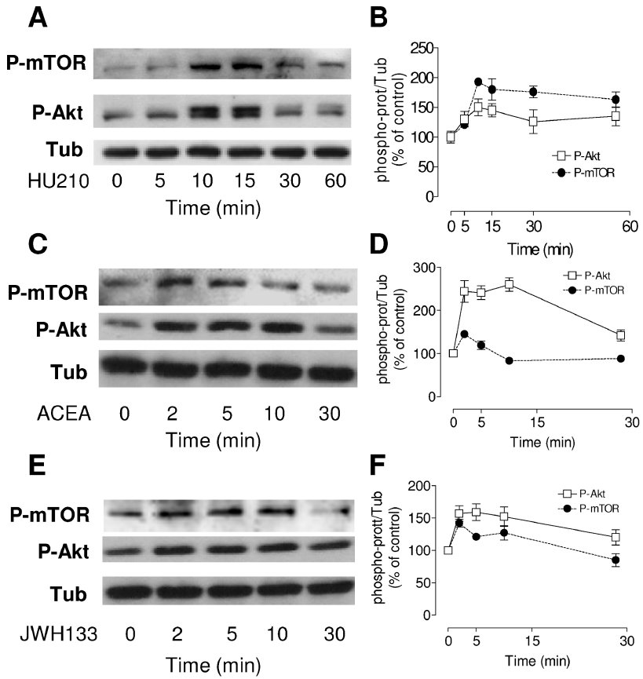
From O Gomez et al. Br J Pharmacol 2011
doi:10.1111/j.1476-5381.2011.01414.x/bph.1414
British Journal of Pharmacology © 2011 The British Pharmacological Society

Slide 7
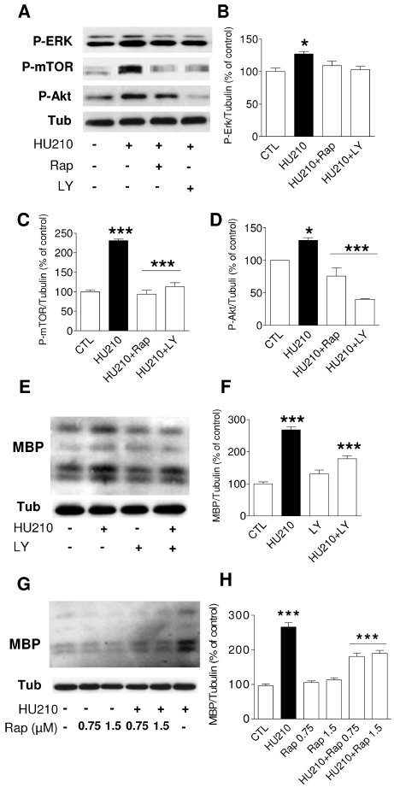
From O Gomez et al. Br J Pharmacol 2011
doi:10.1111/j.1476-5381.2011.01414.x/bph.1414
British Journal of Pharmacology © 2011 The British Pharmacological Society

Slide 8
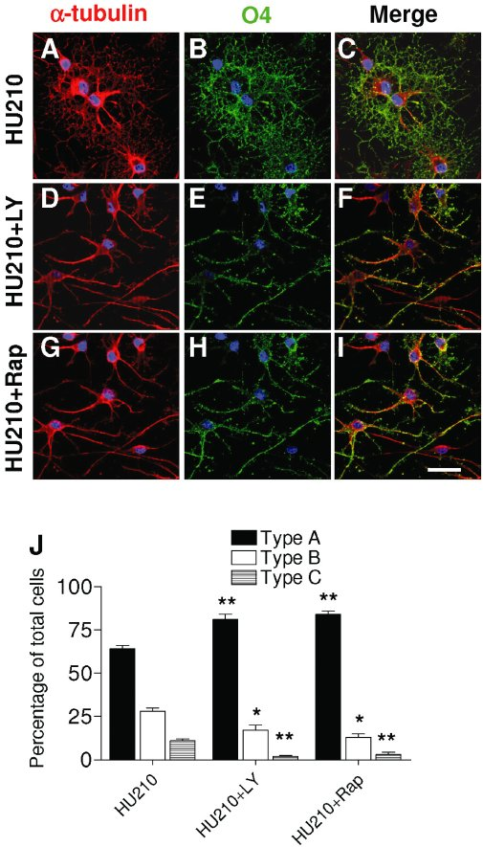
From O Gomez et al. Br J Pharmacol 2011
doi:10.1111/j.1476-5381.2011.01414.x/bph.1414
British Journal of Pharmacology © 2011 The British Pharmacological Society

