Slide 1
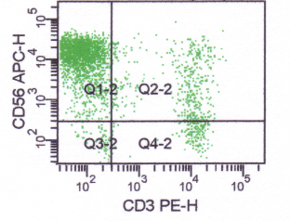
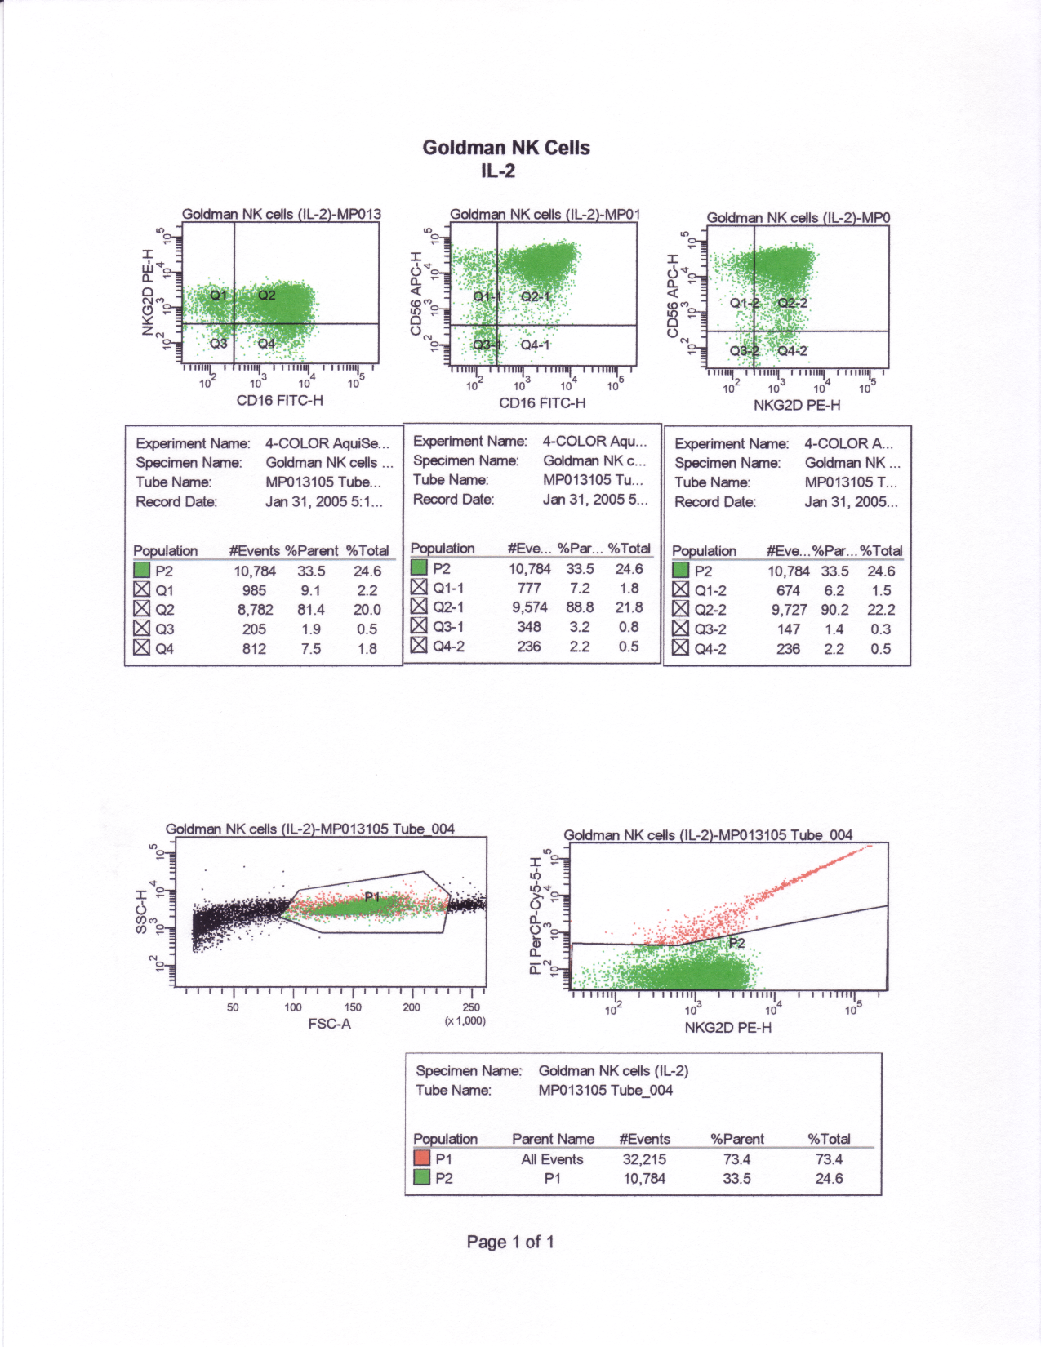
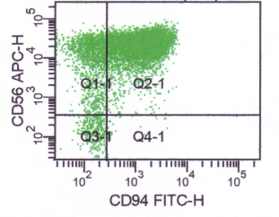

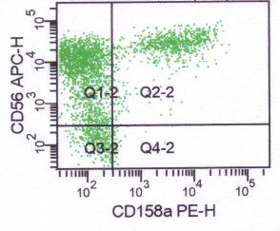
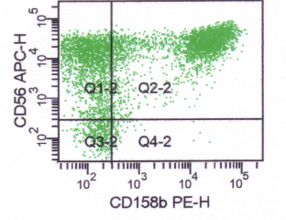
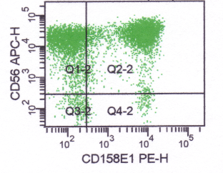
76.6%
15.6%
7.2%
88.8%
15.9%
80.2%
47.9%
48.6%
5.2%
6.2%
90.2%
61.4%
26.0%
33.5%
58.9%
33.5%
61.8%
Supplemental Figure 2: In vitro activated NK cells from patient 888 were analyzed by FACS for the expression of activating receptors NKG2D, CD16, CD94, and NKp46, as well as inhibitory receptors including KIR2DL1 (CD158a), KIR2DL2/3 (CD158b), and KIR3DL1 (CD158e1).

