Slide 1
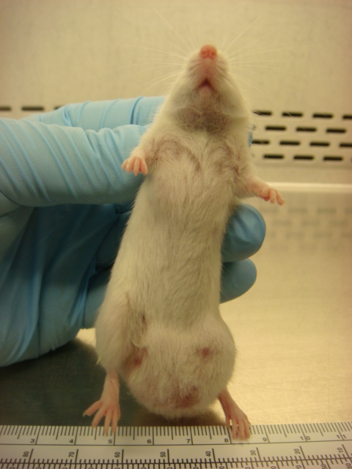
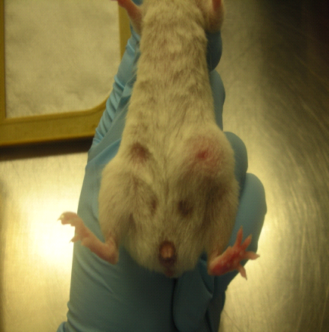
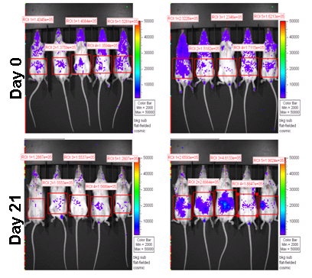
S Figure 1
A
B
C
ALDH^{negative} ALDH^{bright}
PCI-13
ALDH^{negative} ALDH^{bright}
MIA PaCa-2
ALDH^{negative} ALDH^{bright}
MDA-MB-231-Luc

