Slide 1








Supplementary Figure S1
A
B
mPGES-1 RNAi
GFP-mPGES-1
GFP control
mPGES-1 RNAi
RNAi control
GFP-mPGES-1
GFP control
RNAi control
COX-2
COX-2
cPGES
cPGES
mPGES-2
mPGES-2
β-actin
β-actin
Hep3B cell lines
Huh7 cell lines

Slide 2
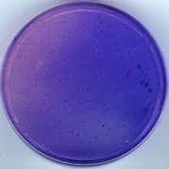
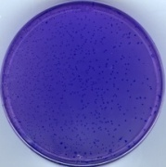
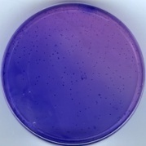
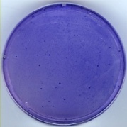
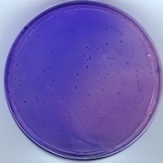
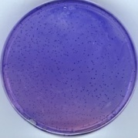
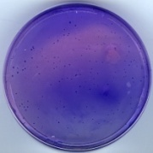
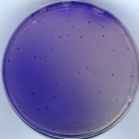
Supplementary Figure S2
A
GFP control
GFP-mPGES-1
P<0.01
P<0.01
RNAi control
mPGES-1 RNAi
B
GFP control
GFP-mPGES-1
P<0.01
P<0.01
RNAi control
mPGES-1 RNAi

Slide 3
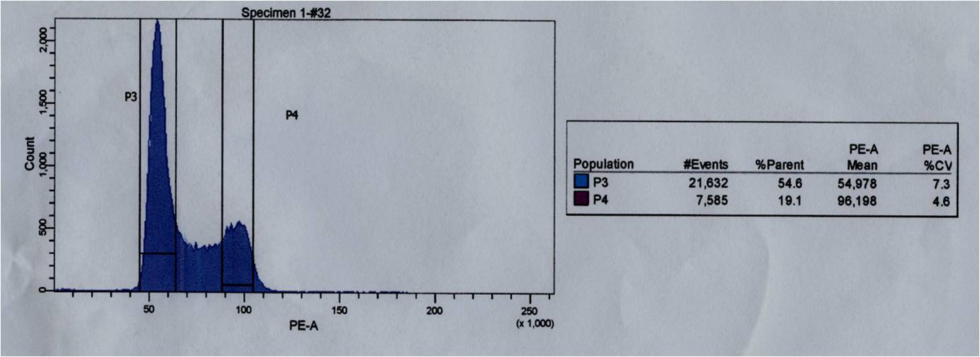
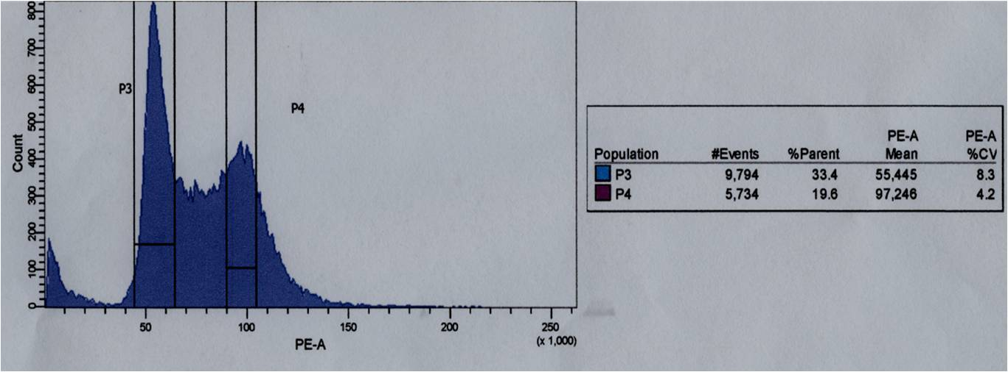
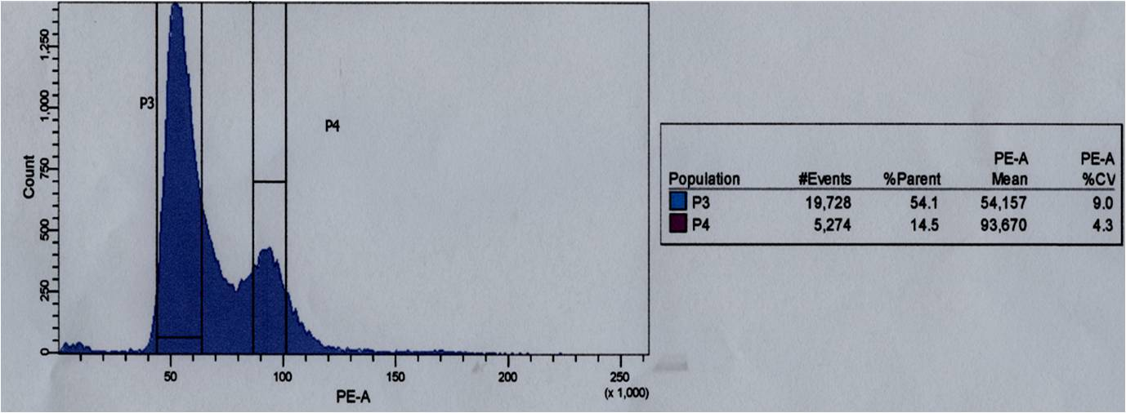
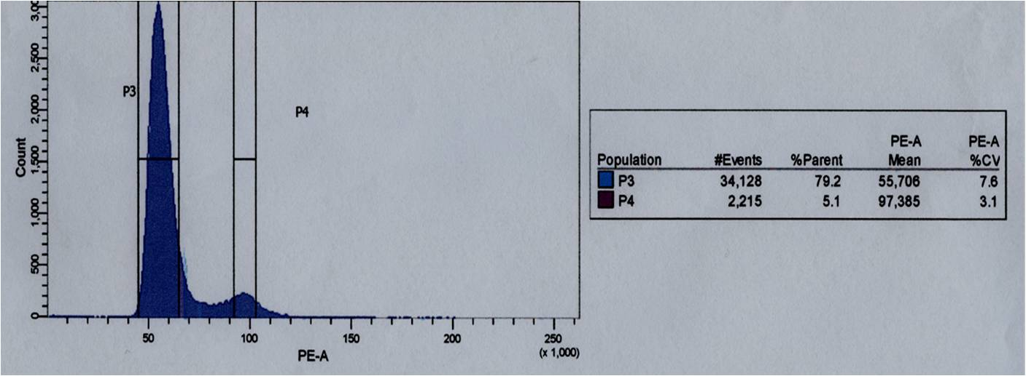
Supplementary Figure S3
A
GFP control
GFP-mPGES-1
RNAi control
mPGES-1RNAi

Slide 4
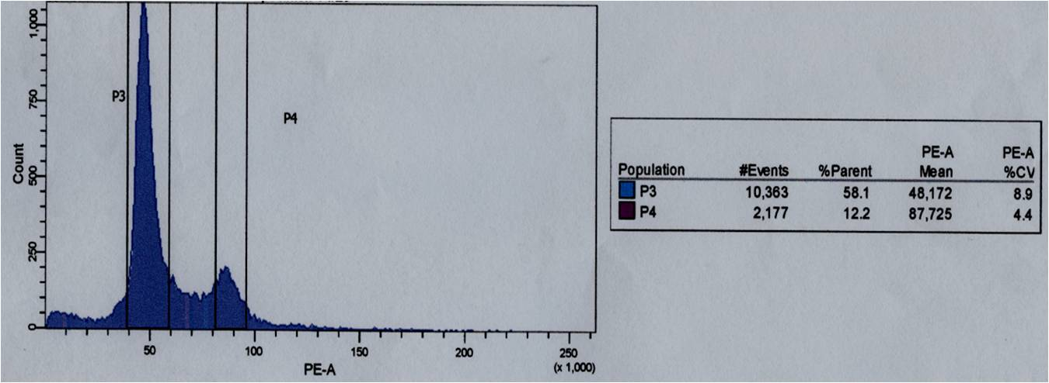
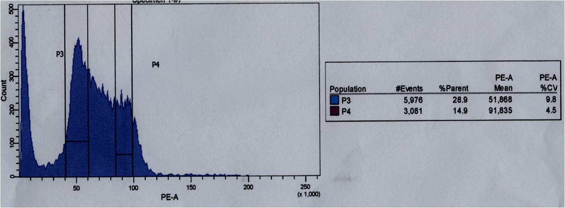
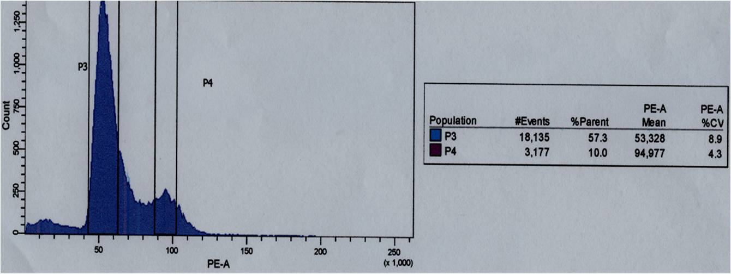
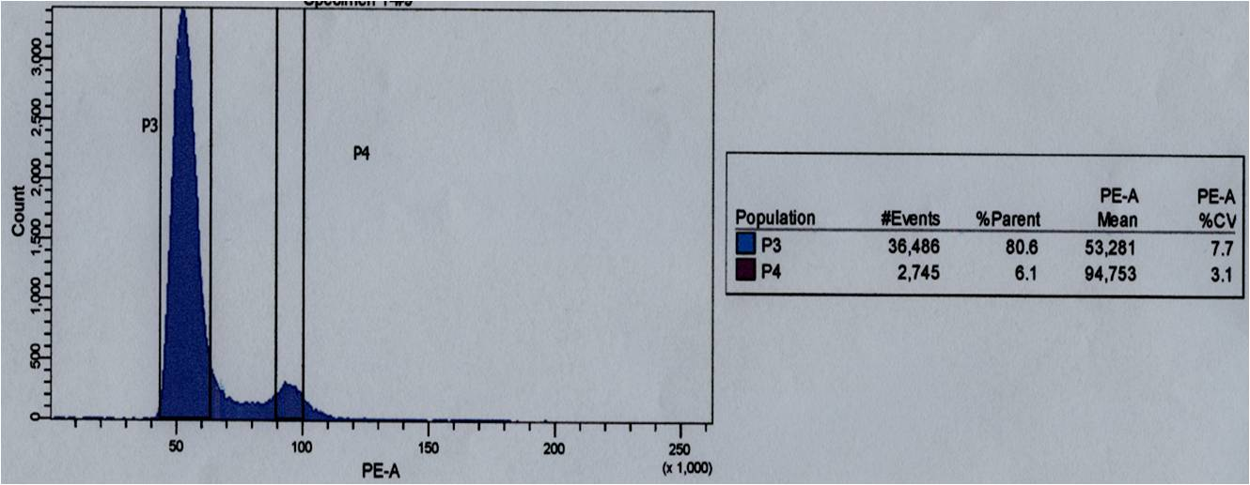
Supplementary Figure S3
B
GFP control
GFP-mPGES-1
RNAi control
mPGES-1RNAi

Slide 5
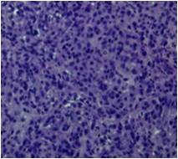

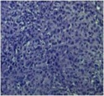
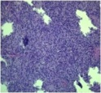
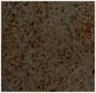
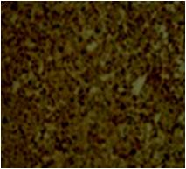
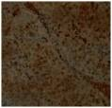
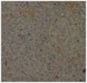
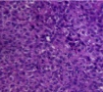
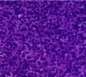
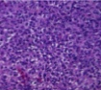
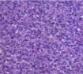




Supplementary Figure S4
A
P<0.01
GFP-mPGES-1
mPGES-1 RNAi
GFP control
RNAi control
P<0.01
H&E
PCNA
B
RNAi control
P<0.01
GFP control
mPGES-1 RNAi
GFP-mPGES-1
H&E
P<0.01
PCNA

Slide 6
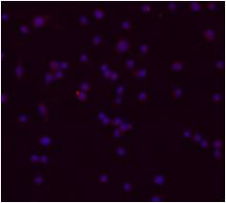
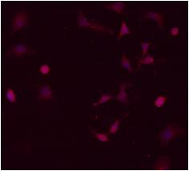
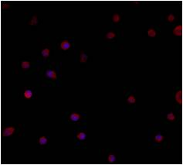
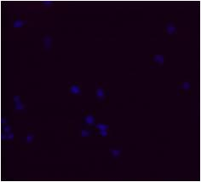
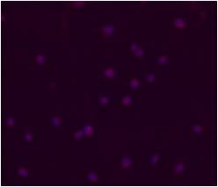
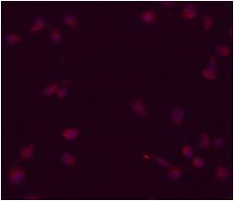
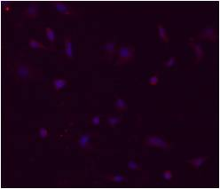
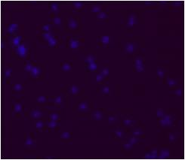
Supplementary Figure S5
A
GFP control
GFP-mPGES-1
RNAi control
mPGES-1 RNAi
B
GFP control
GFP-mPGES-1
RNAi control
mPGES-1 RNAi

