Slide 1
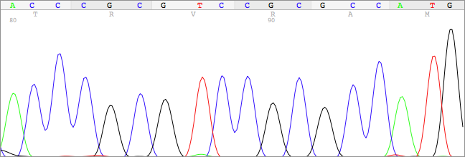
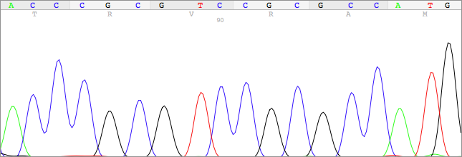
Supplementary Fig 2S.
H226
WT control
Codon: 155 | 156 | 157 | 158 | 159 | 160
ACC CGC GTC CGC GCC ATG

