Slide 1
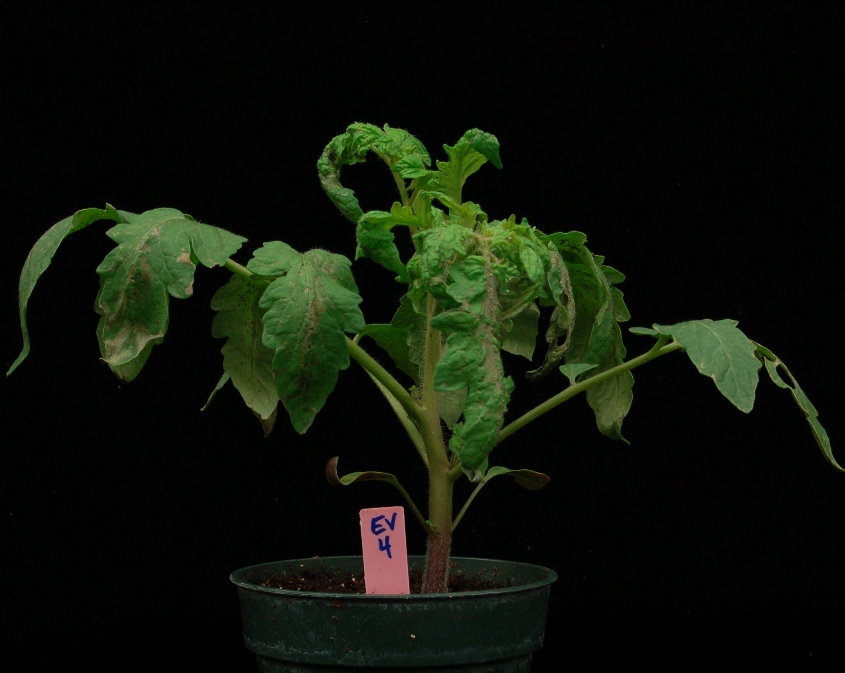
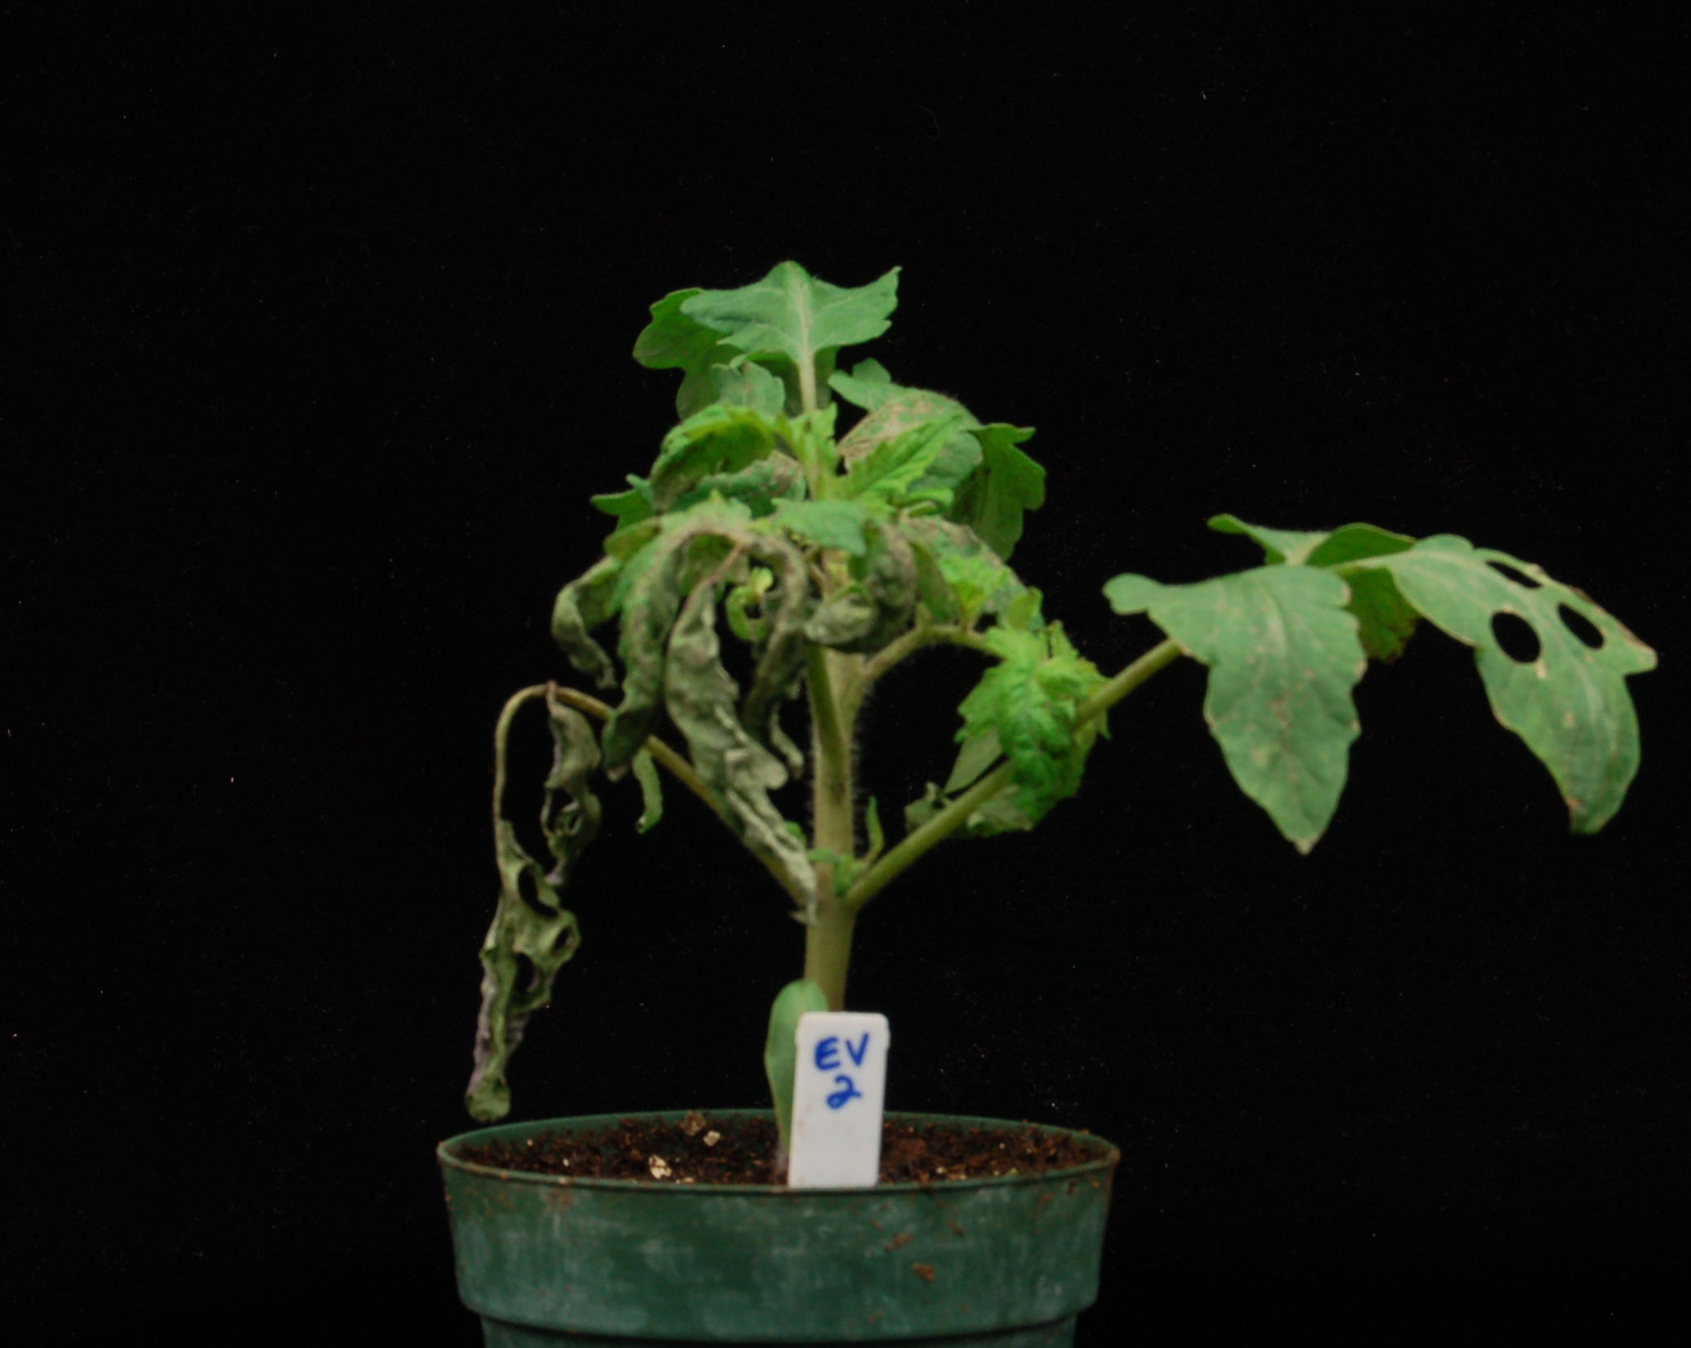
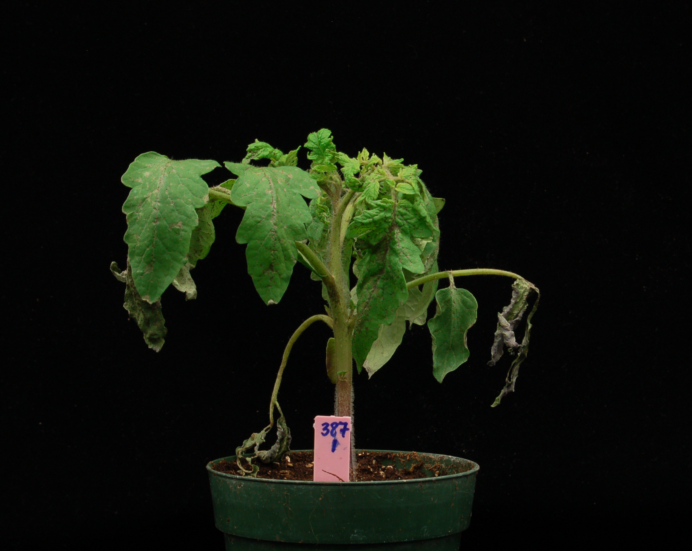
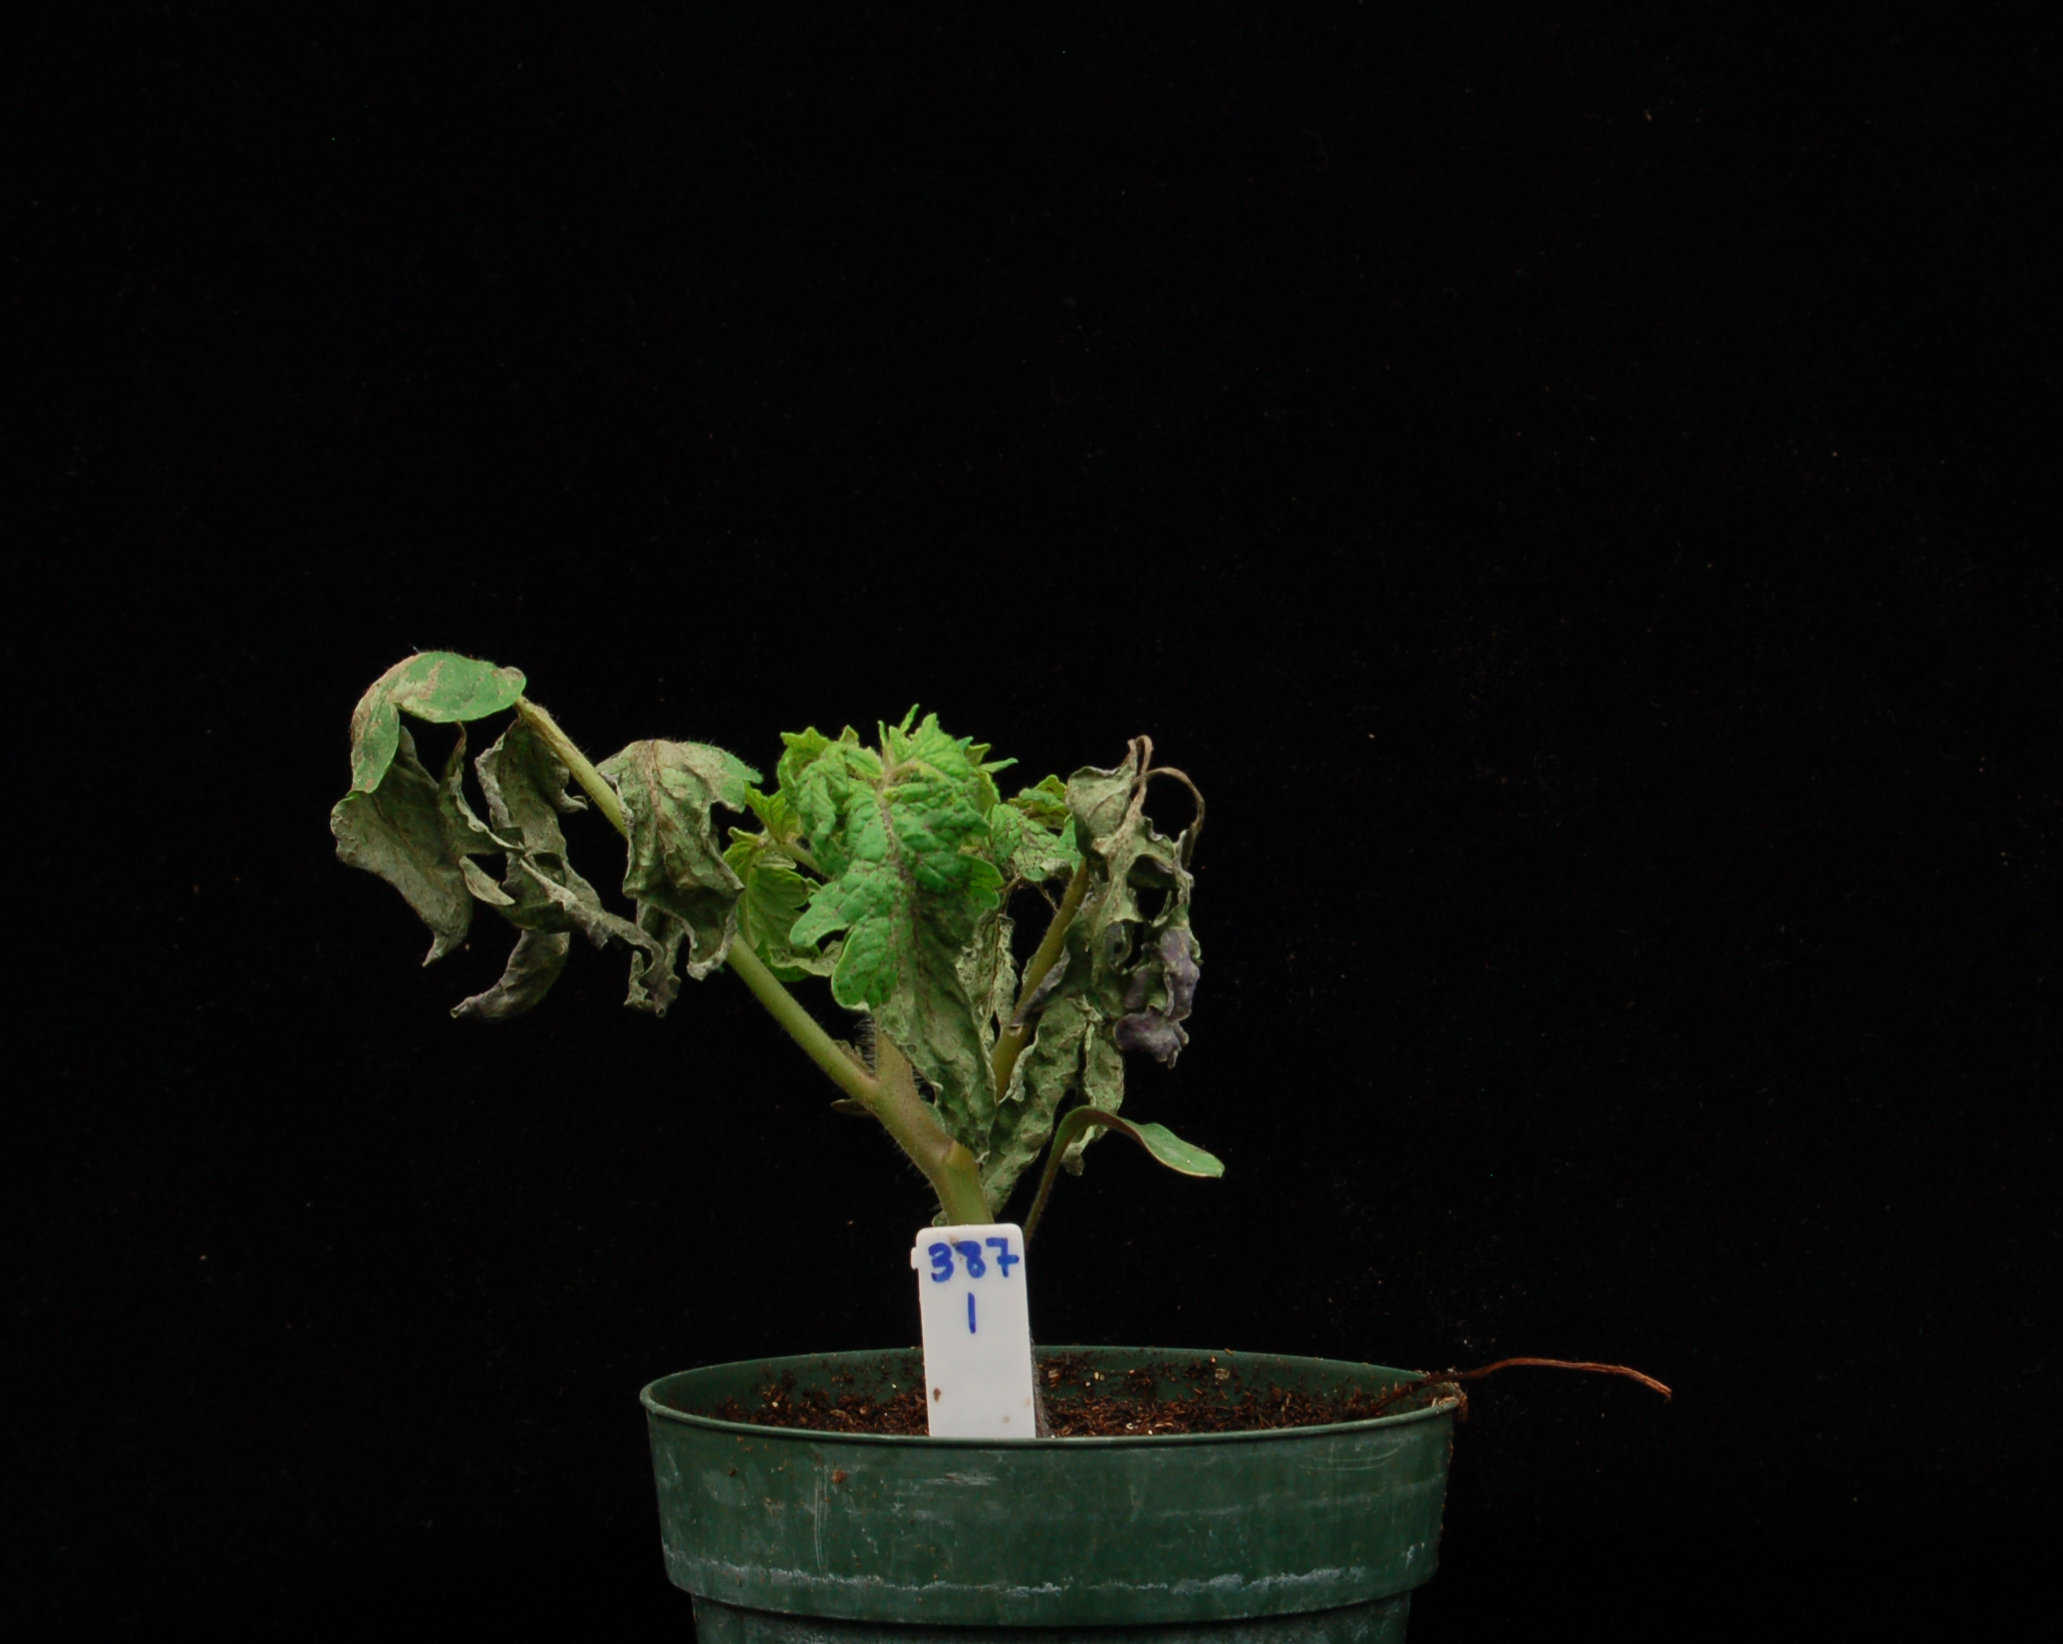
Supplemental Figure S8
a
RG-prf3
hpBti9-CF5
EV
EV
AvrPtoB₁₋₃₈₇
AvrPtoB₁₋₃₈₇
b
EV
AvrPtoB₁₋₃₈₇
*
* p < 0.05
*
RG-prf3 hpBti9-CF5

Slide 2

Supplemental Figure S9
℗
℗
℗
℗
X?
X?
vacuole
X
vacuole
vacuole
PTI
PTI
ETI
PAMP recognized
by Bti9/SlLyk13
Bti9/SlLyk13 lysin motif
Bti9/SlLyk13 kinase domain
AvrPtoB N-terminal region
X?
Substrate of
Bti9/SlLyk13 kinase activity
Pto

