Slide 1
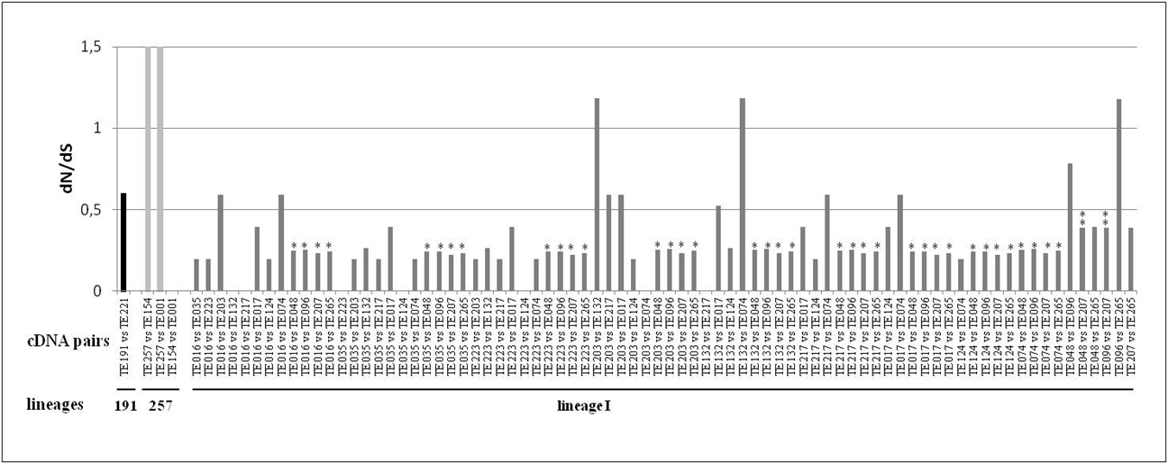
Figure 2S
074

